Slide 1


Slide 2

Plan of the Workshop
1. Introduction
2. Working with OpenRefine
3. Filtering and Sorting with OpenRefine
4. Examining Numbers in OpenRefine
5. Scripts from OpenRefine
6. Exporting and Saving Data from OpenRefine

Slide 3
What is it?
1. Introduction
OpenRefine is a standalone open source desktop application for data clean up and transformation to other formats, the activity known as data wrangling.
It is a Java program hence you operate it through your browser but you don’t need to be online.
Works with large-ish datasets (100,000 rows). Does not scale to many millions. (yet).
More information on the software in here.

Slide 4
Why Using Open Refine?
1. Introduction
Helps you have a good overview of your data
You must save your work to a new file
Incredibly useful for cleaning messy data.
Large and helpful community online. If you need help http://openrefine.org
It is important to know what you did to your data. With OpenRefine, you can capture all actions applied to your raw data and share them with your publication as supplemental material if needed.

Slide 5

Sticker time!!!
1. Introduction
Do you all have Open Refine download and working and the .csv file to work on?

Slide 6

2. Working with OpenRefine
Objectives
Create a new OpenRefine project from a CSV file.
Understand potential problems with file headers.
Use facets to summarize data from a column.
Use clustering to detect possible typing errors.
Understand that there are different clustering algorithms
Employ drop-downs to remove white spaces from cells.
Manipulate data using previous steps with undo/redo.

Slide 7


2. Working with OpenRefine
Creating a Project
(Start looking at your data)
More information in here
Main supported files:
TSV
CSV
*SV
Excel (XLS, XLSX)
JSON
XML
RDF as XML

Slide 8

2. Working with OpenRefine
One type of Facet is called a ‘Text facet’. This groups all the identical text values in a column and lists each value with the number of records it appears in. The facet information always appears in the left hand panel in the OpenRefine interface.
Data Faceting
(Exploring data by applying multiple filters)
Seeing the big picture of your data
Filtering down to just the subset of rows that you want to change in bulk.

Slide 9

2. Working with OpenRefine
Exercise: 1
Using faceting, find out how many different interview_date values there are in the survey results.
Is the column formatted as Number, Date, or Text? How does changing the format change the faceting display?
Use faceting to produce a timeline display for interview_date. You will need to use Edit cells > Common transforms > To date to convert this column to dates
During what period were most of the interviews collected?

Slide 10
2. Working with OpenRefine
More on Faceting
As well as ‘Text facets’ Refine also supports a range of other types of facet. These include:
Numeric facets
Timeline facets (for dates)
Custom facets
Scatterplot facets
Numeric and Scatterplot facets display graphs instead of lists of values. The numeric facet graph includes ‘drag and drop’ controls you can use to set a start and end range to filter the data displayed. These facets are explored further in Examining Numbers in OpenRefine
Custom facets are a range of different types of facets. Some of the default custom facets are:
Word facet - this breaks down text into words and counts the number of records each word appears in
Duplicates facet - this results in a binary facet of ‘true’ or ‘false’. Rows appear in the ‘true’ facet if the value in the selected column is an exact match for a value in the same column in another row
Text length facet - creates a numeric facet based on the length (number of characters) of the text in each row for the selected column. This can be useful for spotting incorrect or unusual data in a field where specific lengths are expected (e.g. if the values are expected to be years, any row with a text length more than 4 for that column is likely to be incorrect)
Facet by blank - a binary facet of ‘true’ or ‘false’. Rows appear in the ‘true’ facet if they have no data present in that column. This is useful when looking for rows missing key data.
OpenRefine Wiki: Faceting

Slide 11

Clustering (Finding groups of different values that might be the same thing)
2. Working with OpenRefine
More on clustering
Edit and control typos and different style of representing the same concept (e.g. Ruaca, Ruca, Ruca-Nhamuenda…)

Slide 12
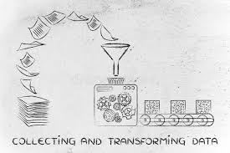
Transforming data he data in the items_owned column is a set of items in a list. The list is in square brackets and each item is in single quotes. Before we split the list into individual items in the next section, we first want to remove the brackets and the quotes.
2. Working with OpenRefine
First we will remove all of the left square brackets ([). In the Expression box type value.replace("[", "") and click OK.
What the expression means is this: Take the value in each cell in the selected column and replace all of the “[” with “” (i.e. nothing - delete).
Click OK. You should see in the items_owned column that there are no longer any left square brackets.

Slide 13

2. Working with OpenRefine
Exercise: 2
Now that we have cleaned out extraneous characters from our items_owned column, we can use a text facet to see which items were commonly owned or rarely owned by the interview respondents.
Click the down arrow at the top of the items_owned column. Choose Facet > Custom text facet...
In the Expression box, type value.split(";").
Click OK.
Use this same strategy to remove the single quote marks ('), the right square brackets (]), and spaces from the items_owned column.
Solution
value.replace("'", "")
value.replace("]", "")
value.replace(" ", "") You should now have a list of items separated by semi-colons (;).

Slide 14

2. Working with OpenRefine
Exercise: 3
Which two items are the most commonly owned? Which are the two least commonly owned?
Perform the same clean up steps and customized text faceting for the months_lack_food column. Which month(s) were farmers more likely to lack food?
Perform the same clean up steps for the months_no_water, liv_owned, res_change, and no_food_mitigation columns. Hint: To reuse a GREL command, click the History tab and then click Reuse next to the command you would like to apply to that column.

Slide 15


2. Working with OpenRefine
Trim Leading and Trailing Whitespace
(Remove blank characters from the beginning and end)
Undo / Redo
(Control your steps)

Slide 16
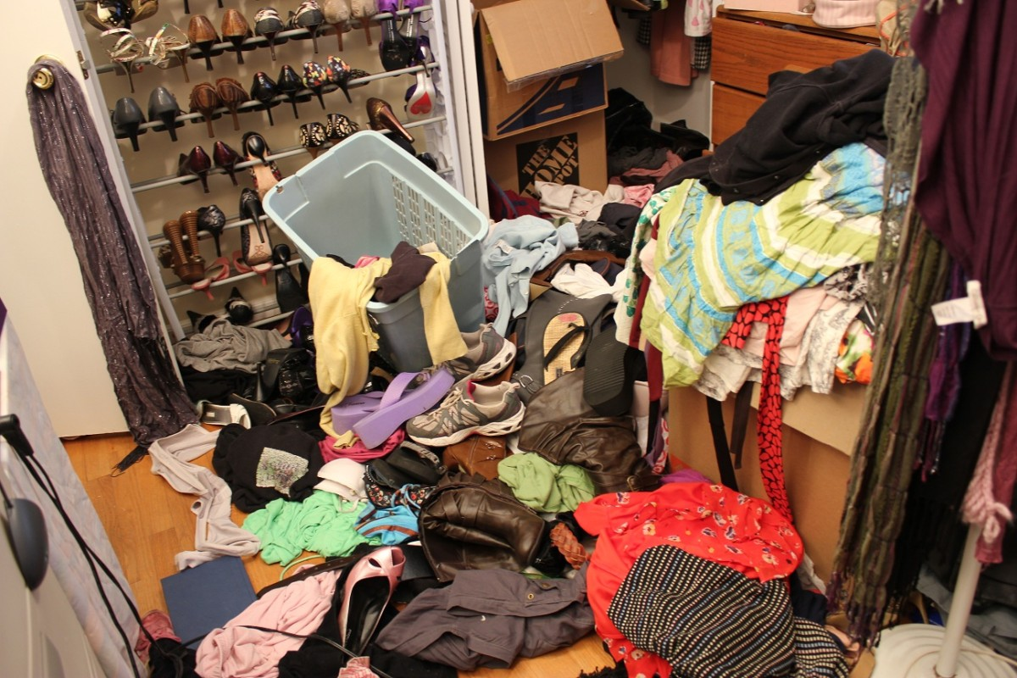
3. Filtering and Sorting with OpenRefine
Tidying Up your Data!
Objectives
Filter to a subset of rows by text filter or include/exclude.
Sort table by a column.
Sort by multiple columns.

Slide 17
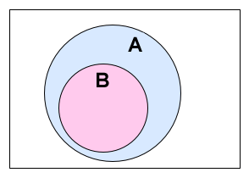

3. Filtering and Sorting with OpenRefine
Filtering
(Working on a subset)
Using Filter and include/exclude

Slide 18


3. Filtering and Sorting with OpenRefine
Sorting Data
(Single column and multiple column)
The first few values are all 0. The altitudes are more likely ‘missing’ than incorrect. The survey is delivered by Smartphone with the gps information added automatically by the app. The lack of an altitude value suggests that the smartphone was unable to provide it and it defaulted to 0.
Exercise 1
Sort the data by gps_Altitude. Do you think the first few entries may have incorrect altitudes?
Sort > Sort... - This option enables you to modify your original sort.
Sort > Reverse - This option allows you to reverse the order of the sort.
Sort > Remove sort - This option allows you to undo your sort.

Slide 19

4. Examining Numbers in OpenRefine
Objectives
Transform a text column into a number column.
Identify and modify non-numeric values in a column using facets.

Slide 20

4. Examining Numbers in OpenRefine
Exercise 4a:
Transform 3 columns (no_members, yrs_liv, and buildings_in_compound)
from text data to number data? What happen to the columns that are not integers?
Exercise 4b:
For a column you transformed to numbers, edit one or two cells, replacing the numbers with text (such as abc) or blank (no number or text).
Use the pulldown menu to apply a numeric facet to the column you edited. The facet will appear in the left panel.

Slide 21

5. Scripts from OpenRefine
Objectives
Describe how OpenRefine generates JSON code.
Demonstrate ability to export JSON code from OpenRefine.
Demonstrate ability to import a JSON code file to apply the analysis to another dataset.

Slide 22
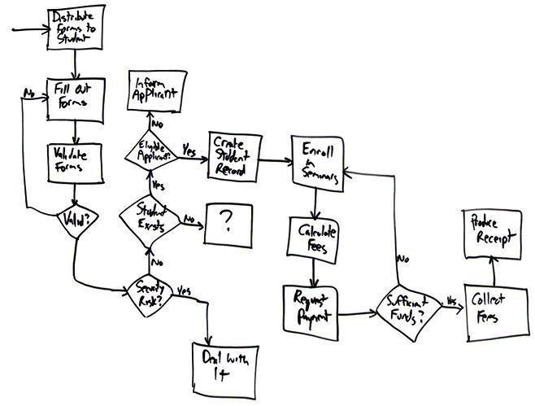
Saving the cleaning flowchart
5. Scripts from OpenRefine
As you conduct your data cleaning and preliminary analysis, Open Refine saves every change you make to the dataset. These changes are saved in a format known as JSON (JavaScript Object Notation). You can export this JSON script and apply it to other data files.
Let’s save our steps

Slide 23
5. Scripts from OpenRefine
Importing a script to use against another dataset
Let’s practice running these steps on a new dataset. We’ll test this on an uncleaned version of the dataset we’ve been working with.
Start a new project in OpenRefine using the messy dataset you downloaded before. Give the project a new name.
Click the Undo / Redo tab > Apply and paste in the contents of .txt file with the JSON code.
Click Perform operations. The dataset should now be the same as your other cleaned dataset.
For convenience, we used the same dataset. In reality you could use this process to clean related datasets. For example, data that you had collected over different fieldwork periods or data that was collected by different researchers (provided everyone uses the same column headings). The data in this file was generated from an eSurvey system with the actual survey being delivered centrally to a smartphone, so the column headings are pretty much guaranteed to be the same.

Slide 24


6. Exporting and Saving Data from OpenRefine
Saving
By default OpenRefine is saving your project continuously. If you close OpenRefine and open it up again, you’ll see a list of your projects. You can click on any one of them to open it up again.
Exporting
You can also export a project. This is helpful, for instance, if you wanted to send your raw data and cleaning steps to a collaborator, or share this information as a supplement to a publication.

Slide 25

Any Question?

