Slide 1

INTRODUCTION TO BAYESIAN STATISTICS

Slide 2



@EdCDCS
For all events, news, and support: cdcs.ed.ac.uk

Slide 3
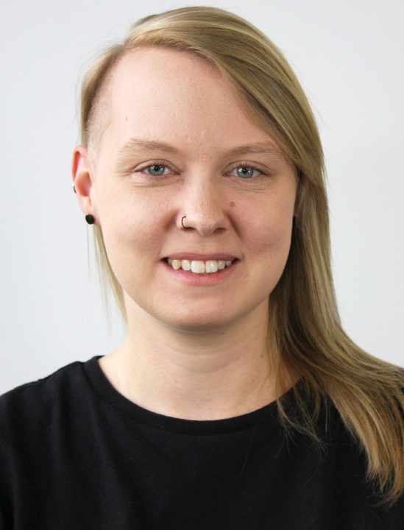
Welcome!
Aislinn Keogh
PhD student in Linguistics
Notes:
A/S

Slide 4
Week 1: Plan for today
14:00 Welcome and introductions
14:10 Crash course in Bayesian inference
14:30 Bayesian inference as a statistical method
14:50 Break
15:00 Key components of Bayesian models
15:55 Wrap up
Find these slides online:
github.com/DCS-training/ Bayesian-Statistics
Notes:
S

Slide 5
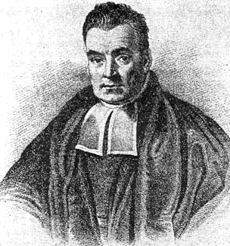
Introducing Bayes
Your friend complains of a headache. Is this headache caused by:
A brain tumour
Dehydration
Athlete’s foot
N.B. Thanks to Simon Kirby/Kenny Smith for this example, which is taken from the Simulating Language course in PPLS.
Notes:
Thomas Bayes: English statistician, philosopher and Presbyterian minister
Formulated a very influential theorem in probability theory called Bayes’ rule
Let’s first get the intuition for Bayes’ rule

Slide 6
Introducing Bayes
Reaching a diagnosis requires you to consider two questions:
How likely is it that someone with each medical condition would exhibit that symptom?
How common is each medical condition?

Slide 7
Introducing Bayes
Likelihood of symptoms given underlying condition:
Brain tumour: headache is very likely Dehydration: headache is very likely Athlete’s foot: headache is very unlikely
If all we care about is the likelihood of symptoms given each underlying condition, we would conclude that your friend either has a brain tumour or is dehydrated.

Slide 8
Introducing Bayes
Probability of underlying conditions:
Brain tumour: very rare Dehydration: very common Athlete’s foot: very common (let’s assume)
If all we care about is the prevalence of each underlying condition, we would conclude that your friend is either dehydrated or suffering from athlete’s foot.

Slide 9
Introducing Bayes
But you didn’t reach either of these conclusions, did you?
You brought the two quantities together in a smart way.
How did you do it?

Slide 10
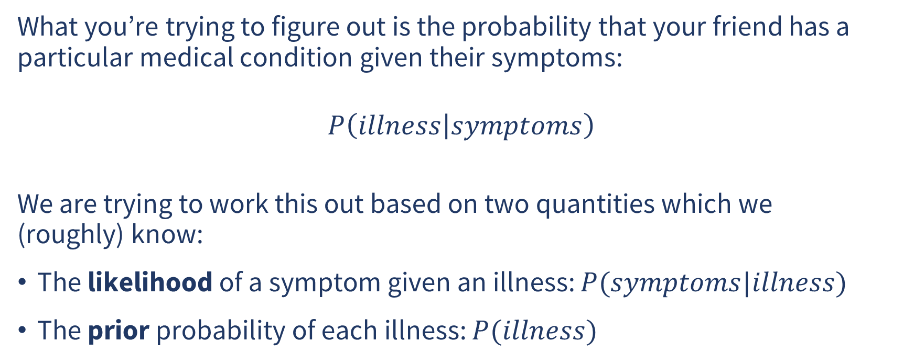
Introducing Bayes
What you’re trying to figure out is the probability that your friend has a particular medical condition given their symptoms:
$$P\left(illness | symptoms\right)$$
We are trying to work this out based on two quantities which we (roughly) know:
The likelihood of a symptom given an illness: $P(symptoms|illness)$
The prior probability of each illness: $P(illness)$

Slide 11
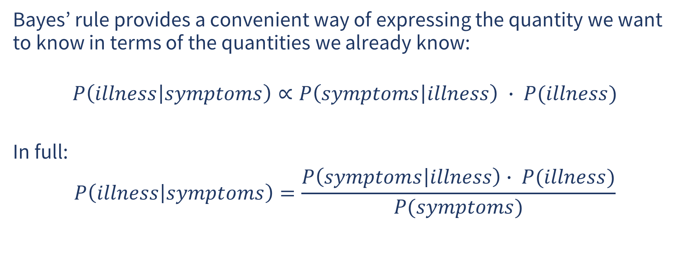
Introducing Bayes
Bayes’ rule provides a convenient way of expressing the quantity we want to know in terms of the quantities we already know:
$$P\left(illness | symptoms\right)∝P\left(symptoms | illness\right) ∙ P(illness)$$
In full:
$$P\left(illness | symptoms\right)=\frac{P\left(symptoms | illness\right)∙ P(illness)}{P(symptoms)}$$

Slide 12
Introducing Bayes
$$P\left(illness | symptoms\right)$$ | The thing we want to know is called the posterior

Slide 13
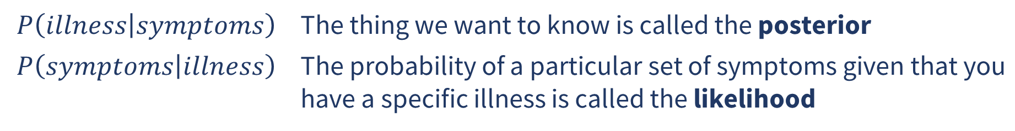
Introducing Bayes
$$P\left(illness | symptoms\right)$$ | The thing we want to know is called the posterior
$$P\left(symptoms | illness\right)$$ | The probability of a particular set of symptoms given that you have a specific illness is called the likelihood

Slide 14
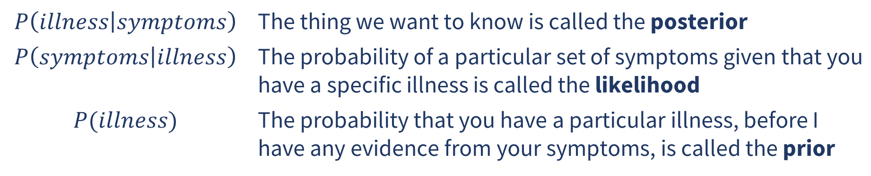
Introducing Bayes
$$P\left(illness | symptoms\right)$$ | The thing we want to know is called the posterior
$$P\left(symptoms | illness\right)$$ | The probability of a particular set of symptoms given that you have a specific illness is called the likelihood
$$P(illness)$$ | The probability that you have a particular illness, before I have any evidence from your symptoms, is called the prior

Slide 15
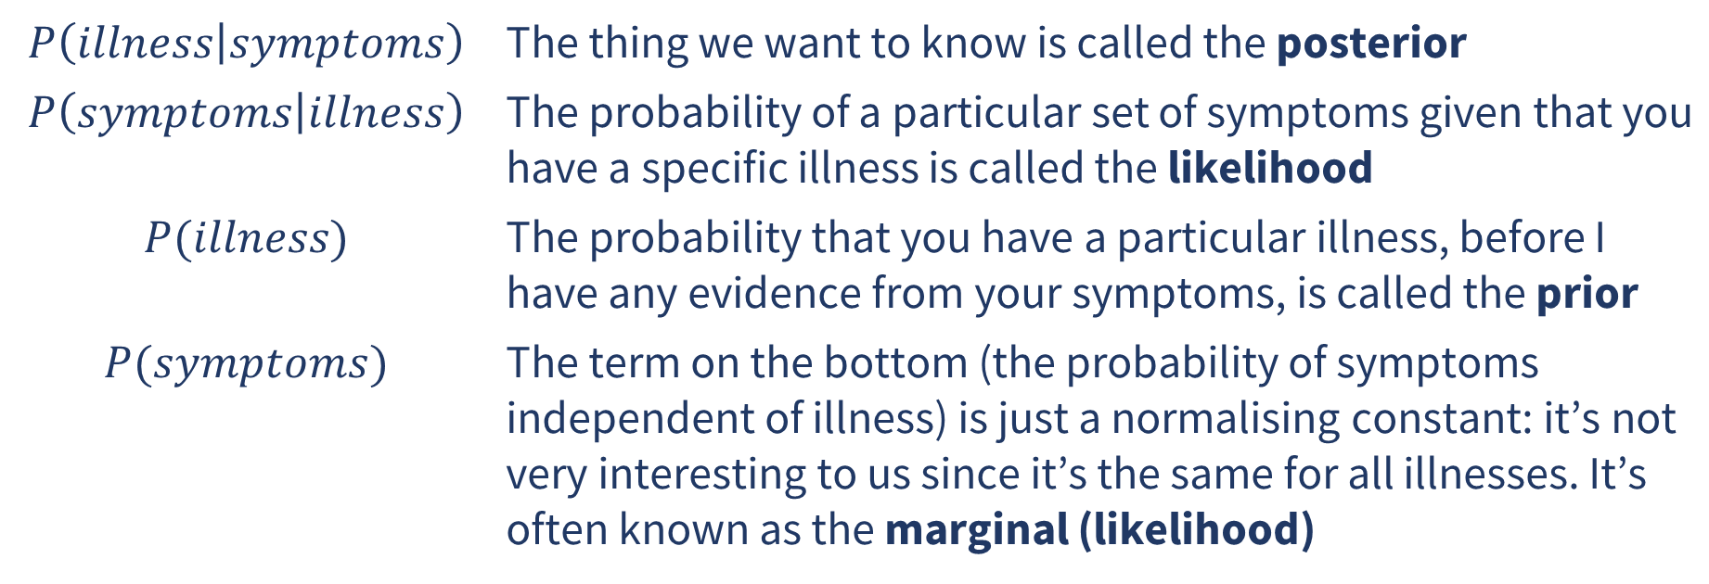
Introducing Bayes
$$P\left(illness | symptoms\right)$$ | The thing we want to know is called the posterior
$$P\left(symptoms | illness\right)$$ | The probability of a particular set of symptoms given that you have a specific illness is called the likelihood
$$P(illness)$$ | The probability that you have a particular illness, before I have any evidence from your symptoms, is called the prior
$$P(symptoms)$$ | The term on the bottom (the probability of symptoms independent of illness) is just a normalising constant: it’s not very interesting to us since it’s the same for all illnesses. It’s often known as the marginal (likelihood)

Slide 16
Introducing Bayes
It makes intuitive sense…
If the likelihood of symptoms given a certain illness is high, this will increase the posterior probability of that illness
If the prior probability of a certain illness is high, this will increase the posterior probability of that illness
If a particular illness has low prior probability, we need some really convincing evidence to make us believe it to be true
Notes:
The posterior is a compromise between the prior and the likelihood

Slide 17
Bayesian inference for statistics
In inferential statistics, we want to use the data we have collected to estimate the value of some parameter(s) of interest, e.g.
How well do experiment participants perform on a binary outcome task (correct/incorrect)?
How many people click a link in version A of our marketing newsletter compared to version B?
How do different patients respond to a particular treatment depending on their age and sex?
Notes:
Chosen these examples cases because they have different kinds of outcomes:
Binary outcome task
Data is drawn from a binomial distribution: number of successes in a sequence of binary outcome trials
Parameter we’re trying to estimate is a probability (intuitively), or the log-odds of a correct response (formally)
Marketing email
Data is drawn from a poisson distribution: how many times is an event likely to occur over a specific period
Parameters we’re trying to estimate are counts: average number of clicks (intercept) and difference between versions (slope)
Medical treatment
Some kinds of data (e.g. change in blood pressure) is drawn from a normal distribution: continuous number line between negative infinity and positive infinity
Parameter we’re trying to estimate is a number along that line: blood pressure could increase (+ve number), decrease (-ve number) or stay the same (0)
Potentially got an interaction term here as well as the slopes for age and sex e.g. maybe older men respond better than younger men but the effect of age goes in the opposite direction for women

Slide 18
Bayesian inference for statistics
The radical difference between Bayesian statistics and frequentist statistics is in how we think of these parameters:
Frequentist: Parameters have fixed values and can be described by point estimates (unknown but certain)
Bayesian: Parameters are random variables and can only be described by probability distributions (unknown and uncertain)

Slide 19
Bayesian inference for statistics
This also means that there is no concept of significance in Bayesian statistics!
Models allocate their beliefs over a range of possible values
We observe the extent to which model estimates are consistent with our hypotheses
But this is not a binary decision (reject the null vs. fail to reject the null, as in frequentist statistics)
Notes:
To do hypothesis testing and find “evidence” for one model over another in Bayesian statistics, you need Bayes factors: we won’t cover these on this course

Slide 20
Bayesian inference for statistics
So how do we use Bayes’ rule to arrive at a probability distribution over plausible values for our parameter(s)?
We combine our data with our prior assumptions about plausible values for each parameter.
Let’s look at this process in more detail.

Slide 21
Welcome back!
INTRODUCTION TO BAYESIAN STATISTICS

Slide 22
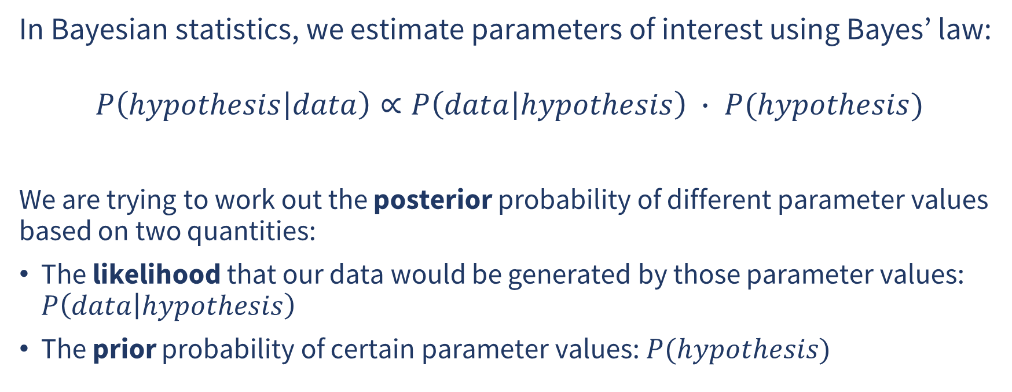
Quick recap
In Bayesian statistics, we estimate parameters of interest using Bayes’ law:
$$P\left(hypothesis | data\right)∝P\left(data | hypothesis\right) ∙ P(hypothesis)$$
We are trying to work out the posterior probability of different parameter values based on two quantities:
The likelihood that our data would be generated by those parameter values: $P\left(data | hypothesis\right)$
The prior probability of certain parameter values: $P(hypothesis)$

Slide 23
Plan for this week
The model-building workflow:
Finding a likelihood function
Identifying parameters required by the likelihood and your research question
Choosing priors for those parameters
Fitting and inspecting models
Interpreting and reporting model results

Slide 24
Week 2: Plan for today
14:00 Welcome
14:05 Self-paced practical
14:50 Break
15:00 Quick chat about datasets/research questions from our own work
15:10 Self-paced practical
15:50 Wrap up
Find these slides online:
github.com/DCS-training/ Bayesian-Statistics

Slide 25
Thank you!
Please fill in the feedback form (you’ll be sent the link)
Feel free to post in the Teams chat if you’re still working through the practical and need any help
Links to additional resources are in the README

