Slide 1




Inferential Statistics
www.cdcs.ed.ac.uk

Slide 2
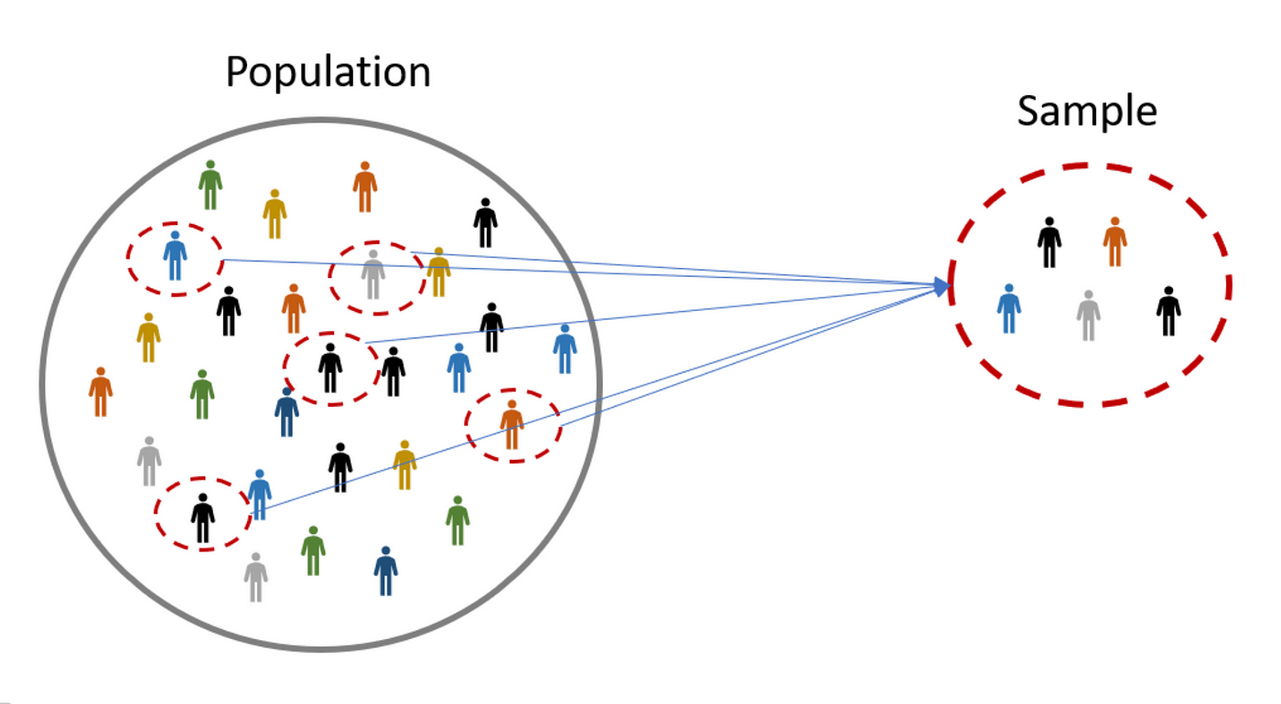
www.cdcs.ed.ac.uk

Slide 3
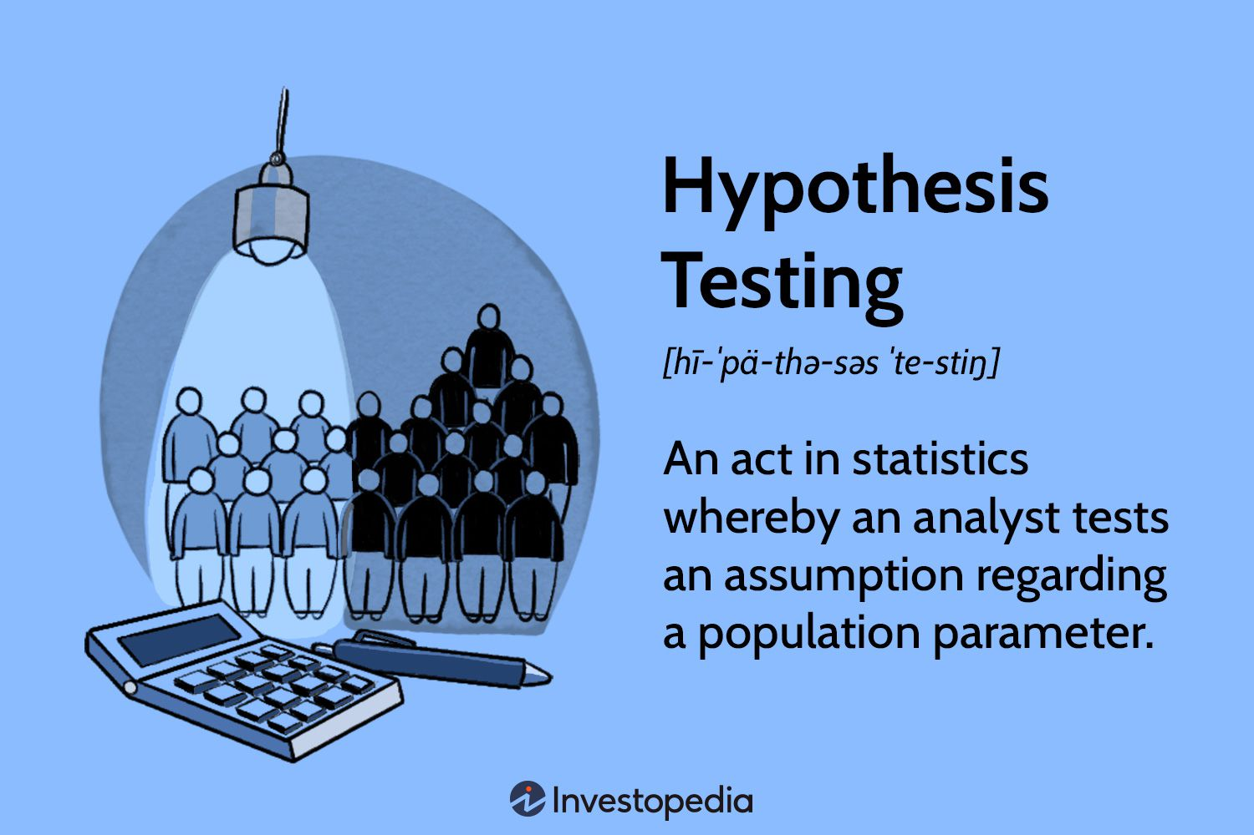
What is a hypothesis?
www.cdcs.ed.ac.uk

Slide 4
Testing a hypothesis.
(Somewhat convoluted) intuition:
Imagine a world where your hypothesis of interest is NOT true, then figure out how unlikely the data, or something more extreme than the data, is in that world.
If it’s unlikely, then you have support for your hypothesis of interest.
www.cdcs.ed.ac.uk

Slide 5
How do I formulate a hypothesis?
H0: Dogs and cats are equally tall on average
H1: Dogs are taller than cats on average
www.cdcs.ed.ac.uk

Slide 6
How do I formulate a hypothesis?
H0: Dogs and cats are equally tall on average
H1: Dogs are taller than cats on average
www.cdcs.ed.ac.uk

Slide 7
How do I formulate a hypothesis?
H0 (null): The “baseline” hypothesis, where your hypothesis of interest is not true
H1 (alternative): The hypothesis you want to test
www.cdcs.ed.ac.uk

Slide 8
Testing a hypothesis.
Null and alternative hypotheses
Figure out how likely the test statistic for the results that are at least as extreme as observed are under the null (i.e., compute the p-value)
www.cdcs.ed.ac.uk

Slide 9
What is a test statistic?
A value you get from samples for the purposes of hypothesis testing.
Example: t-statistic (used to test means or mean differences, among other things)
www.cdcs.ed.ac.uk

Slide 10
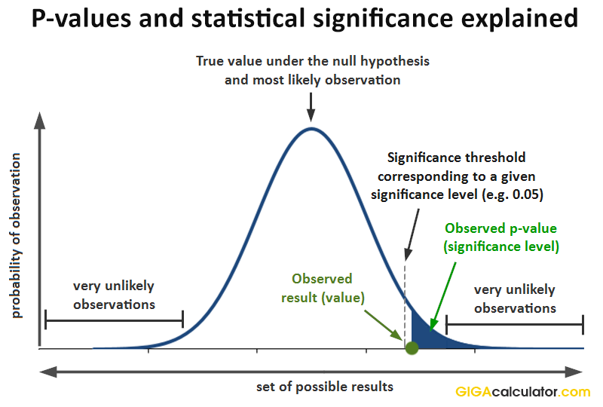
What is a p-value?
www.cdcs.ed.ac.uk

Slide 11
What is NOT a p-value?
A p-value does NOT measure
Probability of null (or alternative, or any) hypothesis being true (or false).
The size of the effect of interest (e.g., a low p-value doesn’t mean that the difference between heights is high)
www.cdcs.ed.ac.uk

Slide 12
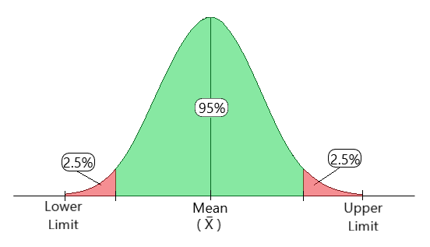
What is a confidence interval?
Confidence interval =
Estimated range of values which is likely to include an unknown value
www.cdcs.ed.ac.uk

Slide 13
Testing a hypothesis.
Null and alternative hypotheses
Figure out how likely the test statistic for the results that are at least as extreme as observed are under the null (i.e., compute the p-value)
Check if p-value falls below your significance level (e.g., p < 0.05 in social sciences and psychology)
www.cdcs.ed.ac.uk

Slide 14
Significance level
Significance level is the acceptable error rate in case the null hypothesis is true (Type I error).
i.e., in a world where your hypothesis is true, how likely is it that you will (falsely) conclude that it is not true (reject the null)?
www.cdcs.ed.ac.uk

Slide 15
BIG STATS POINT
REJECT the NULL if p < 0.05 or NOTHING
www.cdcs.ed.ac.uk

Slide 16
A difference in means
= Paired T-Testing
H0: My two groups have the same mean.
H1: My two groups of data have a different mean.
Assume: The data are independent and the means of the data are normally distributed
www.cdcs.ed.ac.uk

Slide 17
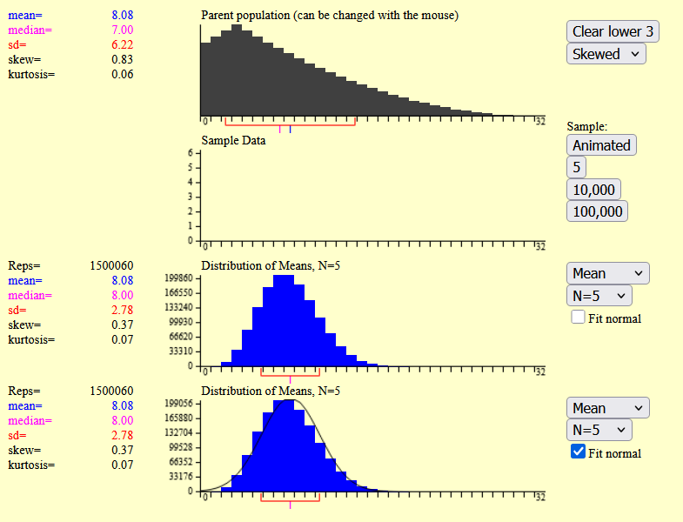
Central Limit Theorem
CLT Simulation
www.cdcs.ed.ac.uk

Slide 18
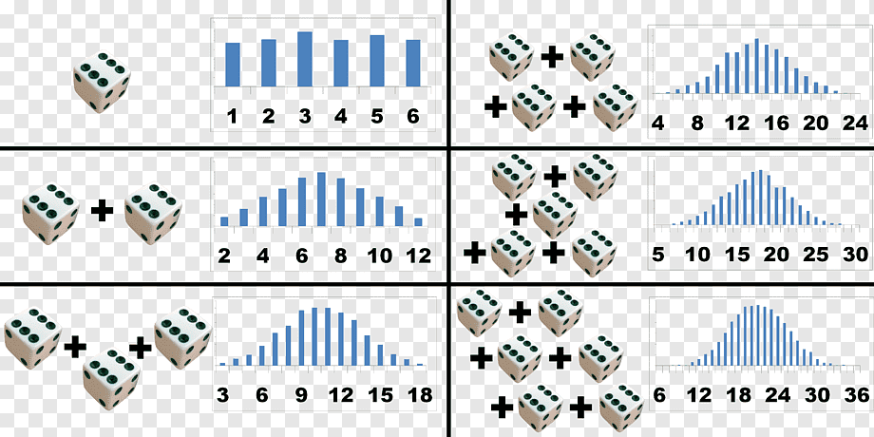
Central Limit Theorem
www.cdcs.ed.ac.uk

Slide 19
Central Limit Theorem
When I have a sample size over 30, I can assume that the mean of the data is normally distributed.
www.cdcs.ed.ac.uk

Slide 20
Exercise (discussion)
A scientist hypothesizes that students from Group A are taller than students from Group B. She calculates the sample mean heights for both groups, and finds that the mean height of Group A is larger by 5 cm. She performs a t-test on the heights and finds that the p-value is 0.00001 (sig. level = 0.05).
Given this result, can she conclude that there is a 99.999% chance that her hypothesis is correct?
www.cdcs.ed.ac.uk

Slide 21
Exercise (discussion)
A scientist hypothesizes that students from Group A are taller than students from Group B. She performs a t-test on Group A and B samples to test whether the mean height difference is 0 and finds that the p-value is very small (p = 0.000002).
Given this result, should she expect that the mean difference between the two groups’ heights is very large? Why?
www.cdcs.ed.ac.uk

Slide 22
Exercise (discussion)
A scientist hypothesizes that students from Group A are taller than students from Group B. She calculates the sample mean heights for both groups, and finds that the mean height of Group A is larger by 5 cm. She performs a t-test on the heights and finds that the p-value is 0.7 (sig. level = 0.05).
Given this result, can she conclude that the mean height of Group A is NOT higher than Group B. Why/why not?
www.cdcs.ed.ac.uk

Slide 23
Let's do some programming
Notebook:
How do I make inferential statistics?
www.cdcs.ed.ac.uk

Slide 24
Feedback for us...
We hope you've enjoyed the course as much as we did.
It is really useful for us to hear your feedback
https://forms.office.com/r/YYNrqvuNr8
Should be really quick and only take 5 mins (maximum!)
www.cdcs.ed.ac.uk

Slide 25


Thank you from us!
Please do check out the other training on the CDCS website. We have lots of different things still on offer this semester!
www.cdcs.ed.ac.uk

