Slide 1

Introduction
to Statistics

Slide 2





Welcome!
Chris Oldnall
Aybuke Atalay
www.cdcs.ed.ac.uk

Slide 3
Descriptive vs Inferential
Descriptive statistics involve summarising and presenting the main features of a dataset, such as measures of central tendency (mean, median, mode) and measures of variability (range, standard deviation), along with identifying the distribution of the data.
Inferential statistics, aims to make predictions or draw conclusions about a population based on a sample of data, using probability theory and statistical inference techniques like hypothesis testing and confidence intervals.
www.cdcs.ed.ac.uk

Slide 4

Session A:
Measures of Central Tendency and Spread
www.cdcs.ed.ac.uk

Slide 5
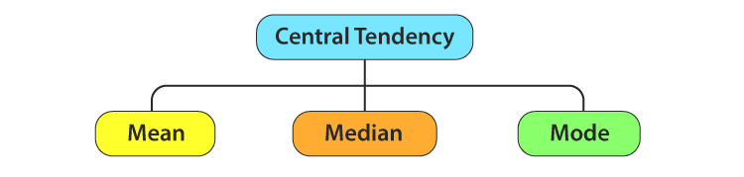
What is a measure of central tendency?
www.cdcs.ed.ac.uk

Slide 6
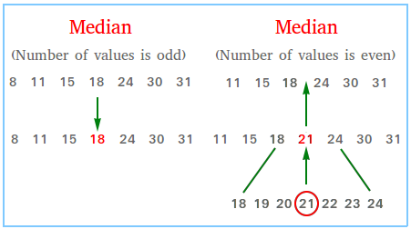
The median.
www.cdcs.ed.ac.uk

Slide 7
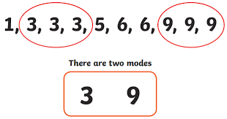
The mode.
www.cdcs.ed.ac.uk

Slide 8
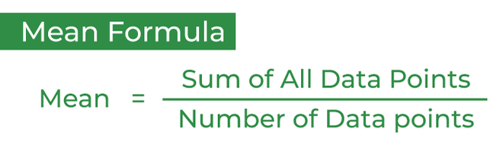
The mean.
www.cdcs.ed.ac.uk

Slide 9
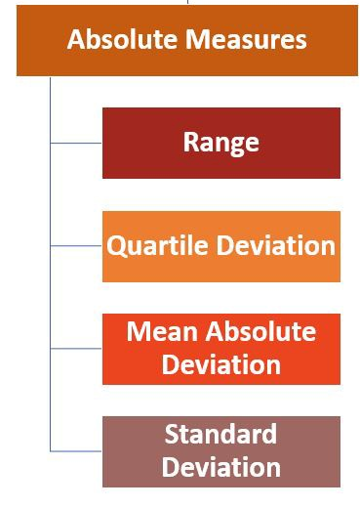
What is a measure of spread (or dispersion?
www.cdcs.ed.ac.uk

Slide 10
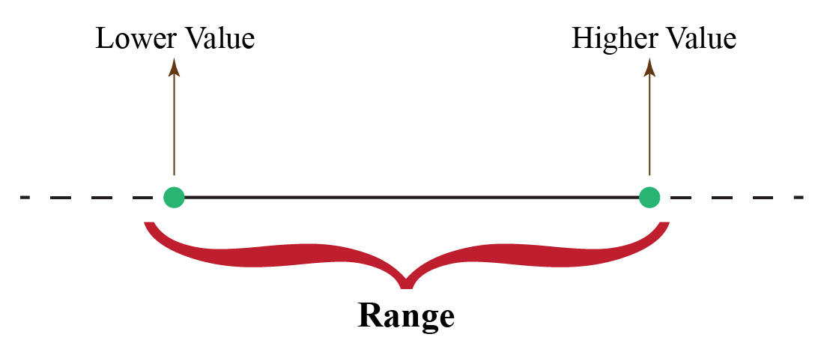
The range.
www.cdcs.ed.ac.uk

Slide 11
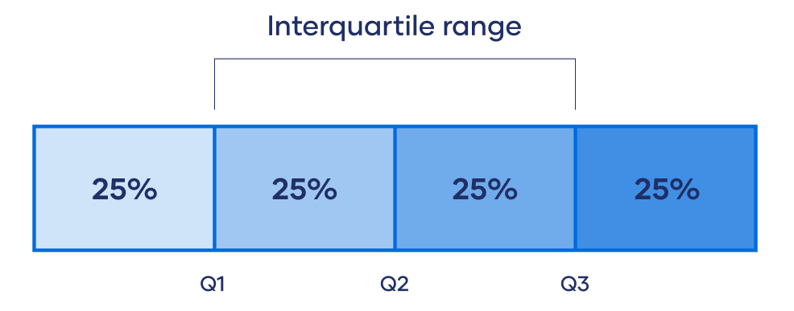
The IQR.
www.cdcs.ed.ac.uk

Slide 12
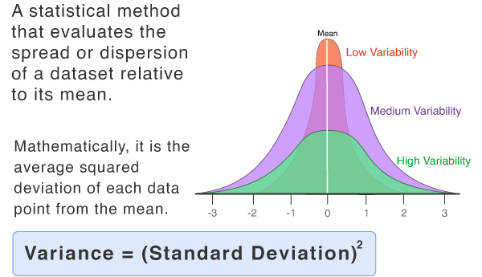
Standard Deviation.
www.cdcs.ed.ac.uk

Slide 13
Let's do some programming
Notebook A:
What are summary statistics?
www.cdcs.ed.ac.uk

Slide 14
Session B:
Distributions and Visualising Statistics
www.cdcs.ed.ac.uk

Slide 15
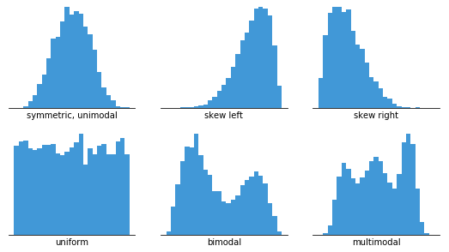
What is a distribution?
www.cdcs.ed.ac.uk

Slide 16
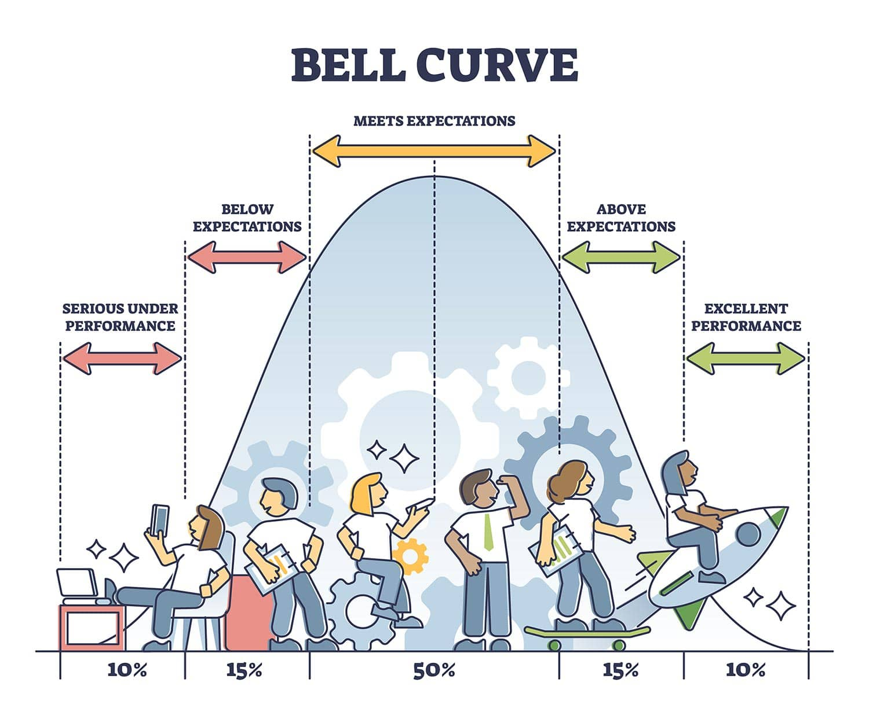
The normal distribution
www.cdcs.ed.ac.uk

Slide 17
Let's do some programming
Notebook B:
Identifying distributions.
www.cdcs.ed.ac.uk

Slide 18
Feedback for us...
We hope you've enjoyed the course as much as we did.
It is really useful for us to hear your feedback
https://forms.office.com/r/YYNrqvuNr8
Should be really quick and only take 5 mins (maximum!)
www.cdcs.ed.ac.uk

Slide 19
Thank you from us!
Please do check out the other training on the CDCS website. We have lots of different things still on offer this semester!
www.cdcs.ed.ac.uk

