Slide 1

Using copyrighted material 15 March 2021
Copyright and licenses
Neil Chue Hong (N.ChueHong@epcc.ed.ac.uk @npch)
ORCID: https://orcid.org/0000-0002-8876-7606 Director, Software Sustainability Institute
Senior Research Fellow, EPCC
University of Edinburgh

Slide 2
Reusing this material
This work is licensed under a Creative Commons Attribution 4.0 International License (CC BY 4.0). See: https://creativecommons.org/licenses/by/4.0/
You are free to:
Share — copy and redistribute the material in any medium or format
Adapt — remix, transform, and build upon the material for any purpose, even commercially.
Under the following terms:
Attribution — You must give appropriate credit, provide a link to the license, and indicate if changes were made. You may do so in any reasonable manner, but not in any way that suggests the licensor endorses you or your use.
No additional restrictions — You may not apply legal terms or technological measures that legally restrict others from doing anything the license permits.
You do not have to comply with the license for elements of the material in the public domain or where your use is permitted by an applicable exception or limitation.
No warranties are given. The license may not give you all of the permissions necessary for your intended use. For example, other rights such as publicity, privacy, or moral rights may limit how you use the material.

Slide 3




www.cdcs.ed.ac.uk

Slide 4
What this workshop covers
Introduction to intellectual property, copyright, and licensing
University commitment to research integrity
Examples of using digital objects: images, databases, software tools
Intellectual Property: “rights granted to creators and owners of works that are the result of human intellectual creativity”
As researchers, we are creators and consumers of many works

Slide 5
IANAL (I Am Not A Lawyer)
This is not legal advice
If you want advice from people with a legal background:
UK Copyright Law: The Basics
Intellectual Property Law
The International Free and Open Source Lawbook
qLegal: advice for tech start-ups + entrepreneurs
tl;dr legal: Software Licenses in Plain English
Open Source Software Watch

Slide 6
Copyright
“legally enforceable property right that enables a rights holder to profit from a work ... preventing others from exploiting the work without the rights holder's say so for a period of time”, Copyright law, Jisc, 2014
Protection of a tangible manifestation of an idea; e.g. a book, image, software, web content, databases, recordings, broadcasts
Copyright is free and automatic – no registration or notice is required
Copyright holder must be a legal entity
Copyright © 2021 The University of Edinburgh
Copyright © 2021 Mo McClean

Slide 7
Copyright rights
Reproduction - copying the work in any way (photocopying, scanning, recording or downloading)
Distribution - issuing copies of the work to the public in print or electronically
Rental and lending of the work to the public
Public performance – performing, showing, playing or broadcasting a work to the public
Adaptation – making of an adaptation of a work
Notes:
Related rights are rights that arise alongside copyright of a new work but they do not always belong to the author of the work.
Moral rights – are protecting the reputation of the author and their intellectual and emotional investment. These are the right to be credited as the author of a work and the right to object to derogatory treatment of their work.
Database right – rights that arise in the selection and presentation of data in a database whether electronic or not.
Performance rights - the rights of performers, singers, dancers or actors in a work
Copyright expires after a set period of time or ‘duration’, after which there are no restrictions on the use of the copyright work. When copyright expires the work is said to pass into the ‘public domain’. There are many different durations of copyright depending on the type of work but the most relevant are:
published literary, artistic, musical or dramatic works – 70 years from the end of the year when the author died
typographical arrangements – 25 years from publication
crown copyright (UK Government) – usually 50 years after creation or publication
sound recordings - 70 years from date of creation or release
film - 70 years from death of the last surviving key contributors (writer, director or soundtrack author)
unpublished literary, artistic, musical or dramatic works – either 70 years following the death of the author or until 31 December 2039 (whichever is later)

Slide 8
Things you can’t copyright
Ideas
Names or titles (but these can be trademarked)
Data and facts (but the way they are expressed can be)
Recipes / formulas (though accompanying instructions, descriptions and images, as well as the layout can)
Template forms (though the layout can)
Inventions, processes and methods (but these can be patented)
3D designs (but these have a similar design rights protection)

Slide 9
Patents
“protect new inventions and cover how things work, what they do, how they do it, what they are made of and how they are made. It gives the owner the right to prevent others from making, using, importing or selling the invention without permission”, Patents, Jisc.
Invention must be novel, i.e. has an ‘inventive step’ that is not obvious to someone who works in the subject area
Invention must be confidential to be patentable
Inventions relating to computer software may be patentable, but only if they involve something more than just software running on a computer in a technically ordinary way

Slide 10
Transferring rights
Copyright is a property right that can be bought and sold
However, a license can be used to give someone other than the copyright holder the right to use the item, without transferring ownership (the copyright)

Slide 11
Licensing
Licensing is official permission to do something, within limits:
You can drink in a pub during their licensed hours
You can play live music as long as it isn’t above 75db
You can drive a vehicle up to 3,500kg with up to 8 seats
Licensing is commonly used to exploit Intellectual Property:
You can use my photograph to advertise your product, but only in the United Kingdom
You can screen this movie in this venue on these dates

Slide 12
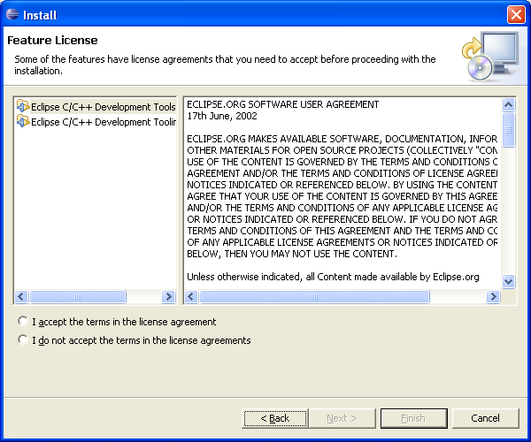
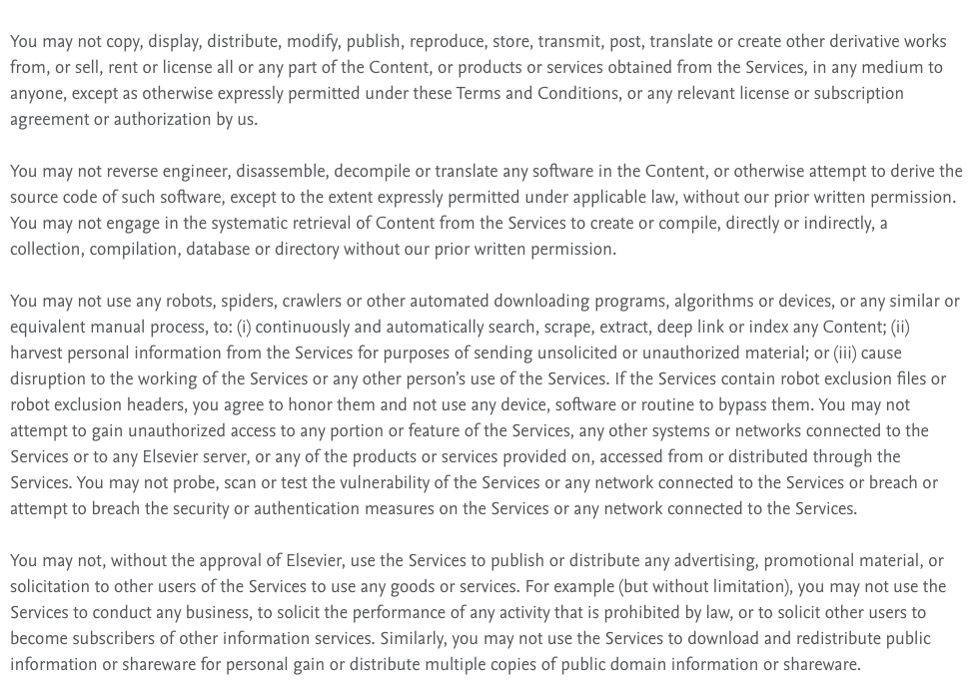
What licensing looks like to most people
Eclipse Development Tools License Acceptance Dialog
Elsevier website terms and conditions – Using our services

Slide 13
University commitment to research integrity
Research Integrity means conducting research in such a way that allows others to have confidence and trust in the methods and the findings of the research.
UKRIO Code of Practice for Research
The UUK Concordat to support Research Integrity
CAHSS Research Integrity and Ethics policies
Includes intellectual property, authorship and plagiarism
https://www.ed.ac.uk/research-office/research-integrity/our-commitment

Slide 14
Reusing this material
This work is licensed under a Creative Commons Attribution 4.0 International License (CC BY 4.0). See: https://creativecommons.org/licenses/by/4.0/
You are free to:
Share — copy and redistribute the material in any medium or format
Adapt — remix, transform, and build upon the material for any purpose, even commercially.
Under the following terms:
Attribution — You must give appropriate credit, provide a link to the license, and indicate if changes were made. You may do so in any reasonable manner, but not in any way that suggests the licensor endorses you or your use.
No additional restrictions — You may not apply legal terms or technological measures that legally restrict others from doing anything the license permits.
License
Rights
Limits
You do not have to comply with the license for elements of the material in the public domain or where your use is permitted by an applicable exception or limitation.
No warranties are given. The license may not give you all of the permissions necessary for your intended use. For example, other rights such as publicity, privacy, or moral rights may limit how you use the material.
Exceptions

Slide 15
Using copyrighted material 15 March 2021
Copyright and licenses
Neil Chue Hong (N.ChueHong@epcc.ed.ac.uk @npch)
ORCID: https://orcid.org/0000-0002-8876-7606 Director, Software Sustainability Institute
Senior Research Fellow, EPCC
University of Edinburgh
© 2021. The University of Edinburgh. All rights reserved.
© 2021. The University of Edinburgh. Licensed under CC BY 4.0.

Slide 16
Using copyrighted material
As researchers and teachers, we use copyrighted material all the time
Reading papers, monographs and books
Photocopying extracts for students
TV, film and video clips
It is the responsibility of the person making the copy to ensure they are complying with the law

Slide 17
Common fallacies around copyright
If it’s available for no cost, I can use it how I want
The cost of an item is not related to the restrictions on its reuse
If it’s on the web, it’s in the public domain and not copyrighted
The opposite is true. All web content is copyrighted unless explicitly in PD.
I can use my students work without their permission
Students at the University of Edinburgh have copyright of their work
If I’m using it for teaching, I have an exemption
This is the idea of fair dealing, and only applies to teachers providing instruction or illustrating a point to students within a school or university

Slide 18
Fair dealing
Certain uses of an artistic work do not require permission from the copyright owner so long as the use is considered to be ‘fair’.
Generally, if the use would not affect sales of the work and if the amount copied is reasonable and appropriate
Quotation and Criticism: relevant and acknowledged (not photos)
Research and Private study: copying for personal use only
Education and Teaching: not a blanket exemption for teachers
Parody: must still be “fair”, does not protect against libel/slander!
Text & Data Mining: where research is not for commercial benefit and research have rights to access the works

Slide 19
Using images and photos
Images are often not covered by fair dealing exemptions
Images contained in sources covered by the University’s CLA Licence may be copied, and used in teaching materials
Most printed books, journals and magazines published in the UK, plus many published overseas and a large number of digital publications
Easier to use open licensed images for illustration
https://search.creativecommons.org/
https://www.flickr.com/creativecommons/
https://unsplash.com/

Slide 20
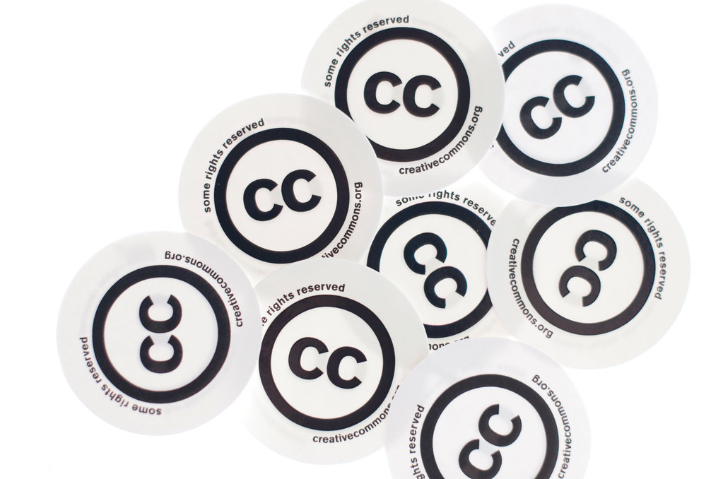
Attributing images
Title, Author, Source, License
Good academic practice
Reference materials you use
Also useful to keep a record of the source of the image
Like keeping a bibliography
"Creative Commons - cc stickers" by Kalexanderson is licensed under CC BY 2.0

Slide 21
Exceptions to using your images
In general, you can use photos you have taken yourself
There are some exceptions
Freedom of Panorama: not all countries allow you to photograph artistic works which are in public places, e.g. the illuminations on the Eiffel Tower
Public space: definitions of public space may differ as may rights (e.g. non-commercial use only) and whether identifiable people may be included
Codice Urbani: Italy has very strict laws around pictures of “cultural goods” requiring authorization to be obtained in advance
This can be particularly problematic if you seek to publish a book using your photos

Slide 22
Using research data and databases
Facts are free – they are considered knowledge, a public good
Research data are generally facts, however some forms can be copyrighted or have additional rights restricting use: if it has been processed into a work, or turned into a database or collection e.g. structured and searchable
You can generally take a copy for your own research
However, if you intend to publish portions of copyrighted data or databases, you must seek consent

Slide 23
Using software
Research software often has one of three types of license:
Commercial (e.g. SPSS, Stata, NVivo, Matlab)
Open source (e.g. R, Python, TensorFlow)
Academic / Non-commercial use (e.g. omnet++, OpenCarp)
The University of Edinburgh has licensing deals for many common packages: https://www.ed.ac.uk/information-services/computing/desktop-personal/software
You must have the right to use the software, through a suitable license. Not all licenses allow you to modify software

Slide 24
Software, Data, OA and Reproducibility
Many publishers are encouraging reproducible research
Likewise, Open Access research is less beneficial if readers cannot replicate the methodology or access the datasets
This may mean that there is a benefit to using software which it is easy for others to access and use, e.g. open source software or widely available commercial software with free licenses for research and teaching

Slide 25
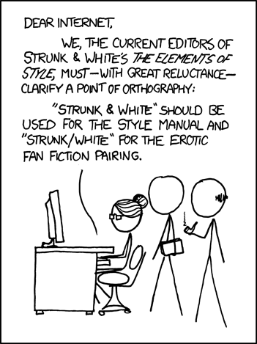
The ultimate edge case: Fan Fiction
Strunk fell back, exhausted onto the great number of dead leaves that were lying on the ground.
"That was incredible," he sighed – his voice passive. "I – I can't describe…"
White smiled, and kissed him again. "It's alright, my darling," he said. "After all – you always said we should omit needless words."
"But darling," cried Strunk, "I don't want no-one else!"
"Control yourself, William", said White sternly. "Your negatives are all over the place."
"No, Elwin," he replied, "they're not." And he opened the bathroom door to reveal Fowler, resplendent in White's velvet dressing-gown.
They lay back and gazed at the stars, in their unfathomable, unsplit infinity.
"Do you ever feel," asked White, "that there's only us two, in the whole of Creation?"
"No," replied Strunk, "Though I do often feel that there are only we two."
"Forget it," said White, getting up and stalking back to the house.
"Uh-oh," said Strunk, "My big mouth and I.”
Contributed by Dan H. and Pflaumbaum to Important editorial advice article at Language Log
Strunk and White by Randall Munroe from xkcd is licensed under CC BY NC 2.5

Slide 26
Summary
Intellectual property law enables creators to profit from their work
You need to know how copyright and licensing impacts your work
The use of copyrighted materials is often allowed for personal research and study, and in limited amounts for teaching
Care must be taken to understand what the license to a work allows you to do, especially around commercial use and publishing
Reference work you use, and keep a record of where it is sourced
Openly licensed work, e.g. Creative Commons or Open Source allows you to reuse

Slide 27
University resources
Library guides: https://www.ed.ac.uk/information-services/library-museum-gallery/library-help/copyright
Frequently Asked Questions (FAQs): https://www.ed.ac.uk/information-services/library-museum-gallery/library-help/copyright/faqs
Open Educational Resources Policy: https://www.ed.ac.uk/files/atoms/files/openeducationalresourcespolicy.pdf

Slide 28
Questions?
Workshop next Monday will cover “Understanding copyright and licensing of your own work”

