Slide 1
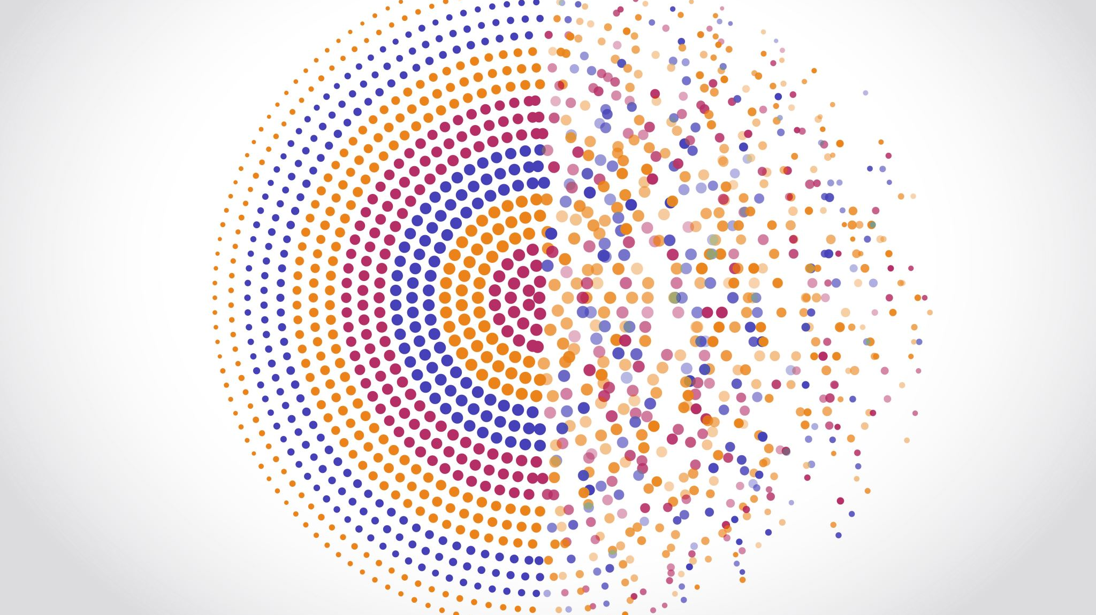
CDCS Training: Machine Learning Model Evaluation
Bhargavi Ganesh

Slide 2
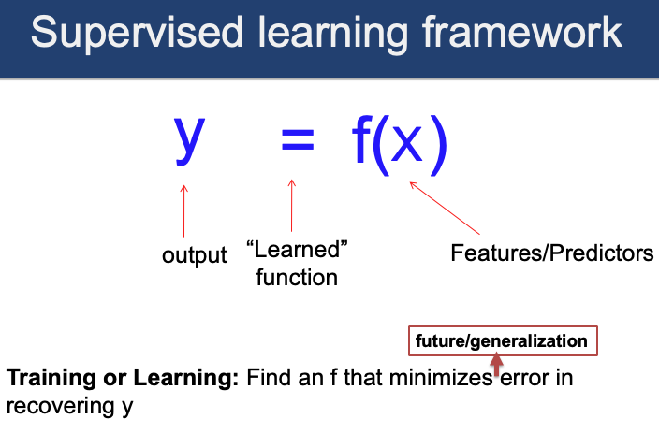
Recap: Supervised Learning

Slide 3
Recap: Model Pipeline
First, we needed to understand what was in our data
Next, we pre-processed the data to get it ready for modeling
After that, we chose a set of models to use and fit our model(s)

Slide 4
Model Pipeline: Evaluation
Now that we have some models fit, we need to evaluate how well the models perform and then choose the best model on this basis
Once we have chosen our best model, we should also conduct some further evaluations to see how it performs on different subgroups
Evaluation is in iterative process that helps us make our models better

Slide 5
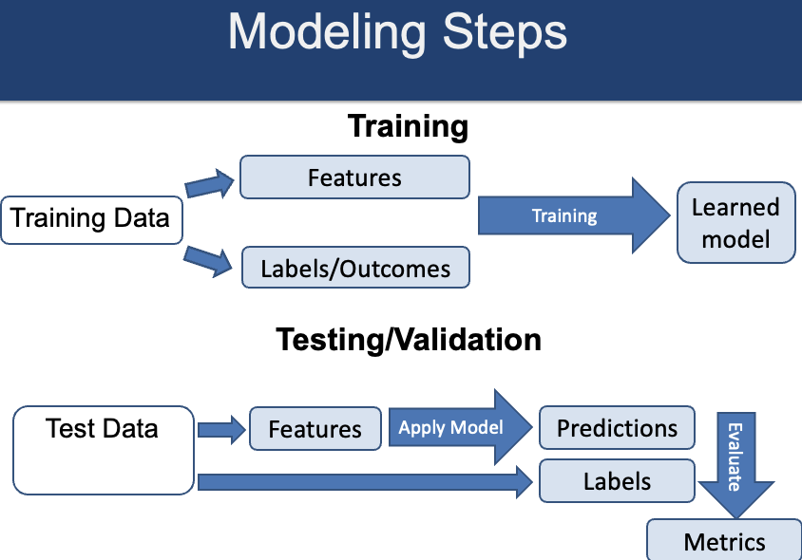
Visual Representation

Slide 6
Question: How do we decide which models to use?
Is it a classification/regression problem? Is it a binary classification problem or a multiple classification problem?
SVM tends to be used for multiclass, whereas logistic/decision trees/random forest can be used for both
How much interpretability is necessary? Do we want to know every step (splits of trees or coefficients?) Or are we ok with a more “black box” approach?
How much time/resources does it take to train the model?
”Simpler models” that optimize efficiency/interpretability (in order of most interpretable to least)
Linear Model
Logistic Model
Decision Trees (with fewer splits)
Random Forest (with feature importances)
Not an exact science, we are typically weighing different tradeoffs

Slide 7
Evaluation metrics
Confusion matrix
Precision
Recall
F1 Score
K-Fold Evaluation

Slide 8
Baseline Models
Typically, we evaluate/compare outputs of different models with that of a ”dummy” classifier, or a classifier that would just randomly predict the most frequent class
We might also use other simple/expert heuristics as our baseline (based on our expectations/knowledge of the field)

Slide 9
Leakage
Data used to train the model contains information about what we’re trying to predict
Will result in better-than-expected, overconfident results
Examples
Including the ground truth (or proxy) as a predictor
Imputing/normalizing the entire dataset
Using future data to make predictions on the past
Using any information not available at time of prediction

Slide 10
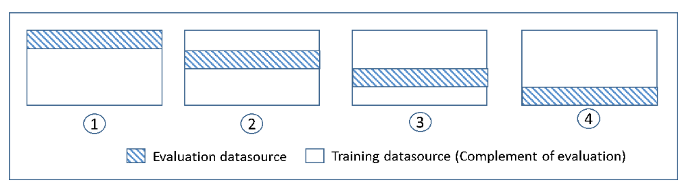
Evaluation Methods: K-Fold Evaluation
https://docs.aws.amazon.com/machine-learning/latest/dg/cross-validation.html

Slide 11
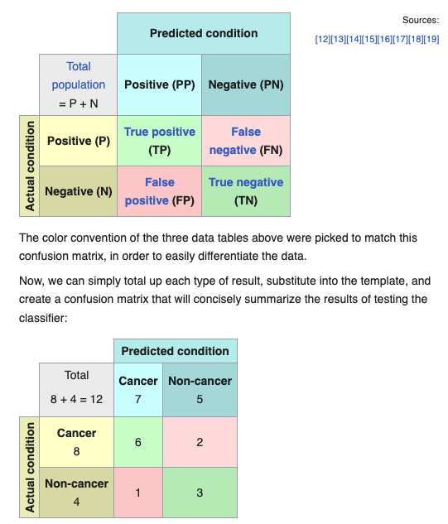
Evaluation Metrics: Confusion Matrix

Slide 12
Evaluation Metrics: Confusion Matrix

Slide 13
Evaluation Metrics: Recall
True Positive Rate = True Positives/Positives = True Positives/(True Positives + False Negatives)
Another word for this is ”sensitivity”
When do we care more about recall?

Slide 14
Evaluation Metrics: Recall
When do we care more about recall?
High risk predictions, such as those present in disease detection and other healthcare applications
Why? The risk involved with a false negative prediction is very high compared to the risk of false positive rate

Slide 15
Evaluation Metrics: Precision
Positive Predictive Value = True Positive/False Positives
When do we care more about precision?

Slide 16
Evaluation Metrics: Precision
When do we care more about precision?
We care more about precision when we want to make sure that we reduce the number of false positives.
E.g. Youtube recommendations. If the user sees recommendations that are not of their liking, they will close the application, which is not what YouTube desires.
Automated marketing campaigns require high precision to ensure that a large number of potential customers will interact with their survey or be interested to learn more.

Slide 17
Evaluation Metrics: F1 Score
Harmonized mean of both precision and recall
When do we want to use this? When we care equally about both the sensitivity (precision) and recall

Slide 18
When to use which metric?
Consider how balanced your dataset is
Balance means (roughly) the same number of positive and negative cases are present in the training data
In balanced datasets, may be more inclined to use accuracy as a metric
When datasets are unbalanced, may want to use precision or recall
Application area also matters: what’s the risk of the type of error that you could be making?

Slide 19
Once we’ve chosen the best model: generate predicted values
This can be done using predict_proba function in sklearn
Can then use a decision cutoff point to determine which probability to assign for class 1 versus 0
Could be based on a number of factors, including business decisions, weighing of different risks of positive/negative classifications, etc.
Note: Decision cutoff point should be considered in evaluation steps. It should not just be arbitrarily chosen.

Slide 20
Once we’ve chosen the best model: Decision cutoff points/thresholds
Based on business decisions
Fraud Prevention: We're a social network company and we'd like to delete fake accounts. We build a classifier that assigns a "fraud score" between 0 and 1 to each account and, after some research, decide that all accounts whose score is above 0.9 should be sent to our fraud team, which will review each case and delete the accounts that are actually fake
Response/Propensity Modeling: We're at an enterprise software company and we'd like to improve our outbound sales program. We buy a large database of potential customers and build a classifier to predict which ones are likely buy our product if contacted by our sales team. We decide that all customers with a "response score" of above threshold 0.7 should get a call
Shopping Cart Abandonment: We're at an e-commerce company, and we'd like to email a 10% off coupon to users who abandoned their shopping carts and won't return organically. (We don't want to give a 10% off coupon to users who are going to return anyway, since then you'd be losing 10% of the sale price.) We build a classifier to predict which users will never return to their carts, and decide that all users with an "abandonment score" above 0.85 should get the 10% off coupon

Slide 21
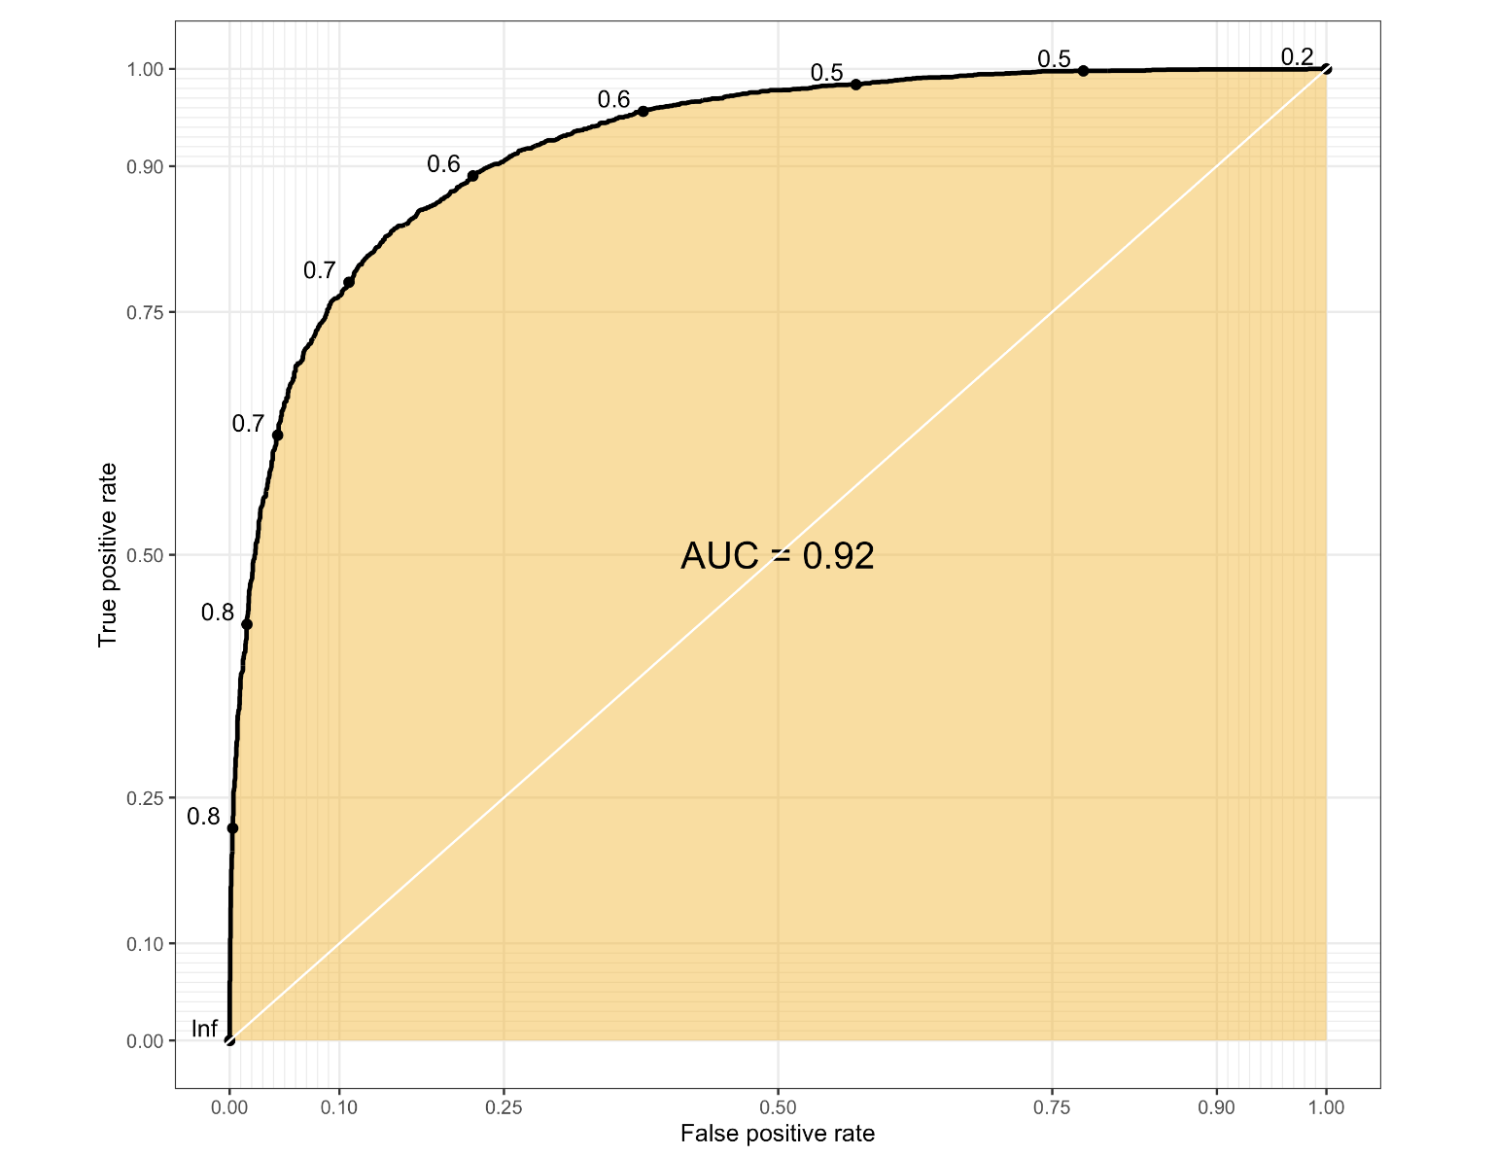
Thresholding based on AUC-ROC curve at different cutoff “threshold” values
https://sinyi-chou.github.io/classification-auc/

Slide 22
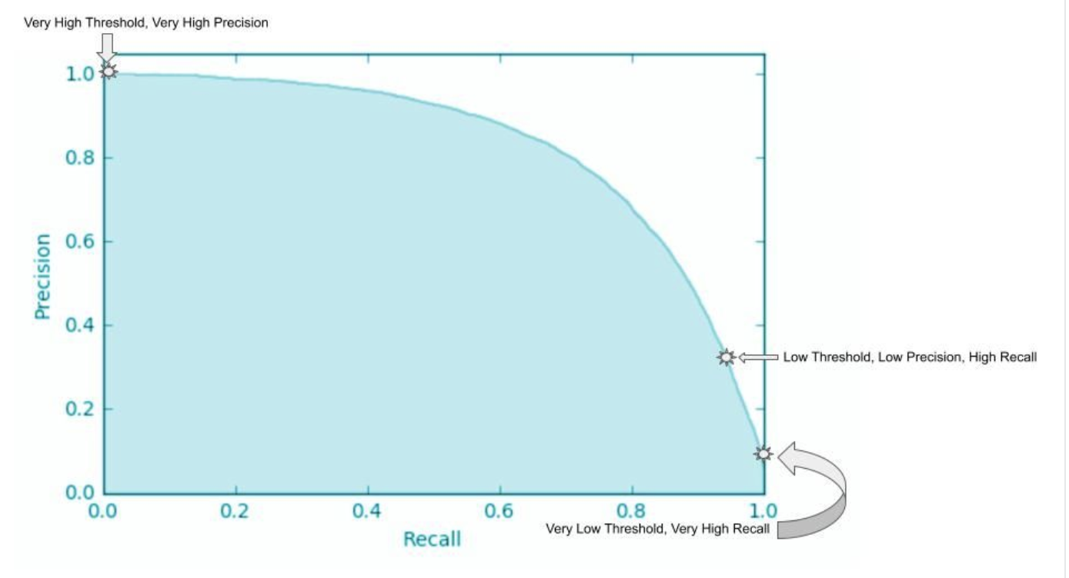
Thresholding based on precision/recall curve at different cutoff “threshold” values
https://www.datacamp.com/tutorial/precision-recall-curve-tutorial

Slide 23
Ethics-related evaluations
Fairness toolkits
IBM fairness toolkit: https://aif360.readthedocs.io/en/latest/modules/generated/aif360.metrics.ClassificationMetric.html#aif360.metrics.ClassificationMetric.statistical_parity_difference

Slide 24
Fairness metrics
Equalized odds
Equality of opportunity
Demographic parity
Predictive parity
Counterfactual fairness
Google fairness glossary: https://developers.google.com/machine-learning/glossary/fairness#:~:text=disparate%20impact-,%23fairness,some%20subgroups%20more%20than%20others

Slide 25
Beyond technical fairness metrics
What are the potential impacts of this model/outcome? Potential misuses?
How can I best inform people who might use my model about how well it performs on different use cases?
Model cards for model reporting (Mitchell et al 2018)
Datasheets for datasets (Gebru et al 2018)

