Slide 1

Intro to Machine learning
Bhargavi Ganesh

Slide 2
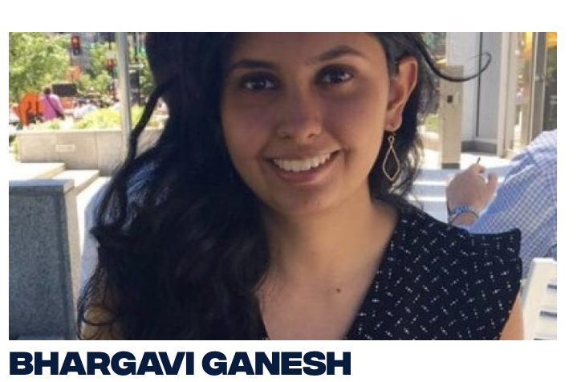
About me
Master’s in Computational Analysis and Public Policy
Experience working with large datasets to assess policy outcomes
Previous background in Statistics/Econometrics
Worked as a data scientist at the Federal Reserve Bank of Philadelphia
Previous instructor for InspiritAI, a program that teaches AI/ML to high school students across the world
Currently work on AI Ethics topics at the intersection of philosophy + informatics + policy

Slide 3
What is Machine Learning?
Process of using data to "train" a model to perform based on patterns found in the data
Typically requires large amounts of data with variance, so that there are many different data points to learn from
There are some patterns we cannot discern ourselves, which potentially may be discerned by the algorithm (enabling us to learn)

Slide 4
Advantages of Machine Learning
Don’t have to assume the distribution of the data
Classifiers can be used on a wide range of different data types, including images, video, text, and sound
Great in situations where you have access to large amounts of data

Slide 5
Things to keep in mind before getting started
Data is messy! Take the time to understand your dataset
Most errors occur in the interpretation step, because you don’t understand your data well enough
Correlation does not equal causation! Be careful when making causal statements regarding your outputs
As a general rule, we have to use proxies → ie deciding that medical spending is a proxy for worse healthcare outcomes
But this can go totally wrong if we don’t understand the correlation between this proxy and other characteristics (observed or unobserved)

Slide 6
Supervised vs. Unsupervised Learning
Supervised learning requires that there is a labeled dataset with a target variable.
Prediction tasks: e.g. predicting the stock market value at the end of this week
Classification tasks: classifying an image as being a cat or a dog
Unsupervised learning involves finding patterns in unlabeled datasets, without a target in mind
Typically involves clustering similar data points
E.g. Google News uses unsupervised learning to categorize news under a label, such as “US News”
E.g. creating customer profiles for ad targeting/recommendation engines

Slide 7
Let’s check your understanding!
DataCamp Exercise1
DataCamp Exercise2

Slide 8
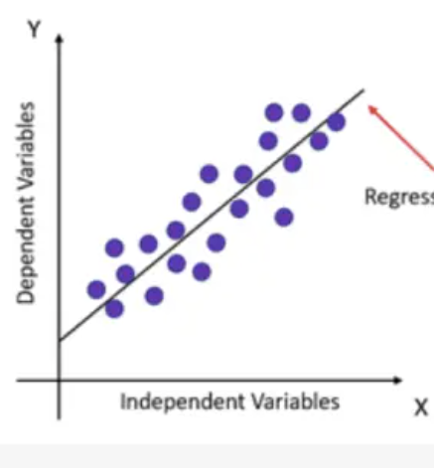
Supervised Learning: Regression
Linear Regression
Predicting output value based on input value and associated weights on different features

Slide 9
Classification: Decision Boundaries
Our model helps us distinguish between different classes in the dataset
The boundary point between different classes is called a decision boundary
Many different algorithms used to determine this boundary
Decision boundary example notebook

Slide 10
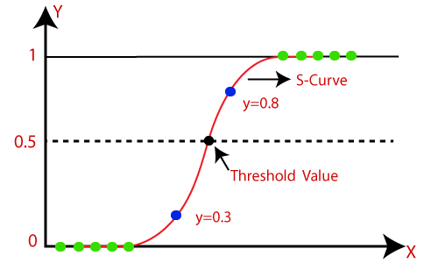
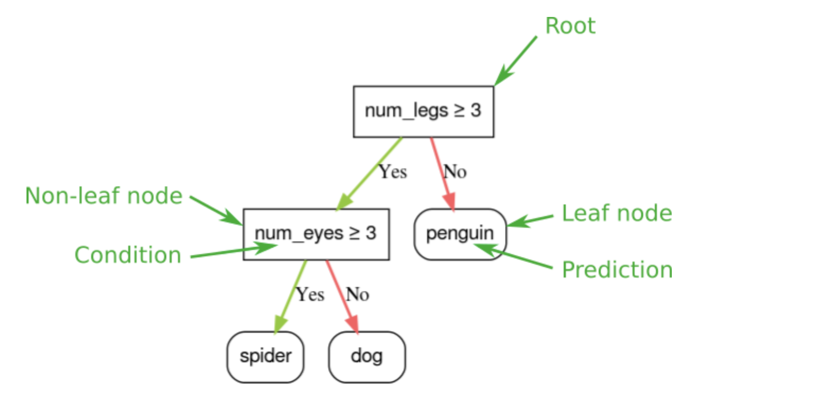
Supervised Learning: Classification
Classification methods:
Logistic Regression: Model which can take discrete or continuous data and predict a binary outcome (1 or 0).
Decision Trees: Data is continually split according to a parameter, and these splits lead to the final outcome

Slide 11
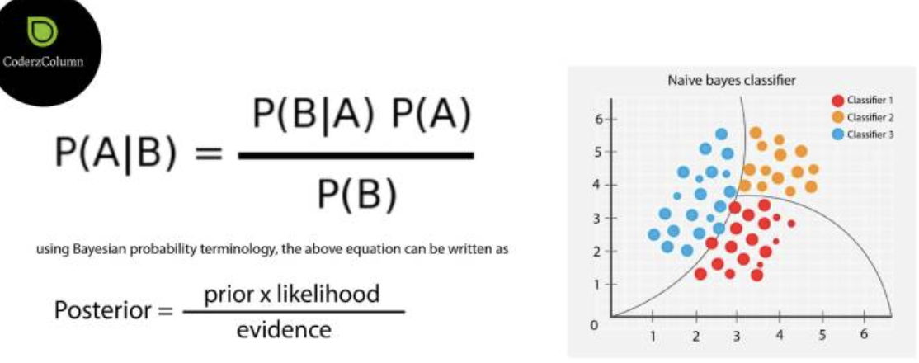
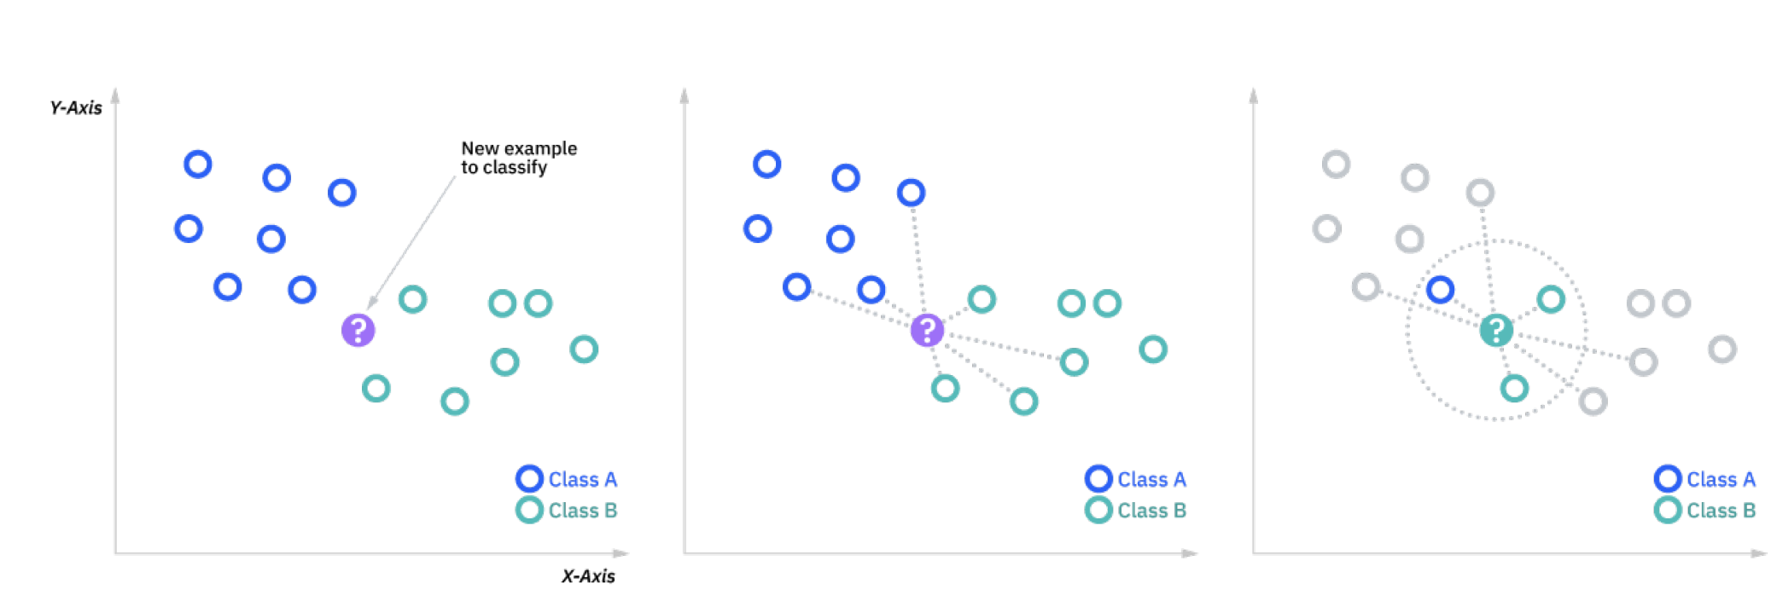
Supervised Learning: Classification (cntd)
Naïve Bayes
Uses simple implementation of Bayes Theorem (very quick to train)
K-Nearest Neighbors (KNN)
Uses Distance metrics to figure out likelihood of classification point
Support Vector Machines (SVM)
More complex algorithm, tends to work well on images

Slide 12
Supervised Learning: Ensemble Methods
Ensemble methods combine multiple different models together to get better overall performance
Bagging (Bootstrap aggregating)
Models like random forest
Create a bootstrapped dataset (a random assortment of original data), then do random splitting of decision trees. Determine the class label for each tree and then use majority voting to decide on a label.
Boosting:
Models like AdaBoost, XGBoost, etc.
Combining a set of weak learners to get a stronger learning algorithm. Focus on previously misclassified input data, to improve those classifications.

Slide 13
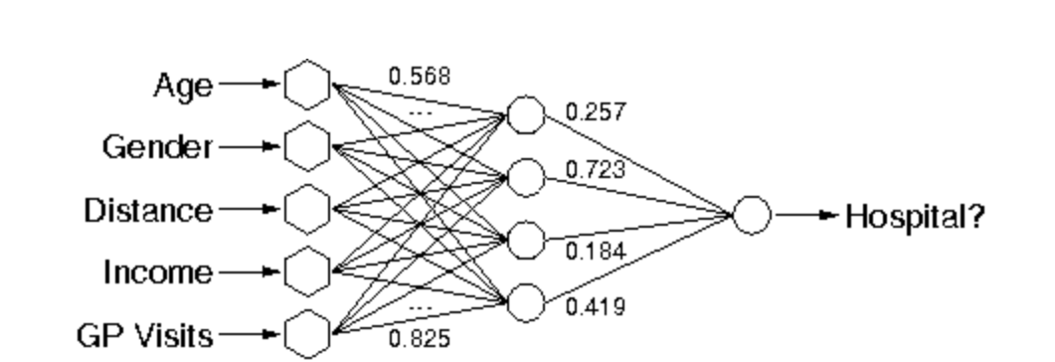
More advanced: Neural Networks
Training:
Difference between processed output of network (prediction) and target output called the error
Network adjusts weighted associations according to learning rule and using error value
Adjustments occur to make the network produce output increasingly similar to target output
Methods such as backpropagation used to update weights

Slide 14
Neural Networks visualization
3blue1Brown

Slide 15
Additional clarifications
Technically, KNN, Decision Trees, and ensemble methods like RandomForest can be used for both classification and regression.
But in practice they tend to be used more for classification.

Slide 16
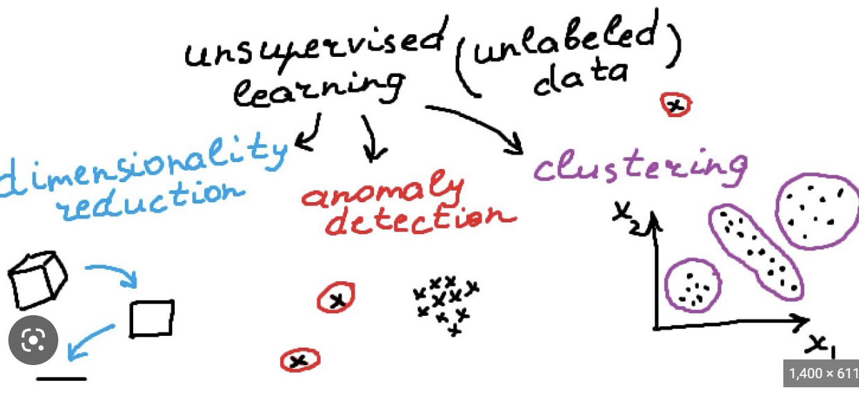
Unsupervised Learning Examples
Dimensionality reduction
Methods such as principal component analysis (PCA)
Clustering
Methods such as topic modeling
E.g. Clustering different words within a corpus: Topic modeling example
Use distance metrics for clustering (example here)

Slide 17
Process of training a supervised learning model
Fun Example!

Slide 18
Pre-Processing
Often, you need to pre-process your data
Removing N/As
Occasionally make continuous variables discrete
Normalizing/Regularizing data (might aid in interpretation as well)

Slide 19
Train/Test Splits
We want to separate our data into training and testing data (at the minimum)
Sometimes we will want to split our data into training, validation, and testing (hold out method) → we will discuss this more in the lecture on evaluation
What percentage should go into training/testing?
No universal answer to this question
Depends on size/nature of data
Must consider computational costs for training/evaluation, and representativeness of training set vs. testing set
Common split %s:
Train: 80%, Test: 20%
Train: 67%, Test: 33%
Train: 50%, Test: 50%

Slide 20
General challenge: Bias/Variance tradeoff
Bias refers to the errors that result from the model not learning the relationships between data and target variable well enough. High bias would lead to underfitting.
Variance refers to errors that result from the model being too sensitive to the data. High variance would mean that you have overfitting.
It’s a tradeoff because you have to manage

Slide 21
Other challenges
More complex models require more computing power
Machine learning models can take days to run (on our laptops) if the algorithm is complex enough, dataset is large (many columns), etc.
Might need access to a server if you want your models to run faster
This is really important because it will impact model choice sometimes

Slide 22
Machine Learning Pitfalls
Data not representative enough to generalize
Class imbalance problem → might be worse at predicting positive classes
If our model just ”memorizes” the training data --> not very useful in the real world

Slide 23
Be a model doctor! Evaluation
Super important to evaluate models
In today’s class we will only look at accuracy → predicted yes cases versus actual yes cases
Methods of evaluation will be discussed in the next class

