Slide 1

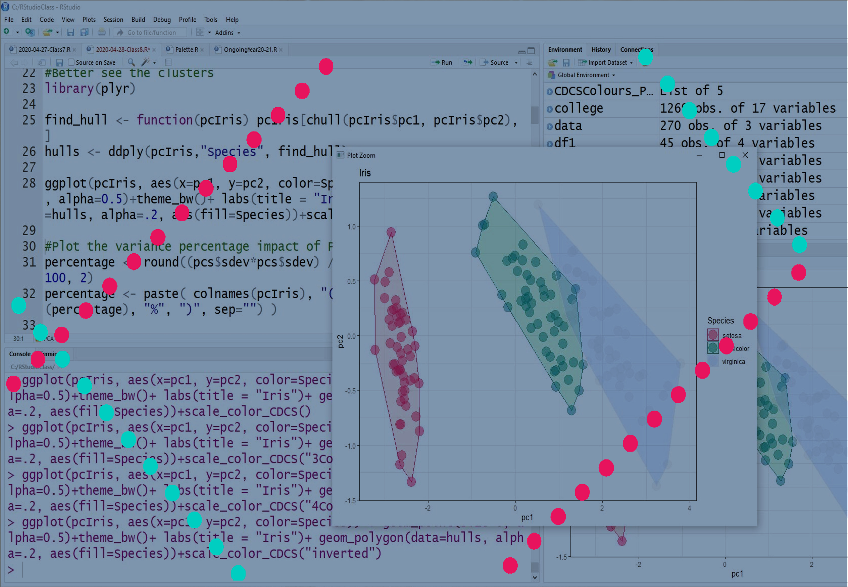
Statistics and Visualisation with R
Lucia.michielin@ed.ac.uk

Slide 2
Today Program
Discuss the results of the challenge
Intro to Statistics
Descriptive Statistics
Summarising Statistics
Exploring 1 variable: Plotting distribution Histograms and Denstiy plot

Slide 3

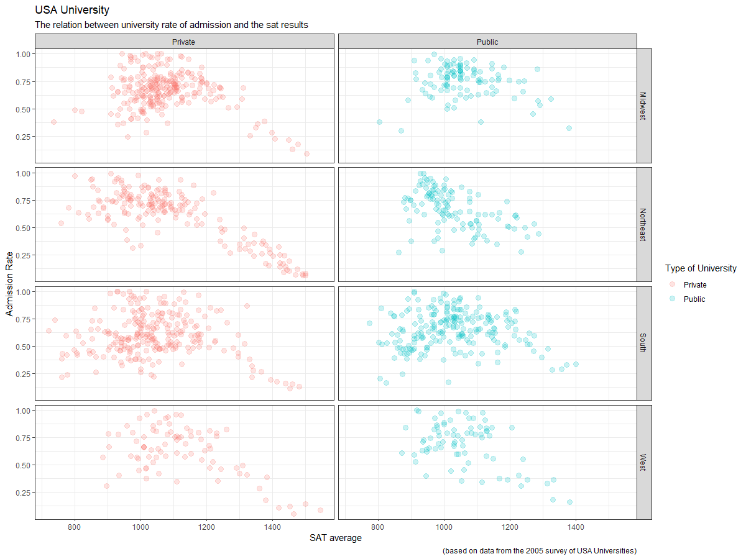

Challenge 1
www.cdcs.ed.ac.uk

Slide 4

Solution
ggplot(college, aes(x=sat_avg, y=admission_rate, color=control ))
+ geom_point(size=3, alpha=0.5)
+theme_bw()
+facet_grid(region~control)
+ labs(title = "USA University", subtitle = "The relation between university rate of admission and the sat results", caption = "(based on data from the 2005 survey of USA Universities)", x = "SAT average", y= "Admission Rate", color = "Type of University")
www.cdcs.ed.ac.uk

Slide 5
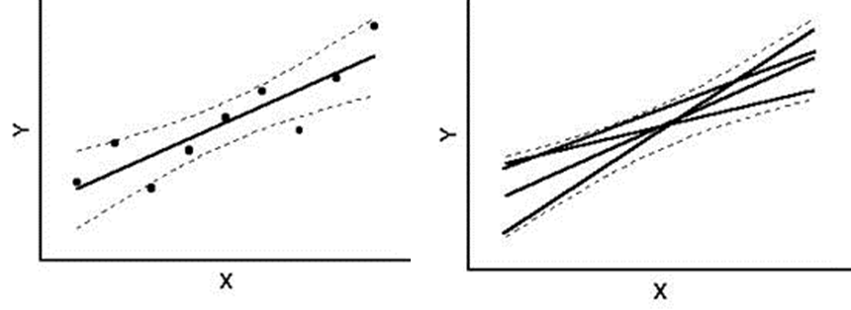
The best fitted line
+ geom_smooth ()
Best fitted line: the line or curve that better fit the
By default it shows the line and a grey area corresponding to the 95% probability that the true best fit line lies in this interval (Confidence interval)
From
http://www.real-statistics.com/
www.cdcs.ed.ac.uk

Slide 6
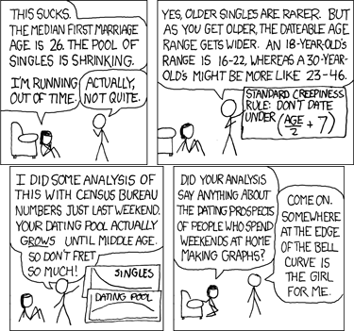
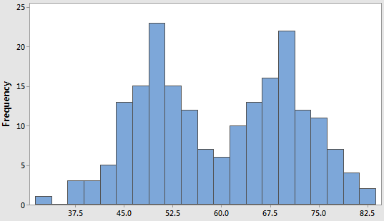
Welcome to statistics
Descriptive Statistics:
Descriptive statistics uses the data to provide descriptions of the sample, either through numerical calculations or graphs or tables. They mostly summarize the sample (Summarizing statistics)
https://xkcd.com/314/
From https://statisticsbyjim.com/
www.cdcs.ed.ac.uk

Slide 7
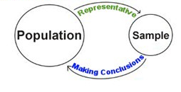
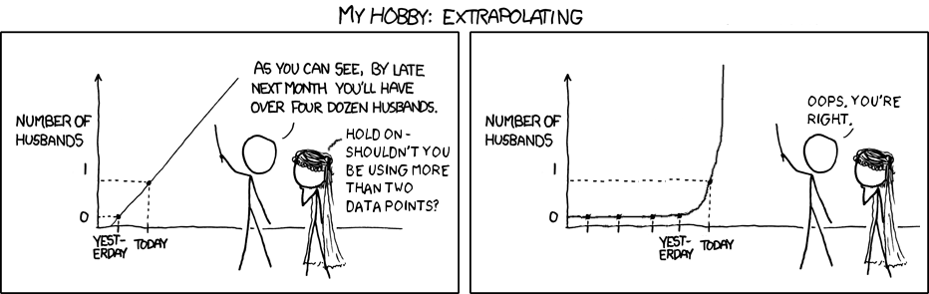
Welcome to statistics
Inferential Statistics:
Inferential statistics makes inferences and predictions about a population based on a sample of data taken from the population in question.
www.cdcs.ed.ac.uk

Slide 8
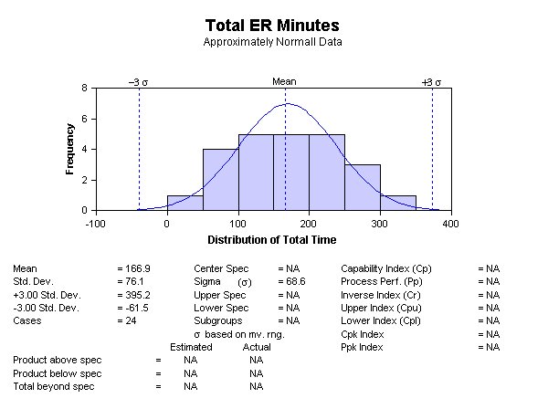
Explore your sample: Summary Stats
From
www.statit.com
Graphic Visualisation
Central Tendency
and
Measures of Dispertion
Mathematical Visualisation
www.cdcs.ed.ac.uk

Slide 9
Central Tendency
Arithmetic mean average value of the sample sum(all values) divided by (number values)
Median value is the value splitting the higher and the lower half of the sample
Mode the most repeated value of a sample
mean(iris$Petal.Width)
median(iris$Petal.Width)
Modes <- function(Petal) {
uniqv <- unique(iris$Petal.Width) uniqv[which.max(tabulate(match(iris$Petal.Width, uniqv)))]
}
www.cdcs.ed.ac.uk

Slide 10
Measures of Dispersion
Variance
Variance is the squared mean difference between each value and the mean divided by the sample size – 1.
var(iris$Petal.Width)
From https://medium.com/
www.cdcs.ed.ac.uk

Slide 11
Measures of Dispersion
Standard Deviation
the standard deviation is a measure of the amount of variation or dispersion of a set of values. A low standard deviation indicates that the values tend to be close to the mean.
sd(iris$Petal.Width)
From https://medium.com/
www.cdcs.ed.ac.uk

Slide 12

Subsetting the sample
In order to analyse the differences in the sample you are analysing you need do perfrom all the measures we saw so far across the different subsample (each subsample correspond to a different categorical value)
virginica<- subset(iris, Species=="virginica")
From https://www.memecreator.org/
www.cdcs.ed.ac.uk

Slide 13
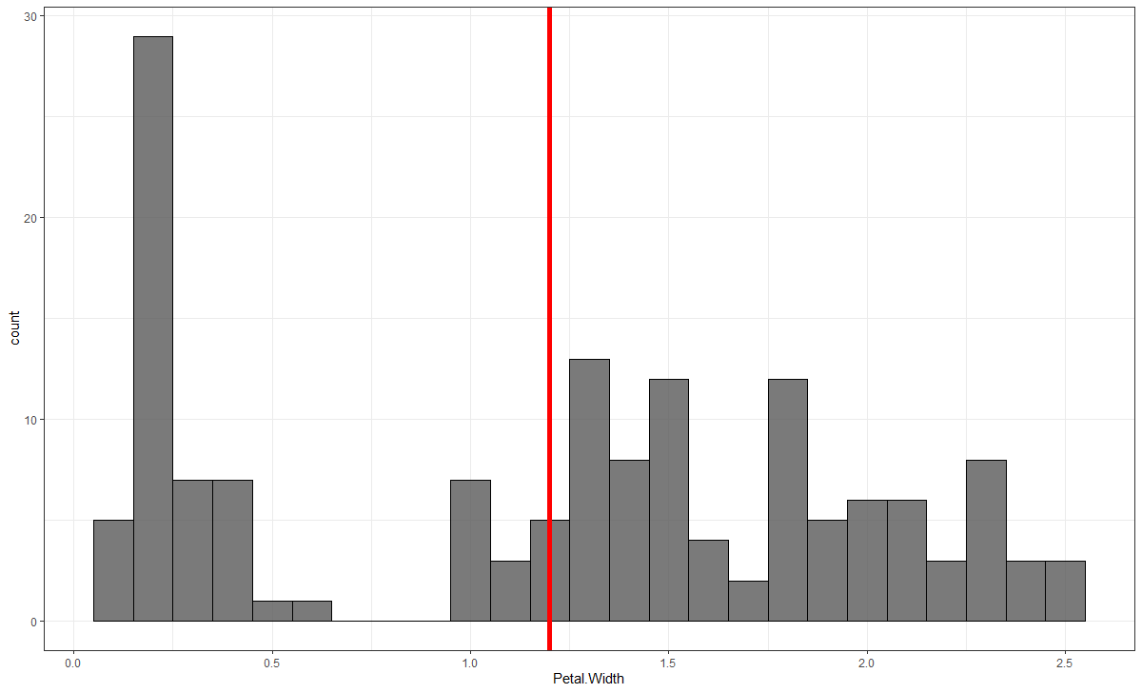
Visualise the distribution: Histogram and Density plots
A histogram is an approximate representation of the distribution of numerical or categorical data.
geom_histogram
www.cdcs.ed.ac.uk

Slide 14
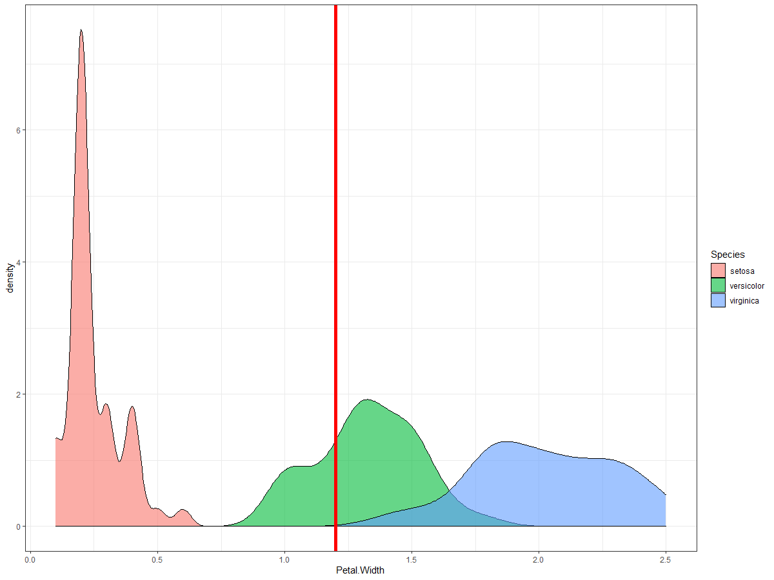
Visualise the distribution: Histogram and Density plots
Visualise the distribution: Histogram and Density plots
A density plot is a representation of the distribution of a numeric variable. It uses a kernel density estimate to show the probability density function of the variable. It is a smoothed version of the histogram and is used in the same concept.
geom_density
www.cdcs.ed.ac.uk

Slide 15
Challenge 2
Create a graph that would analyse the central tendency and dispersion of the faculty salary average
Check if the Region where the universities are located influences the salary average
Compute the mean, median, and standard deviation of the salary average across the 4 regions. Can you understand better the differences across the 4 areas now?
Which way of showing the summarizing stats of the sample do you find more intuitive
www.cdcs.ed.ac.uk

Slide 16
Challenge 2: Solution
ggplot(college, aes(x=faculty_salary_avg)) + geom_histogram(alpha=0.8, color="black", binwidth=750)+geom_vline(aes(xintercept = mean(faculty_salary_avg)),col='red',size=2)+theme_bw()+ labs(title = "USA University", subtitle = "Average Income of the professors across the different regions", caption = "(based on data from the 2005 survey of USA Universities)", x = "SAT average", color = "Regions")
Midwest <- subset(college, region=="Midwest")
Northeast <- subset(college, region=="Northeast")
South <- subset(college, region=="South")
West <- subset(college, region=="West")
www.cdcs.ed.ac.uk

Slide 17
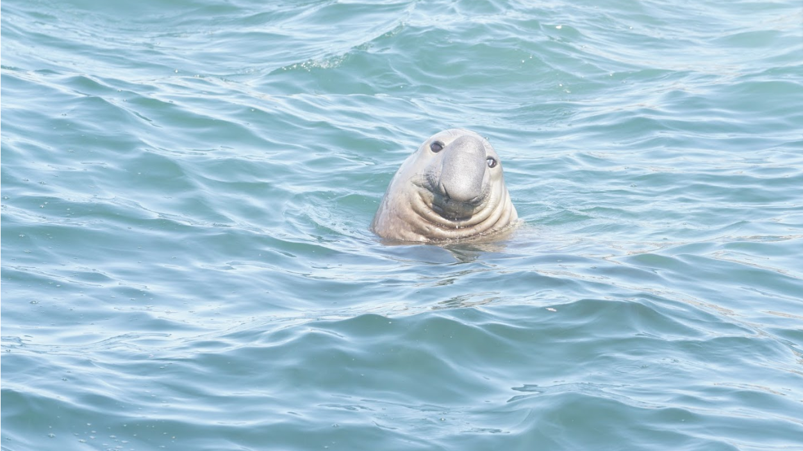
Any Question?
www.cdcs.ed.ac.uk

Slide 18
Next Class
Discuss Challenge 2
Boxplots
Playing with colours
Exporting graphs

Slide 19
References and other Resources
https://www.linkedin.com/learning/r-statistics-essential-training
https://www.youtube.com/channel/UCtYLUTtgS3k1Fg4y5tAhLbw
http://statistics-help-for-students.com/What_are_measures_of_central_tendency_and_dispersion.htm#.Xsqyf2gzbIU
https://derangedphysiology.com/main/cicm-primary-exam/required-reading/research-methods-and-statistics/Chapter%203.0.2/variability-dispersion-and-central-tendency
https://us.sagepub.com/sites/default/files/upm-assets/43350_book_item_43350.pdf
https://rcompanion.org/handbook/C_02.html
https://towardsdatascience.com/descriptive-statistics-in-r-8e1cad20bf3a
http://www.sthda.com/english/wiki/descriptive-statistics-and-graphics
https://www.youtube.com/watch?v=BiLIcCtXmm0
https://www.youtube.com/watch?v=SzZ6GpcfoQY

