Slide 1

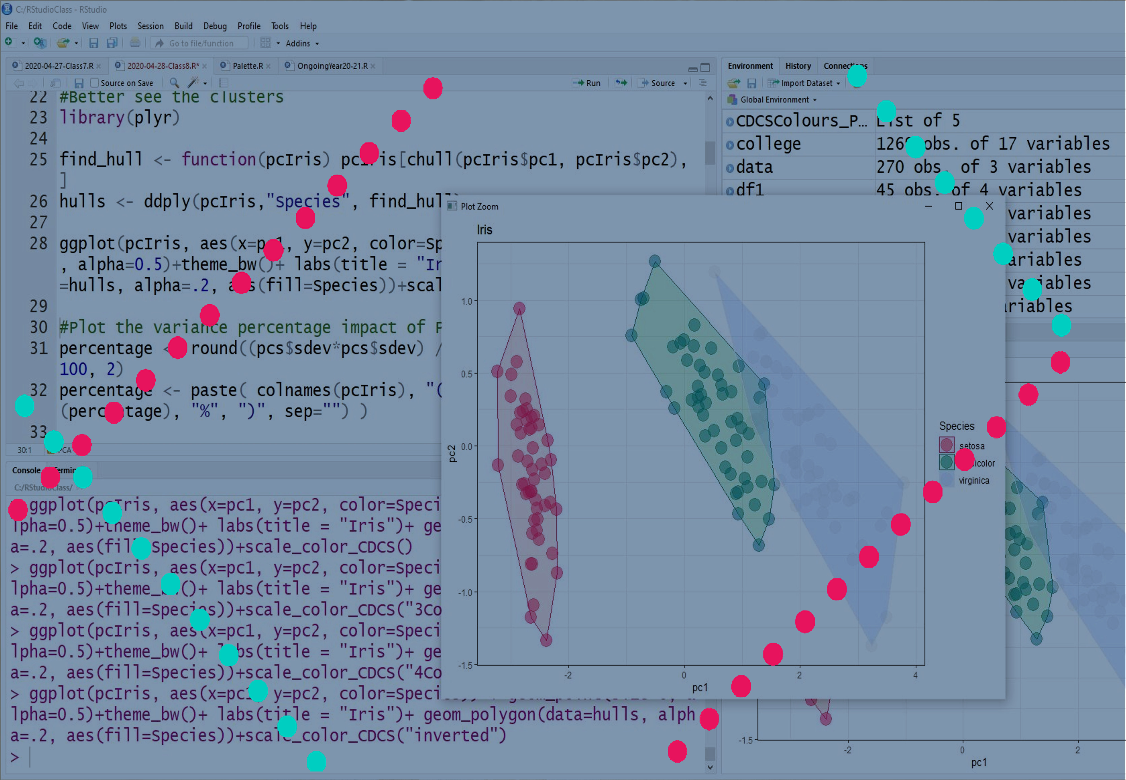
Statistics and Visualisation with R
lmichiel@exseed.ed.ac.uk

Slide 2
Today Program
Discuss Challenge 2
Boxplots
Playing with colours
Exporting graphs

Slide 3

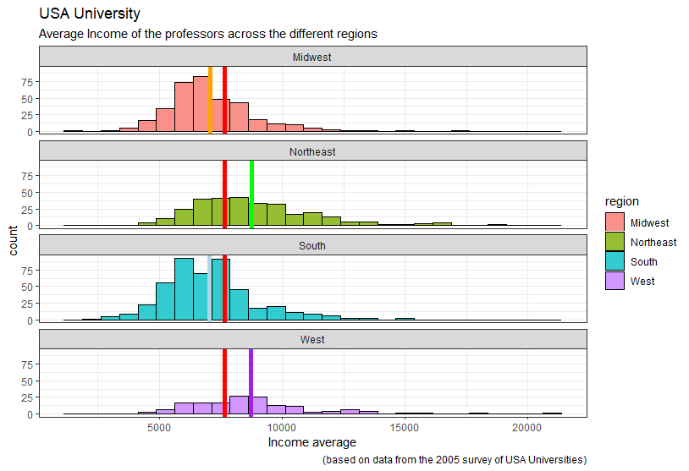

Challenge 2
www.cdcs.ed.ac.uk

Slide 4

Challenge 2: Solution
ggplot(college, aes(x=faculty_salary_avg, fill=region)) +
geom_histogram(alpha=0.8, color="black", binwidth=750)+
geom_vline(aes(xintercept = mean(faculty_salary_avg)),col='red',size=2)+ theme_bw()+
facet_wrap(~region, ncol = 1)+
labs(title = "USA University", subtitle = "Average Income of the professors across the different regions", caption = "(based on data from the 2005 survey of USA Universities)", x = "Income average", color = "Regions")+
geom_vline(data=filter(college, region=="Midwest"),aes(xintercept =mean(faculty_salary_avg)) ,col='orange',size=2)+
geom_vline(data=filter(college, region=="Northeast"),aes(xintercept = mean(faculty_salary_avg)),col='green',size=2)+
geom_vline(data=filter(college, region=="South"),aes(xintercept = mean(faculty_salary_avg)),col='light blue',size=2)+
geom_vline(data=filter(college, region=="West"),aes(xintercept = mean(faculty_salary_avg)),col='purple',size=2)
www.cdcs.ed.ac.uk

Slide 5
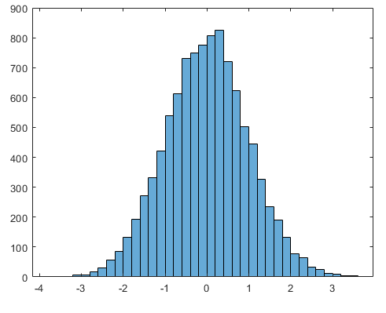
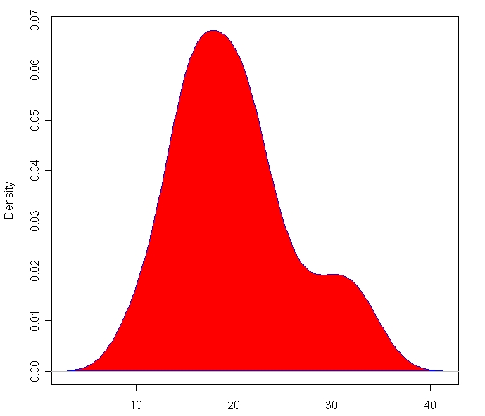
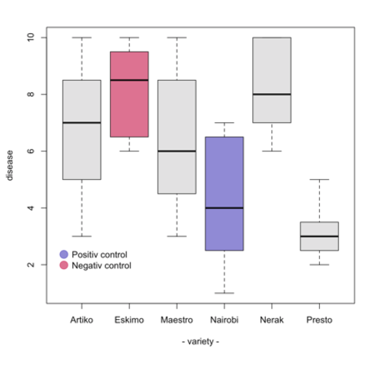
Distribution
Histogram
Density Plot
Boxplot
https://www.r-graph-gallery.com/
www.cdcs.ed.ac.uk

Slide 6
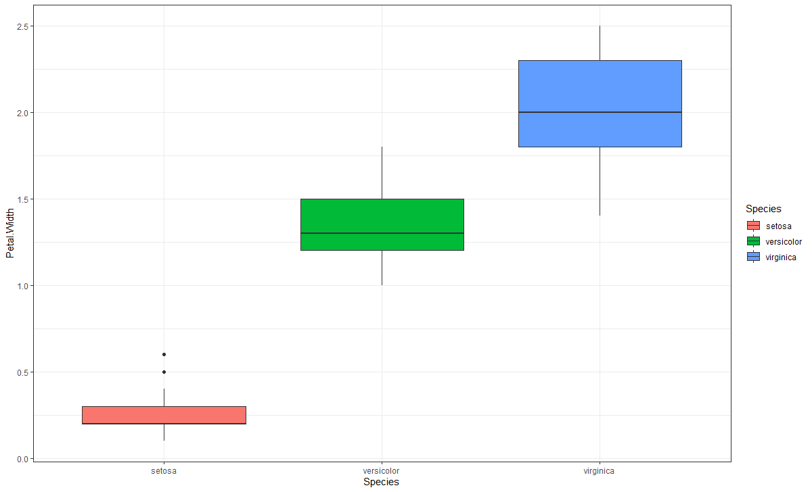
From Histogram to boxplot
The thick black line is the median.
The boxes represent 50% of the sample closest to the median
The whiskers correspond to 95% of the sample closest to the median aka 2SD from the median
The dots represent the outliers
www.cdcs.ed.ac.uk

Slide 7
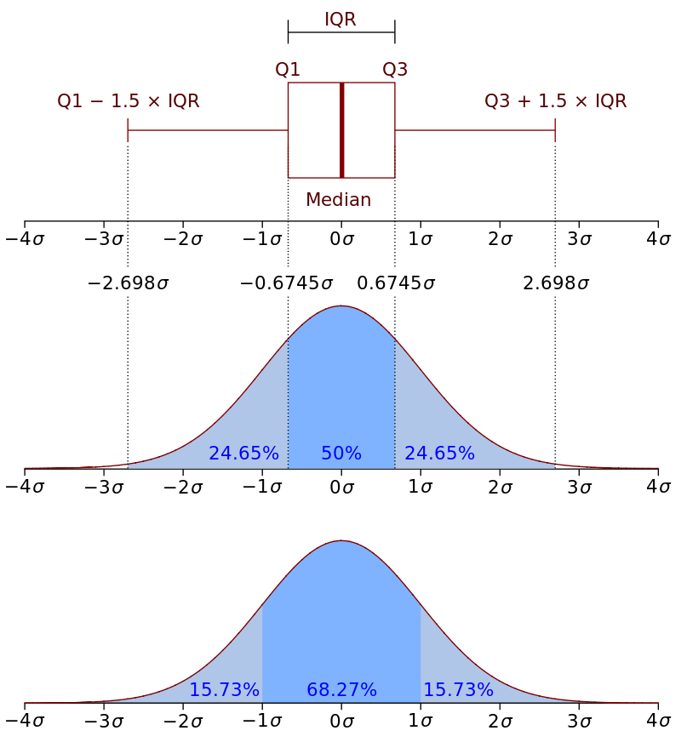
File:Boxplot vs PDF.png
From Histogram to boxplot
boxplot
The outliers are all the value below or above 1.5* the interquartile range from Q1 and Q3
www.cdcs.ed.ac.uk

Slide 8
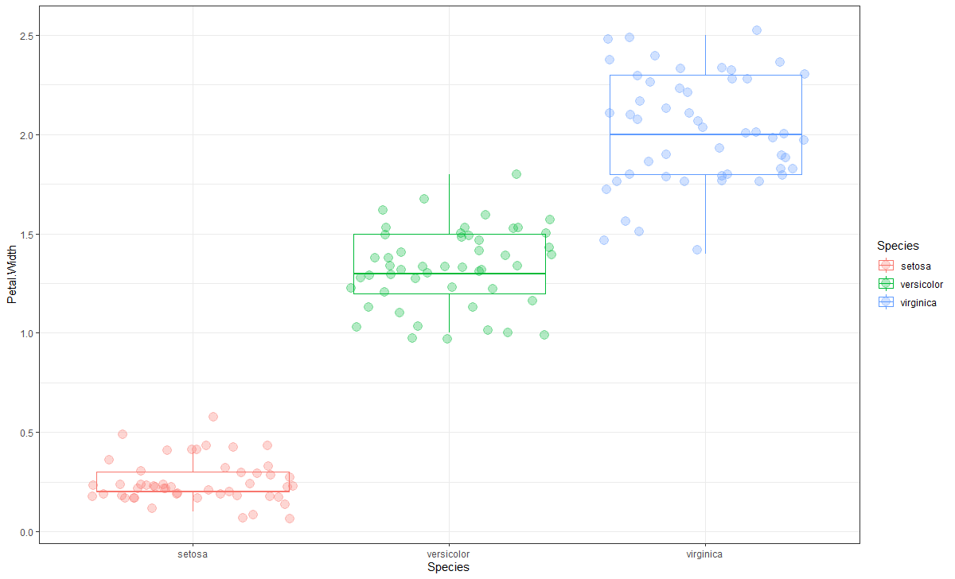
From Histogram to boxplot
By adding a
+ geom_jitter(size= 4, alpha =0.3)
you can add the information of the single observations
www.cdcs.ed.ac.uk

Slide 9
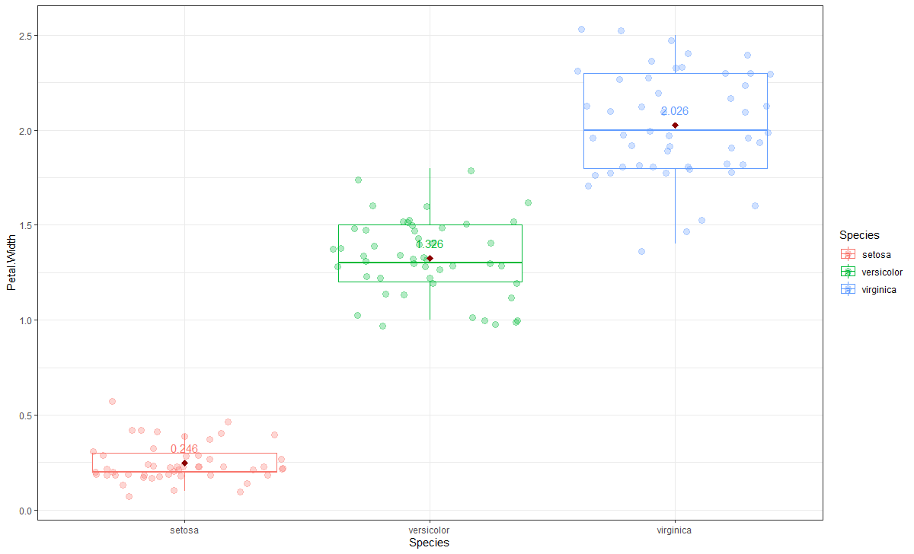
Adding the mean information
You cand add the mean information by create a means dataframe using the aggregate command
And then use stat_summary and geom_text comands
www.cdcs.ed.ac.uk

Slide 10
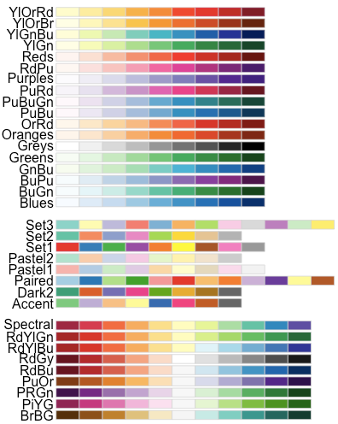
Playing with colours
Color brewer Palettes
https://www.datanovia.com/en/blog/top-r-color-palettes-to-know-for-great-data-visualization/
www.cdcs.ed.ac.uk

Slide 11
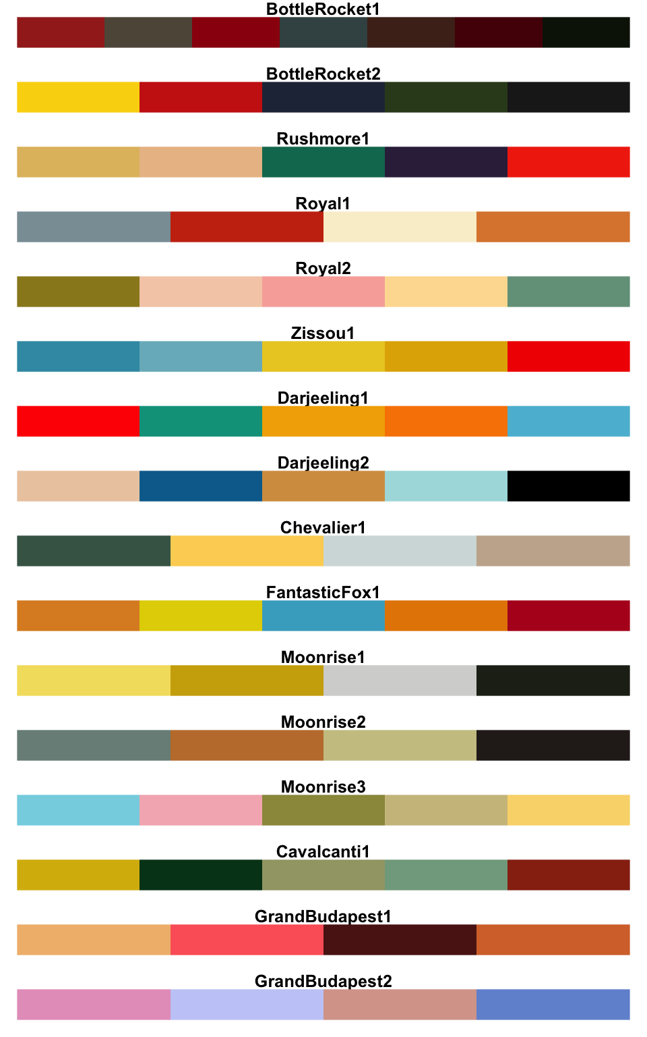
Playing with colours
Wesander Palettes
https://www.datanovia.com/en/blog/top-r-color-palettes-to-know-for-great-data-visualization/
www.cdcs.ed.ac.uk

Slide 12
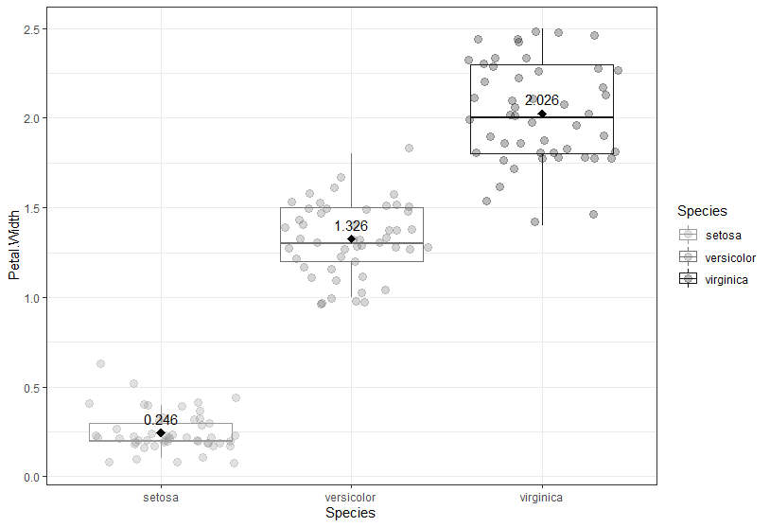
Using a Gray values palette
You can plot everything in a gray scale by using
+ scale_color_grey(start = 0.6, end = 0.1)
Start: the lighter value
End: the darker color
www.cdcs.ed.ac.uk

Slide 13
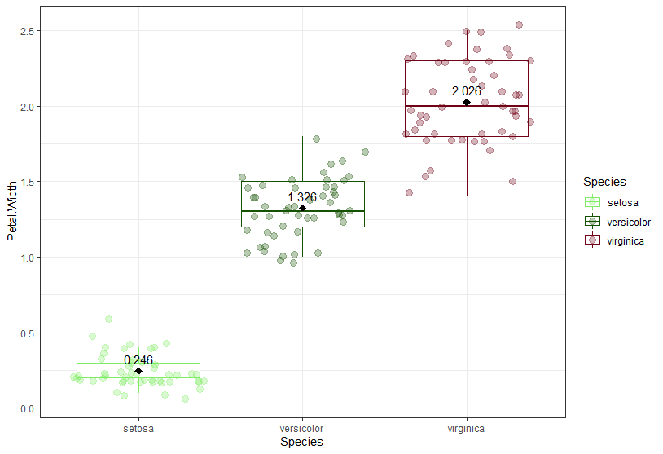
Manually changing colours
You can use either the hex values (https://www.hexcolortool.com/)
or the colours names recognised by ggplot (http://sape.inf.usi.ch/quick-reference/ggplot2/colour)
You need to select a n number of colors corresponding to the number of different colours you need within a concatenate function (c)
www.cdcs.ed.ac.uk

Slide 14
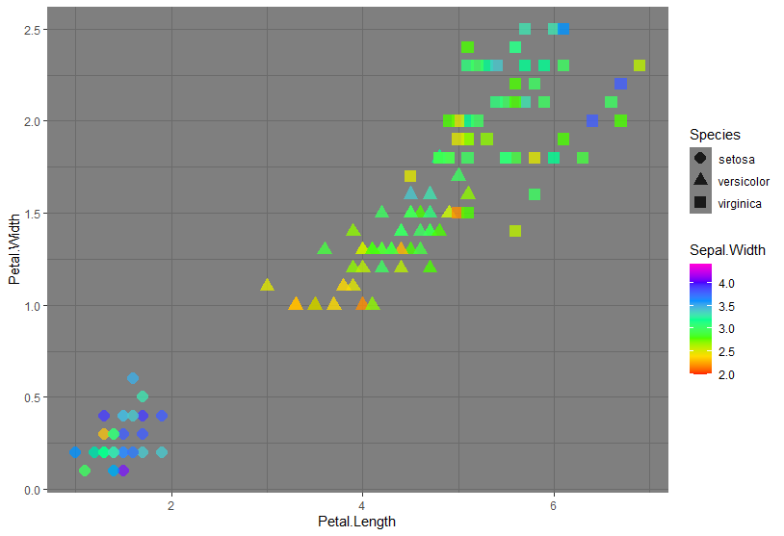
Continuous colours
When instead of a series of values you need a continous palette like for scatterplots you can use:
+scale_color_gradientn(colours = rainbow(7))
7: is the number of colours the system will use and rainbow is the palette
www.cdcs.ed.ac.uk

Slide 15
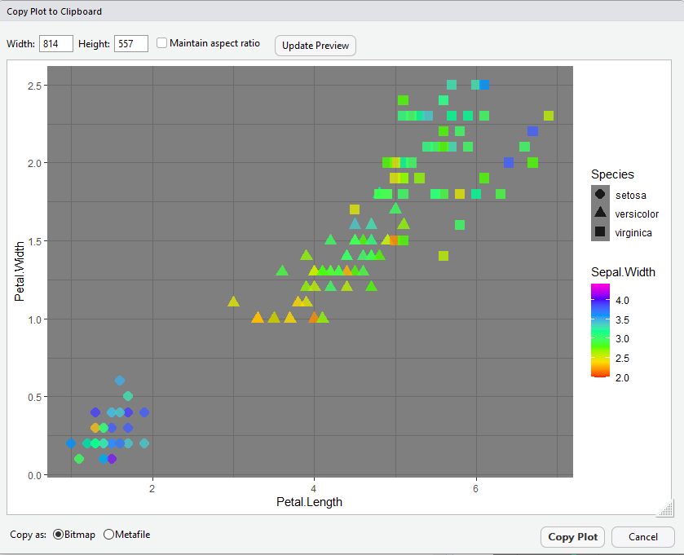
If you are not sure of the proportions you want to use use the Copy plot to Clipboard first and then export in the format you want
Export and set proportion of a graph
www.cdcs.ed.ac.uk

Slide 16
Challenge 3
Create a boxplot visualization that would analyze the variation of the faculty salary average across the different regions.
Add to the visualization the representation of the single observations (Tip: use geom_jitter)
Set the parameters to make the graph more readable (size and alpha of the jitters, hide the outliers of the boxplot, change the colors to something you like more)
Export the final graph into the plot folder
www.cdcs.ed.ac.uk

Slide 17
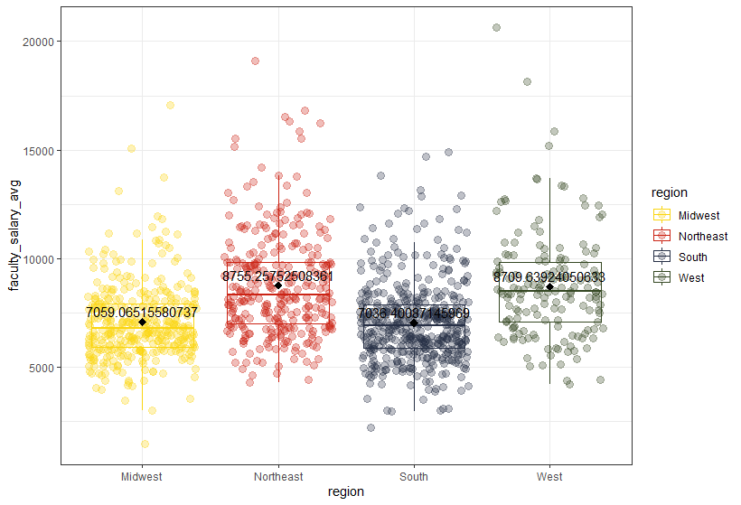
Challenge 3: Solution
www.cdcs.ed.ac.uk

Slide 18
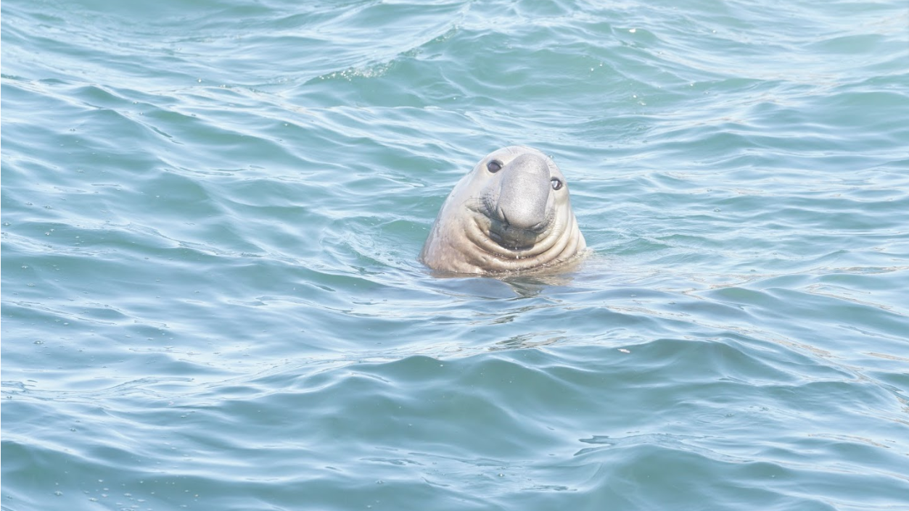
Any Question?
www.cdcs.ed.ac.uk

Slide 19
Next Class
Data Collection
Datesets biases
Inferential statistics
Probability

Slide 20
References and other Resources
Sample, Population and Bias
https://stattrek.com/sampling/populations-and-samples.aspx
https://www.statisticssolutions.com/what-is-the-difference-between-population-and-sample/
https://www.youtube.com/watch?v=eIZD1BFfw8E
https://towardsdatascience.com/what-is-statistical-bias-and-why-is-it-so-important-in-data-science-80e02bf7a88d
https://www.dummies.com/education/math/statistics/how-to-identify-statistical-bias/
https://data36.com/statistical-bias-types-explained/
https://www.statisticshowto.com/what-is-bias/
Setting Colour
https://www.datanovia.com/en/blog/top-r-color-palettes-to-know-for-great-data-visualization/
https://www.datanovia.com/en/blog/ggplot-colors-best-tricks-you-will-love/
https://www.hexcolortool.com/
http://www.cookbook-r.com/Graphs/Colors_(ggplot2)/
http://www.sthda.com/english/wiki/ggplot2-colors-how-to-change-colors-automatically-and-manually
https://www.r-graph-gallery.com/ggplot2-color.html
http://sape.inf.usi.ch/quick-reference/ggplot2/colour

Slide 21
References and other Resources
Boxplot
http://www.cookbook-r.com/Graphs/Plotting_distributions_(ggplot2)/
https://www.r-graph-gallery.com/boxplot.html
http://www.sthda.com/english/wiki/ggplot2-box-plot-quick-start-guide-r-software-and-data-visualization
https://ggplot2.tidyverse.org/reference/geom_boxplot.html
http://t-redactyl.io/blog/2016/04/creating-plots-in-r-using-ggplot2-part-10-boxplots.html
https://www.linkedin.com/learning/data-visualization-in-r-with-ggplot2/box-plots?autoplay=true&u=50251009

