Slide 1

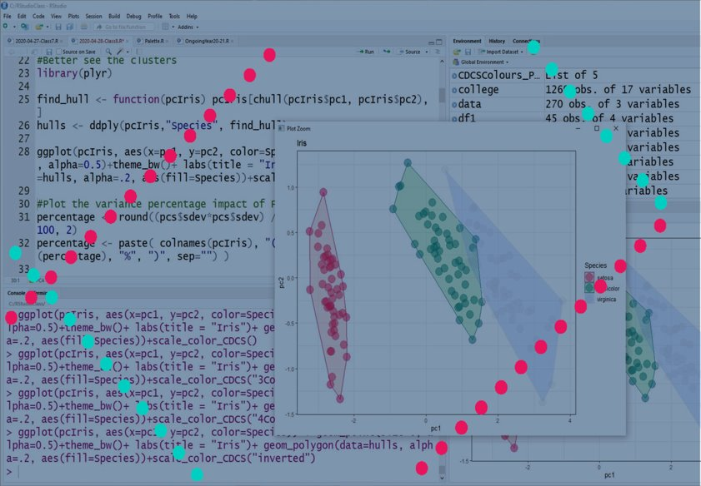
Basic Statistics and Visualisation with R
Lucia.michielin@ed.ac.uk

Slide 2
Today Program
Hypothesis testing
Null-Hypothesis
Main types of tests
Limitations and corrections

Slide 3

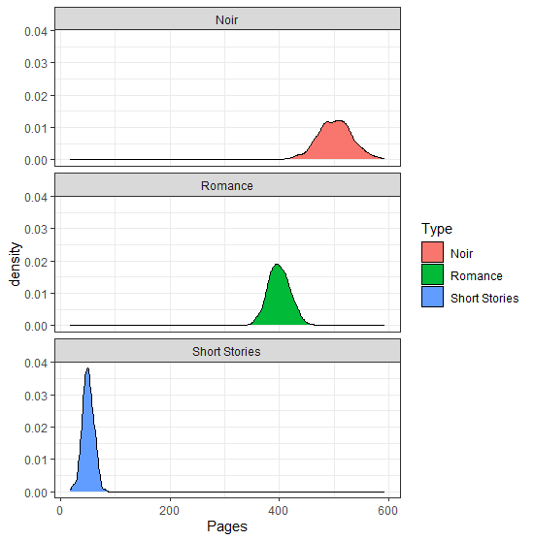
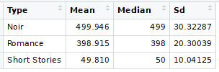

Testing
We see some differences here…Let’s do some testing
Challenge 4: Solution
www.cdcs.ed.ac.uk

Slide 4
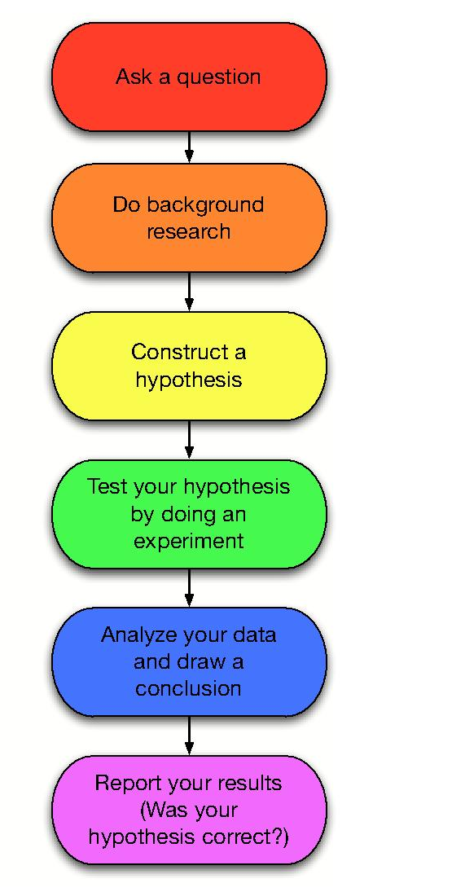

These are the 2 steps that you alwasys have to follow.
There is no analysis without the formulation of a proper research hypothesis
Scientific Process
www.cdcs.ed.ac.uk

Slide 5


Let’s start Testing
Checking list
A Dataset with some evidence
A Hypothesis (that need to be translated in something the system will understand)
A Method to compare the formal model against data
DATA
HYPOTHESIS
METHOD
www.quickmeme.com
www.cdcs.ed.ac.uk

Slide 6
Null-hypothesis Significance Testing
Very popular test to check your hypothesis
You need to:
Define a null-hypothesis (the opposite of what you are supposing): “The number of pages in a book is not linked to the typology of the book”
Compute the chances that the pattern you see in the evidence was created by pure chance
If this chance is low enough you can reject the null-hypothesis
www.cdcs.ed.ac.uk

Slide 7
Establishing the Threshold
Establish the Threshold = ALPHA
Compute the probability that the opposite hypothesis is true = p-value
If P-value <alpha we can reject the null-hypothesis
If P-value >alpha we cannot reject the null-hypothesis
How do you assess this threshold?
https://xkcd.com/1478/
www.cdcs.ed.ac.uk

Slide 8
P-Values and the 0.05 Threshold
0.05 has longly be regarded as the standard threshold meaning that the chances that the NH is true are below 5%
BUT
NHST was invented in Medicine during clinical trials where
H1 the drug works
H0 the drug is not working
The hypotheses are only 2 and mutually exclusive
Hypotheses in Humanities are far more nuanced so everything needs to be analyse carefully
https://xkcd.com/1478/
www.cdcs.ed.ac.uk

Slide 9
Test limitations
Parametric vs not parametric =if you perform your parametric tests on non parametric samples your results will be useless
Type 1 Error = Incorrect rejection of a true null-Hypothesis (if your p-value is 0.05 it means there is still a 5% chance that the N-H is correct)
Type 2 Error = Incorrect retainment of a false null-Hypothesis (False negative) Again a p-values of 0.1 means there is 10% chance of Randomness, still 90% chance you are looking to something
www.cdcs.ed.ac.uk

Slide 10

Corrections
Bonferroni Correction
The Bonferroni correction adjusts probability (p) values because of the increased risk of a type I error when making multiple statistical tests. Reduce the chance of a type I error but at the expense of a type II error.
Adjusted alpha value = original alpha / n. Tests
https://conceptspacecartography.com/truth-coming-out-of-her-well/
www.cdcs.ed.ac.uk

Slide 11
Student T-test
What you need
Independent Variable (what I think cause the pattern i see) IT NEEDS TO BE BINARY
Depended Variable (continuous)
Null-Hypothesis: The mean of both groups are equal
Parametric (data HAVE TO be normally distributed)
Can I predict the weight of a book based on the type of binding?
www.cdcs.ed.ac.uk

Slide 12
Read the Results
Welch Two Sample t-test
data: GluedBook$Weight and SewnBook$Weight
t = -136.97,
df = 2220,
p-value < 2.2e-16
alternative hypothesis: true difference in means is not equal to 0 95 percent confidence interval:
-401.6670 -390.3277
sample estimates:
mean of x mean of y
400.9620 796.9593
Name of the test
Data on which the test is performed
t-statistic
Degree of Freedom
P-Value = 0.000000000000022
There is 95% chance that the difference between the means is between those 2 values
Mean of the 2 samples
www.cdcs.ed.ac.uk

Slide 13
Read the Results
t-statistic:
It is a measure of the distance between expected and observed values in your dataset.
Degree of Freedom:
How much independent is your sample.
Large df means that the sample is much more clustered around the mean value. Meaning it has a low standard deviation
www.cdcs.ed.ac.uk

Slide 14
Perform a Bonferroni Correction
If you run more than one test: i.e. if the categorical variable you are analysing has more than 2 values you will have to perform a Bonferroni correction to limit the Type 1 error
pValuesTypes <- c(2.2e-16, 2.2e-16, 2.2e-16)
AdjutedPValuesTypes <- p.adjust(pValuesTypes, method="bonferroni")
print(AdjutedPValuesTypes)
https://conceptspacecartography.com/truth-coming-out-of-her-well/
www.cdcs.ed.ac.uk

Slide 15
Anova (Analysis of Variance)
What you need
Independent Variable (what I think cause the pattern i see) categorical
Depended Variable (what I think is influenced) continuous
Null-Hypothesis: The mean of all groups are equal
Parametric (data HAVE TO be normally distributed)
Can I predict the lenght of a book based on the type of Book
www.cdcs.ed.ac.uk

Slide 16
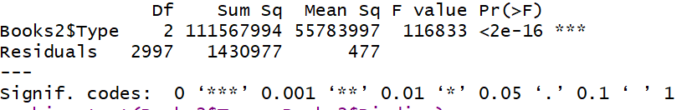
Read the Results
Link to more info
The F value is the equivalent of the T-Statistic for ANOVAs.
It is a measure of the variation within samples of the same group against variation between groups (a value of F = 1 would mean no difference).
For the independent variable period you get a Pr or p-value.
The symbols at the right define significance and they are explained in the last line.
Sum Sq. This is the variability of the model's predicted values. In other words, it is the variability of the response due to its relationship with the predictor.
At this point you can just say yes but not see how
www.cdcs.ed.ac.uk

Slide 17
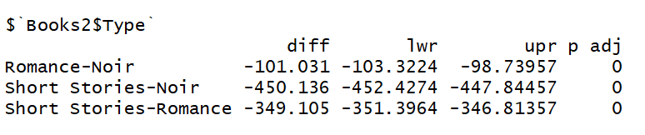
Tukey multiple pairwise-comparisons
Performing multiple pairwise-comparison between the means of groups.
lower end point of the interval
upper end point of the interval
Adjusted P-values
difference in the observed means
www.cdcs.ed.ac.uk

Slide 18
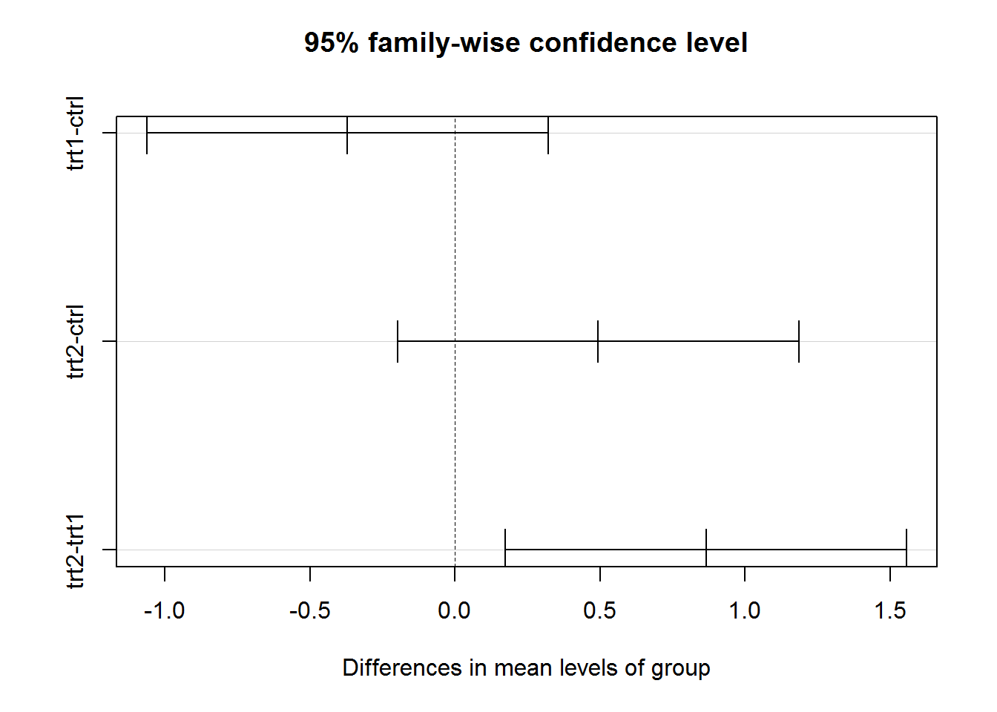
Tukey multiple pairwise-comparisons
Performing multiple pairwise-comparison between the means of groups.
www.cdcs.ed.ac.uk

Slide 19
Chi Squared test of Indipendence
What you need
Independent Variable (what I think cause the pattern i see) Categorical
Depended Variable (what I think is influenced) Categorical
Null-Hypothesis: There is no relationship between the both variables
Does the type of Book influence the type of binding
www.cdcs.ed.ac.uk

Slide 20
Read the Results
TEST | Pearson's Chi-squared test
DATA | Books2$Type and Books2$Binding
X-squared | 2000
df | 2 (degree of freedom)
p-value | < 2.2e-16
Link to more info
www.cdcs.ed.ac.uk

Slide 21
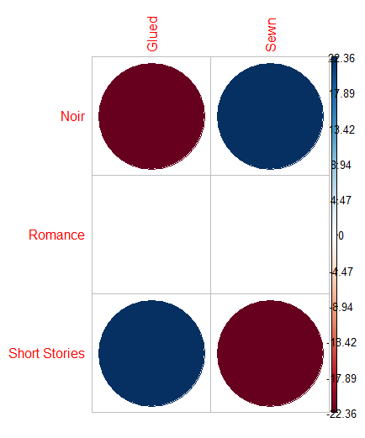
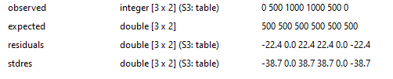
Read the Results
Visualise the result better
chisq <- chisq.test(Books$Type, Books$Binding)
Observed counts
chisq$observed
Expected(evenly distributed-NullHypothesis)
chisq$expected
Residual difference between expected and observed
chisq$residuals
Link to more info
www.cdcs.ed.ac.uk

Slide 22
Kolmogorov-Smirnov test
What you need
2 sets of continuos data (Page lenght) or better one binary and one continuous
Null-Hypothesis: (both sets were generated by the same process)
NON-Parametric: For when my data are not normally distributed
Does the type of binding influence the page numbers of books
www.cdcs.ed.ac.uk

Slide 23
Read the Results
TEST | Two-sample Kolmogorov-Smirnov test
DATA | GluedBook$Pages and SewnBook$Pages
D (maximum difference between the two probability distributions) | 0.99133
p-value | < 2.2e-16
alternative hypothesis | two-sided
www.cdcs.ed.ac.uk

Slide 24

Any Question?
www.cdcs.ed.ac.uk

Slide 25
Next Class
Stacked Bars graphs
Cleaning Sample
Order Results
Changing scale axis

Slide 26
https://opentextbc.ca/researchmethods/chapter/understanding-null-hypothesis-testing/
https://en.wikipedia.org/wiki/Exclusion_of_the_null_hypothesis
https://www.khanacademy.org/math/statistics-probability/significance-tests-one-sample/more-significance-testing-videos/v/hypothesis-testing-and-p-values
https://en.wikipedia.org/wiki/Statistical_hypothesis_testing
https://www.youtube.com/watch?v=NF5_btOaCig
https://www.youtube.com/watch?v=0oc49DyA3hU&pp=qAMBugMGCgJpdBAB
https://www.youtube.com/watch?v=5Z9OIYA8He8&pp=qAMBugMGCgJpdBAB
https://www.youtube.com/watch?v=NF5_btOaCig&pp=qAMBugMGCgJpdBAB
https://www.youtube.com/watch?v=ZO2RmSkXK3c
https://www.statisticshowto.com/probability-and-statistics/hypothesis-testing/
References and other Resources

