Slide 1

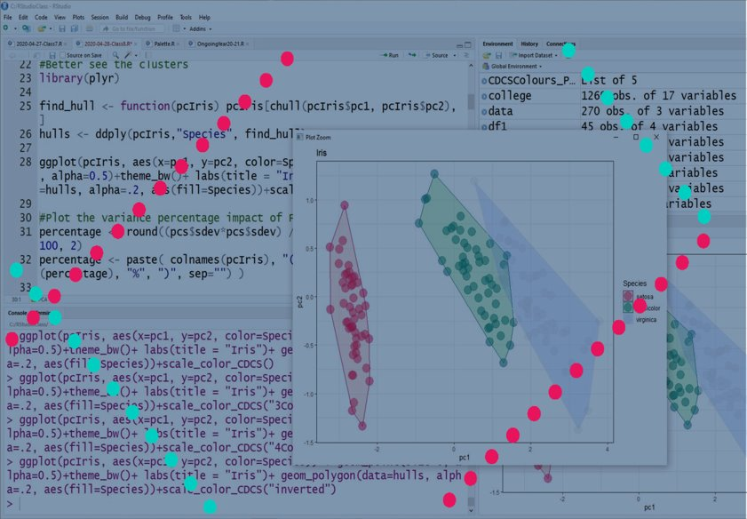
Basic Statistics and Visualisation with R
lucia.michielin@ed.ac.uk

Slide 2
Today Program
PCA
Cluster Analysis

Slide 3

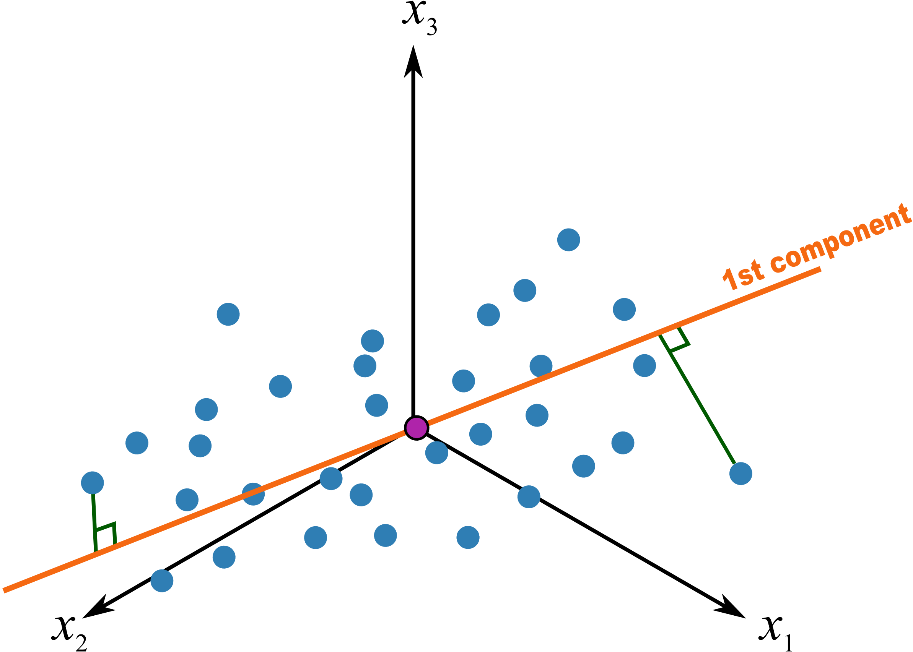

PCA
It is a tecnique to observe on how a categorical variable influence of 3 or more continuous variable
What do you need
3 or more continuous variable
1 or more categorical variable
Principles
It is based on linear regression
It will plot the best fitting line for describing the distributions
Line that minimise the distance from the regression line
Line that maximise the distances between the plotted values and the origin
Link to a video explaining the technique
Pull in the outliers by doing a log transformation of the continuous value
www.cdcs.ed.ac.uk

Slide 4
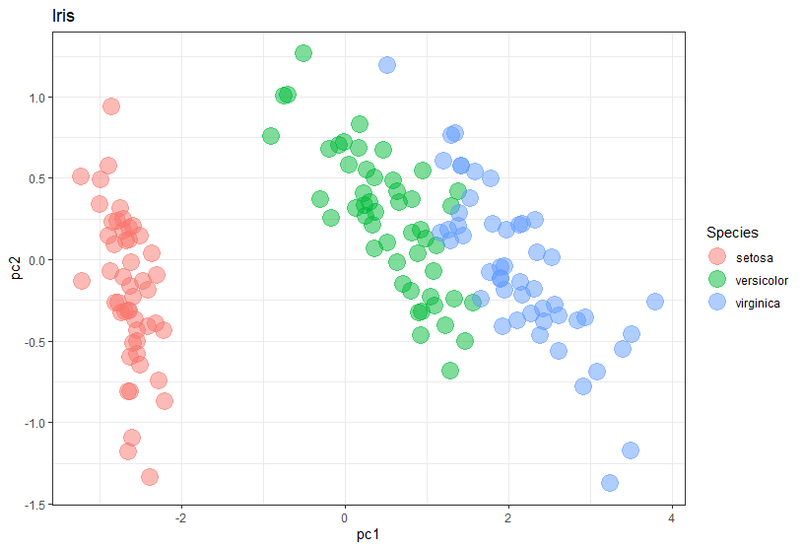
PCA
Normally most variation are captured by PC1 and PC2 so we can use them to replot our sample in two dimensions
Pull in the outliers by doing a log transformation of the continuous value
Work very well for morphometric analysis
e.g. can I determine which cellphone model I am looking at based on series of measures (width, height, thickness, size of the camera etc…)
www.cdcs.ed.ac.uk

Slide 5
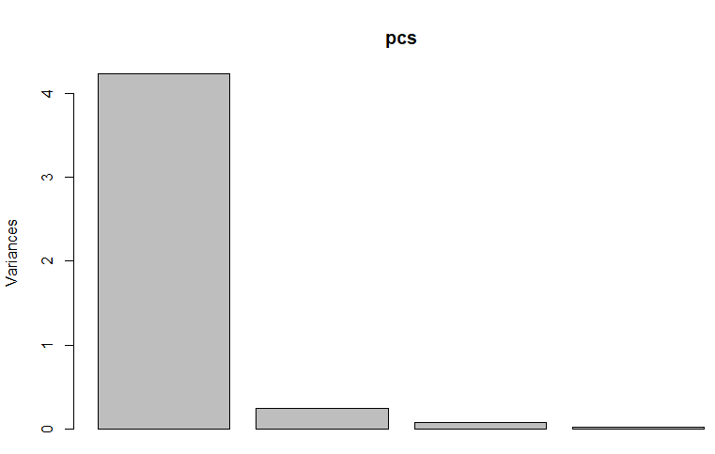
PCA Limitation
When you use PCA analysis you need to be sure that you are looking at the highest percentage of variation.
If the sum of PC1 and PC2 does not correspond to at least 90% of the total variances my result cannot be accurate
Pull in the outliers by doing a log transformation of the continuous value
pcs <- prcomp(measures)
PC1
PC2
PC3
PC4
www.cdcs.ed.ac.uk

Slide 6
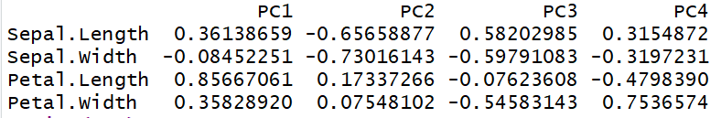

Read the variation
Pull in the outliers by doing a log transformation of the continuous value
Recepie
0.8566 Petal length
0.3613 Sepal length
0.3582 Petal width
0.0845 Sepal width
https://www.loveandoliveoil.com/2014/10/the-antioxidant-aperol-tangerine-cocktail.html
www.cdcs.ed.ac.uk

Slide 7
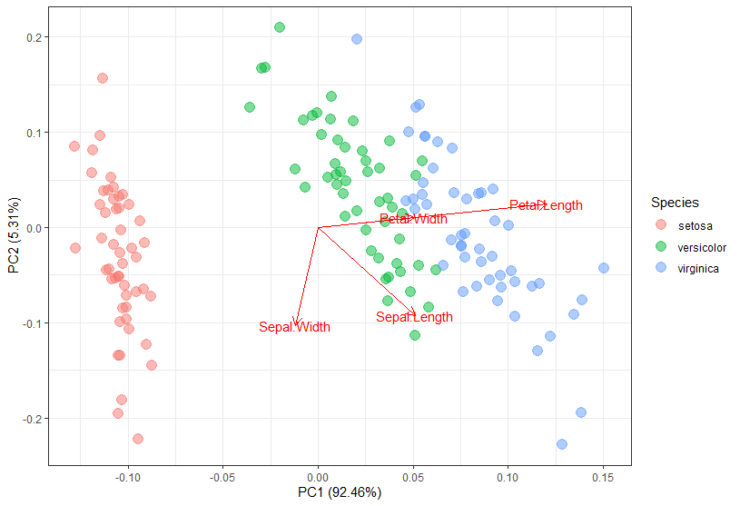
Visualise the results
Pull in the outliers by doing a log transformation of the continuous value
www.cdcs.ed.ac.uk

Slide 8
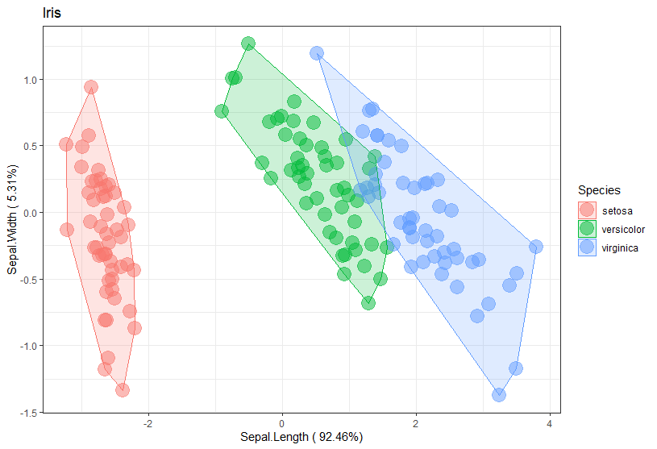
Cluster results
If we observe the result of the PCA we conducted on the Iris sample it is quite clear that Setosa are a separate groups but also Versicolor and Virginica tend to cluster differently
But there is more I can do except eyeballing it
www.cdcs.ed.ac.uk

Slide 9
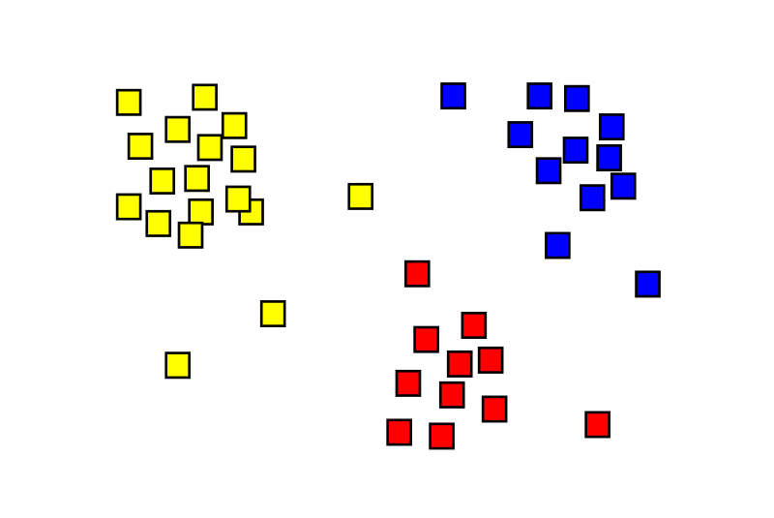
Cluster analysis
Cluster analysis or clustering is the task of grouping a set of objects in such a way that objects in the same group (called a cluster) are more similar (in some sense) to each other than to those in other groups (clusters).
Wikipedia
Different approaches
www.cdcs.ed.ac.uk

Slide 10
Cluster algorithms
Depending on the type o data you are dealing with there are different algorithms that can be used
You know the number of groups
No clear groups but similarities
Catalogue of groups
K-Means
Hierarchical clustering
Discriminant analysis
www.cdcs.ed.ac.uk

Slide 11
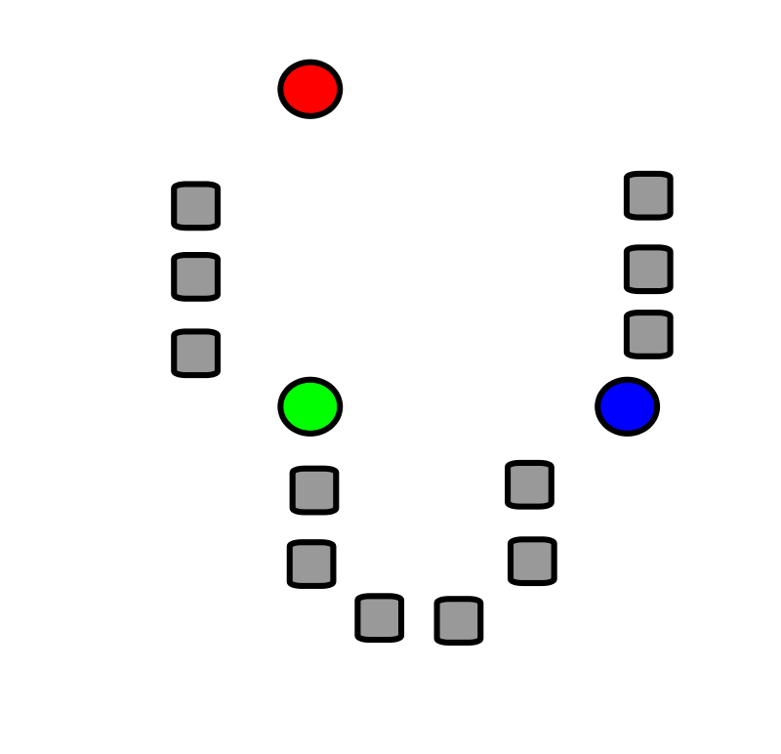
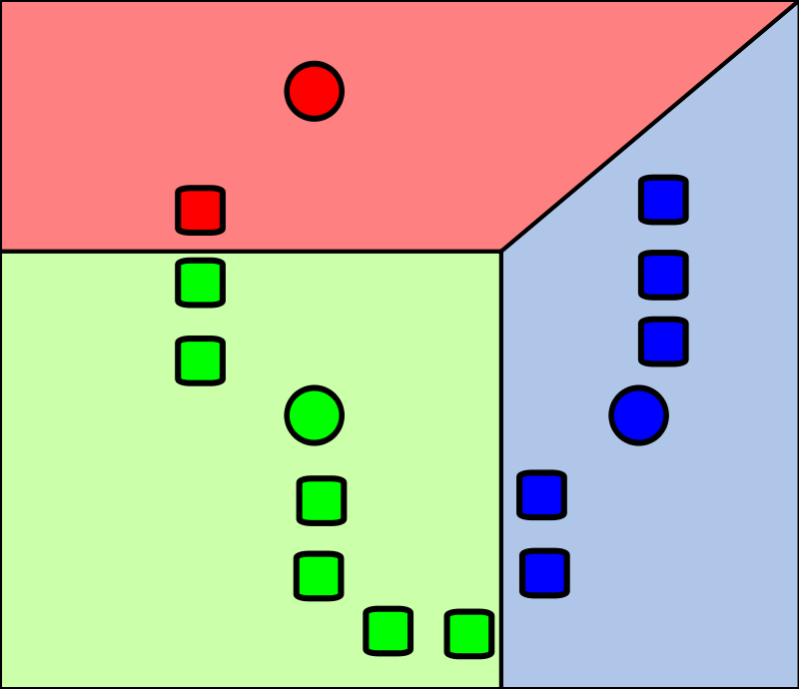
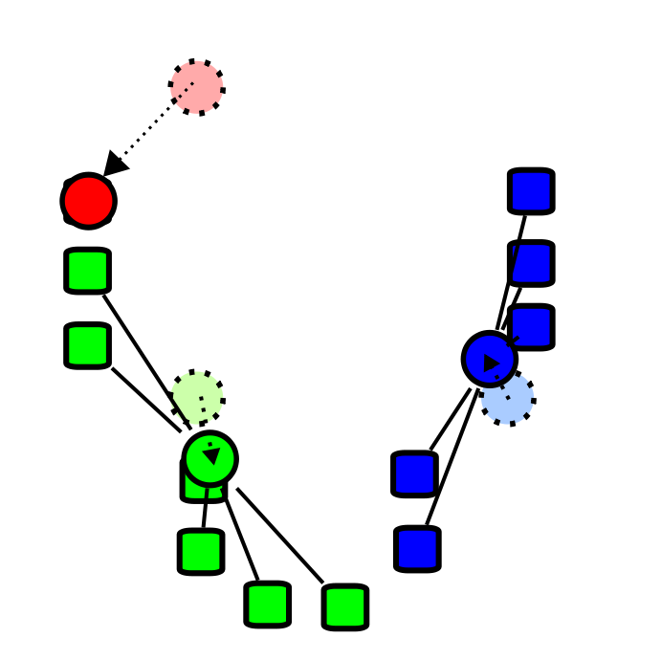
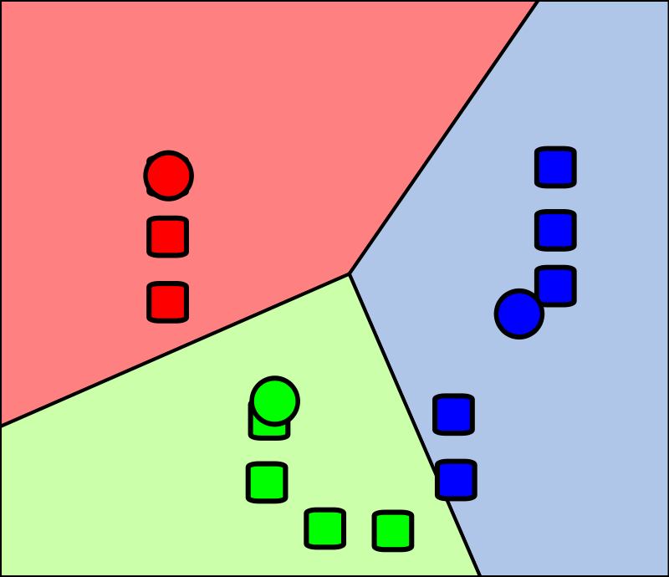
K- Means
Wikipedia
Phase 1:
3 random means are generated in the sample
Phase 2:
Cluster are created by associating every association to the nearest mean
Phase 3:
The centroid of each cluster is calculated
Phase 4:
Step 2 and 3 repeated till getting the best fit
www.cdcs.ed.ac.uk

Slide 12
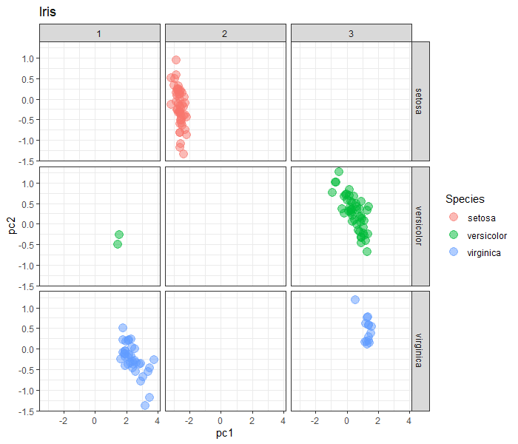
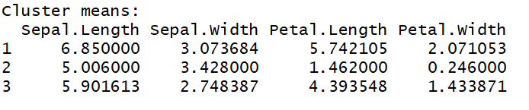
K- Means Results
K-means clustering with 3 clusters of sizes 38, 50, 62
Population of the 3 clusters
ggplot(kmeanIris, aes(x=pc1, y=pc2, col=Species)) + geom_point(size=4, alpha=0.5)+theme_bw()+ labs(title = "Iris")+ facet_grid(Species~cluster)
www.cdcs.ed.ac.uk

Slide 13
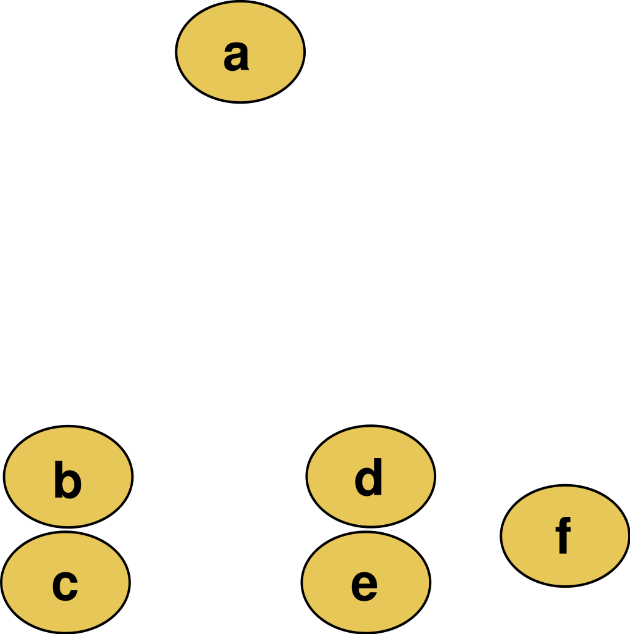
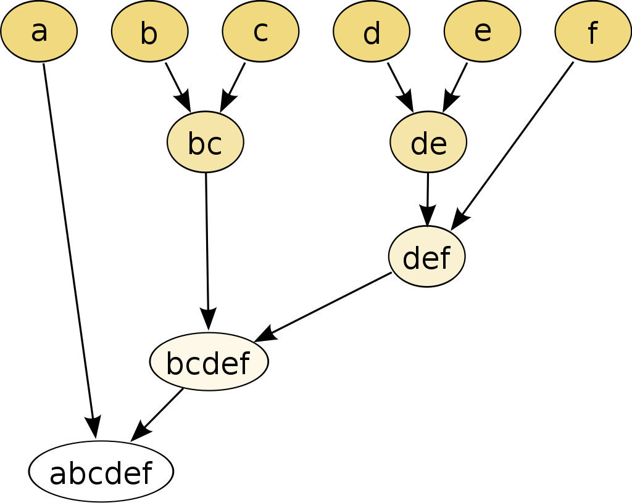
Hierarchical Clustering
Wikipedia
The system uses the pairwise distances between each observation to generate a dendogram definying these distances
www.cdcs.ed.ac.uk

Slide 14

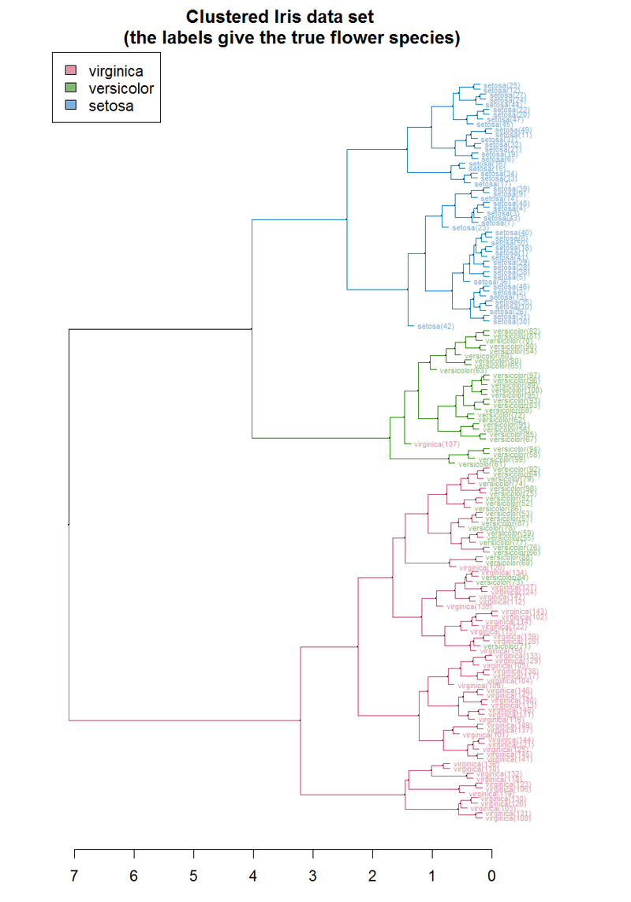
One of the simplest way of performing a hierarchical cluster analysis is Unweighted pair group method with arithmetic mean
Hierarchical Clustering
UPGMA method
It uses the unweighted pairwise euclidean distances between the samples
More intuitively it start from pairng each most similar observation and then build the way up to the tree graph producing the average for every step back
www.cdcs.ed.ac.uk

Slide 15
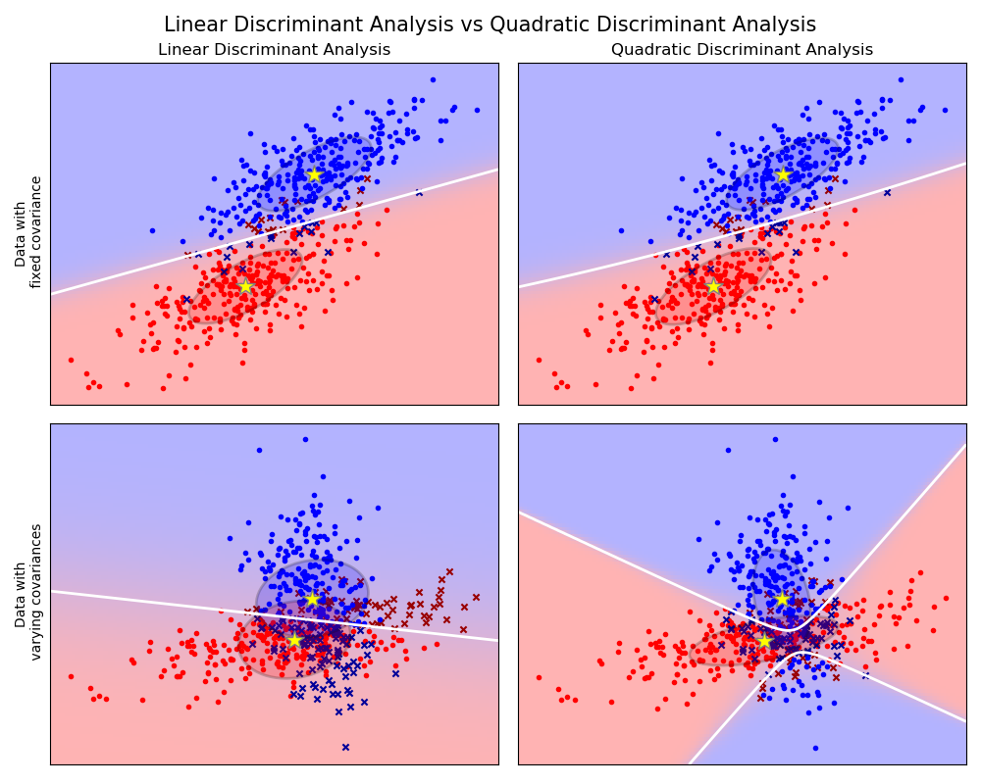
Discriminant Analysis
Use the principle of machine learning to train the system in determining the clusters
Maximise the seperability among the known categories
It is based on maximise the likewood that an observation belong to a cluster
Really useful if I need to apply it to new discovers for which I do not have data yet
Link
https://scikit-learn.org/stable/modules/lda_qda.html
www.cdcs.ed.ac.uk

Slide 16
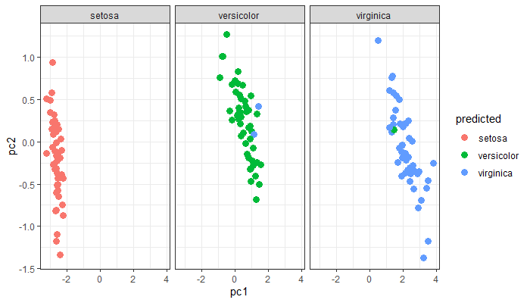
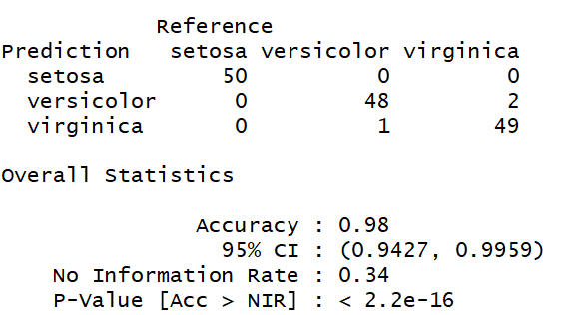
Read the Results
www.cdcs.ed.ac.uk

Slide 17
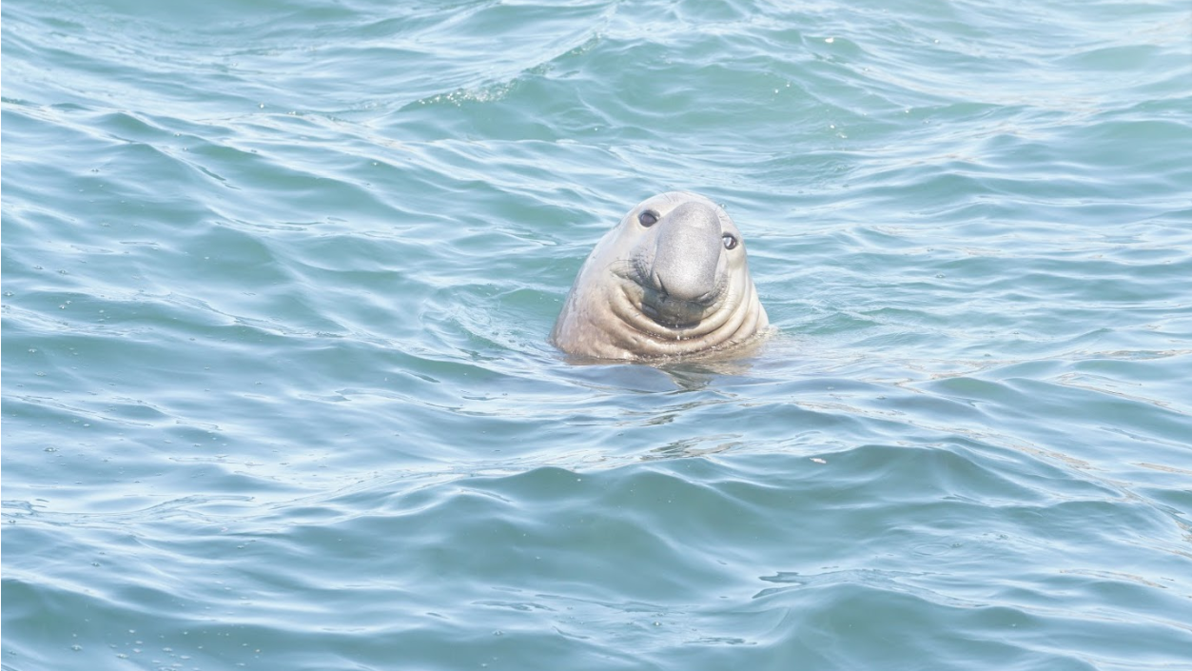
Any Question?
www.cdcs.ed.ac.uk

Slide 18
Next Class
Covariance
Regression
Similarity and difference coefficients

Slide 19
Challenge 7
Compute the PCA that will analyse if the combination of the tuition, salary average, loan default rate, and Median debt are connected to the type of university (public/private)
#Remember that you ne ed to first extract the numerical variables you want to use
#Then compute the PCA
#Then add PC1 and PC2 to the original dataset
#Finally plot the result
#If you want you can use a Chull to draw the borders of the subsets
Use the K-means to do a cluster analysis of the data
#Start from extracting the numerical variables
#Compute the K-means (in this case the number of clusters is 2)
#Then add the cluster to the original dataset
#Finally plot the results
As usual if you do have your dataset try use that dataset instead
www.cdcs.ed.ac.uk

Slide 20
References
PCA
http://www.sthda.com/english/articles/31-principal-component-methods-in-r-practical-guide/118-principal-component-analysis-in-r-prcomp-vs-princomp/
https://cran.r-project.org/web/packages/ggfortify/vignettes/plot_pca.html
https://towardsdatascience.com/principal-component-analysis-pca-101-using-r-361f4c53a9ff
https://www.linkedin.com/learning/r-statistics-essential-training/conducting-a-principal-components-factor-analysis?autoplay=true&u=50251009
https://www.youtube.com/watch?v=FgakZw6K1QQ&t=985s
https://www.youtube.com/watch?v=0Jp4gsfOLMs
Cluster Analysis
https://en.wikipedia.org/wiki/Cluster_analysis
https://www.statmethods.net/advstats/cluster.html
https://www.datanovia.com/en/blog/cluster-analysis-in-r-practical-guide/
https://www.datanovia.com/en/blog/types-of-clustering-methods-overview-and-quick-start-r-code
http://girke.bioinformatics.ucr.edu/GEN242/pages/mydoc/Rclustering.html
https://www.linkedin.com/learning/r-statistics-essential-training/conducting-a-cluster-analysis?autoplay=true&u=50251009
K-Means
https://www.youtube.com/watch?v=4b5d3muPQmA
https://www.youtube.com/watch?v=tkAJT8gWBSY
https://www.datanovia.com/en/lessons/k-means-clustering-in-r-algorith-and-practical-examples/
https://www.datacamp.com/community/tutorials/k-means-clustering-r
https://uc-r.github.io/kmeans_clustering
Hierarchical clustering
https://cran.r-project.org/web/packages/dendextend/vignettes/Cluster_Analysis.html
https://rpubs.com/markloessi/499252
https://www.datacamp.com/community/tutorials/hierarchical-clustering-R
https://www.youtube.com/watch?v=7xHsRkOdVwo
https://www.youtube.com/watch?v=tkAJT8gWBSY
Discriminant analysis
http://www.sthda.com/english/articles/36-classification-methods-essentials/146-discriminant-analysis-essentials-in-r/
https://www.r-bloggers.com/discriminant-analysis-statistics-all-the-way/
https://www.statmethods.net/advstats/discriminant.html
https://rpubs.com/Nolan/298913
https://www.youtube.com/watch?v=r-AQxb1_BKA

Slide 21

Feedback
This series of trainings depend on annually allocated founds!!! To secure them we need to provide detailed feedback on them
More on the Peer Learning Cohorts
https://www.cdcs.ed.ac.uk/training/cdcs-peer-learning-cohorts
https://edin.ac/33TwJxY

