Slide 1
Systematic Literature Reviews with R: From Search Results to Evidence Synthesis
Dandian Yang

Slide 2
Workshop Overview
Introduction to systematic review workflows
Why use R for evidence synthesis
Key R packages for systematic reviews
Hands‑on demonstrations and exercises

Slide 3
Learning Objectives
Understand
Understand the systematic review workflow in R
Import and manage
Import and manage bibliographic data
Remove
Remove duplicates and screen studies
Conduct
Conduct basic meta‑analysis
Visualise and report
Visualise and report results reproducibly

Slide 4
What is a Systematic Review?
Structured and transparent literature synthesis
Follows predefined protocols
Comprehensive search strategy
Reproducible analysis and reporting

Slide 5
Typical Systematic Review Workflow
Define research question
Literature search
Screening and eligibility
Data extraction
Evidence synthesis and reporting

Slide 6
PRISMA 2020 Checklist
PRISMA flow diagram included
*Title says “systematic review”*
≥2 databases searched
Full search string reported
Inclusion/exclusion criteria defined
Screening process explained
Risk of bias assessed
Results clearly summarised

Slide 7
The process of the primary search
Identify the PICO elements according to the reserach questions
Plan the search strategy, identify the serach database resources
Excute the search and record the results of each search
Refine the results and group the results with limiters
Review the literature

Slide 8
Define research question
PICO framework (Tricco et al., 2011).
Population
Intervention/Exposure
Comparison (Optional)
Outcome
Adapted to PEO framework
RQ: What is the impact of digital device use on mental health in young adults?
Notes:
Population: Young adults (e.g., 18–25 years)Exposure: Digital devices (smartphones, social media, screen time)Outcome: Mental health (depression, anxiety, wellbeing)

Slide 9
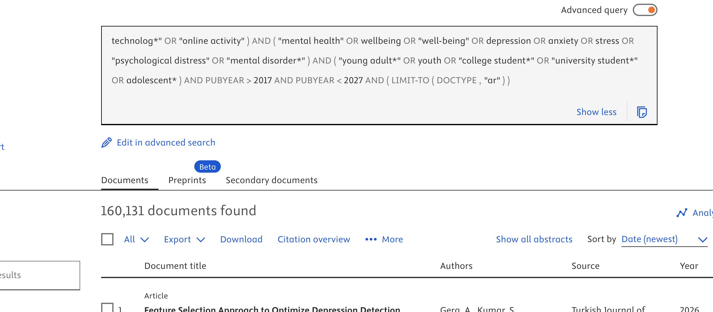
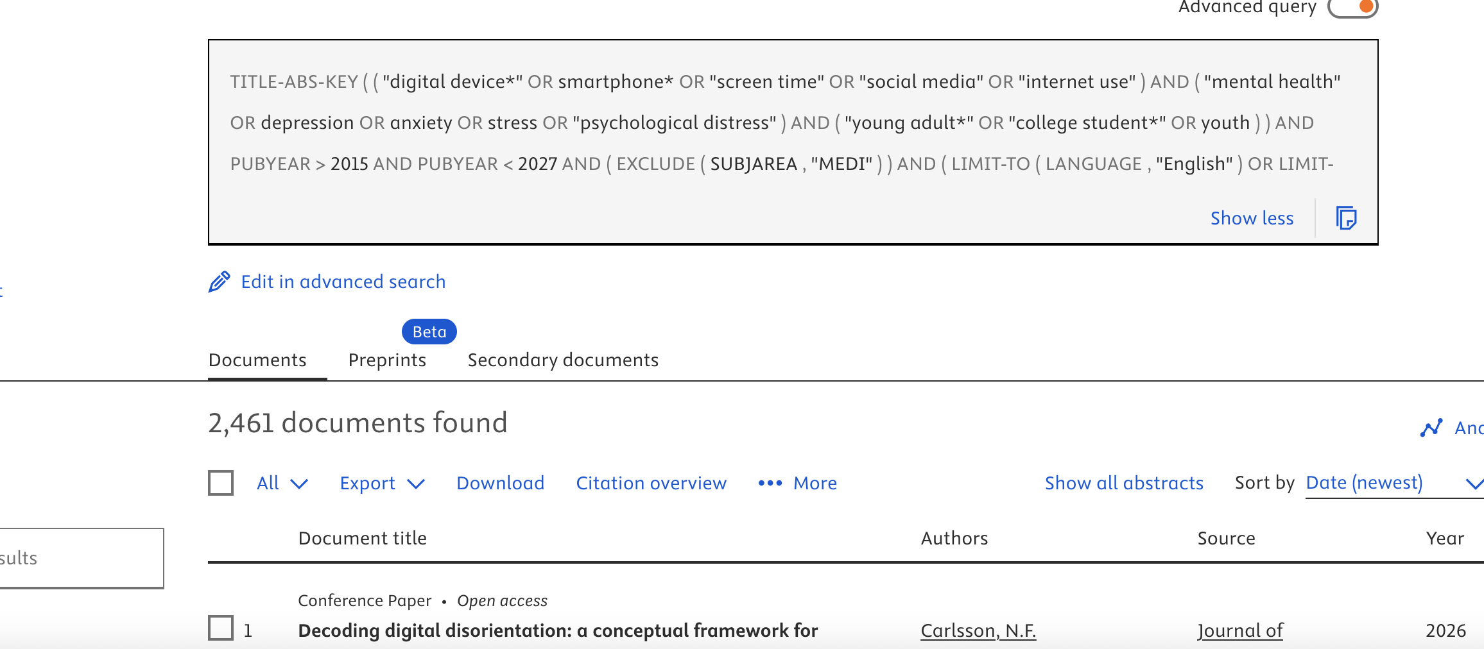
Search Strategy
Boolean Search String
Field-specific search
("digital device*" OR smartphone* OR "mobile phone*" OR "screen time" OR "social media" OR "internet use" OR "digital technolog*" OR "online activity")
AND
("mental health" OR wellbeing OR "well-being" OR depression OR anxiety OR stress OR "psychological distress" OR "mental disorder*")
AND
("young adult*" OR youth OR "college student*" OR "university student*" OR adolescent*)

Slide 10
Literature Search In a standard systematic review, we need to search not only titles but also abstracts and keywords .
Titles Only
Title+Abstract+Keywords
Miss many relevant studies
Bias your results toward narrowly titled papers
Increase sensitivity and finds more studies
Improve completeness of literature
PRISMA-quality reviews

Slide 11
Apply in Major Database
Scopus:TITLE-ABS-KEY()
Web of Science:TS=
Google Scholar: searches full text automatically, which makes the result broader but less precise. (Can use )
After apply search with Title+Abstract+Keyword search, then refine with filters (year/ subject area/languages)
To download metadata(Scopus), use Google Chrome

Slide 12
Why Use R for Systematic Reviews?
Open source and widely used
Reproducible workflows
Automation of repetitive tasks
Advanced statistical analysis and visualisation

Slide 13
Where R Fits in the Workflow
Import bibliographic records
Deduplicate references
Assist screening processes
Run meta‑analysis
Produce figures and reports

Slide 14
Key R Packages
revtools
synthesisr
dplyr

Slide 15
Importing Bibliographic Data
Export search results from databases
Common formats: RIS, BibTeX, CSV
Load files into R
Inspect imported records

Slide 16
Example Databases
Scopus
Web of Science
Google Scholar
DiscoverEd

Slide 17
Reading Bibliographic Files in R
Using
Using revtools::read_bibliography()
Handling
Handling RIS and CSV files
Viewing
Viewing imported records
Checking
Checking variable structure

Slide 18
Combining Search Results
Merge
Merge results from multiple databases
Create
Create unified dataset
Prepare
Prepare for deduplication

Slide 19
Understanding Duplicate Records
Multiple databases index same studies
Duplicate titles and authors
Duplicate DOIs
Important to remove before screening

Slide 20
Deduplication with R
Automated duplicate detection
Manual verification
Saving cleaned dataset
Ensuring transparent workflow

Slide 21
Questions & Discussion
Tricco AC, Straus SE, Moher D. How can we improve the interpretation of systematic reviews? BMC Med. 2011 Mar 30;9:31. doi: 10.1186/1741-7015-9-31.

