Slide 1



Topic Modelling with BERT
April 3th 2026
Session 1
Joy Lan
www.cdcs.ed.ac.uk

Slide 2
Course plan
W1: Lead by Joy Lan
What is topic modelling
What is BERT
How does BERT work
W2: Lead by Aybuke Atalay
Interpretation
Visualisation
Fine-tuning
www.cdcs.ed.ac.uk

Slide 3
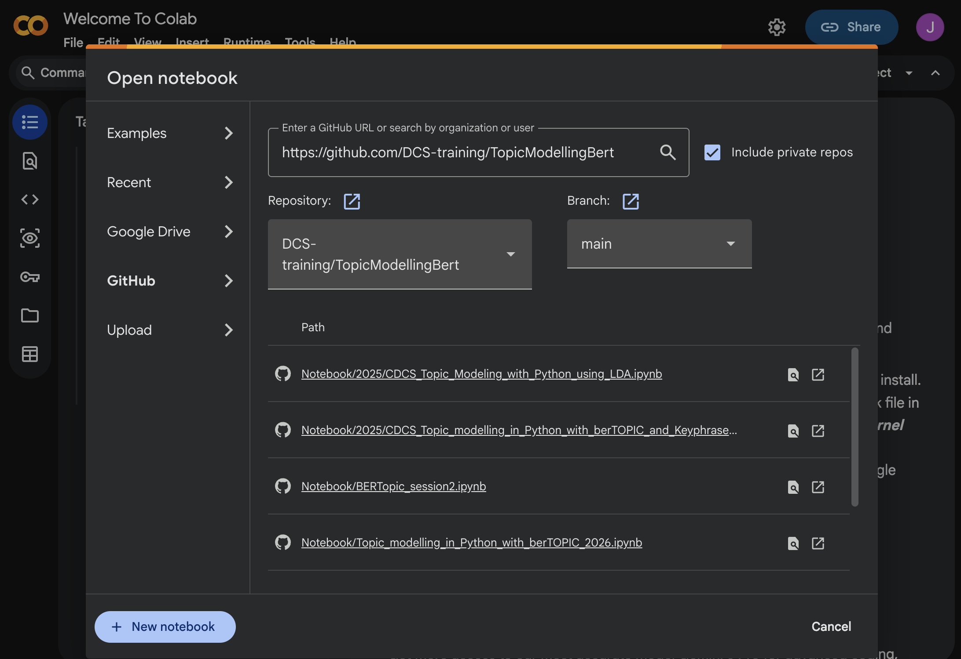
www.cdcs.ed.ac.uk

Slide 4
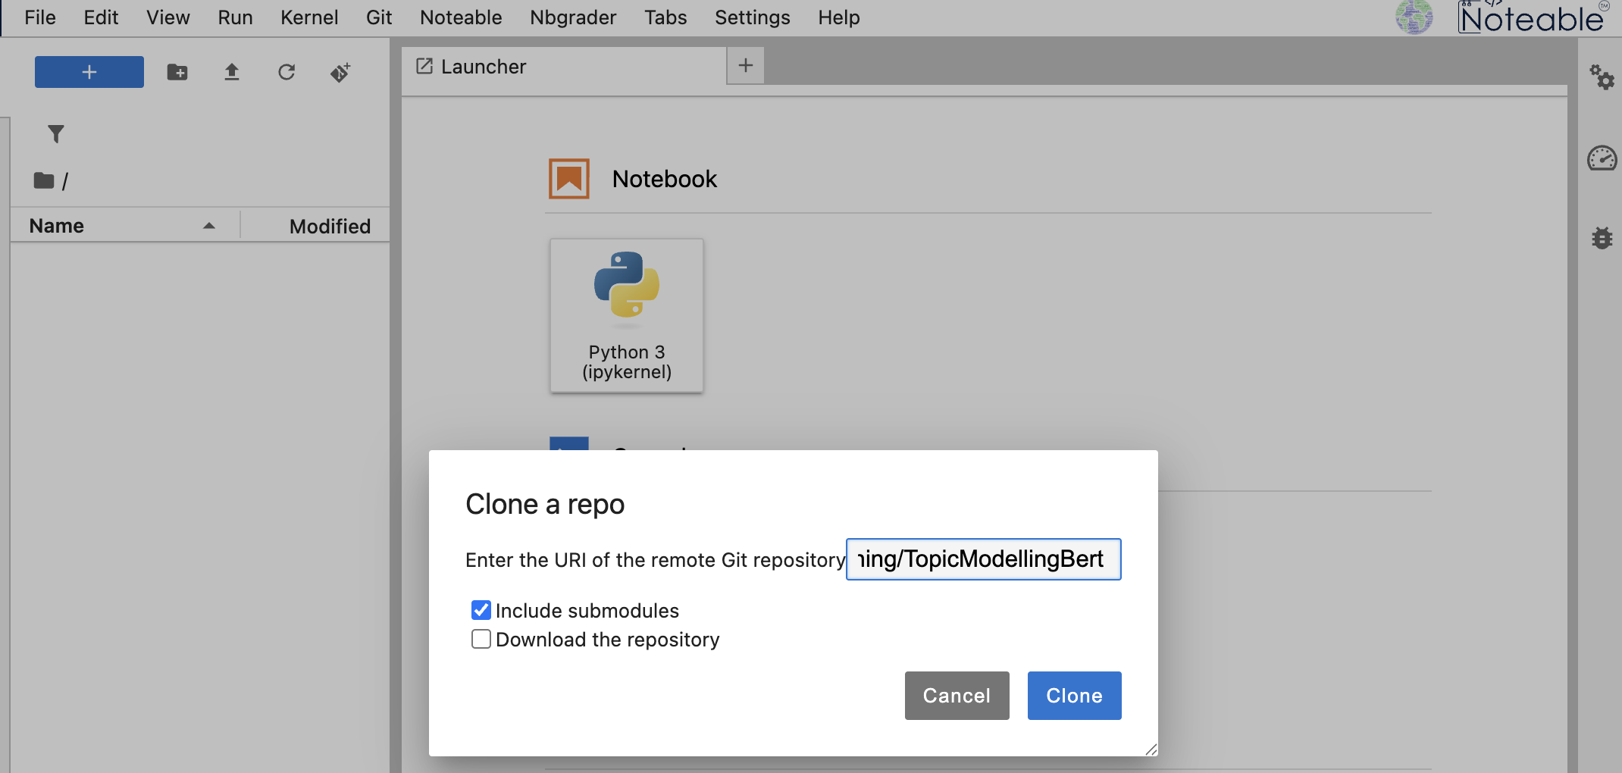
www.cdcs.ed.ac.uk

Slide 5
Billions of texts. What are they saying?
Every day we generate more text than any person can read.
Journals, policy documents, reports, news, social media…
www.cdcs.ed.ac.uk

Slide 6
We want to (quickly) discover what people are talking about?
Where do you start?
How can we make sense of the text?
www.cdcs.ed.ac.uk
Notes:
manual qualitative coding doesn’t scale, and keyword search can’t reliably capture synonyms, context, or “aboutness.”

Slide 7
Know your data, know your goal
Q1. What do you know about your data?
Metadata: source, timeframe, language, how it was collected?..
Content: general topic, coherence, length, etc.
Q2. What is your analytical goal?
Exploring patterns in a collection of documents
Classify documents into categories
Analysing meaning, framing and discourse in texts
www.cdcs.ed.ac.uk

Slide 8
Supervised & Unsupervised learning in NLP
Supervised learning such as text classification, can be used to:
Train a model that can later detect or predict a “defined label”.
Validate and test coding scheme.
You’ll need:
A defined label set
Labelled documents
Model configurations
You’ll get:
A trained model that can assign predicted label(s) to new data
Evaluation metrics that help you assess the model performance
www.cdcs.ed.ac.uk

Slide 9
Supervised & Unsupervised learning in NLP
Unsupervised learning , such as topic modelling can be used to:
Train a model that can later detect or predict a “defined label”.
Validate and test coding scheme.
You’ll need:
An optional label set
(Unlabelled) documents
Model configurations
You’ll get:
Topics/clusters described by keywords/representative texts
Topic–document relationships
www.cdcs.ed.ac.uk

Slide 10
When do you use topic modelling in NLP?
Goal | Input | Output | Choice
Detection and prediction Validate and test coding scheme | A defined label set Labelled documents Model configurations | Predicted label(s) for new documents Evaluation metrics on test data | supervised learning
Discover themes/patterns Generate candidate codes for qualitative analysis Support sense-making and sampling for close reading | A defined label set (opt.) Unlabelled documents Model configurations | Topics/clusters described by keywords/representative texts Topic–document relationships | unsupervised learning Topic modelling
www.cdcs.ed.ac.uk

Slide 11
Machine learning methods cannot replace human interpretation.
www.cdcs.ed.ac.uk

Slide 12
What we can and cannot do with topic modelling?
What themes appear in collection of documents?
How do discussions about a specific issue change over time?
How do different organisations emphasise different issues?
What is the author’s main argument in this document?
Is this text supportive or critical of a policy/idea?
What causes a particular issue or outcome?
www.cdcs.ed.ac.uk

Slide 13
How does topic modelling work?
www.cdcs.ed.ac.uk

Slide 14
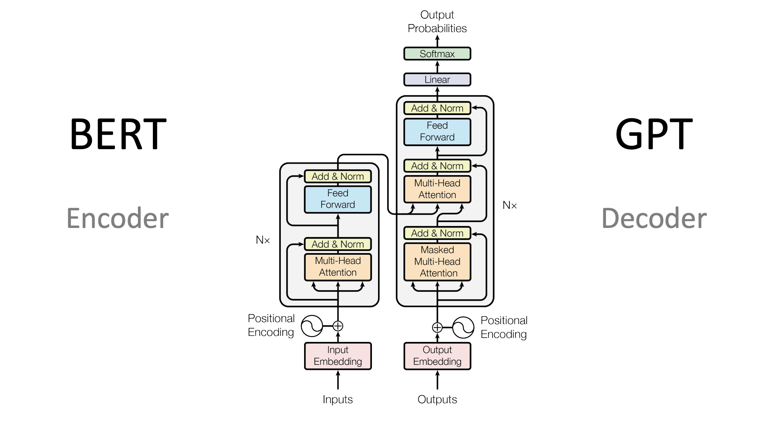
BERT - Transformer models
www.cdcs.ed.ac.uk
Notes:
To encode (to let computer understand human languages)

Slide 15
Transformer Model
Embedding + Positional Encoding + self attention
Embedding turns each token in a piece of text corresponds to a vector in semantic space
Positional encoding generate another vector that represents the position (order) of the word in the text.
Self-attention is relational weighting, and the results reweighted the embedding vector.
ex. The animal didn’t cross the street because it was too tired.
www.cdcs.ed.ac.uk
Notes:
To encode (to let computer understand human languages)

Slide 16
BERTopic – Configuration
Steps | What does it do? | Syntax
01 Text representation | Turn each document into numerical form that captures sematic meanings. | embedding_model = "all-mpnet-base-v2”
02 Reduce dimensionality | Makes clustering more effective Shapes how topics will form | umap_model (applied by default)
03 Cluster reduced embedding | Groups documents into clusters based on similarity | hdbscan_model (applied by default)
04 Topic representation | Extracts words/phrases from documents in each cluster Counts their frequency | vectorizer_model
05 Create topic | Identify words that are: frequent in this topic rare in other topics | ctfidf_model (class-based TF-IDF, applied by default)
06 Refine topic representation (optional) | Improves topic labels using embedding-based methods | representation_model KeyBERTInspired etc.

Slide 17
BERTopic – 01 Text Representation
BoW: What words are there?
TF-IDF: Which words matter most?
BERT: What does the word mean here?
www.cdcs.ed.ac.uk
Notes:
Counts how many times each word appears Ignores order and context

Slide 18
Text Representation - BoW
Corpus containing 2 texts:
Text 1: I went to the bank to check my interest and a charge on my account, but the current balance looked wrong.
Text 2 : The current in the stream created a steady flow of water, while the battery powered a light in the open field near the bank.
Word | T1 | T2
bank | 1 | 1
interest | 1 | 0
charge | 1 | 0
current | 1 | 1
battery | 0 | 1
light | 0 | 1
stream | 0 | 1
field | 0 | 1
flow | 0 | 1
www.cdcs.ed.ac.uk

Slide 19
Text Representation - TF-IDF
Corpus containing 2 texts:
Text 1: I went to the bank to check my interest and a charge on my account, but the current balance looked wrong.
Text 2 : The current in the stream created a steady flow of water, while the battery powered a light in the open field near the bank.
Word | T1 | T2
bank | 0.2 | 0.2
interest | 0.9 | 0.0
charge | 0.9 | 0.0
current | 0.2 | 0.2
battery | 0.0 | 0.9
light | 0.0 | 0.9
stream | 0.0 | 0.9
field | 0.0 | 0.9
flow | 0.0 | 0.9
www.cdcs.ed.ac.uk

Slide 20
Text Representation – Embedding Model
Corpus containing 2 texts:
Text 1: I went to the bank to check my interest and a charge on my account, but the current balance looked wrong.
Text 2 : The current in the stream created a steady flow of water, while the battery powered a light in the open field near the bank.
Word | T1 | T2
bank | [0.8, 0.7, 0.1] | [0.2, 0.3, 0.6]
current | [0.7, 0.6, 0.2] | [0.3, 0.4, 0.2]
interest | [0.9, 0.8, 0.1] | —
stream | — | [0.2, 0.3, 0.9]
battery | — | [0.3, 0.5, 0.8]
www.cdcs.ed.ac.uk

Slide 21
BERTopic – 02 Reduce Dimensionality
Define how documents cluster: UMAP
Embeddings are high-dimensional (each token is a vector)
UMAP reduces them and it allows easier clustering
You can determine if you want to focus on local structure(more topics) or global structure (fewer topics)
www.cdcs.ed.ac.uk

Slide 22
BERTopic – 03 Cluster reduced embedding
Groups documents into clusters: HDBSCAN
It is an unsupervised machine learning algorithm used for clustering, based on similarity.
This is where topics are generated
You can determine the number of clusters you want and adjust the algorithm
www.cdcs.ed.ac.uk

Slide 23
BERTopic – 04 Topic Representation
Extracts words/phrases from documents in each cluster:
topic vectorizer
This determines how your topic is represented/described.
You can remove overly common and rare words
Use multi-word expressions instead of one word (N-gram)
www.cdcs.ed.ac.uk

Slide 24
BERTopic – 05 Create Topics
Create the topics: c-TF-IDF
Now that the documents are grouped together into clusters. This step treats each cluster as one document
Identify words that are:
frequent in this topic and rare in other topics
www.cdcs.ed.ac.uk

Slide 25
Topic modelling: workflow
a statistical method to discover topics in a set of documents
Cleaning
Tokenisation
Build model
Train model
Evaluation + visualisation
www.cdcs.ed.ac.uk

Slide 26
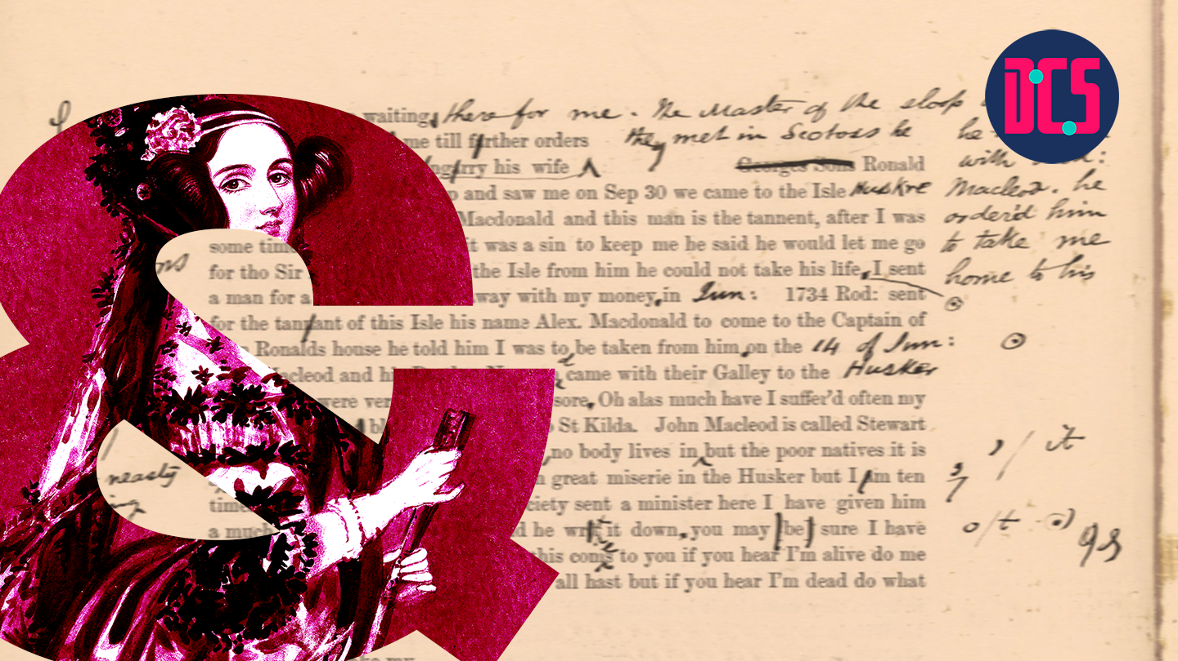
Let’s Code
Session 1

Slide 27
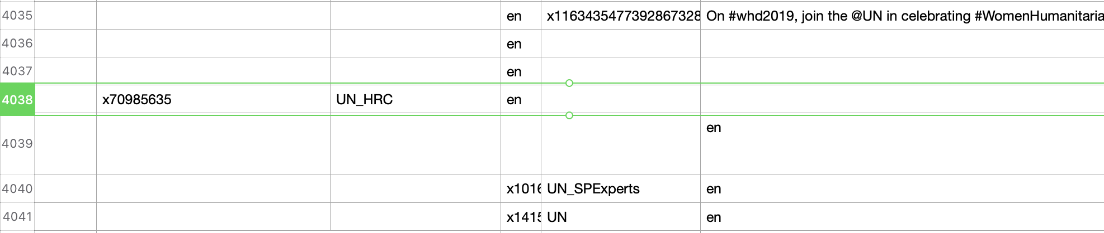
Codebook
Text cleaning
The original data set has a mismatch of columns at row 4037
www.cdcs.ed.ac.uk

Slide 28
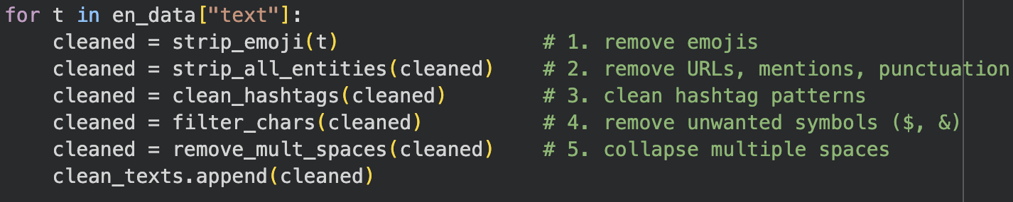
Codebook
Text cleaning
www.cdcs.ed.ac.uk

Slide 29
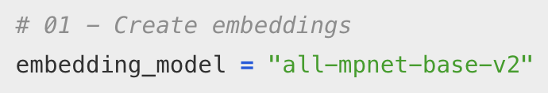
Codebook
Embedding model
"all-mpnet-base-v2" is a pre-trained Sentence Transformer (based on BERT-like architecture)
It converts each document into a vector (numbers) or simply put, it turns each document into one dense vector
See: https://huggingface.co/sentence-transformers
www.cdcs.ed.ac.uk
Notes:
https://huggingface.co/sentence-transformers

Slide 30
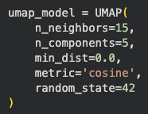
Codebook
UMAP (default)
n_neighbors
Low → captures local structure
High → captures global structure
n_components
Dimensions after reduction
min_dist
Low → tighter clusters
High → more spread-out clusters
random_state
Allows you to reproduce the same results
www.cdcs.ed.ac.uk

Slide 31
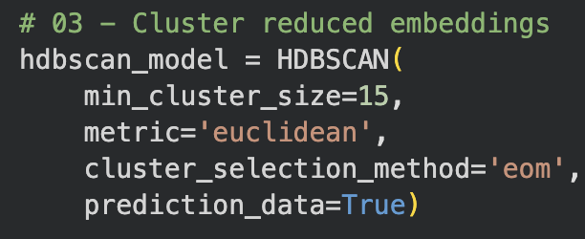
Codebook
HDBSCAN (default)
min_cluster_size
Low → fewer topics
High → more topics
metric
How distance between documents is measured
cluster_selection_method
eom = Excess of Mass
Chooses stable, dense clusters
Alternatively use ‘leaf’ for smaller clusters
www.cdcs.ed.ac.uk

Slide 32
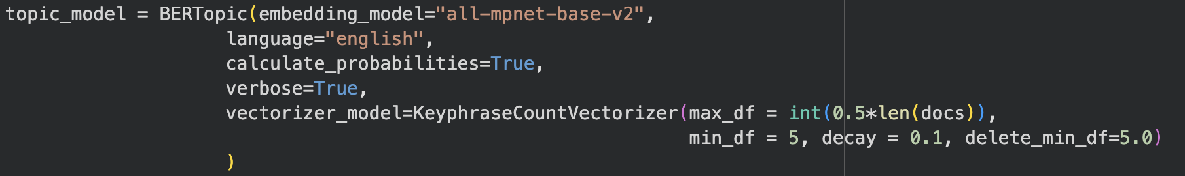
Codebook
KeyphraseVectorizers
KeyphraseCountVectorize extract phrases that describe the topics
c-TF-IDF is automatically applied during this step
max_df = 0.5 * len(docs) → Ignore phrases appearing in too many documents min_df = 5 → Only keep phrases appearing in at least 5 documents
decay = 0.1 → Reduces influence of very frequent terms over time
delete_min_df = 5.0 → Removes very rare/unstable phrases
www.cdcs.ed.ac.uk

Slide 33
Codebook
Calculate probabilities
Documents can partially belong to multiple topics.
www.cdcs.ed.ac.uk
www.cdcs.ed.ac.uk

Slide 34
Let’s Code
Session 1

Slide 35
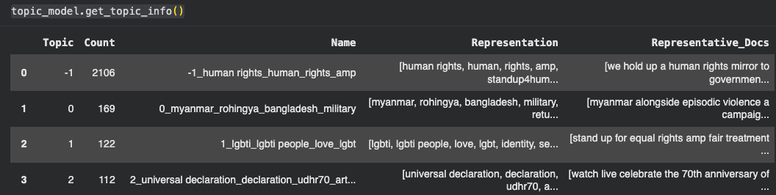
Codebook
Get topic information
Each topic is represented by a group of words
-1 refers to all outliers and should typically be ignored.
www.cdcs.ed.ac.uk
Notes:
Each topic is represented by a group of words
-1 refers to all outliers and should typically be ignored.

Slide 36
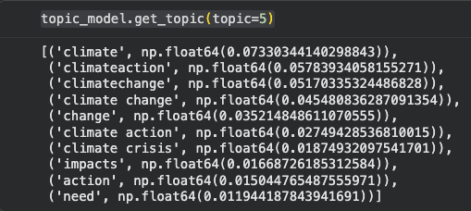
Codebook
Get topic words
Each topic is composed of a group of words.
Words with higher scores mean that the word are more representative of the topic, compared to the other words.
www.cdcs.ed.ac.uk

Slide 37
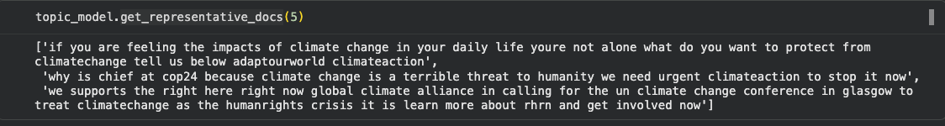
Codebook
Get representative documents
This function returns the documents sample that best embody the semantic meaning of the topic.
www.cdcs.ed.ac.uk
Notes:
he specific text samples from your dataset that best embody the semantic meaning and core themes of a generated topic.

Slide 38
Codebook
Check the topic of each document
In this example,
Document 1 belongs to topic 9,
Document 2 does not have a main topic, etc.
www.cdcs.ed.ac.uk

Slide 39
Attributes
There are a number of attributes that you can access after having trained your BERTopic model:
Attribute | Description
topics_ | The topics that are generated for each document after training or updating the topic model.
probabilities_ | The probabilities that are generated for each document if HDBSCAN is used.
topic_sizes_ | The size of each topic
topic_mapper_ | A class for tracking topics and their mappings anytime they are merged/reduced.
topic_representations_ | The top n terms per topic and their respective c-TF-IDF values.
c_tf_idf_ | The topic-term matrix as calculated through c-TF-IDF.
topic_labels_ | The default labels for each topic.
custom_labels_ | Custom labels for each topic as generated through set_topic_labels.
topic_embeddings_ | The embeddings for each topic if embedding_model was used.
representative_docs_ | The representative documents for each topic if HDBSCAN is used.
www.cdcs.ed.ac.uk

Slide 40
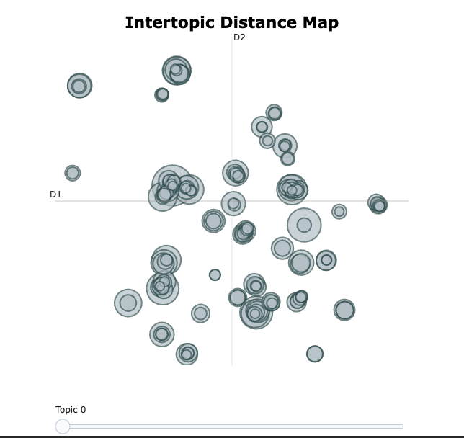
Codebook
www.cdcs.ed.ac.uk

Slide 41
Session 1 Wrap-up
www.cdcs.ed.ac.uk

Slide 42
Next Week:
How can we interpret the results?
How can we improve the model performance (that make more sense)
www.cdcs.ed.ac.uk

Slide 43
Additional Resources
examples of supervised learning in social studies
Nelson, L. K., Burk, D., Knudsen, M., & McCall, L. (2021). The future of coding: A comparison of hand-coding and three types of computer-assisted text analysis methods. Sociological Methods & Research, 50(1), 202-237.
Rona-Tas, A., Cornuéjols, A., Blanchemanche, S., Duroy, A., & Martin, C. (2019). Enlisting supervised machine learning in mapping scientific uncertainty expressed in food risk analysis. Sociological Methods & Research, 48(3), 608-641.
www.cdcs.ed.ac.uk

Slide 44
Additional Resources
examples of topic modelling
Grubbs, A. E., Sinha, N., Garg, R., & Barber, E. L. (2023). Use of topic modeling to assess research trends in the journal Gynecologic Oncology. Gynecologic oncology, 172, 41-46.
Grajzl P, Murrell P. Using Topic-Modeling in Legal History, with an Application to Pre-Industrial English Case Law on Finance. Law and History Review. 2022;40(2):189-228. doi:10.1017/S0738248022000153
www.cdcs.ed.ac.uk

Slide 45
Thank you
www.cdcs.ed.ac.uk

