Slide 1
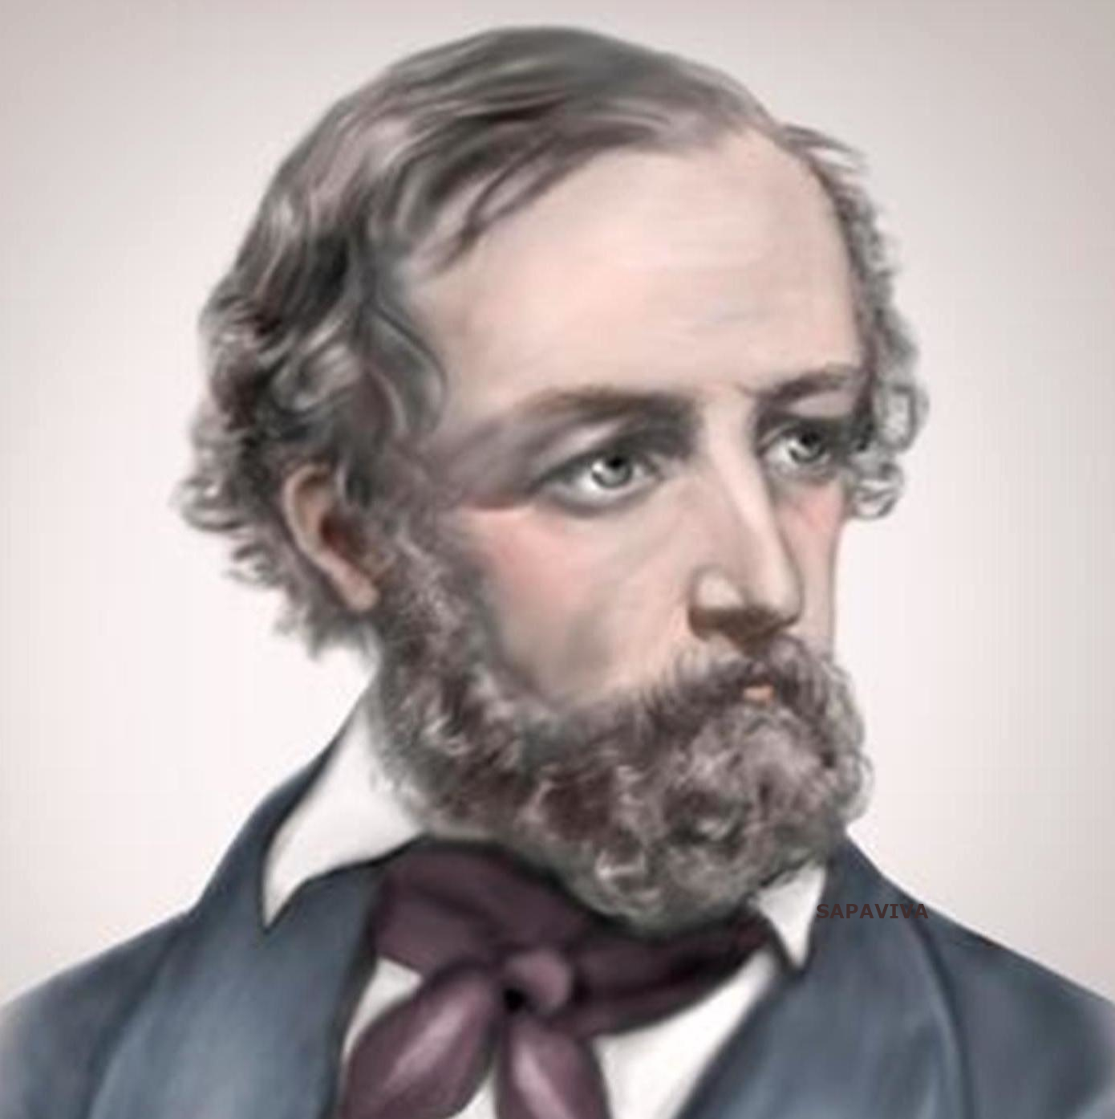

Topic Modelling with LDA
Instructor: Xandra Dave Cochran
April 3-10, 2024
Centre for Data, Culture & Society

Slide 2
Topic Modelling:
Unsupervised Machine Learning

Slide 3
Topic Modelling:
Unsupervised Machine Learning
Identifies clusters of related words in text

Slide 4
Topic Modelling:
Unsupervised Machine Learning
Identifies clusters of related words in text
Does not require predefined categories – good for discovery and exploration of a dataset

Slide 5
Introductions!
Is there anyone here today that wasn’t here for BERTopic last week? If so – HELLO! Welcome! And…

Slide 6
Introductions!
Is there anyone here today that wasn’t here for BERTopic last week? If so – HELLO! Welcome! And… What is your previous experience with machine learning? Why are you interested in topic modelling? Have you used LLMs before? Is there a dataset you have in mind to use for topic modelling in future?

Slide 7
Latent Dirichlet Allocation
This is a rather more old-school model than BERTopic – introduced by Blei, Ng & Jordan in 2003

Slide 8
Latent Dirichlet Allocation
This is a rather more old-school model than BERTopic – introduced by Blei, Ng & Jordan in 2003
No billion-parameter neural networks here: the model is simpler & and, arguably, it’s easier to interpret its outputs (eXplainable AI – XAI)

Slide 9
Latent Dirichlet Allocation
This is a rather more old-school model than BERTopic – introduced by Blei, Ng & Jordan in 2003
No billion-parameter neural networks here: the model is simpler & and, arguably, it’s easier to interpret its outputs (eXplainable AI – XAI)
But is it as good?

Slide 10
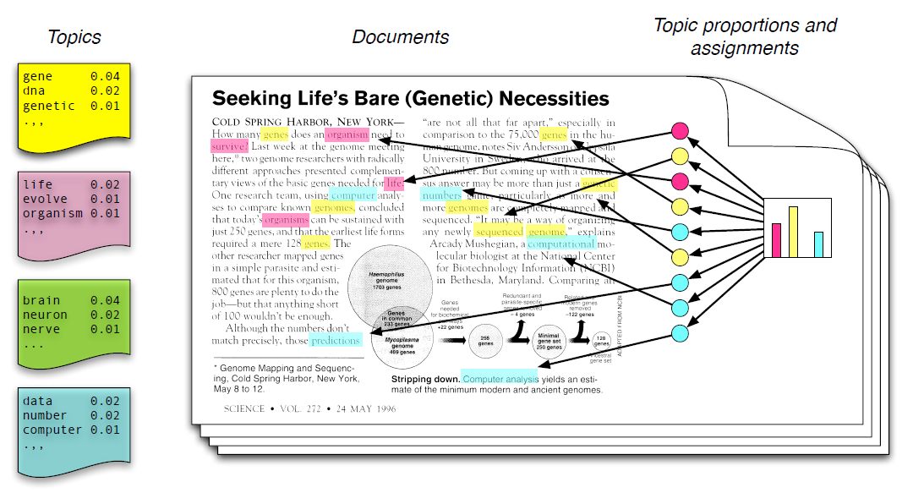
Latent Dirichlet Allocation
Topics are vectors of probabilities of words

Slide 11
Latent Dirichlet Allocation
Topics are vectors of probabilities of words
A document may be a blend of multiple topics

Slide 12
Latent Dirichlet Allocation
Topics are vectors of probabilities of words
A document may be a blend of multiple topics
The model makes use of Dirichlet Distributions to model the relations from Topics to Documents and Words to Topics…

Slide 13

Latent Dirichlet Allocation
music
A Dirichlet distribution a generative model...
music
food
data
science
data
science
food
coffee

Slide 14
Bag of Words
We simplify the data by throwing out word order and just considering the number of occurrences of each word in a document

Slide 15
Bag of Words
We simplify the data by throwing out word order and just considering the number of occurrences of each word in a document
We also ignore stop-words like ‘and’, ‘is’, etc

Slide 16
Bag of Words
We simplify the data by throwing out word order and just considering the number of occurrences of each word in a document
We also ignore stop-words like ‘and’, ‘is’, etc
Also numbers, links, punctuation, etc

Slide 17
Bag of Words
We simplify the data by throwing out word order and just considering the number of occurrences of each word in a document
We also ignore stop-words like ‘and’, ‘is’, etc
Also numbers, links, punctuation, etc
Also anything else we think is going to be frequent across all documents – like ‘UN’ in a corpus of UN tweets

Slide 18
DEMO

Slide 19
Number of topics (k)
How do we know how many topics we need?

Slide 20
Number of topics (k)
How do we know how many topics we need?
Try different numbers of topics and see what gives a sensible result!

Slide 21
Number of topics (k)
How do we know how many topics we need?
Try different numbers of topics and see what gives a sensible result!
We can use coherence scores (a measure of the internal similarity of a topic) to evaluate the quality of a topic or collection of topics

Slide 22
Number of topics (k)
How do we know how many topics we need?
Try different numbers of topics and see what gives a sensible result!
We can use coherence scores (a measure of the internal similarity of a topic) to evaluate the quality of a topic or collection of topics
“It is based on the topic's top 15 words and shows how strongly pairs of these top 15 words support each other within the corpus” (Syed & Spruit 2017)

Slide 23
Number of topics (k)
How do we know how many topics we need?
Try different numbers of topics and see what gives a sensible result!
We can use coherence scores (a measure of the internal similarity of a topic) to evaluate the quality of a topic or collection of topics
“It is based on the topic's top 15 words and shows how strongly pairs of these top 15 words support each other within the corpus” (Syed & Spruit 2017)
Agrees well with human evaluations of topic quality

Slide 24
DEMO

Slide 25
Compare to BERTopic…
More pre-processing
Uses only corpus data
Instability
Complexity

Slide 26
DEMO

Slide 27
Thanks Everyone!
Next step: Notebook 3, BYO Data with BERTopic
Will be released by the 12th
Complete in your own time, optional
Please message me on Teams for office hours to discuss!

