Slide 1


Slide 2



@EdCDCS
For all events, news, and support: cdcs.ed.ac.uk

Slide 3
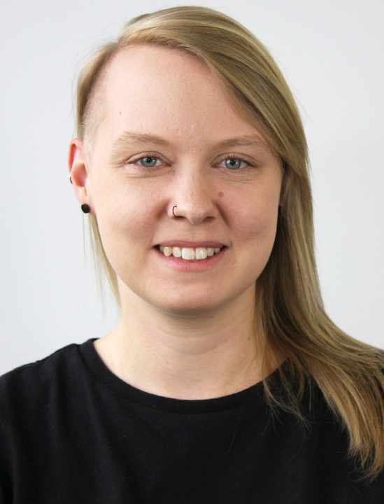
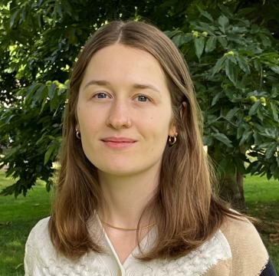
Welcome!
Sarah Schöttler
PhD student in data visualization & visualization developer
Aislinn Keogh
PhD student in Linguistics
Notes:
A/S

Slide 4
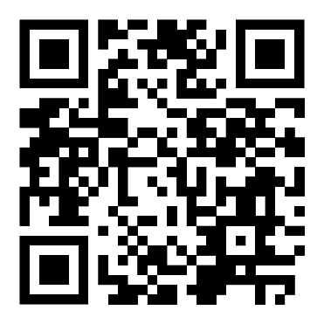
Week 1: Plan for today
14:00 Introduction + setup
14:20 Programming practical
14:55 Break
15:05 Brief check-in + common questions
15:15 Programming practical
15:55 Wrap up + plans for next week
Find these slides online:
github.com/DCS-training/
data-analysis-in-python

Slide 5
What we’ll cover on this course
Week 1
Useful Python libraries for data analysis
How to import datasets
Understanding the structure of dataframes
Data wrangling
Handling missing data
Week 2
Calculating summary (descriptive) statistics
Looking at data by groups
Data visualisation

Slide 6
Disclaimer
I don’t do a lot of data analysis in Python!
But I’m good at Python programming in general
And I do work with a lot of tabular data
Working with tabular data is all about:
Understanding what is possible in general
Figuring out the exact syntax to do that in whatever language you’re using

Slide 7
Pair programming

Slide 8
Getting set up on Noteable
Open https://noteable.edina.ac.uk/login
Log in with your EASE credentials
Under ‘Standard Notebook (Python 3)’, click ‘Start’
From the Noteable homepage, click the ‘+GitRepo’ button at the top right of the screen
In the ‘Git Repository URL’ field, copy the link to this GitHub repository: https://github.com/DCS-training/data-analysis-in-python. Ignore all other fields.
Once filled in, click the ‘clone’ button. Wait a few moments and a new folder should appear!
Navigate to the ‘practical’ folder and open week-1.ipynb

Slide 9
Welcome back!

Slide 10
Week 2: Plan for today
14:00 Introduction + setup
14:15 Programming practical
14:55 Break
15:05 Brief check-in + common questions
15:15 Programming practical
15:55 Wrap up
Find these slides online:
github.com/DCS-training/
data-analysis-in-python

Slide 11
Pair programming

Slide 12
Getting set up on Noteable
Open https://noteable.edina.ac.uk/login
Log in with your EASE credentials
Under ‘Standard Notebook (Python 3)’, click ‘Start’
From the Noteable homepage, click the ‘+GitRepo’ button at the top right of the screen
In the ‘Git Repository URL’ field, copy the link to this GitHub repository: https://github.com/DCS-training/data-analysis-in-python. Ignore all other fields.
Once filled in, click the ‘clone’ button. This won’t overwrite any changes you made to the Week 1 practical, it will just download the new materials for Week 2
Navigate to the ‘practical’ folder and open week-2.ipynb

