Slide 1
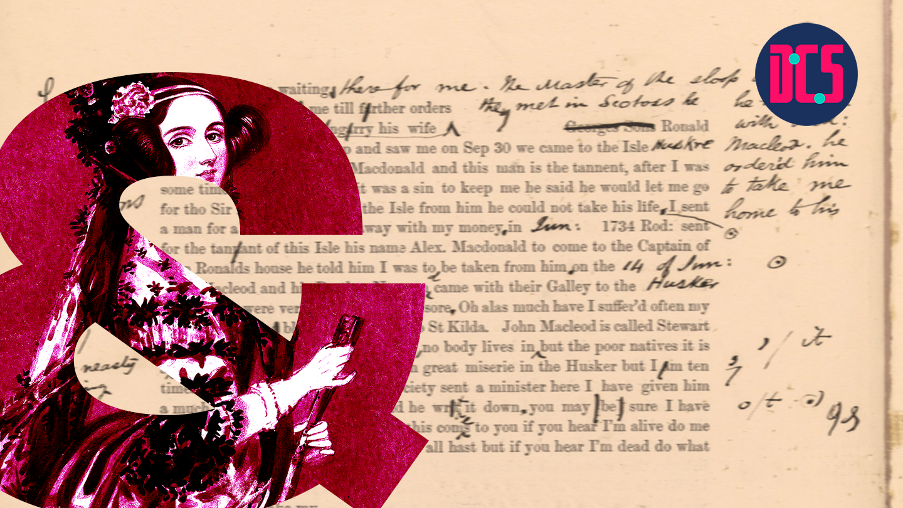
12th–19th February 2025 Centre for Data, Culture & Society
INTRODUCTION TO TEXT
ANALYSIS WITH PYTHON
Instructor: Xandra Dave Cochran

Slide 2
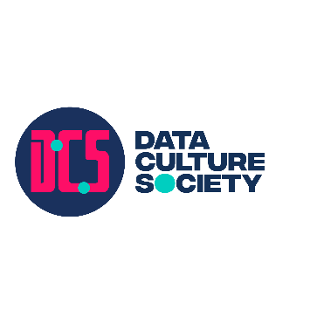

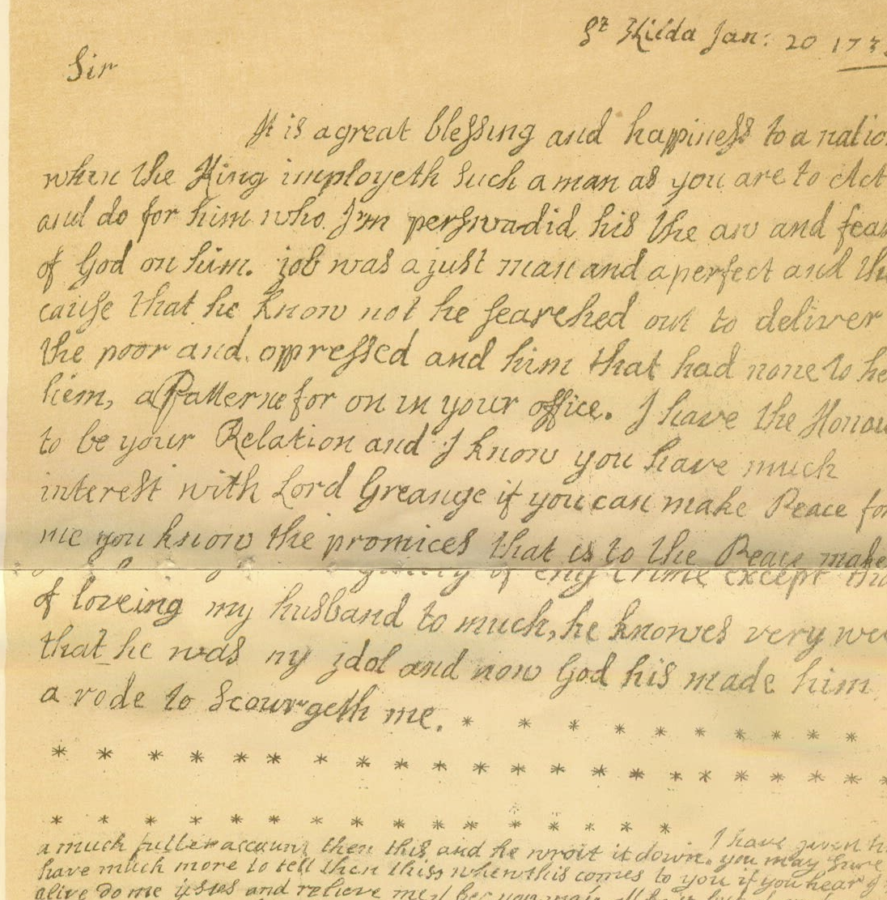


Course Topics
Text Analysis – analysing unstructured data
Python
Regular Expressions
Natural Language Toolkit (NLTK)
www.cdcs.ed.ac.uk
Notes:
Building capacity in the Digital Humanities
The Digital Research Infrastructure for the Arts and Humanities (DARIAH) aims to enhance and support digitally-enabled research and teaching across the arts and humanities. DARIAH is a network of people, expertise, information, knowledge, content, methods, tools and technologies from its member countries. It develops, maintains and operates an infrastructure in support of ICT-based research practices and sustains researchers in using them to build, analyse and interpret digital resources. By working with communities of practice, DARIAH brings together individual state-of-the-art digital arts and humanities activities and scales their results to a European level. It preserves, provides access to and disseminates research that stems from these collaborations and ensures that best practices, methodological and technical standards are followed.

Slide 3
Course Structure
Anticipate about ~7 hours/week
2 hour course meeting, 2-4 Wednesday
1 assignment per week, ~2 hours
Office hours on request
Independent learning, ~2 hours
Teams for introductions, meetings, office hours, questions, files
www.cdcs.ed.ac.uk
Notes:
Building capacity in the Digital Humanities
The Digital Research Infrastructure for the Arts and Humanities (DARIAH) aims to enhance and support digitally-enabled research and teaching across the arts and humanities. DARIAH is a network of people, expertise, information, knowledge, content, methods, tools and technologies from its member countries. It develops, maintains and operates an infrastructure in support of ICT-based research practices and sustains researchers in using them to build, analyse and interpret digital resources. By working with communities of practice, DARIAH brings together individual state-of-the-art digital arts and humanities activities and scales their results to a European level. It preserves, provides access to and disseminates research that stems from these collaborations and ensures that best practices, methodological and technical standards are followed.

Slide 4
INTRODUCTIONS
Why are you interested in text analysis?
Have you used Python before?
Have you used Jupyter Notebooks before?
Have you used Regular Expressions before?
Have you used NLTK before?

Slide 5
Participant Expectations
Wednesday classes are introductions to material
Assignments will be given on Thursday
Classes are not recorded but all class materials will be uploaded to Teams
Please let me know in advance if you cannot attend!
Message me on Teams to schedule office hours for questions
www.cdcs.ed.ac.uk
Notes:
Building capacity in the Digital Humanities
The Digital Research Infrastructure for the Arts and Humanities (DARIAH) aims to enhance and support digitally-enabled research and teaching across the arts and humanities. DARIAH is a network of people, expertise, information, knowledge, content, methods, tools and technologies from its member countries. It develops, maintains and operates an infrastructure in support of ICT-based research practices and sustains researchers in using them to build, analyse and interpret digital resources. By working with communities of practice, DARIAH brings together individual state-of-the-art digital arts and humanities activities and scales their results to a European level. It preserves, provides access to and disseminates research that stems from these collaborations and ensures that best practices, methodological and technical standards are followed.

Slide 6
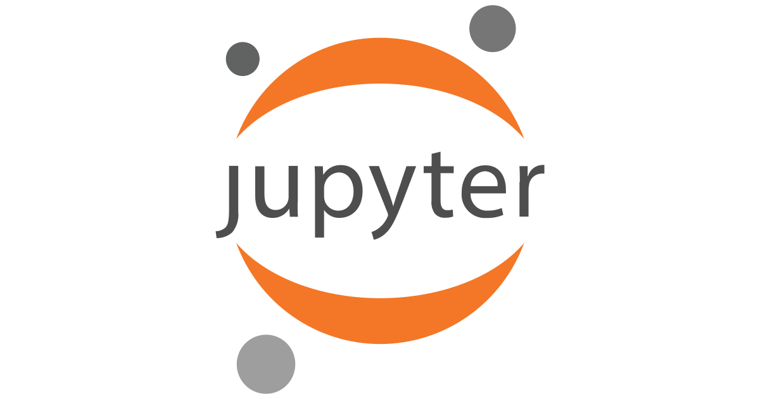
Course Software
Jupyter Notebooks / Jupyterlabs
With Notable https://www.ed.ac.uk/information-services/learning-technology/noteable/accessing-noteable
After logging into MyEd: https://noteable.edina.ac.uk/launch
With Google Colab https://colab.research.google.com
Locally (install with pip/pip3 or conda)
www.cdcs.ed.ac.uk
Notes:
Building capacity in the Digital Humanities
The Digital Research Infrastructure for the Arts and Humanities (DARIAH) aims to enhance and support digitally-enabled research and teaching across the arts and humanities. DARIAH is a network of people, expertise, information, knowledge, content, methods, tools and technologies from its member countries. It develops, maintains and operates an infrastructure in support of ICT-based research practices and sustains researchers in using them to build, analyse and interpret digital resources. By working with communities of practice, DARIAH brings together individual state-of-the-art digital arts and humanities activities and scales their results to a European level. It preserves, provides access to and disseminates research that stems from these collaborations and ensures that best practices, methodological and technical standards are followed.

Slide 7
DEMO 1

Slide 8
Further Resources
Noteable User Guide: https://noteable.edina.ac.uk/user_guide/#hide_ge_7
Jupyter Notebooks in Noteable: https://github.com/edina/Exemplars2020/blob/master/TeachingDocs/Tutorials/UsingNoteableBeginner.ipynb
Jupyter Notebooks: https://glam-workbench.github.io/getting-started/
Python: https://programminghistorian.org/en/lessons/introduction-and-installation
www.cdcs.ed.ac.uk
Notes:
Building capacity in the Digital Humanities
The Digital Research Infrastructure for the Arts and Humanities (DARIAH) aims to enhance and support digitally-enabled research and teaching across the arts and humanities. DARIAH is a network of people, expertise, information, knowledge, content, methods, tools and technologies from its member countries. It develops, maintains and operates an infrastructure in support of ICT-based research practices and sustains researchers in using them to build, analyse and interpret digital resources. By working with communities of practice, DARIAH brings together individual state-of-the-art digital arts and humanities activities and scales their results to a European level. It preserves, provides access to and disseminates research that stems from these collaborations and ensures that best practices, methodological and technical standards are followed.

Slide 9
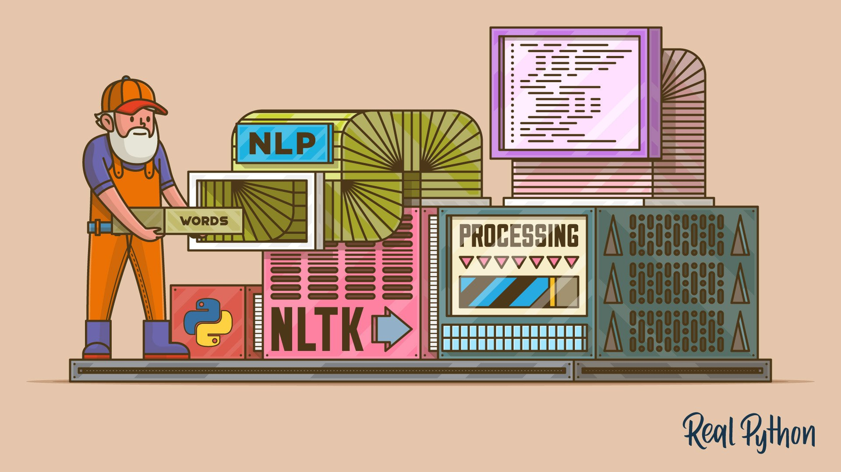
NLTK
Natural Language Toolkit
Natural language = human language
= “unstructured”data
www.cdcs.ed.ac.uk
Notes:
Building capacity in the Digital Humanities
The Digital Research Infrastructure for the Arts and Humanities (DARIAH) aims to enhance and support digitally-enabled research and teaching across the arts and humanities. DARIAH is a network of people, expertise, information, knowledge, content, methods, tools and technologies from its member countries. It develops, maintains and operates an infrastructure in support of ICT-based research practices and sustains researchers in using them to build, analyse and interpret digital resources. By working with communities of practice, DARIAH brings together individual state-of-the-art digital arts and humanities activities and scales their results to a European level. It preserves, provides access to and disseminates research that stems from these collaborations and ensures that best practices, methodological and technical standards are followed.

Slide 10
NLTK
Examples of data sources for natural language:
• Books
• Newspapers
• Magazines
• Websites
• Transcriptions of audio (i.e. interview, movie dialogue)
• Social media
Always read the licensing/copyright information and terms of use!
www.cdcs.ed.ac.uk
Notes:
Building capacity in the Digital Humanities
The Digital Research Infrastructure for the Arts and Humanities (DARIAH) aims to enhance and support digitally-enabled research and teaching across the arts and humanities. DARIAH is a network of people, expertise, information, knowledge, content, methods, tools and technologies from its member countries. It develops, maintains and operates an infrastructure in support of ICT-based research practices and sustains researchers in using them to build, analyse and interpret digital resources. By working with communities of practice, DARIAH brings together individual state-of-the-art digital arts and humanities activities and scales their results to a European level. It preserves, provides access to and disseminates research that stems from these collaborations and ensures that best practices, methodological and technical standards are followed.

Slide 11
Why use NLTK
What kinds of questions can you ask when you can use a programming language to study hundreds, thousands, or even millions of pages of digital text?
“Distant reading”
www.cdcs.ed.ac.uk
Notes:
Building capacity in the Digital Humanities
The Digital Research Infrastructure for the Arts and Humanities (DARIAH) aims to enhance and support digitally-enabled research and teaching across the arts and humanities. DARIAH is a network of people, expertise, information, knowledge, content, methods, tools and technologies from its member countries. It develops, maintains and operates an infrastructure in support of ICT-based research practices and sustains researchers in using them to build, analyse and interpret digital resources. By working with communities of practice, DARIAH brings together individual state-of-the-art digital arts and humanities activities and scales their results to a European level. It preserves, provides access to and disseminates research that stems from these collaborations and ensures that best practices, methodological and technical standards are followed.

Slide 12
Why use NLTK
What kinds of questions can you ask when you can use a programming language to study hundreds, thousands, or even millions of pages of digital text?
“Distant reading”
NLTK Isn’t everything
What kinds of questions can you ask when you can physically hold and look at a printed text, be it an original publication or later edition of the text?
“Close reading”
Book history
www.cdcs.ed.ac.uk
Notes:
Building capacity in the Digital Humanities
The Digital Research Infrastructure for the Arts and Humanities (DARIAH) aims to enhance and support digitally-enabled research and teaching across the arts and humanities. DARIAH is a network of people, expertise, information, knowledge, content, methods, tools and technologies from its member countries. It develops, maintains and operates an infrastructure in support of ICT-based research practices and sustains researchers in using them to build, analyse and interpret digital resources. By working with communities of practice, DARIAH brings together individual state-of-the-art digital arts and humanities activities and scales their results to a European level. It preserves, provides access to and disseminates research that stems from these collaborations and ensures that best practices, methodological and technical standards are followed.

Slide 13
NLTK Terminology
Tokens vs. words
Digitized vs. digital
Normalization (a.k.a. standardization)
Document vs. corpus vs. corpora
www.cdcs.ed.ac.uk
Notes:
Building capacity in the Digital Humanities
The Digital Research Infrastructure for the Arts and Humanities (DARIAH) aims to enhance and support digitally-enabled research and teaching across the arts and humanities. DARIAH is a network of people, expertise, information, knowledge, content, methods, tools and technologies from its member countries. It develops, maintains and operates an infrastructure in support of ICT-based research practices and sustains researchers in using them to build, analyse and interpret digital resources. By working with communities of practice, DARIAH brings together individual state-of-the-art digital arts and humanities activities and scales their results to a European level. It preserves, provides access to and disseminates research that stems from these collaborations and ensures that best practices, methodological and technical standards are followed.

Slide 14
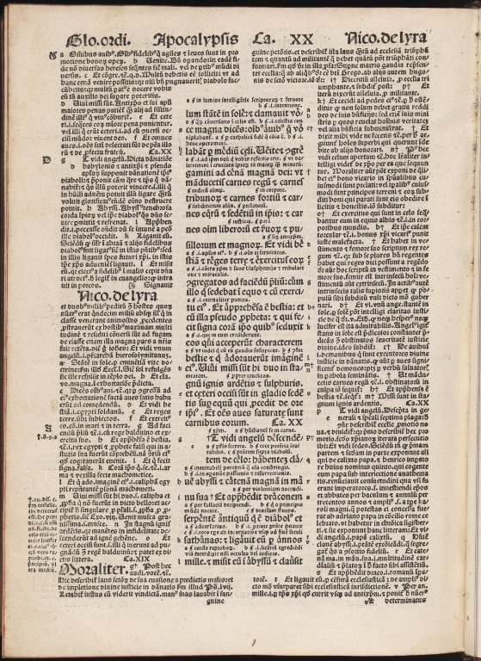
Summarising a Text
Built-in functions include:
len(text)
sorted(vocabulary_of_text)
NLTK Text methods include:
Text.count(word)
Reference: https://www.nltk.org/book/ch01.html
Biblia Sacra by N/A - University of Edinburgh, United Kingdom - CC BY.
https://www.europeana.eu/item/9200261/BibliographicResource_3000058482943
www.cdcs.ed.ac.uk
Notes:
Building capacity in the Digital Humanities
The Digital Research Infrastructure for the Arts and Humanities (DARIAH) aims to enhance and support digitally-enabled research and teaching across the arts and humanities. DARIAH is a network of people, expertise, information, knowledge, content, methods, tools and technologies from its member countries. It develops, maintains and operates an infrastructure in support of ICT-based research practices and sustains researchers in using them to build, analyse and interpret digital resources. By working with communities of practice, DARIAH brings together individual state-of-the-art digital arts and humanities activities and scales their results to a European level. It preserves, provides access to and disseminates research that stems from these collaborations and ensures that best practices, methodological and technical standards are followed.

Slide 15
DEMO 2

Slide 16
Getting to know a text
NLTK Text methods include:
Text.concordance("word", lines=20)
Text.similar("word")
Text.common_contexts(["list", "of", "words"])
Text.dispersion_plot(["list", "of", "words"])
www.cdcs.ed.ac.uk
Notes:
Building capacity in the Digital Humanities
The Digital Research Infrastructure for the Arts and Humanities (DARIAH) aims to enhance and support digitally-enabled research and teaching across the arts and humanities. DARIAH is a network of people, expertise, information, knowledge, content, methods, tools and technologies from its member countries. It develops, maintains and operates an infrastructure in support of ICT-based research practices and sustains researchers in using them to build, analyse and interpret digital resources. By working with communities of practice, DARIAH brings together individual state-of-the-art digital arts and humanities activities and scales their results to a European level. It preserves, provides access to and disseminates research that stems from these collaborations and ensures that best practices, methodological and technical standards are followed.

Slide 17
DEMO 3–5

Slide 18
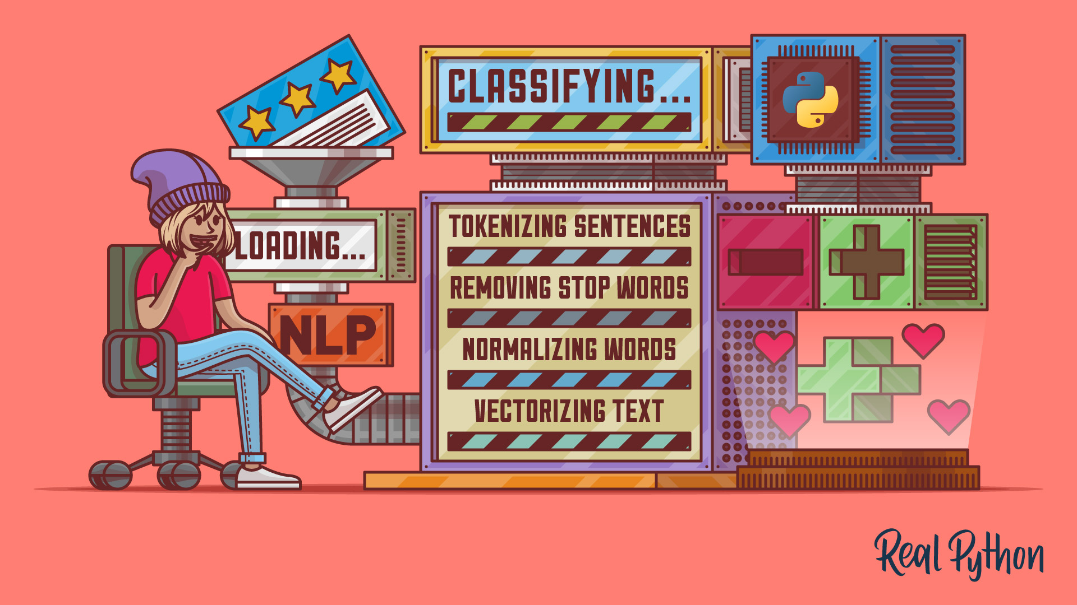
The Building Blocks
Tokenization - words/punctuation, sentences
Normalization
Stemming and lemmatizing
Frequency counts
Part-of-speech tagging
www.cdcs.ed.ac.uk
Notes:
Building capacity in the Digital Humanities
The Digital Research Infrastructure for the Arts and Humanities (DARIAH) aims to enhance and support digitally-enabled research and teaching across the arts and humanities. DARIAH is a network of people, expertise, information, knowledge, content, methods, tools and technologies from its member countries. It develops, maintains and operates an infrastructure in support of ICT-based research practices and sustains researchers in using them to build, analyse and interpret digital resources. By working with communities of practice, DARIAH brings together individual state-of-the-art digital arts and humanities activities and scales their results to a European level. It preserves, provides access to and disseminates research that stems from these collaborations and ensures that best practices, methodological and technical standards are followed.

Slide 19


Tokenisation
Tokenisation involves breaking down a piece of text into smaller units called tokens.
Tokens can be individual words, sentences, or even characters, depending on the level of granularity desired.
Tokenisation helps in standardizing and organizing text data, making it easier to analyse and process.
Word-based tokenisation breaks down text into individual words, treating each word as a separate token.
www.cdcs.ed.ac.uk

Slide 20
Text cleaning & pre-processing
Formatting text for analysis and removing extraneous informationWorkflows vary depending on research objective, field, and dataset
Common steps include standardising capitalisation, removing URLs and symbols, stopword removal, tokenisation, stemming, and lemmatization
Stopwords include words like “a,” “the,” “of,” “an” that don’t add meaning to the dataset
www.cdcs.ed.ac.uk

Slide 21
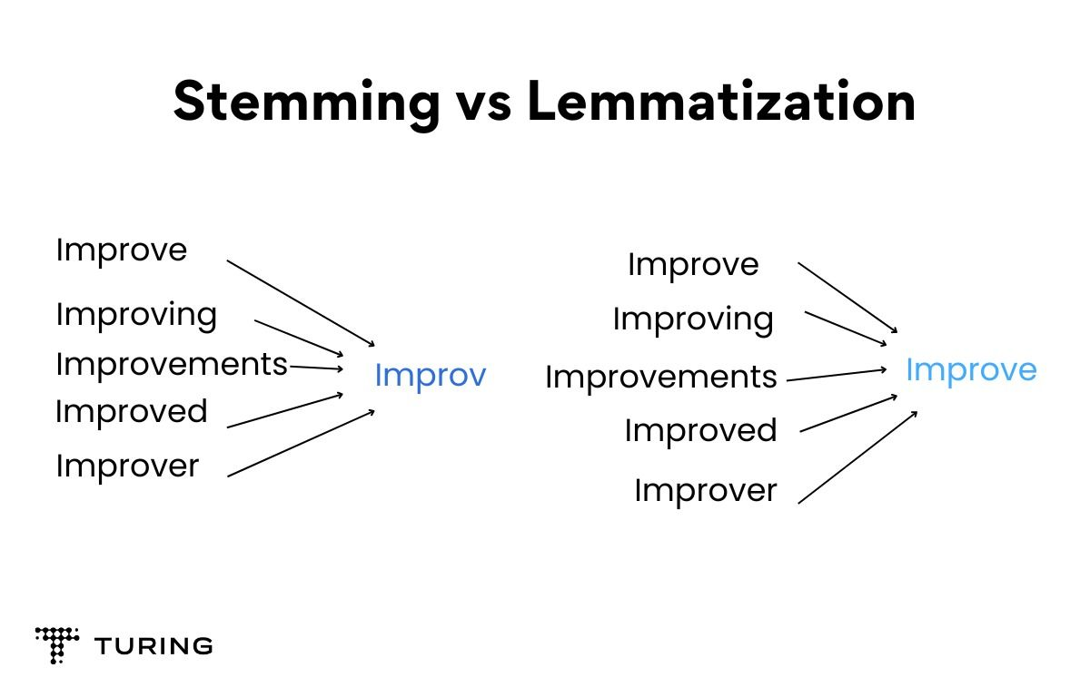
Stemming & Lemmatization
www.cdcs.ed.ac.uk

Slide 22
DEMO 6 & 7

Slide 23
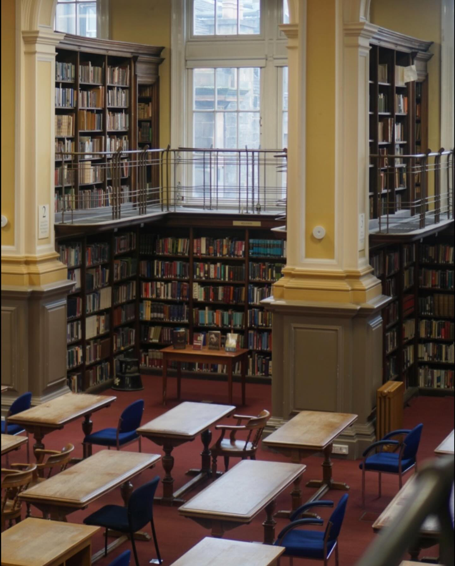
Finding Text Sources
Libraries - NLS Data Foundry (data.nls.uk)
Project Gutenberg (gutenberg.org)
Hathi Trust Digital Library (hathitrust.org)
Websites - Internet Archive (archive.org)'s Wayback Machine, UK Web
archive (webarchive.org.uk)
Newspaper archives (universities often subscribe to them!)
www.cdcs.ed.ac.uk
Notes:
Building capacity in the Digital Humanities
The Digital Research Infrastructure for the Arts and Humanities (DARIAH) aims to enhance and support digitally-enabled research and teaching across the arts and humanities. DARIAH is a network of people, expertise, information, knowledge, content, methods, tools and technologies from its member countries. It develops, maintains and operates an infrastructure in support of ICT-based research practices and sustains researchers in using them to build, analyse and interpret digital resources. By working with communities of practice, DARIAH brings together individual state-of-the-art digital arts and humanities activities and scales their results to a European level. It preserves, provides access to and disseminates research that stems from these collaborations and ensures that best practices, methodological and technical standards are followed.

Slide 24
Research with NLTK
Who is named in a text?
What places are named in a text?
Chunking and Named Entity Recognition
How does the vocabulary of an author change over time?
Lexical Diversity
www.cdcs.ed.ac.uk
Notes:
Building capacity in the Digital Humanities
The Digital Research Infrastructure for the Arts and Humanities (DARIAH) aims to enhance and support digitally-enabled research and teaching across the arts and humanities. DARIAH is a network of people, expertise, information, knowledge, content, methods, tools and technologies from its member countries. It develops, maintains and operates an infrastructure in support of ICT-based research practices and sustains researchers in using them to build, analyse and interpret digital resources. By working with communities of practice, DARIAH brings together individual state-of-the-art digital arts and humanities activities and scales their results to a European level. It preserves, provides access to and disseminates research that stems from these collaborations and ensures that best practices, methodological and technical standards are followed.

Slide 25
Research with NLTK
What are the common themes throughout a corpus?
Topic Modeling
What attitudes are expressed in a corpus?
Sentiment Analysis
What words occur near each other throughout a corpus? How does the meaning of a word change over time?
Word Embeddings
www.cdcs.ed.ac.uk
Notes:
Building capacity in the Digital Humanities
The Digital Research Infrastructure for the Arts and Humanities (DARIAH) aims to enhance and support digitally-enabled research and teaching across the arts and humanities. DARIAH is a network of people, expertise, information, knowledge, content, methods, tools and technologies from its member countries. It develops, maintains and operates an infrastructure in support of ICT-based research practices and sustains researchers in using them to build, analyse and interpret digital resources. By working with communities of practice, DARIAH brings together individual state-of-the-art digital arts and humanities activities and scales their results to a European level. It preserves, provides access to and disseminates research that stems from these collaborations and ensures that best practices, methodological and technical standards are followed.

Slide 26
Next Week
Research with NLTK on a corpus
NLTK with pandas (for tabular data)
NLTK with Altair (for data visualization)
Regular Expression practice
Cleaning messy text
Resources for more text analysis practice
www.cdcs.ed.ac.uk
Notes:
Building capacity in the Digital Humanities
The Digital Research Infrastructure for the Arts and Humanities (DARIAH) aims to enhance and support digitally-enabled research and teaching across the arts and humanities. DARIAH is a network of people, expertise, information, knowledge, content, methods, tools and technologies from its member countries. It develops, maintains and operates an infrastructure in support of ICT-based research practices and sustains researchers in using them to build, analyse and interpret digital resources. By working with communities of practice, DARIAH brings together individual state-of-the-art digital arts and humanities activities and scales their results to a European level. It preserves, provides access to and disseminates research that stems from these collaborations and ensures that best practices, methodological and technical standards are followed.

Slide 27
Further Resources from CDCS
• Digital Method of the Month on Text Analysis
• Training Pathway for Text Analysis
www.cdcs.ed.ac.uk
Notes:
Building capacity in the Digital Humanities
The Digital Research Infrastructure for the Arts and Humanities (DARIAH) aims to enhance and support digitally-enabled research and teaching across the arts and humanities. DARIAH is a network of people, expertise, information, knowledge, content, methods, tools and technologies from its member countries. It develops, maintains and operates an infrastructure in support of ICT-based research practices and sustains researchers in using them to build, analyse and interpret digital resources. By working with communities of practice, DARIAH brings together individual state-of-the-art digital arts and humanities activities and scales their results to a European level. It preserves, provides access to and disseminates research that stems from these collaborations and ensures that best practices, methodological and technical standards are followed.

Slide 28
Thanks Everyone!
Next class: Wednesday 19th, 2-4PM
Please message me on Teams for office hours!

