Slide 1

12th–19th February 2025 Centre for Data, Culture & Society
INTRODUCTION TO TEXT
ANALYSIS WITH PYTHON
Instructor: Xandra Dave Cochran

Slide 2
Course Structure
Anticipate about ~7 hours/week
2 hour course meeting, 2-4 Wednesday
1 assignment per week, ~2 hours
Office hours on request
Independent learning, ~2 hours
Teams for introductions, meetings, office hours, questions, files

Slide 3

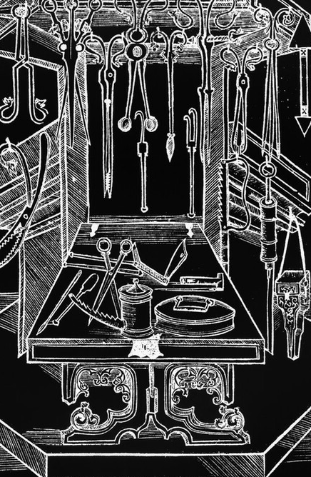
Course Topics
Text Analysis – analysing unstructured data
Python
Regular Expressions
Natural Language Toolkit (NLTK)

Slide 4
INTRODUCTIONS
Why are you interested in text analysis?
Have you used Python before?
Have you used Jupyter Notebooks before?
Have you used Regular Expressions before?
Have you used NLTK before?

Slide 5
Participant Expectations
Wednesday classes are introductions to material
Assignments will be given on Thursday
Classes are not recorded but all class materials will be uploaded to Teams
Please let me know in advance if you cannot attend!
Message me on Teams to schedule office hours for questions

Slide 6
Course Software
Jupyter Notebooks / Jupyterlabs
• With Notable
https://www.ed.ac.uk/information-services/learning-technology/
noteable/accessing-noteable
After logging into MyEd: https://noteable.edina.ac.uk/launch
• With Google Colab
https://colab.research.google.com
• Locally (install with pip/pip3 or conda)

Slide 7
DEMO

Slide 8
Further Resources
Noteable User Guide
https://noteable.edina.ac.uk/user_guide/#hide_ge_7
Jupyter Notebooks in Noteable
https://github.com/edina/Exemplars2020/blob/master/TeachingDocs/Tutorials/UsingNoteableBeginner.ipynb
Jupyter Notebooks
https://glam-workbench.github.io/getting-started/
Python
https://programminghistorian.org/en/lessons/introduction-and-installation

Slide 9
NLTK
Natural Language Toolkit
Natural language = human language = “unstructured”data

Slide 10
NLTK
Examples of data sources for natural language:
• Books
• Newspapers
• Magazines
• Websites
• Transcriptions of audio (i.e. interview, movie dialogue)
• Social media
Always read the licensing/copyright information and terms of use!

Slide 11
Why use NLTK?
What kinds of questions can you ask when you can use a programming language to study hundreds, thousands, or even millions of pages of digital text?
“Distant reading”

Slide 12
NLTK isn’t everything
What kinds of questions can you ask when you can physically hold and look at a printed text, be it an original publication or later edition of the text?
“Close reading”
Book history

Slide 13
NLTK Terminology
Tokens vs. words
Digitized vs. digital
Normalization (a.k.a. standardization)
Document vs. corpus vs. corpora

Slide 14
Summarizing a Text
Built-in functions include:
len(text)
sorted(vocabulary_of_text)
NLTK Text methods include:
Text.count(word)
Reference:
https://www.nltk.org/book/ch01.html

Slide 15
DEMO

Slide 16
Getting to know a text
NLTK Text methods include:
Text.concordance(“word”, lines=20)
Text.similar(“word”)
Text.common_contexts([“list”, “of”, “words”])
Text.dispersion_plot([“list”, “of”, “words”])
Reference: https://www.nltk.org/book/ch01.html

Slide 17
DEMO

Slide 18
The Building Blocks
Tokenization - words/punctuation, sentences
Normalization
Stemming and lemmatizing
Frequency counts
Part-of-speech tagging

Slide 19
DEMO

Slide 20
Finding Text Sources
Libraries - NLS Data Foundry (data.nls.uk)
Project Gutenberg (gutenberg.org)
Hathi Trust Digital Library (hathitrust.org)
Websites - Internet Archive (archive.org)'s Wayback Machine, UK Web
archive (webarchive.org.uk)
Newspaper archives (universities often subscribe to them!)

Slide 21
Research with NLTK
Who is named in a text?
What places are named in a text?
Chunking and Named Entity Recognition
How does the vocabulary of an author change over time?
Lexical Diversity

Slide 22
Research with NLTK
Who is named in a text?
What are the common themes throughout a corpus?
Topic Modeling
What attitudes are expressed in a corpus?
Sentiment Analysis
What words occur near each other throughout a corpus? How does the meaning of a word change over time?
Word Embeddings

Slide 23
Next Week
Research with NLTK on a corpus
NLTK with pandas (for tabular data)
NLTK with Altair (for data visualization)
Regular Expression practice
Cleaning messy text
Resources for more text analysis practice

Slide 24
Further Resources
CDCS
• Digital Method of the Month on Text Analysis
• Training Pathway for Text Analysis

Slide 25
Thanks Everyone!
Next class: Wednesday 19th, 2-4PM
Please message me on Teams for office hours!

