Slide 1
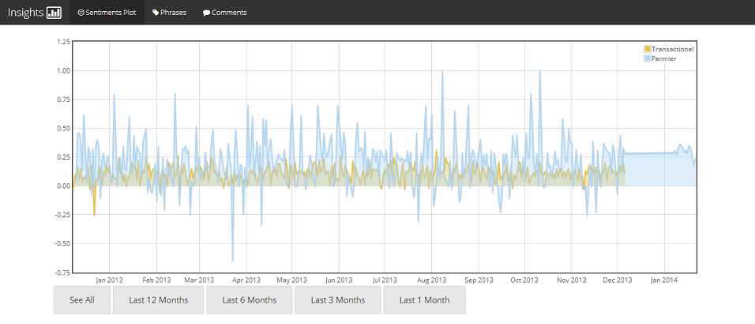
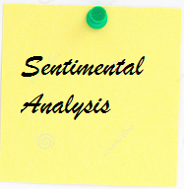

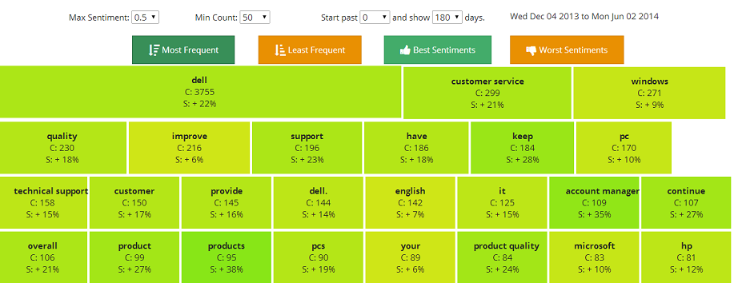

Slide 2
PRESENT SCENARIO
Python
WORKING SCENARIO
Python
FAVOURED END STAGE
IronPython/.NET Frame Work
Ported NLTK (Iron Python)
NLTK
NLTK
Dell-Specific Custom Sentimental Analyzer
Custom Sentimental Analyzer
TextBlob

