Slide 1
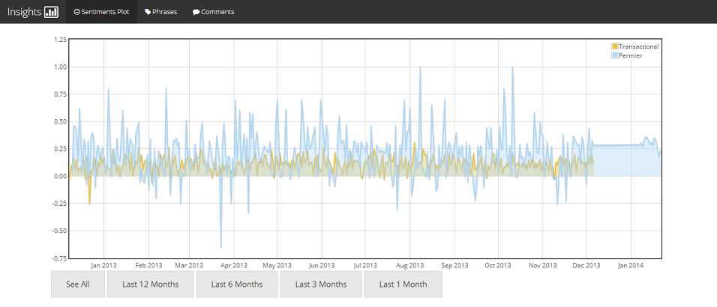
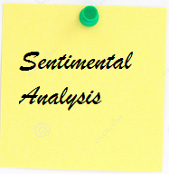

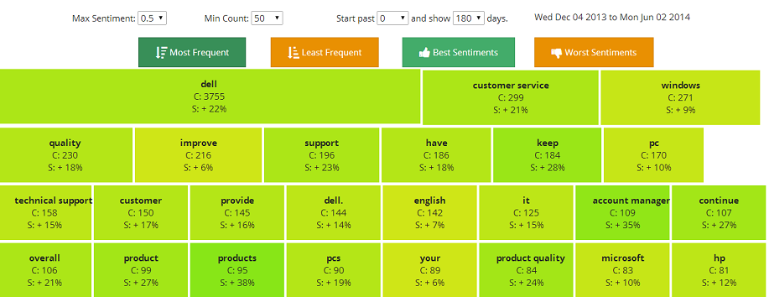

Slide 2
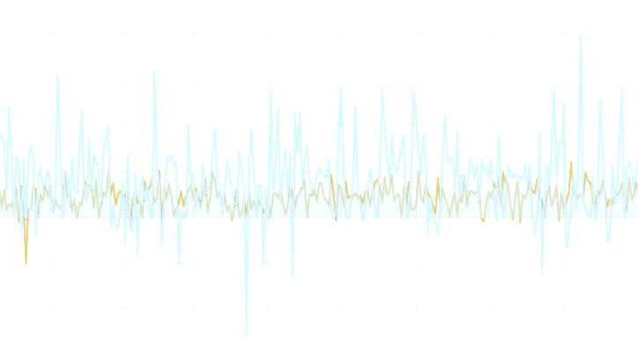
Present Situation
- Built upon Python, NLTK, Text blob.
Sentimental analysis is implicit one in Text blob – provides accuracy of 50%.
Phrase extraction is implicit – not specific.
Proposed Changes
Utilize Iron Python, import NLTK.
Utilize Custom Sentiment Analyzer – lighter, better accuracy.
Phrase extraction made DELL specific.
Improving Accuracy and Adding Features
Get familiar with Tools and Language
Documentation and Design
Coding and Testing
May26 June5 June20 July19

