Slide 1
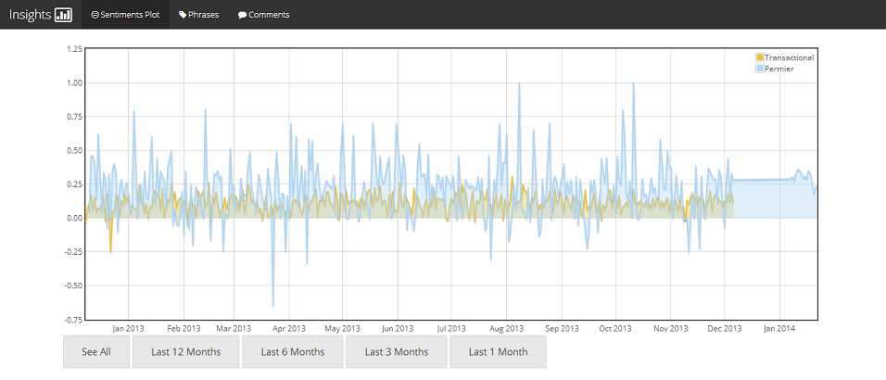
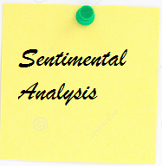
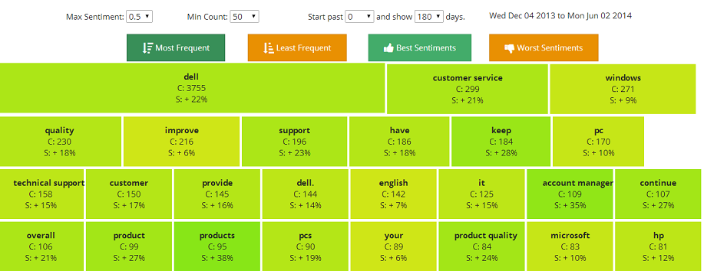
Sentimental Analysis
(a computational study of opinions)
An attempt to analyze posts/survey data coming in and generate easily interpretable representation (graphs/heat maps) on products, quality of service etc.
The amount of feedback/survey data generated is voluminous and manually going through comments to generate opinion data is time-consuming. Sentiment Analysis automates this entire process providing valuable information on area of improvement, quality of service and product acceptance.

Slide 2
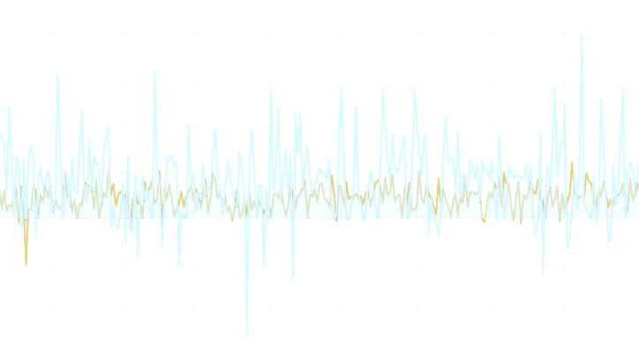
Present Situation
- Built upon Python, NLTK, Text blob.
Sentimental analysis is implicit one in Text blob – provides accuracy of 50%.
Phrase extraction is implicit – not specific.
Proposed Changes
Utilize Iron Python, import NLTK.
Utilize Custom Sentiment Analyzer – lighter, better accuracy.
Phrase extraction made DELL specific.
Improving Accuracy and Adding Features
Get familiar with Tools and Language
Documentation and Design
Coding and Testing
May26 June5 June20 July19

