Slide 1
Superstore Business Intelligence Final Project
SQL Server | SSIS | SSAS | Power BI | Excel | MDX | Data Mining
Course: Intelligent Decision Support Systems
Practice Instructor: Nguyễn Thị Kim Phụng
One main database: SuperstoreDW
Star schema centered on FactSales
Validated data mining rules
Student: Võ Thành Danh - 22520201
Class: MSIS4263.Q21.CTTT

Slide 2
End-to-End BI Architecture
The submission pipeline loads CSV data into SuperstoreDW and then publishes analytical models.
CSV Source Sample - Superstore.csv
SSIS Landing SuperstoreDW.dbo.stg_Orders
Star Schema FactSales + Dimensions
Semantic Layer SSAS Cube / Power BI
Consumption Excel, MDX, Dashboards, Mining
The internal landing table is located inside SuperstoreDW; no separate staging database is used.
FactSales stores measurable order-line events and connects to all dimensions through surrogate keys.
SSAS, Power BI, Excel, and MDX consume the curated analytical layer rather than raw landing data.
Superstore BI Final Project | 2

Slide 3
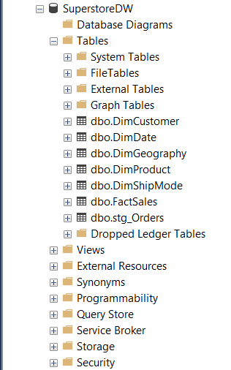
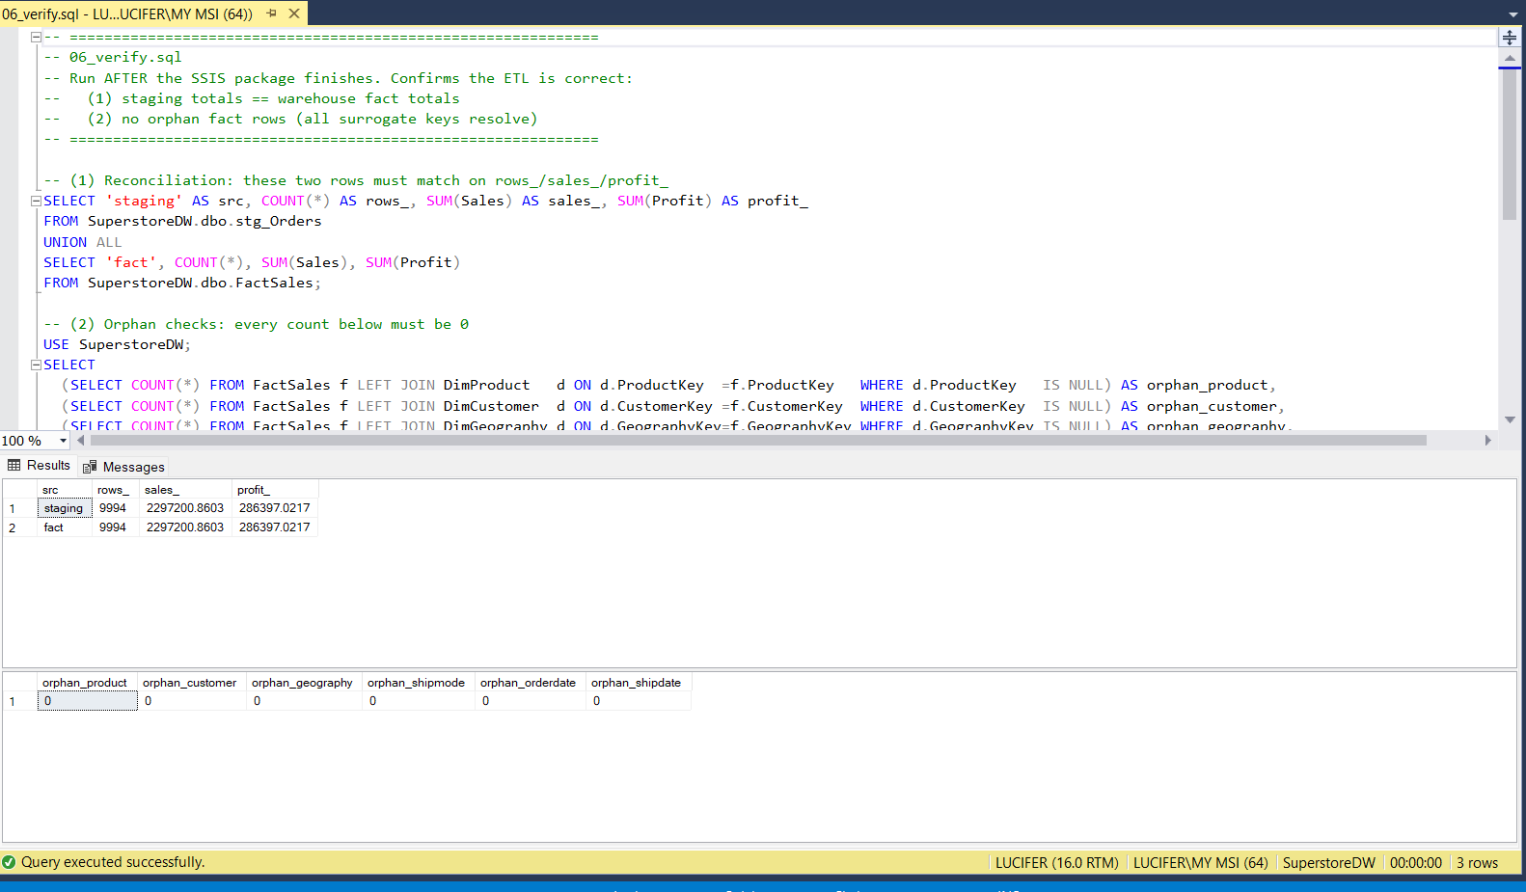
SQL Server: One-Database Warehouse Design
Evidence that the main submission database is SuperstoreDW.
dbo.stg_Orders is an internal landing table for raw CSV rows.
FactSales contains the analytical measures: Sales, Quantity, Discount, Profit, and DeliveryDays.
Verification confirms row-count and measure reconciliation between landing and fact tables.
Superstore BI Final Project | 3

Slide 4
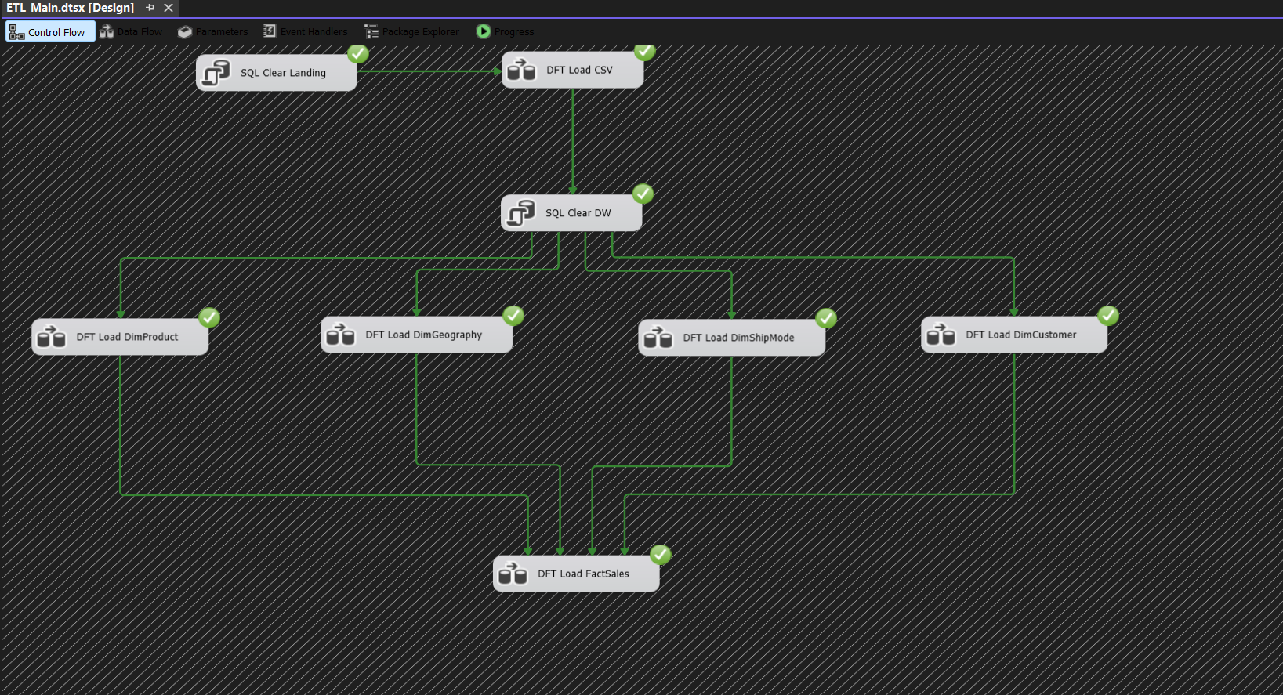
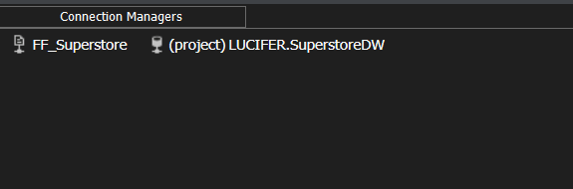
SSIS Main Package: Repeatable ETL Pipeline
ETL_Main.dtsx is the main submission package; ETL_DirectCSV.dtsx is demo-only.
CSV is loaded into SuperstoreDW.
Only the SuperstoreDW project connection is used for the main pipeline.
The flow loads landing, dimensions, and FactSales in dependency order.
Superstore BI Final Project | 4

Slide 5
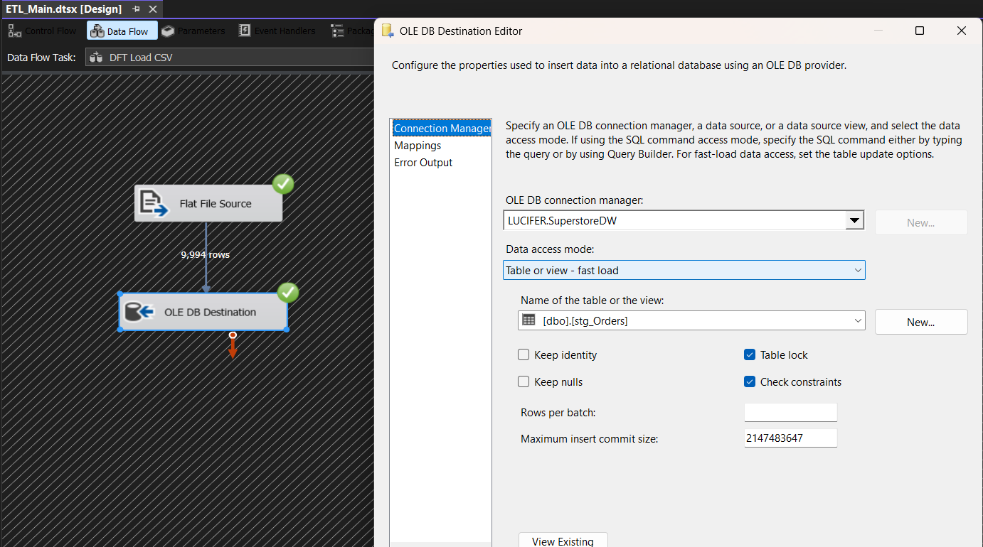
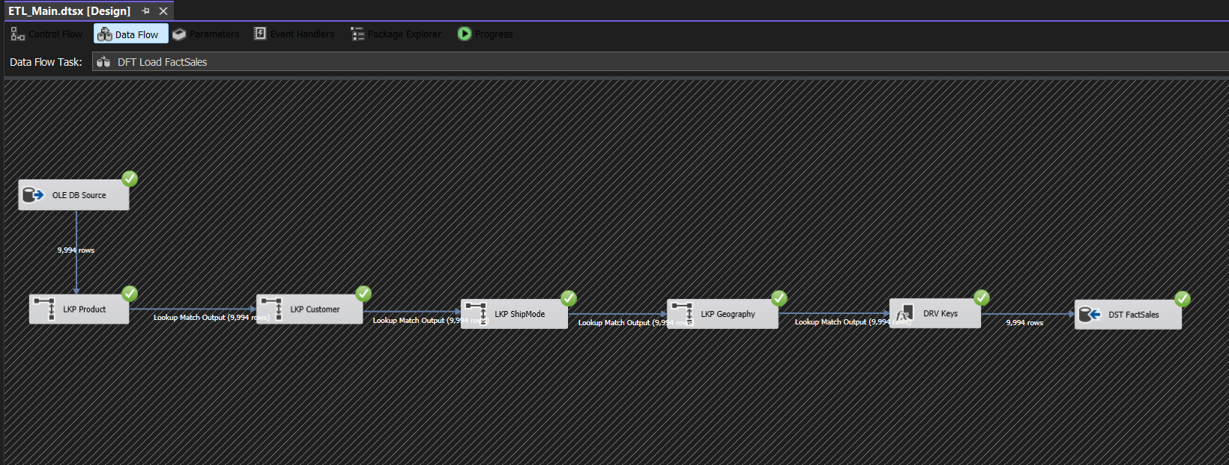
SSIS Data Flows: Landing and Fact Loading
The design separates raw landing from the analytical fact table.
CSV to internal landing table: SuperstoreDW.dbo.stg_Orders
Fact load resolves surrogate keys and writes analytical measures to FactSales
Superstore BI Final Project | 5

Slide 6
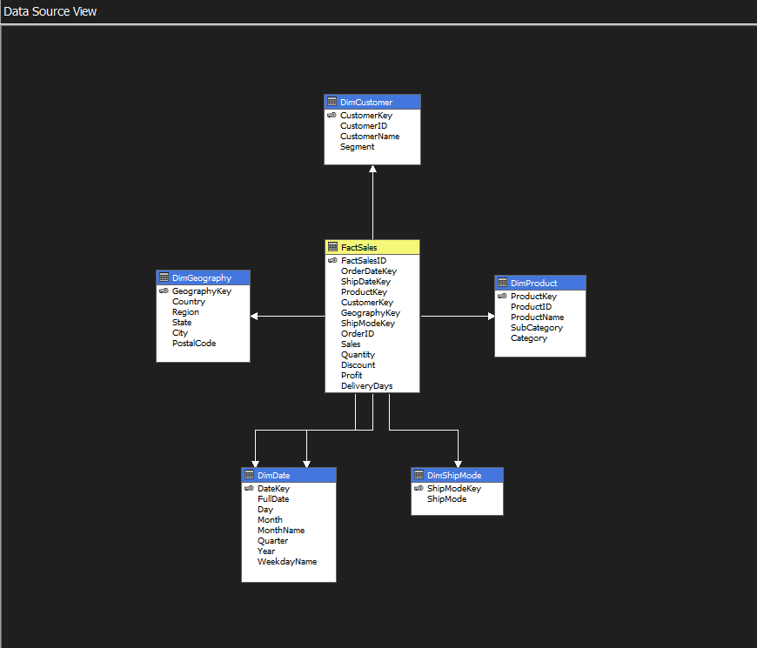
FactSales: Central Analytical Fact Table
FactSales is not a temporary table; it is the measurable core of the star schema.
FactSales stores order-line measures: Sales, Quantity, Discount, Profit, and DeliveryDays.
Dimensions answer analytical context: by product, customer, geography, date, and ship mode.
Measures should not be stored inside dimensions, because that would reduce flexibility and may cause double counting.
SSAS and Power BI both follow the same star-schema model.
Superstore BI Final Project | 6

Slide 7
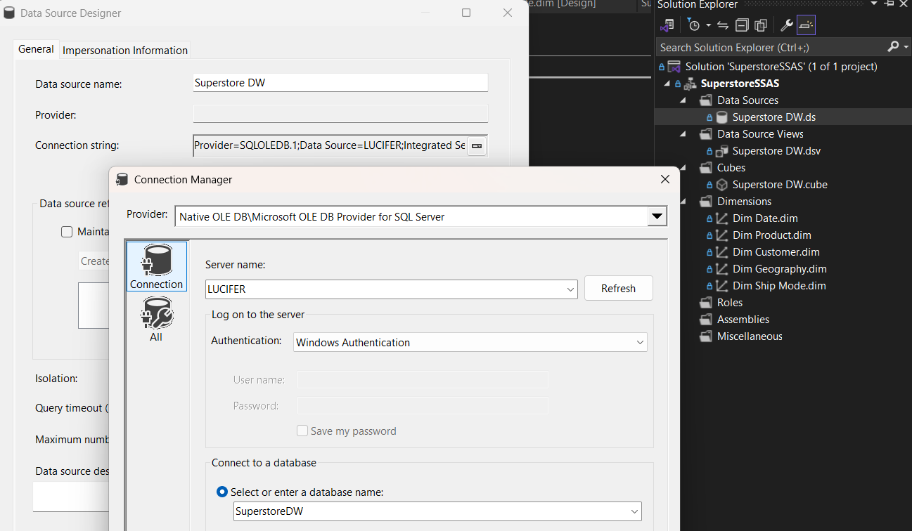
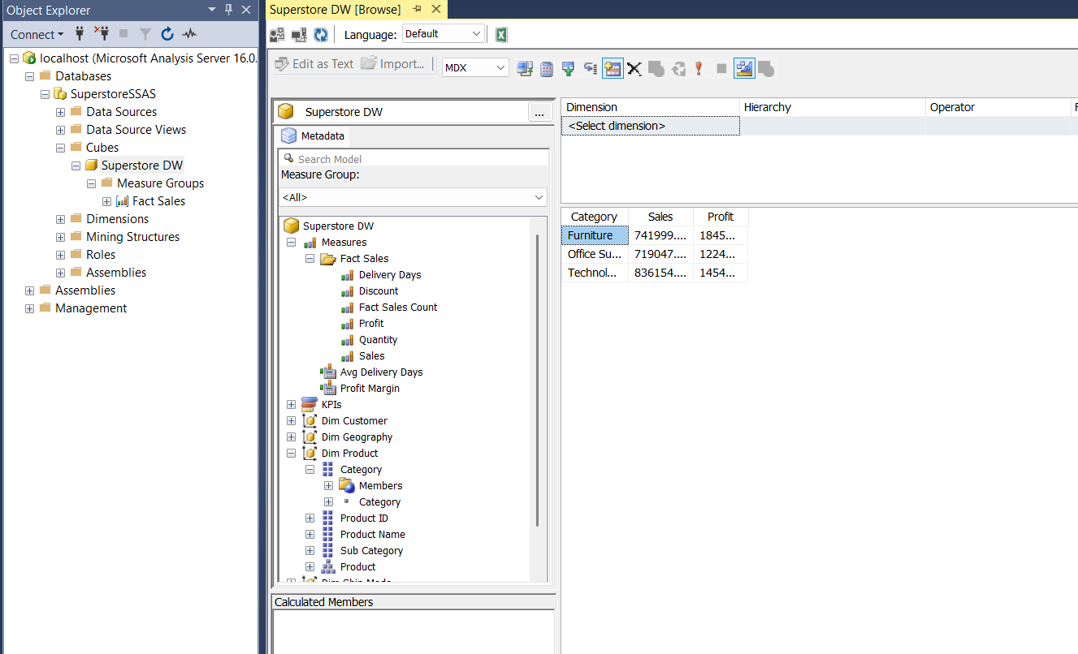
SSAS Cube: Curated Analytical Layer
The cube is deployed from SuperstoreDW and excludes the internal landing table.
The SSAS data source points to SuperstoreDW.
The Data Source View uses FactSales and five dimensions.
Cube browsing confirms Sales and Profit can be aggregated by Product Category.
This layer supports MDX, Excel PivotTables, and cube browsing.
Superstore BI Final Project | 7

Slide 8
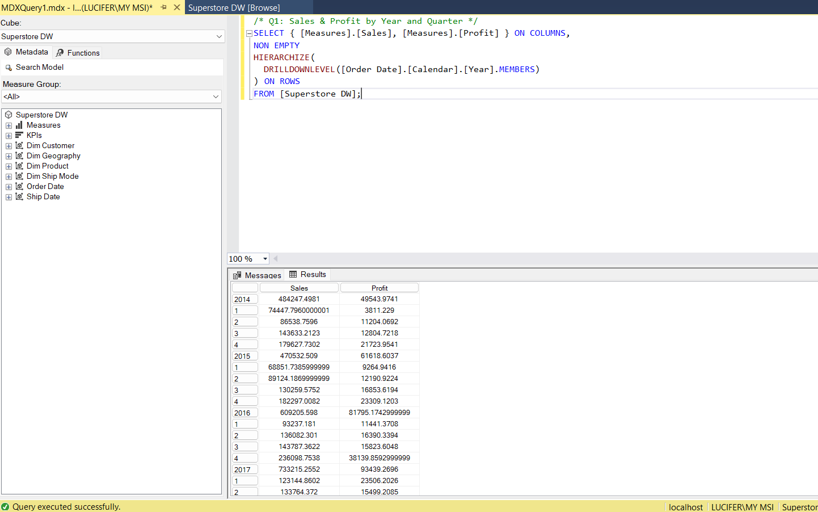
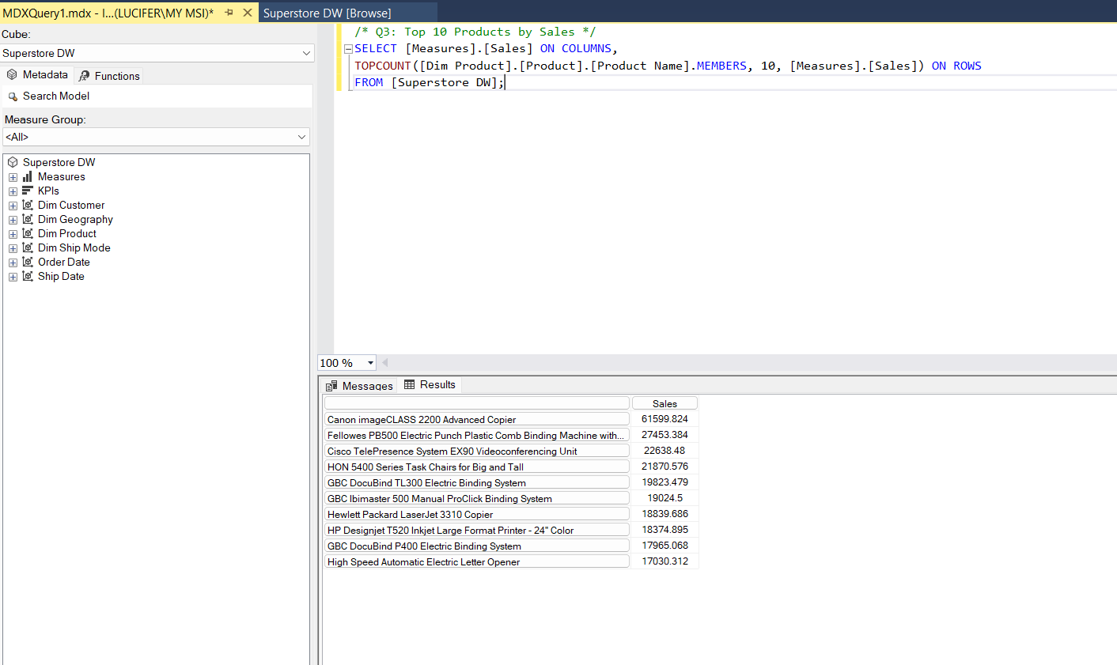
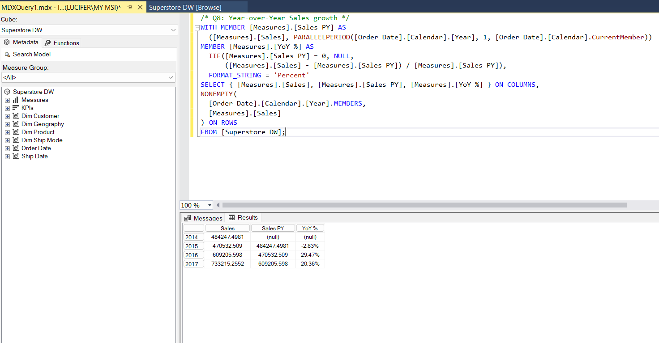
MDX Analysis: Analytical Queries on the Cube
MDX validates cube usability and demonstrates OLAP-style analysis.
Q1: Sales and Profit by Year/Quarter
Q3: TOPCOUNT for Top 10 Products
Q8: Year-over-Year growth using PARALLELPERIOD
Superstore BI Final Project | 8

Slide 9
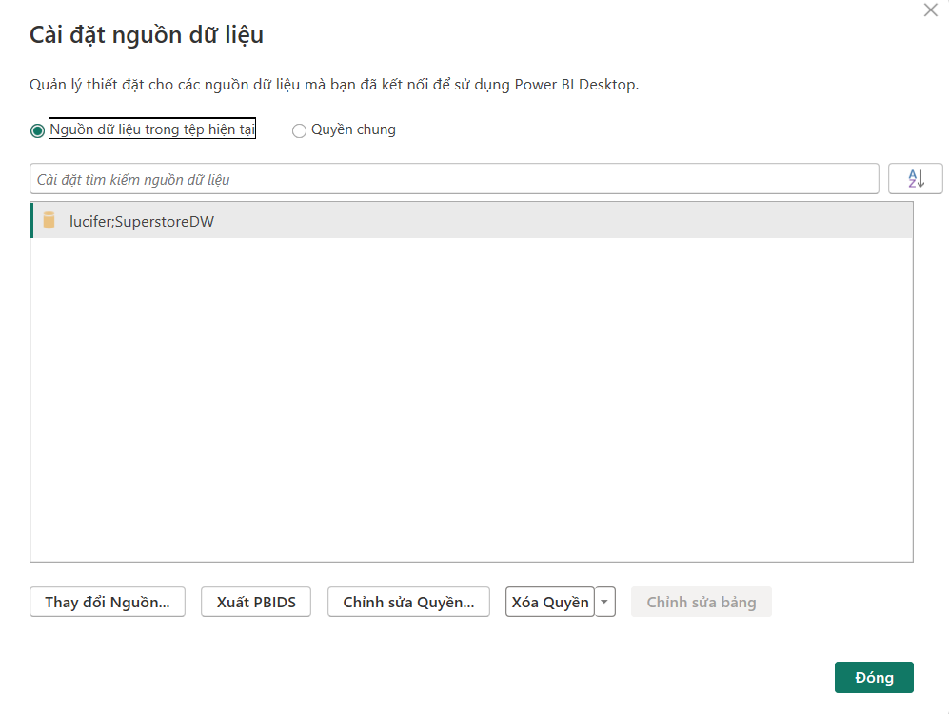
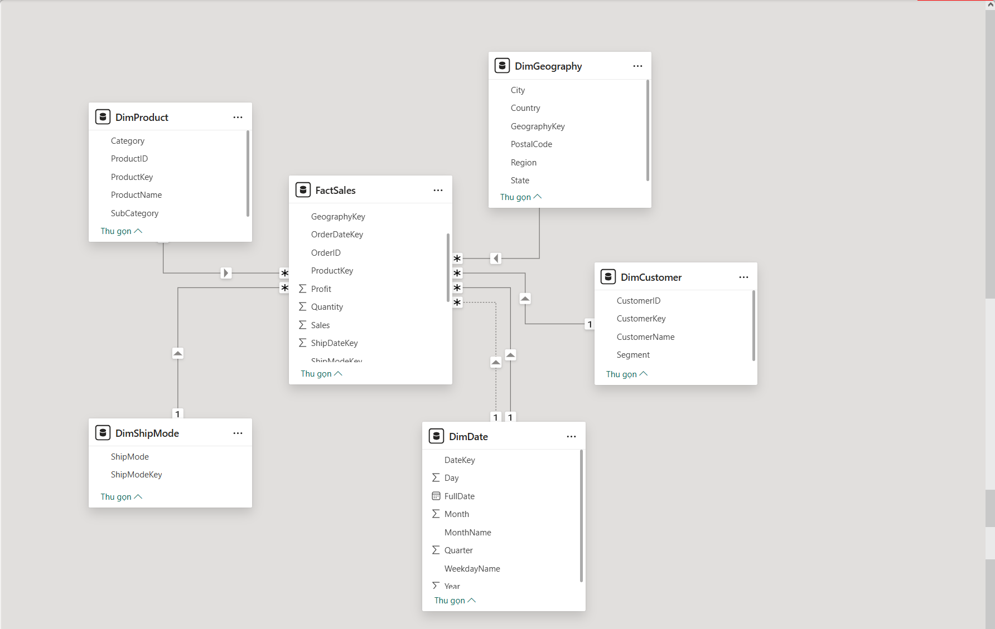
Power BI Semantic Model
Power BI consumes SuperstoreDW analytical tables and preserves the warehouse star schema.
Source: SuperstoreDW.
FactSales is the central many-side table.
Dimension tables filter and slice the measures.
Superstore BI Final Project | 9

Slide 10
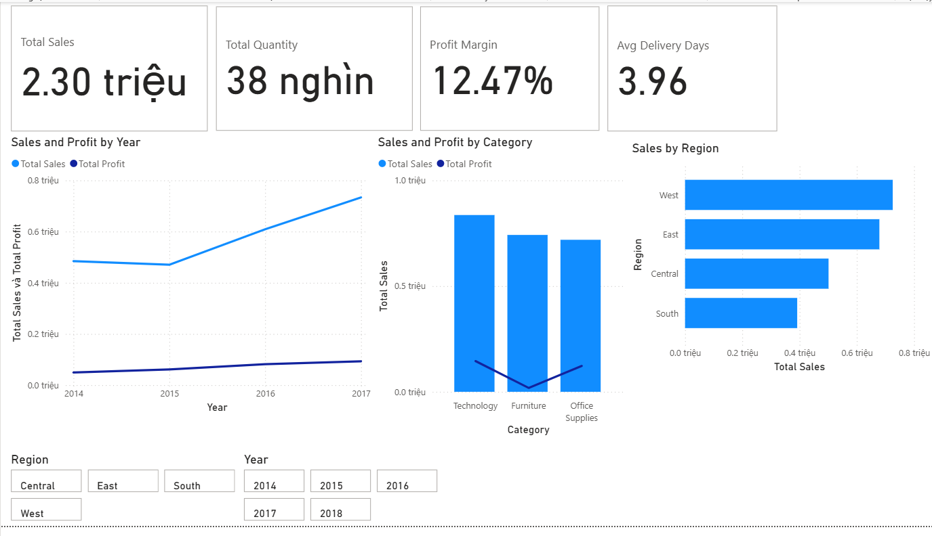
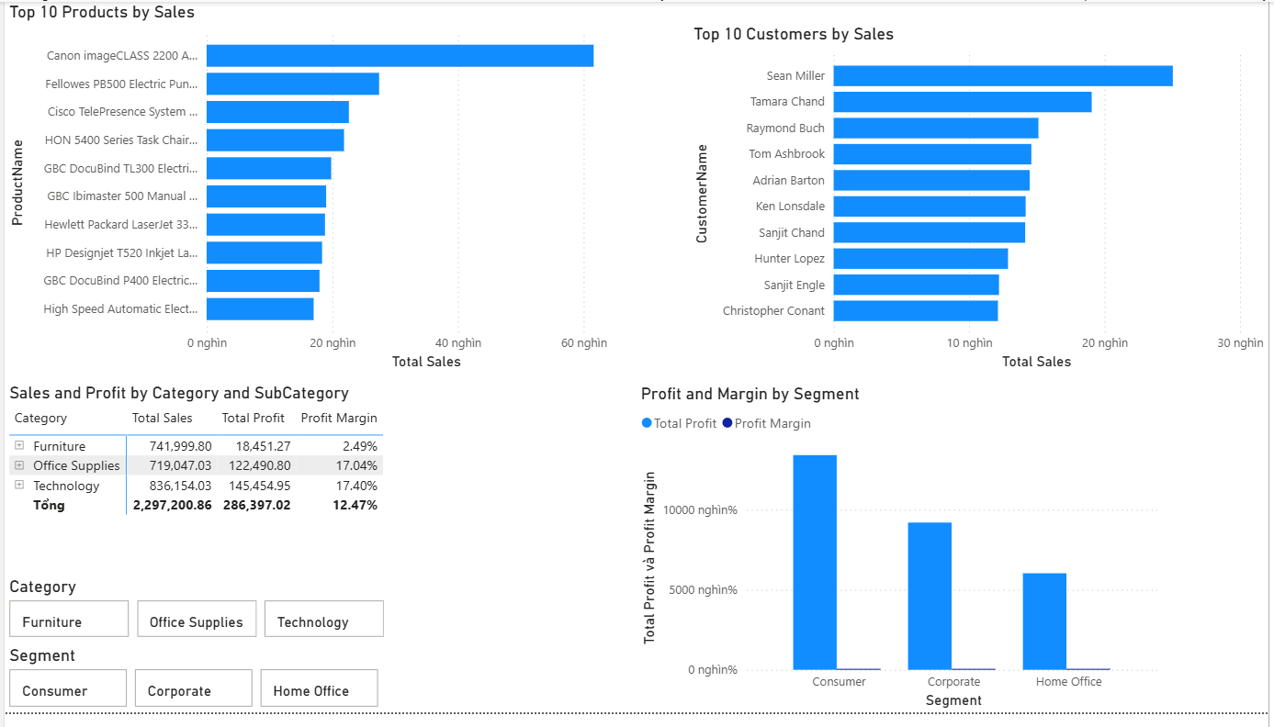
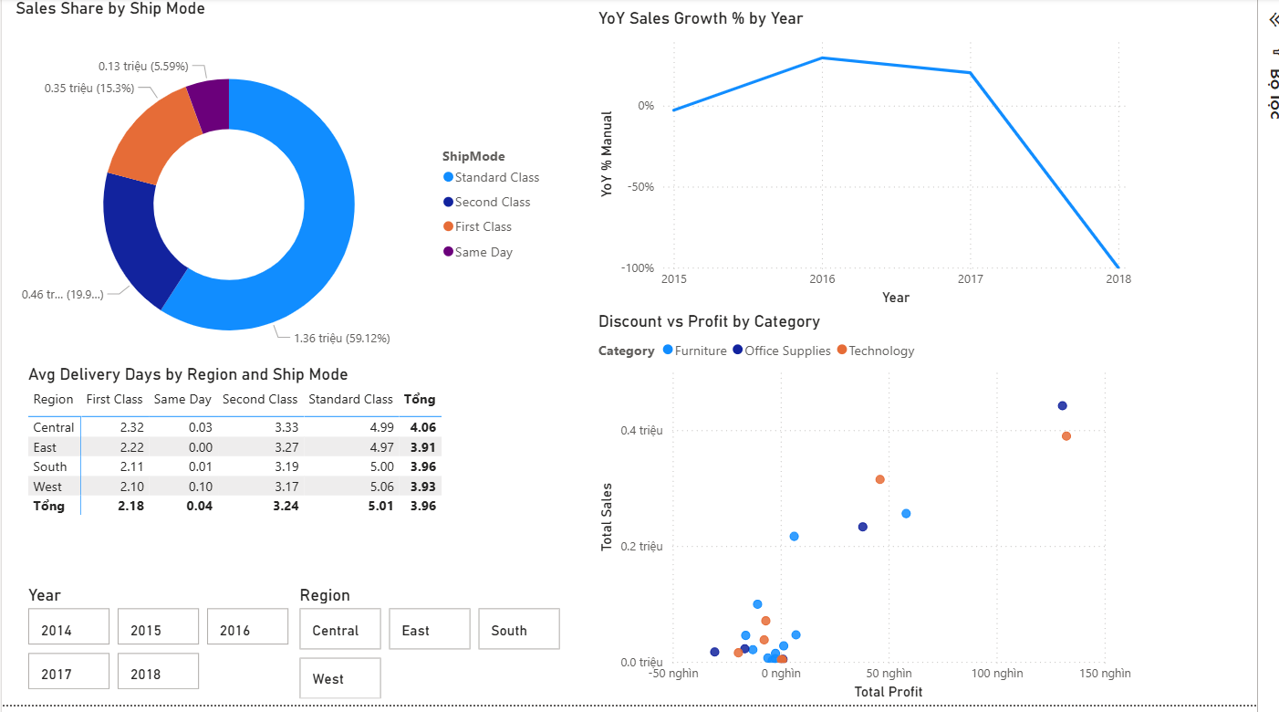
Power BI Reporting Pages
Dashboards translate warehouse measures into business-facing insights.
Overview KPIs and trends
Product and customer analysis
Shipping and geography analysis
Superstore BI Final Project | 10

Slide 11
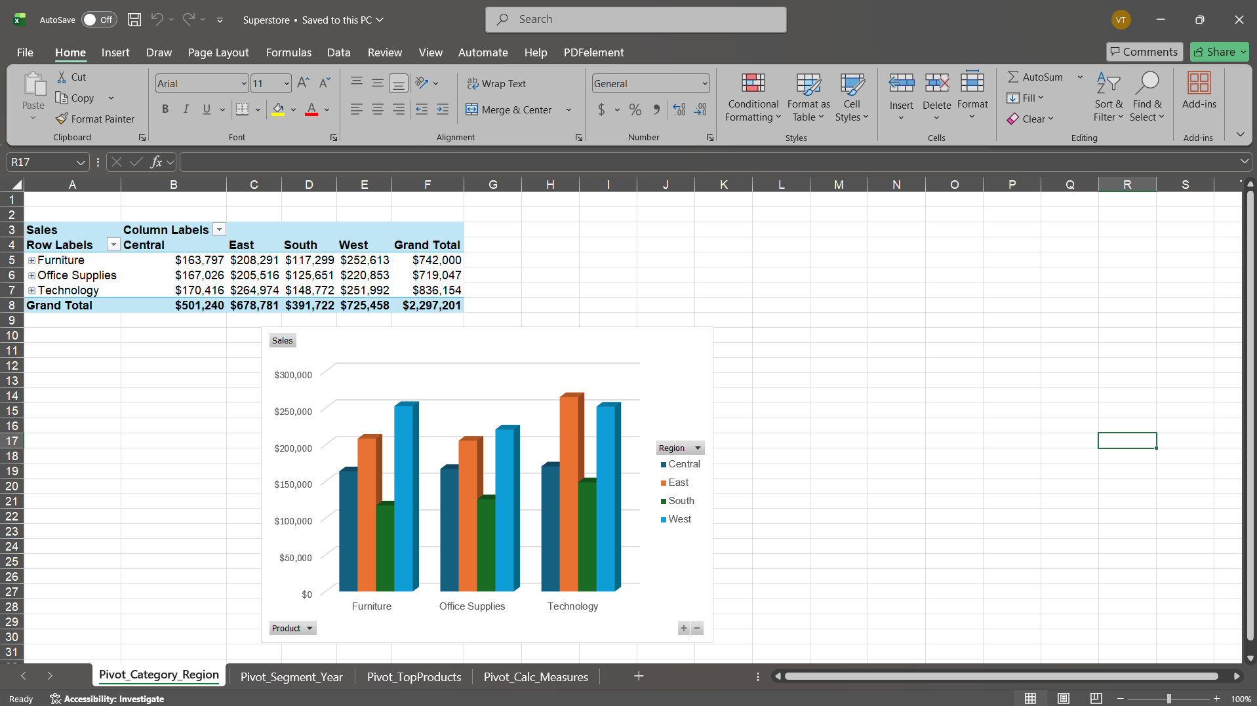
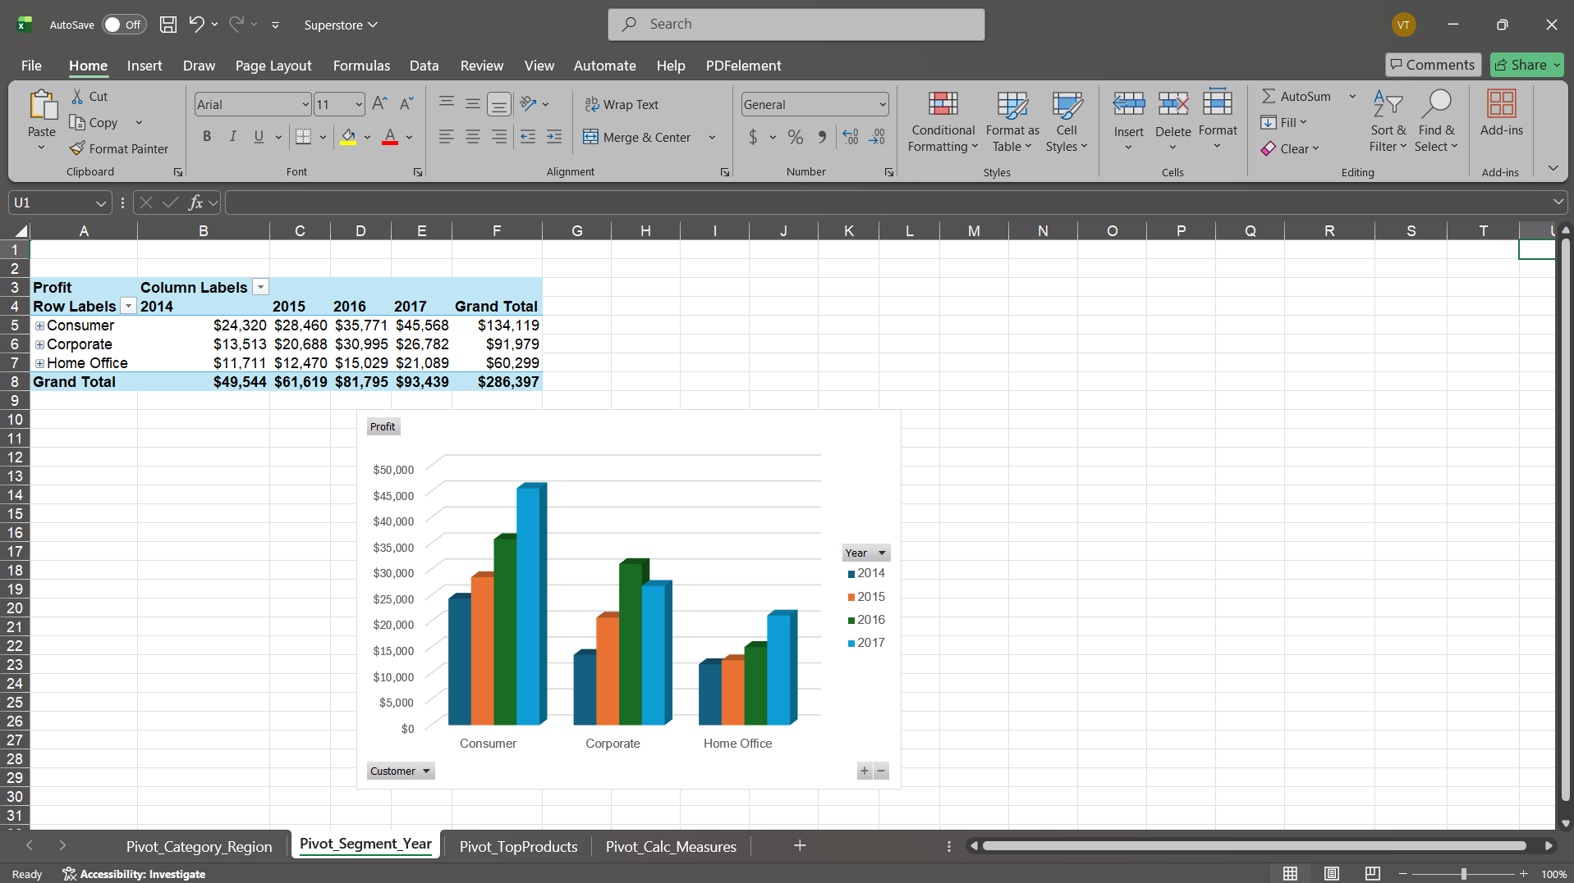
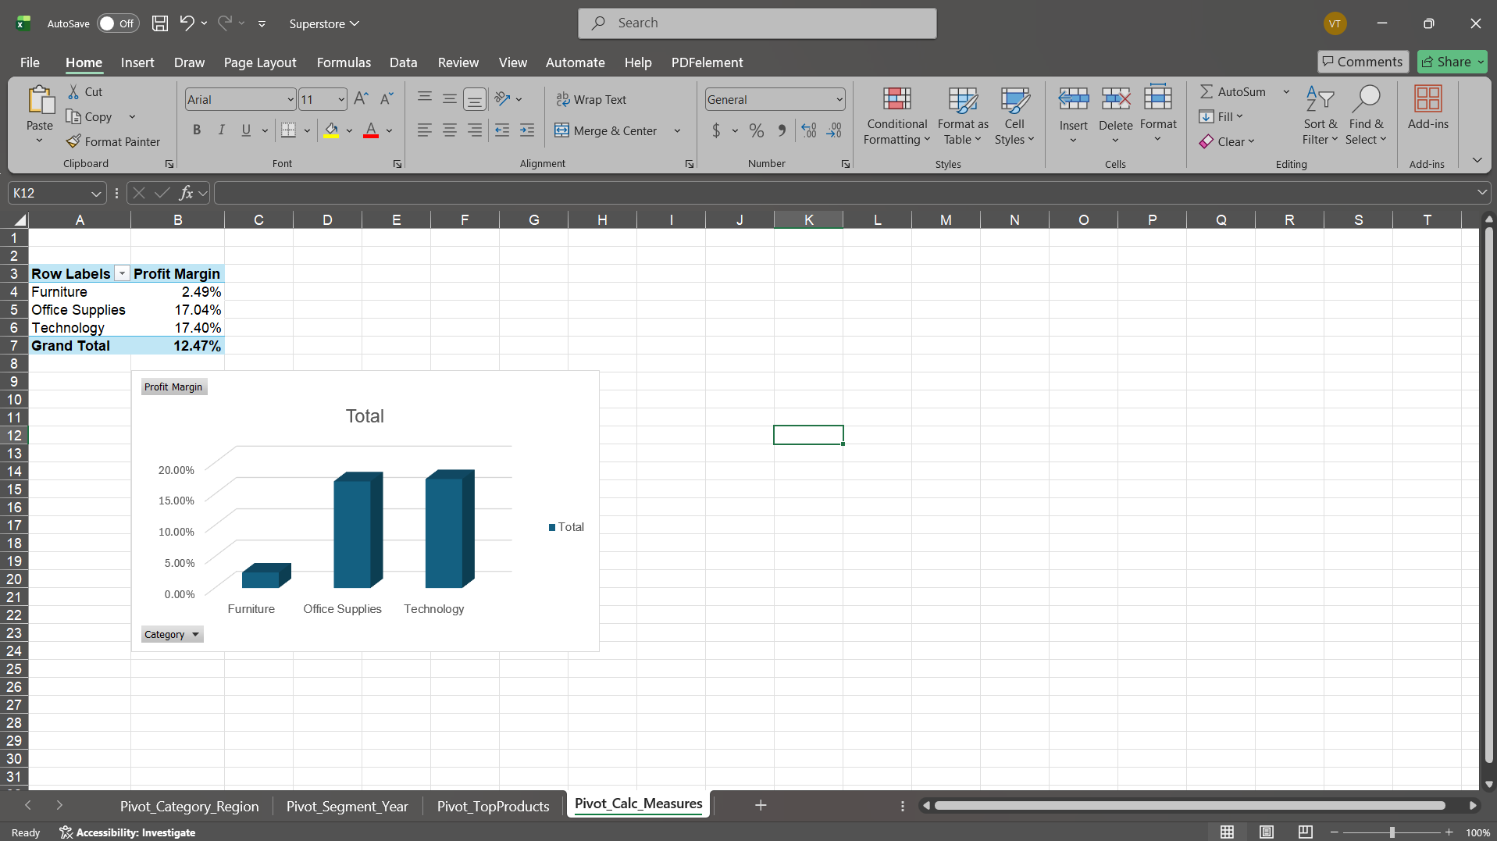
Excel Pivot Analysis
Excel connects to the analytical layer for familiar PivotTable reporting.
Category and region analysis
Segment by year analysis
Calculated measures in PivotTable
Superstore BI Final Project | 11

Slide 12
Data Mining Extension
The data mining component adds predictive and behavioral insights beyond OLAP reporting.
Decision Tree Classification Supervised rule discovery for Profit/Loss order lines
K-Means RFM Segmentation Unsupervised customer grouping by Recency, Frequency, Monetary
Decision Tree model: baseline accuracy 80.63%, test accuracy 94.40%, macro F1-score 90.33%.
Random Forest benchmark accuracy is 94.28%, supporting the interpretable Decision Tree choice because the ensemble does not materially outperform the simpler model.
K-Means uses k = 4 with Silhouette score 0.3554, indicating moderate but usable behavioral segmentation.
The outputs are designed for decision support: risk review for discounts and differentiated customer strategies.
Superstore BI Final Project | 12

Slide 13
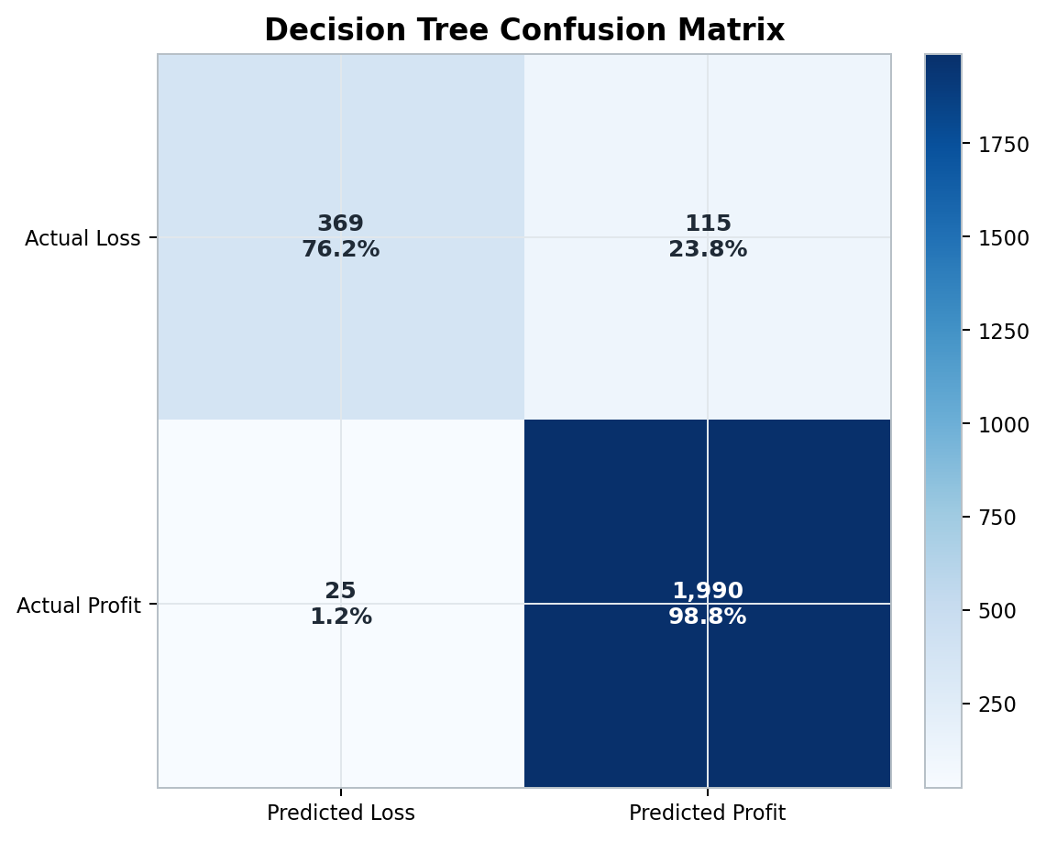
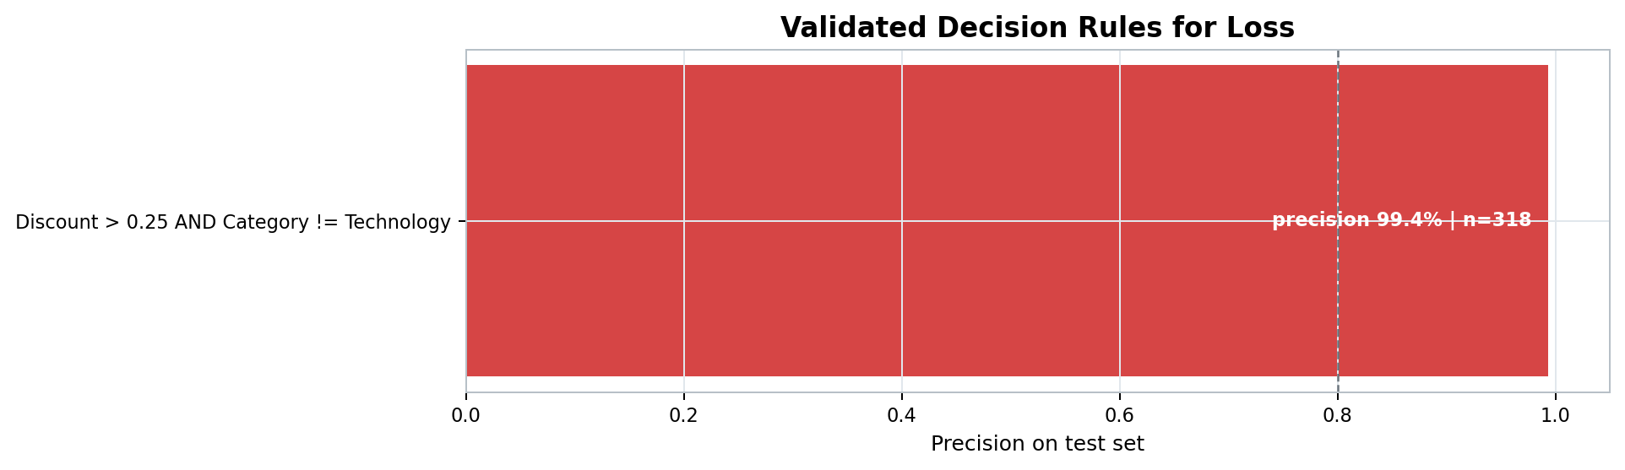
Decision Tree: Validated Loss-Risk Rule
The strongest rule links high discounts to loss-making order lines.
Key rule: Discount > 0.25 AND Category != Technology -> Loss.
Test support: 318 records; precision: 99.37%.
Business action: review high discounts outside Technology before order approval.
The model should support human review rather than fully automate pricing decisions.
Superstore BI Final Project | 13

Slide 14
Business Interpretation of Decision Tree Output
The classification output is useful because it translates model behavior into operational discount control.
Risk Detected High discount outside Technology
Model Evidence 316 correct out of 318 test cases
Business Response Manager review before approval
The confusion matrix shows 369 correctly detected loss-making order lines and 1,990 correctly detected profitable order lines.
The 115 missed losses indicate that the model is a risk-screening tool, not a complete profitability guarantee.
False positives are acceptable in this context because they mainly create additional review, while false negatives may allow margin leakage.
The validated rule can be implemented as a simple policy: flag non-Technology orders when Discount exceeds 25%.
The insight supports category-aware discount governance rather than a single discount threshold for all products.
The rule has high precision but partial coverage, so it should be combined with reporting and managerial judgement.
Superstore BI Final Project | 14

Slide 15
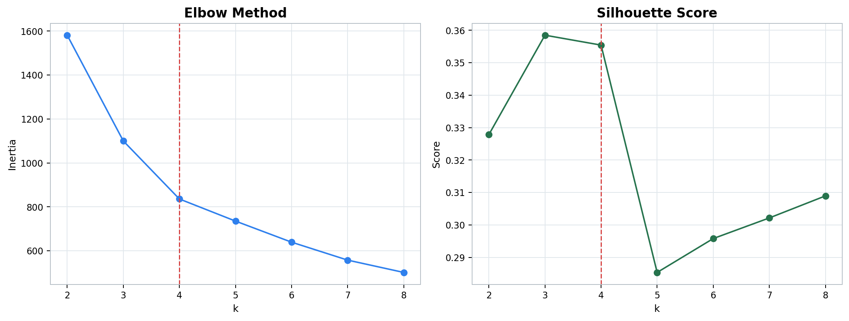
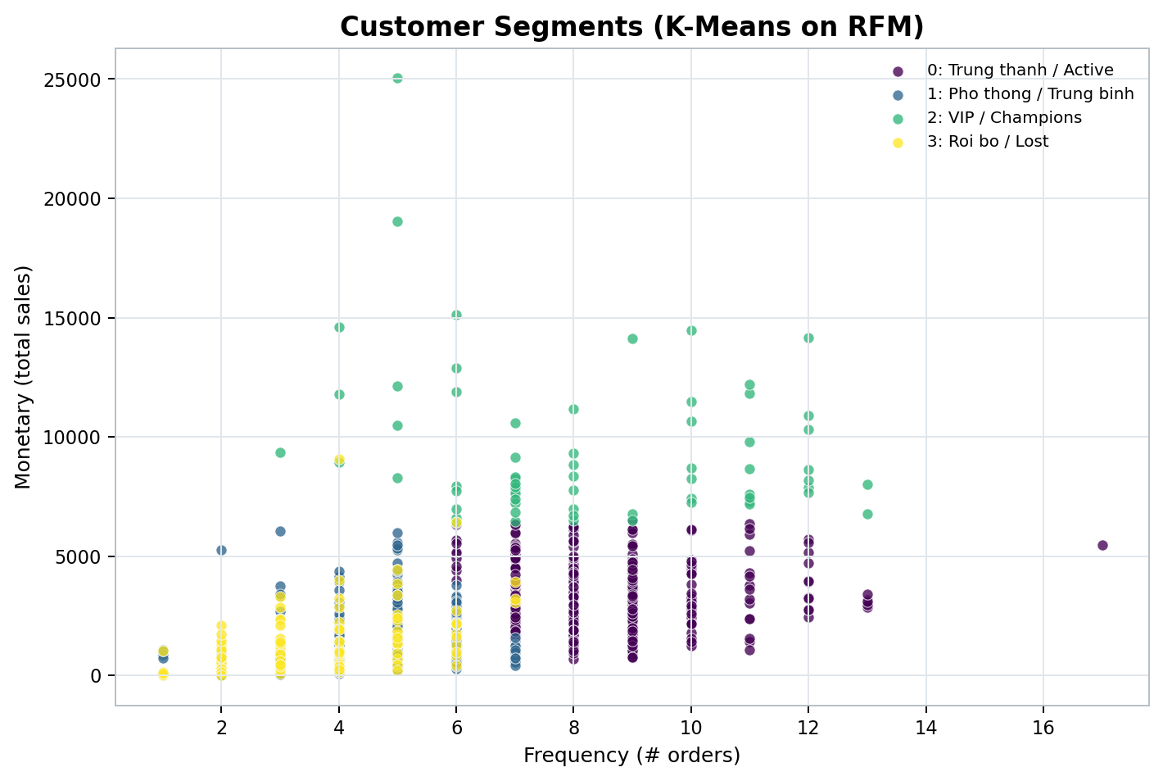
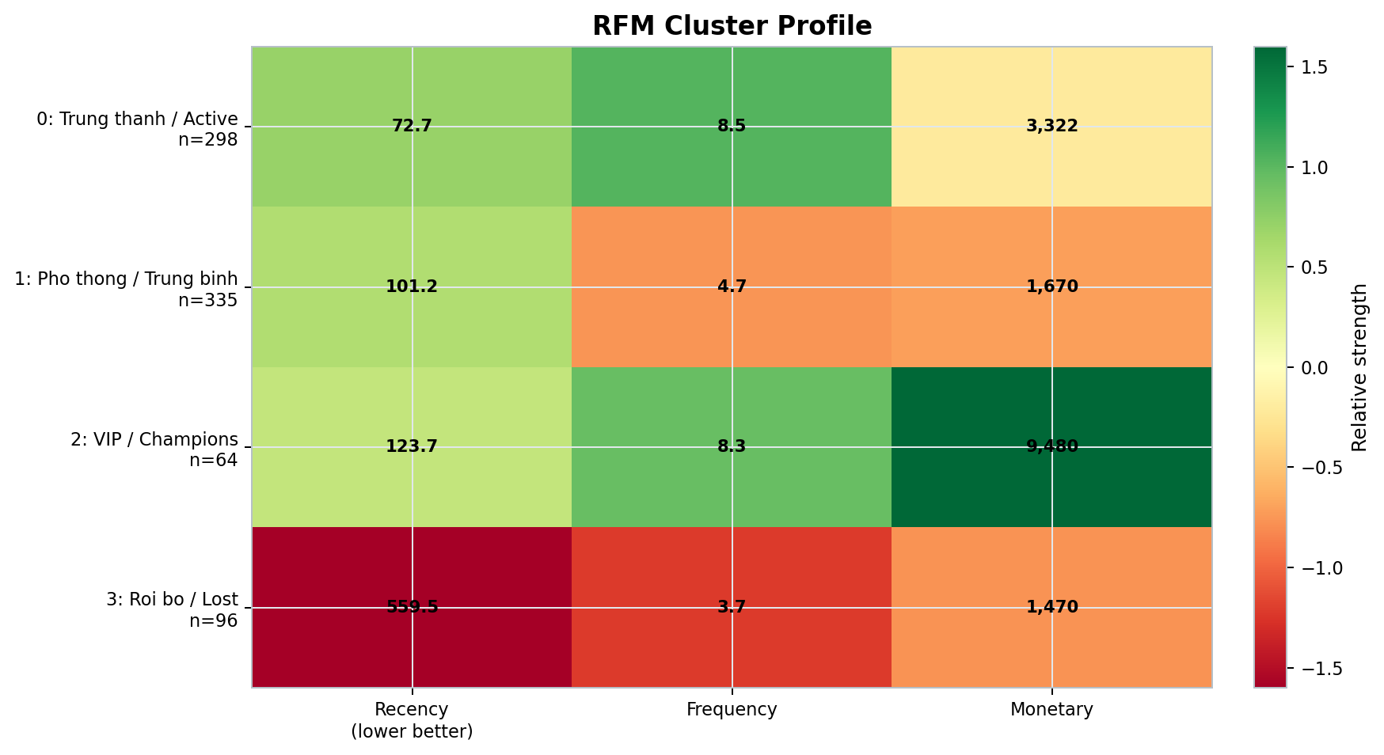
K-Means RFM Segmentation
Four stable customer segments support differentiated marketing actions.
Elbow and Silhouette evidence for k = 4
VIP / Champions: high monetary value.
Trung thanh / Active: recent and frequent customers.
Roi bo / Lost: high recency, selective win-back.
Superstore BI Final Project | 15

Slide 16
Business Strategy from RFM Segments
RFM output becomes useful when each cluster is connected to a concrete business action.
VIP / Champions 64 customers
Trung thanh / Active 298 customers
Pho thong / Trung binh 335 customers
Roi bo / Lost 96 customers
Highest monetary value.
Protect revenue through retention.
Use loyalty benefits and premium offers.
Recent and frequent buyers.
Increase basket value.
Use cross-sell and category expansion.
Largest average-value group.
Small frequency gains can scale.
Use targeted promotions and bundles.
Long inactive customers.
Avoid expensive retention by default.
Use low-cost win-back tests.
The Silhouette score of 0.3554 suggests moderate separation; therefore, the clusters should be used as decision-support segments, not rigid customer labels.
Superstore BI Final Project | 16

Slide 17
Key Findings
The BI solution supports operational reporting, OLAP analysis, and data mining interpretation.
The final submission pipeline uses SuperstoreDW as the main SQL Server database; no separate staging database is required.
dbo.stg_Orders is an internal landing table for controlled ETL and reconciliation.
FactSales is the central analytical fact table for Sales, Quantity, Discount, Profit, and DeliveryDays.
SSAS, Power BI, Excel, and MDX all consume the curated star schema rather than raw landing data.
Data mining shows that high discounting outside Technology is a strong loss-risk indicator.
RFM segmentation identifies actionable customer groups for retention, cross-selling, and win-back campaigns.
Superstore BI Final Project | 17

Slide 18
Submission Readiness
The source and evidence are aligned with the revised project requirement.
SQL scripts create SuperstoreDW, internal landing table, dimensions, DimDate, and FactSales.
ETL_Main.dtsx is the main SSIS pipeline; ETL_DirectCSV.dtsx is retained only as a demo package.
Verification confirms 9,994 rows in both stg_Orders and FactSales, matching Sales and Profit totals, with zero orphan keys.
SSAS cube, Power BI report, Excel PivotTables, MDX queries, and data mining outputs are ready as report evidence.
Recommended next work: final captioning, screenshot numbering, and export to PDF for submission.
Superstore BI Final Project | 18

