Slide 1
Multi-Faceted Customer Intelligence
An End-to-End Data Mining Pipeline on Online Retail II
Data Mining 2026 — Final Project
Team 4 — University of Information Technology, VNU-HCM
Nguyen Minh Cuong (22520177) • Vo Thanh Danh (22520201) • Nguyen Vinh Dat (22520228) • Nguyen Huu Dinh (22520251)
02 June 2026

Slide 2
The Problem
Three siloed questions every retailer asks
• WHO are my customers? — segmentation
• WHO will leave? — churn prediction
• WHAT do they buy together? — basket analysis
Why this matters
+5%
customer retention
Solved in isolation, these analyses miss the joint signal that drives retention ROI.
drives 25–95% profit growth (Bain & Co.)
Team 4 — Multi-Faceted Customer Intelligence (Online Retail II)
2 / 20
Notes:
Open with the three questions. Emphasise the cost asymmetry: retaining is 5-25x cheaper than acquiring.

Slide 3
Dataset — UCI Online Retail II
UK-centric online retailer, 2009-12 to 2011-12
1.07M
805K
5,878
raw transactions
after cleaning
unique customers
4,631
41
2 yr
stock codes
countries
time span
Columns (8, all transaction-level): Invoice · StockCode · Description · Quantity · Price · InvoiceDate · CustomerID · Country
No customer attributes (name / contact / demographics) exist beyond the CustomerID key — a null CustomerID therefore carries no recoverable customer information.
Source: https://archive.ics.uci.edu/dataset/502/online+retail+ii
Team 4 — Multi-Faceted Customer Intelligence (Online Retail II)
3 / 20

Slide 4
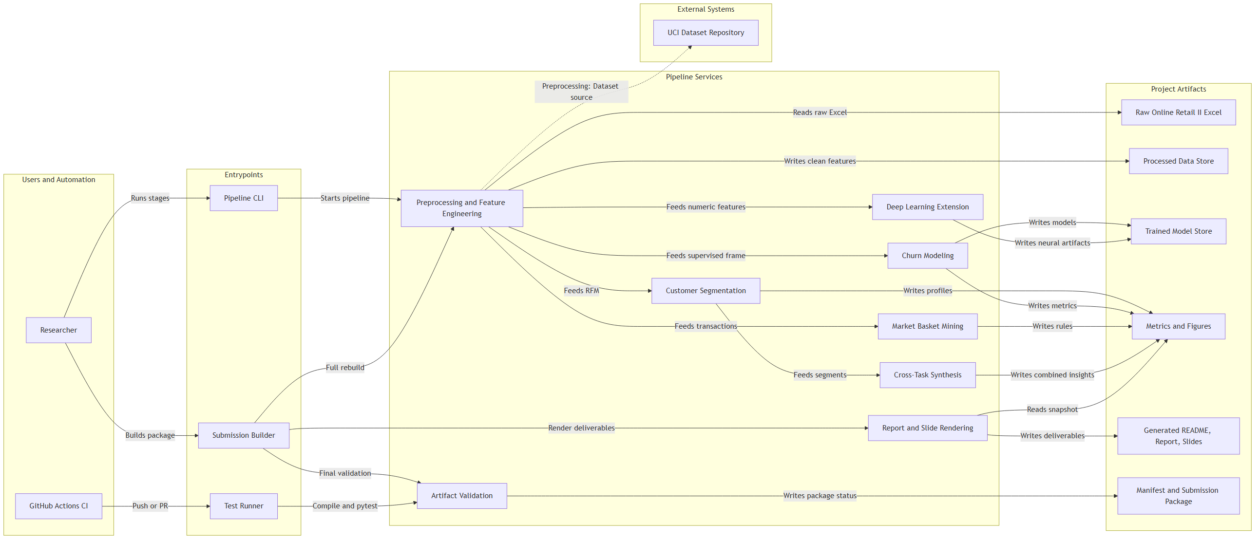
System Architecture
Users & automation → entry points → pipeline services → artifact stores
Team 4 — Multi-Faceted Customer Intelligence (Online Retail II)
4 / 20
Notes:
One coherent, reproducible pipeline: all four course topics + a DL extension, driven by a CLI/submission-builder, guarded by tests + a validator, with the report/slides/README generated from one metrics snapshot.

Slide 5
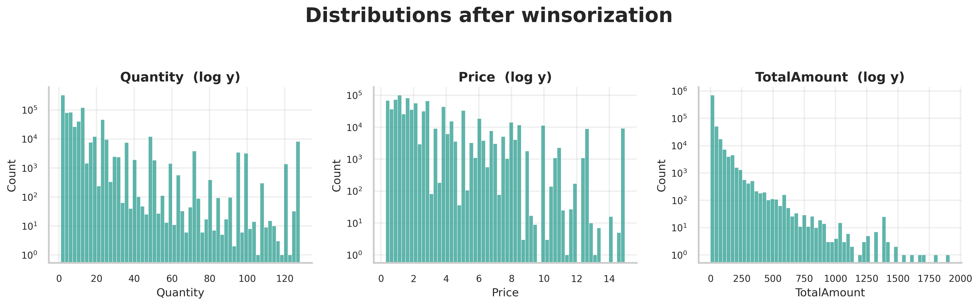
Preprocessing
From raw 1.07M rows to clean 805K rows — only 24.5% dropped
• Drop 22.8% rows with null CustomerID
• Remove cancellation invoices (prefix 'C')
• Drop non-positive Quantity / Price
• Winsorize Quantity & Price at 1%/99% quantiles
• Derive TotalAmount = Quantity × Price
• Compute RFM + behavioral features per customer
• Label churn: no activity in 90 d after 2011-09-01
Filter removed | % of raw rows
Missing CustomerID | 22.8%
Cancellation invoices (C) | 1.8%
Non-positive Qty / Price | 2.4%
Total rows removed | 24.5%
Dropping null-CustomerID rows is mandatory (RFM / churn are per-customer) yet costs only 3.5% of units & 13.7% of revenue — almost no purchasing signal lost.
Quantity / Price / TotalAmount distributions after winsorization
Team 4 — Multi-Faceted Customer Intelligence (Online Retail II)
5 / 20

Slide 6
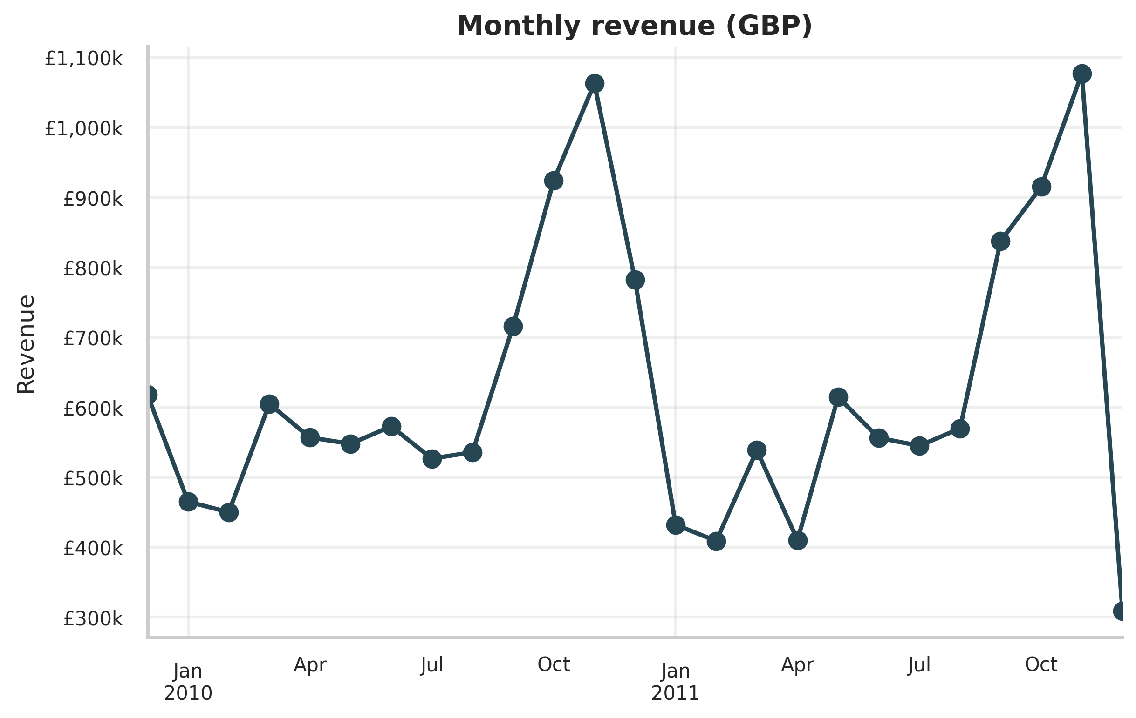
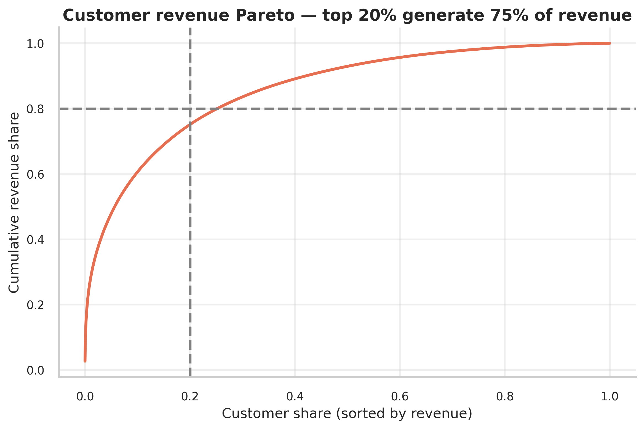
EDA — Revenue & Customer Pareto
Q4 seasonality + top 20% of customers drive most revenue
Team 4 — Multi-Faceted Customer Intelligence (Online Retail II)
6 / 20

Slide 7
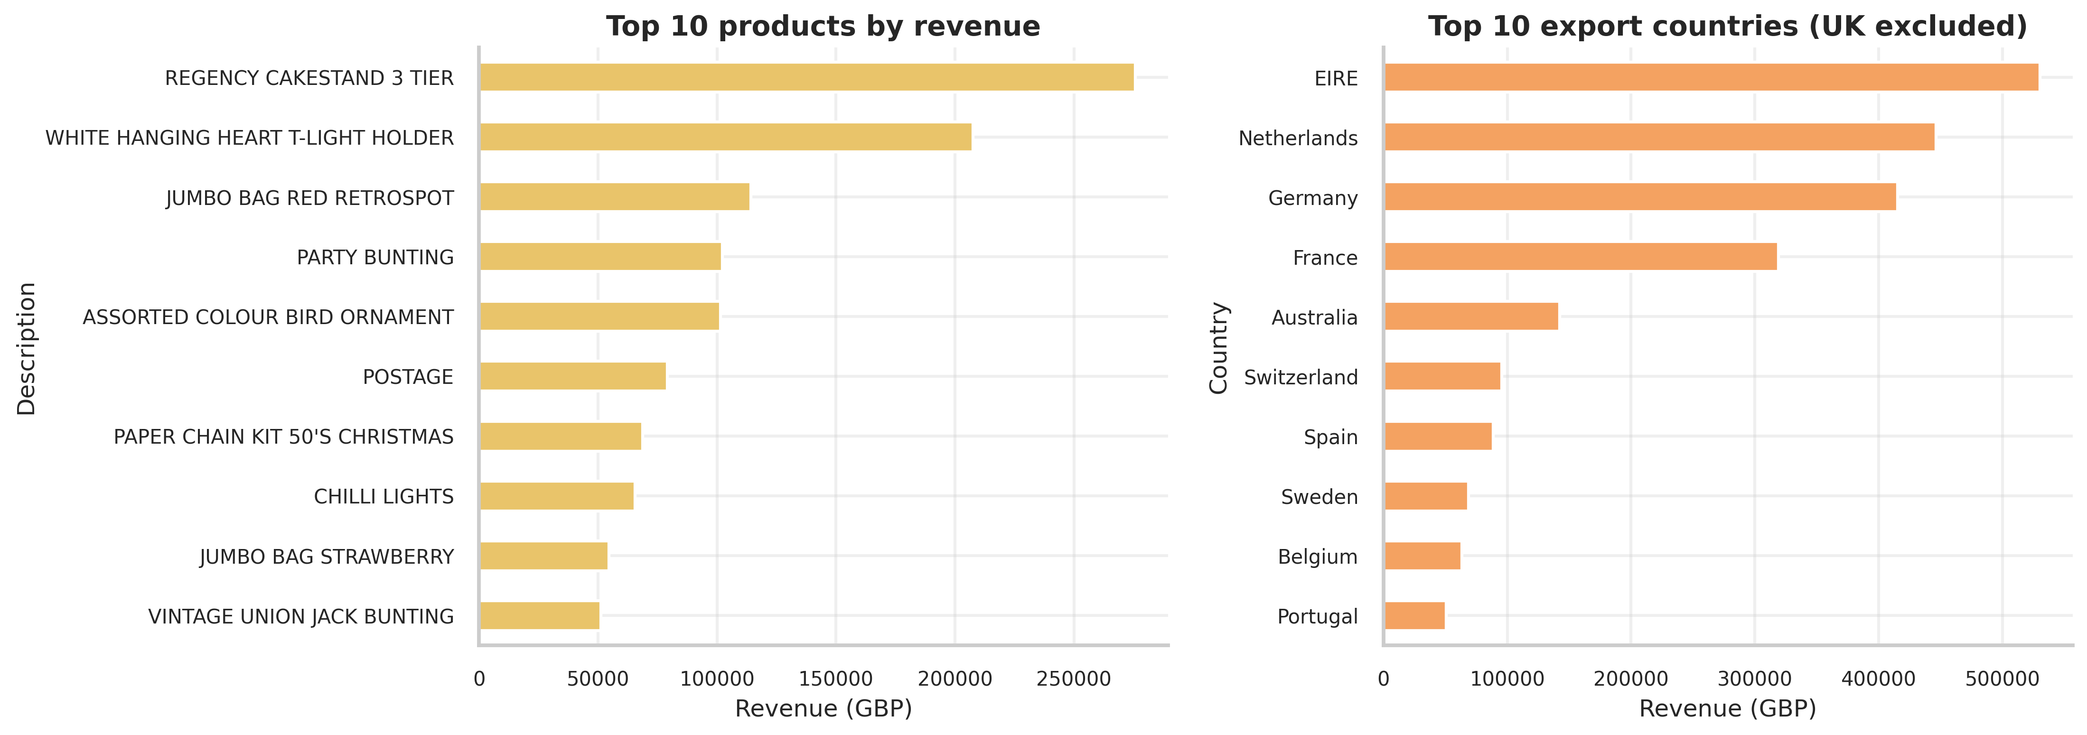
EDA — Top Products & Export Countries
Long-tail product mix; concentrated international demand
Team 4 — Multi-Faceted Customer Intelligence (Online Retail II)
7 / 20

Slide 8
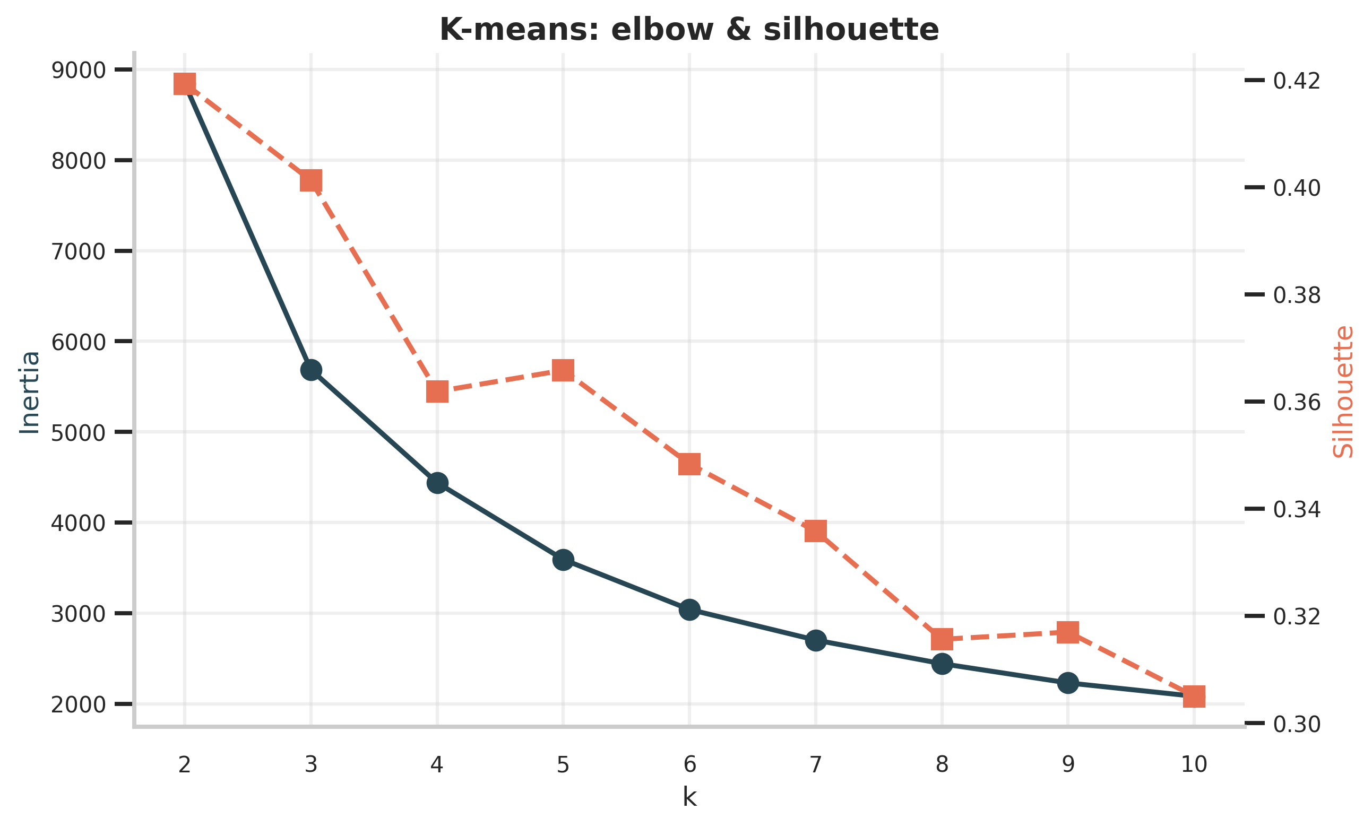
Customer Segmentation — Three Algorithms Compared
K-means vs DBSCAN vs AGNES on log-transformed RFM
Algorithm | k | Silhouette ↑ | Davies-B ↓ | Calinski-H ↑
KMeans | 2 | 0.419 | 0.886 | 5840
DBSCAN | 13 | -0.120 | 1.632 | 742
AGNES | 2 | 0.388 | 0.789 | 4304
• K-means k=2 wins silhouette (0.42) — best partitional fit
• DBSCAN fragments into 13 + noise — wrong fit for heavy-tail
• AGNES Ward close second; chosen k=2 confirmed by dendrogram
Team 4 — Multi-Faceted Customer Intelligence (Online Retail II)
8 / 20
Notes:
Emphasise that DBSCAN's negative silhouette is the textbook signal that density-based clustering fails on heavy-tail RFM data.

Slide 9
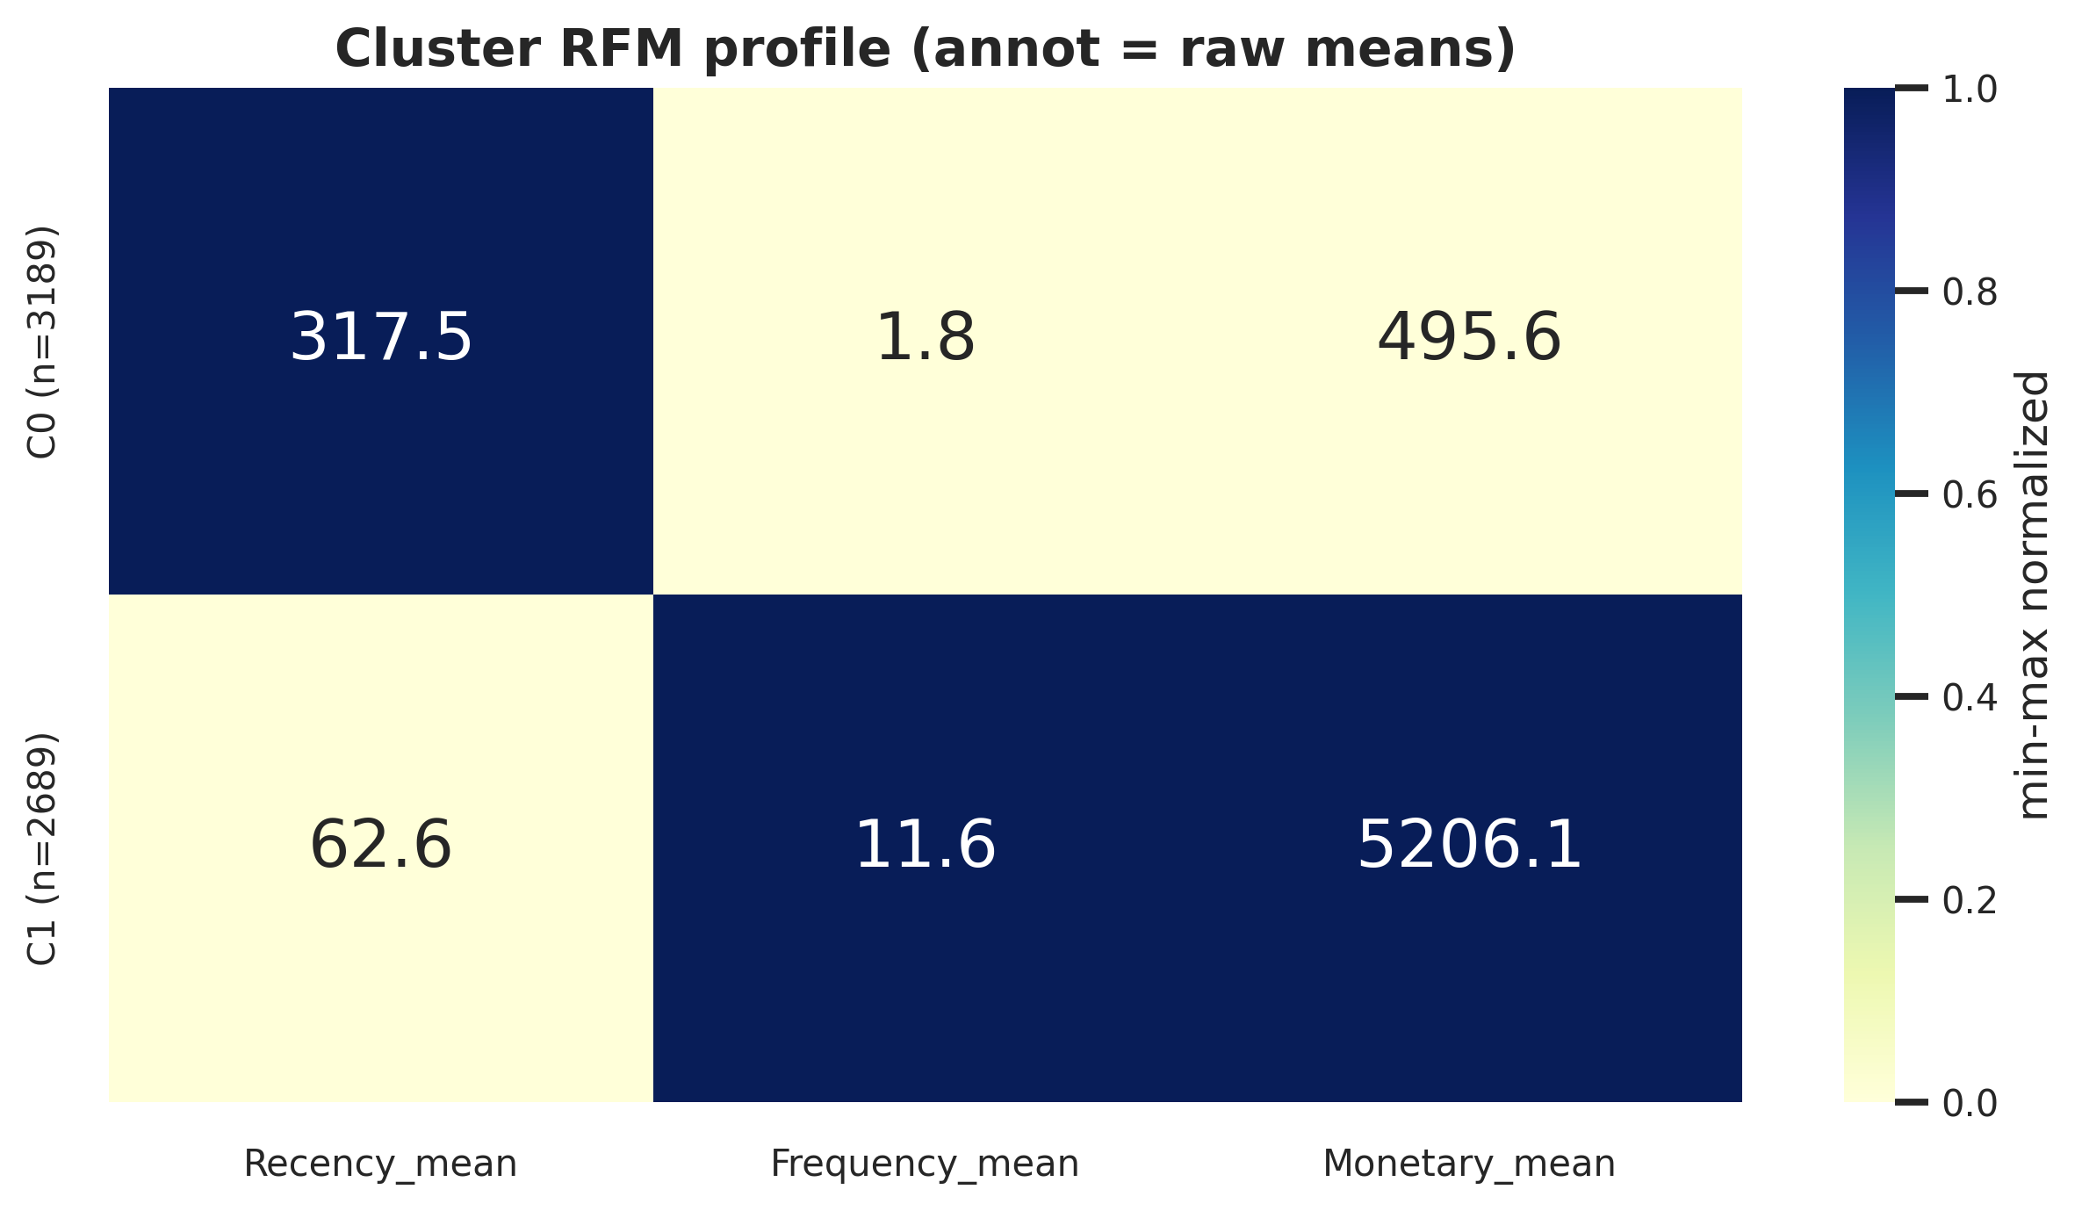
Two Customer Segments — Crystal Clear Interpretation
Dormant (54%) vs Active loyal (46%)
Dormant
Recency 317 d Frequency 1.85 Monetary £496
Active loyal
Recency 63 d Frequency 11.55 Monetary £5,206
Team 4 — Multi-Faceted Customer Intelligence (Online Retail II)
9 / 20

Slide 10
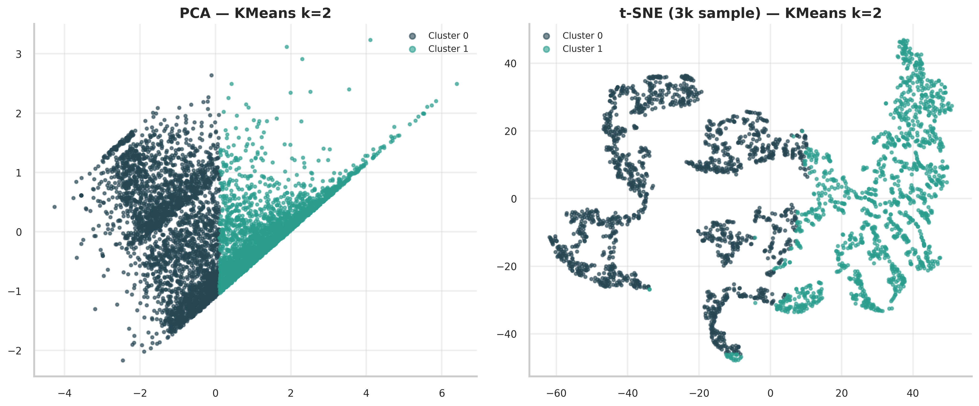
2-D Projection — PCA & t-SNE
Clean separation along the first principal component
Team 4 — Multi-Faceted Customer Intelligence (Online Retail II)
10 / 20

Slide 11
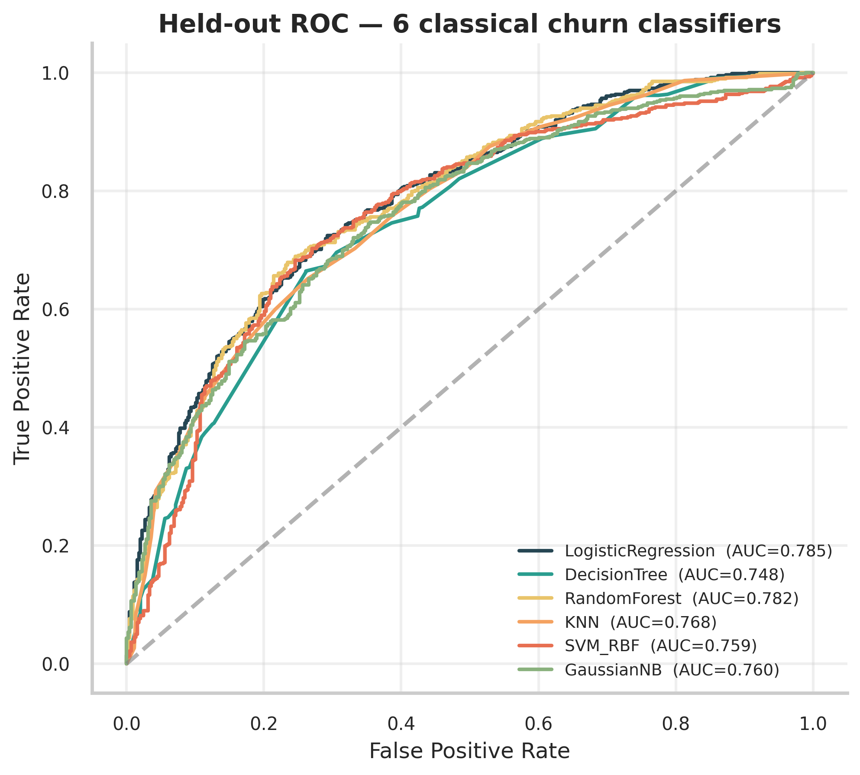
Churn Classification — 7 Models Compared
5-fold CV + held-out test; SMOTE inside folds
Model | AUC | F1 | Precision | Recall
LogisticRegression | 0.785 | 0.739 | 0.770 | 0.711
RandomForest | 0.782 | 0.745 | 0.747 | 0.744
KNN | 0.767 | 0.721 | 0.740 | 0.703
GaussianNB | 0.760 | 0.744 | 0.724 | 0.766
SVM_RBF | 0.759 | 0.745 | 0.752 | 0.738
DecisionTree | 0.748 | 0.724 | 0.754 | 0.696
MLP (PyTorch) | 0.783 | 0.738 | 0.756 | 0.721
Team 4 — Multi-Faceted Customer Intelligence (Online Retail II)
11 / 20

Slide 12
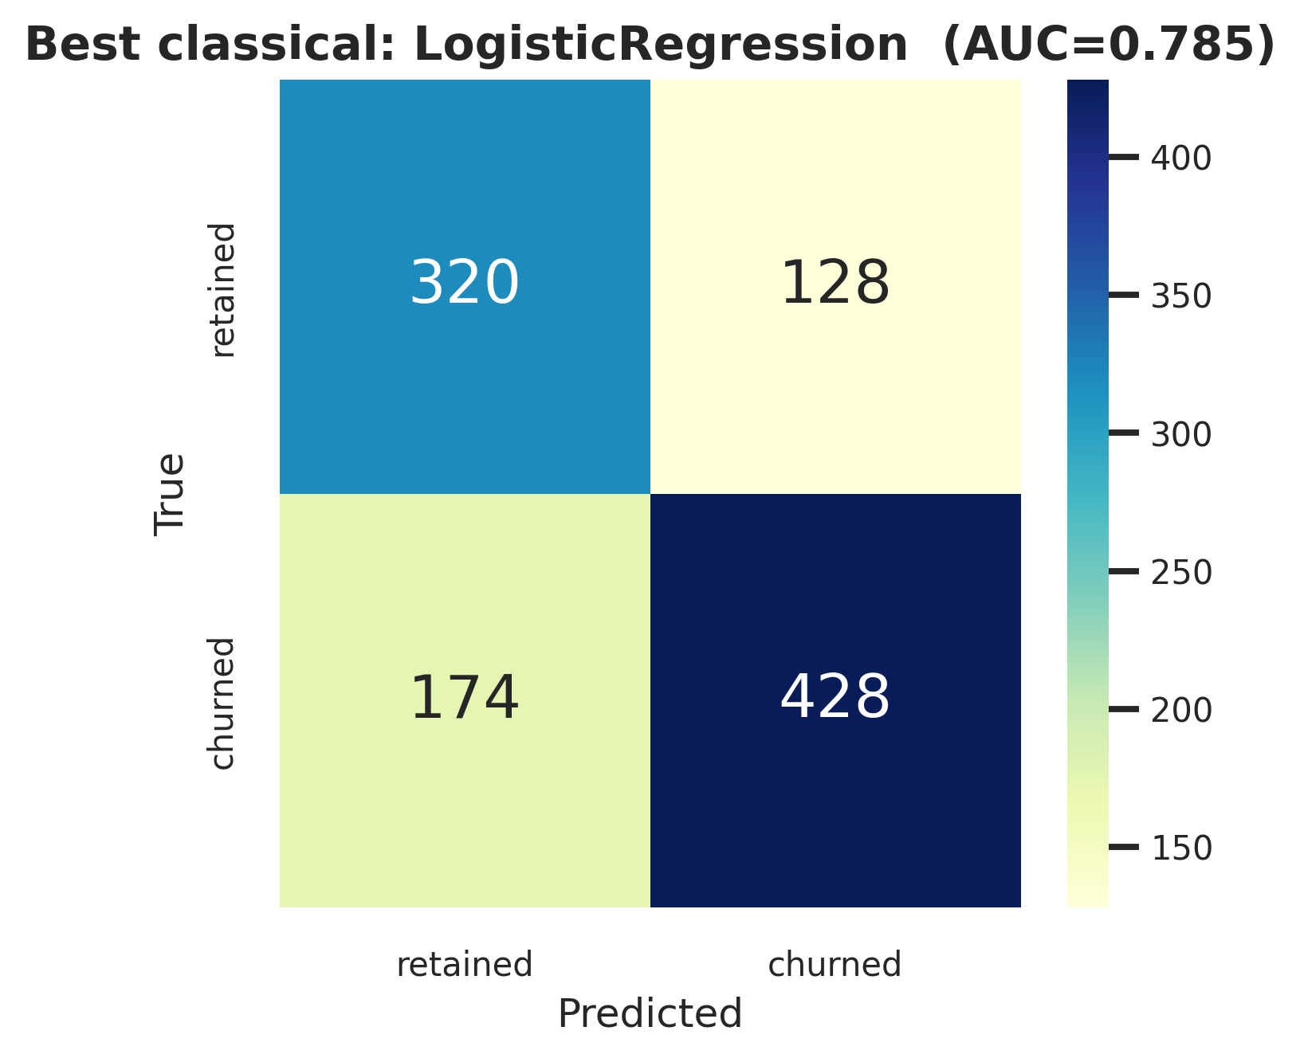
Best Model — LogisticRegression (AUC 0.785)
RandomForest within 0.003 · MLP AUC 0.783
• AUC 0.7850 · F1 0.7392 · Recall 0.7110
• MLP test: AUC 0.7832 · Precision 0.7561 · Recall 0.7209
• Classical and MLP converge — feature ceiling on RFM+behavioural
• → classical models preferred (cheaper, interpretable)
• → DL would need richer signals (sequences, sessions) to pull ahead
Team 4 — Multi-Faceted Customer Intelligence (Online Retail II)
12 / 20

Slide 13
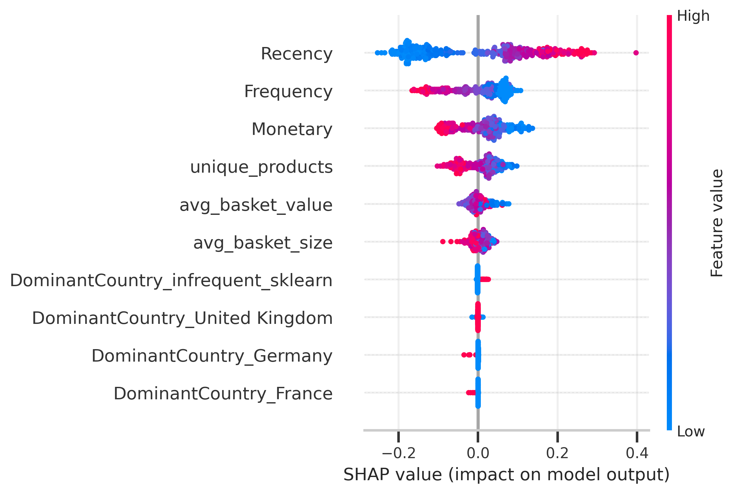
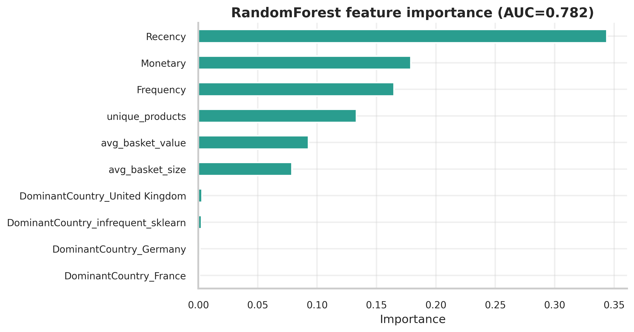
Explainability — SHAP on RandomForest
Recency dominates; behavioural features add the rest
Team 4 — Multi-Faceted Customer Intelligence (Online Retail II)
13 / 20
Notes:
Mention the Recency-churn structural correlation here — we revisit it in limitations.

Slide 14
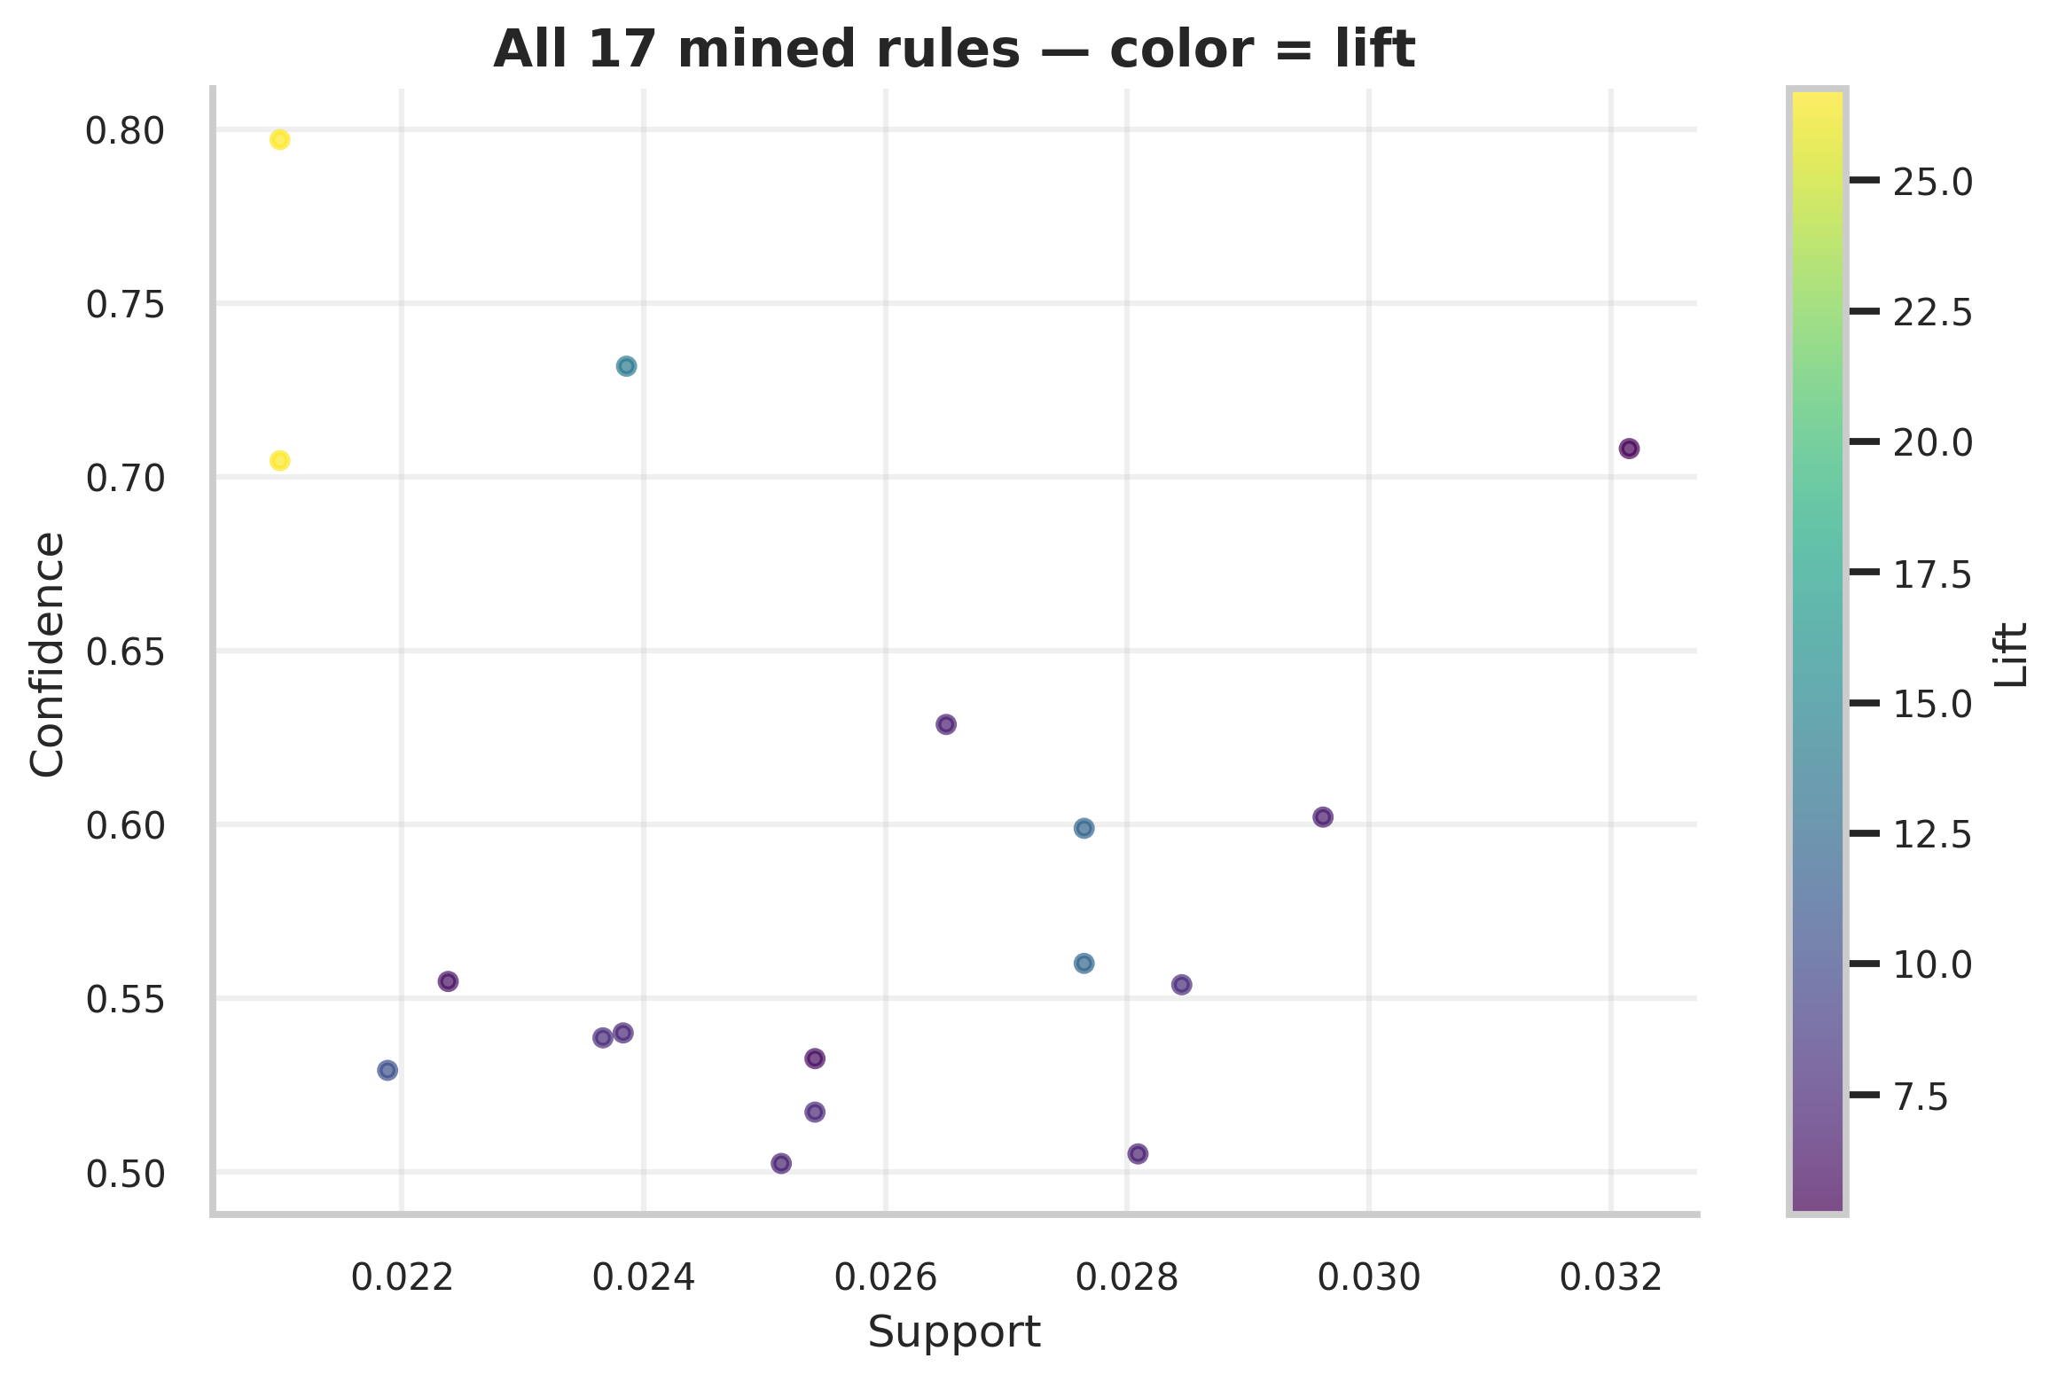
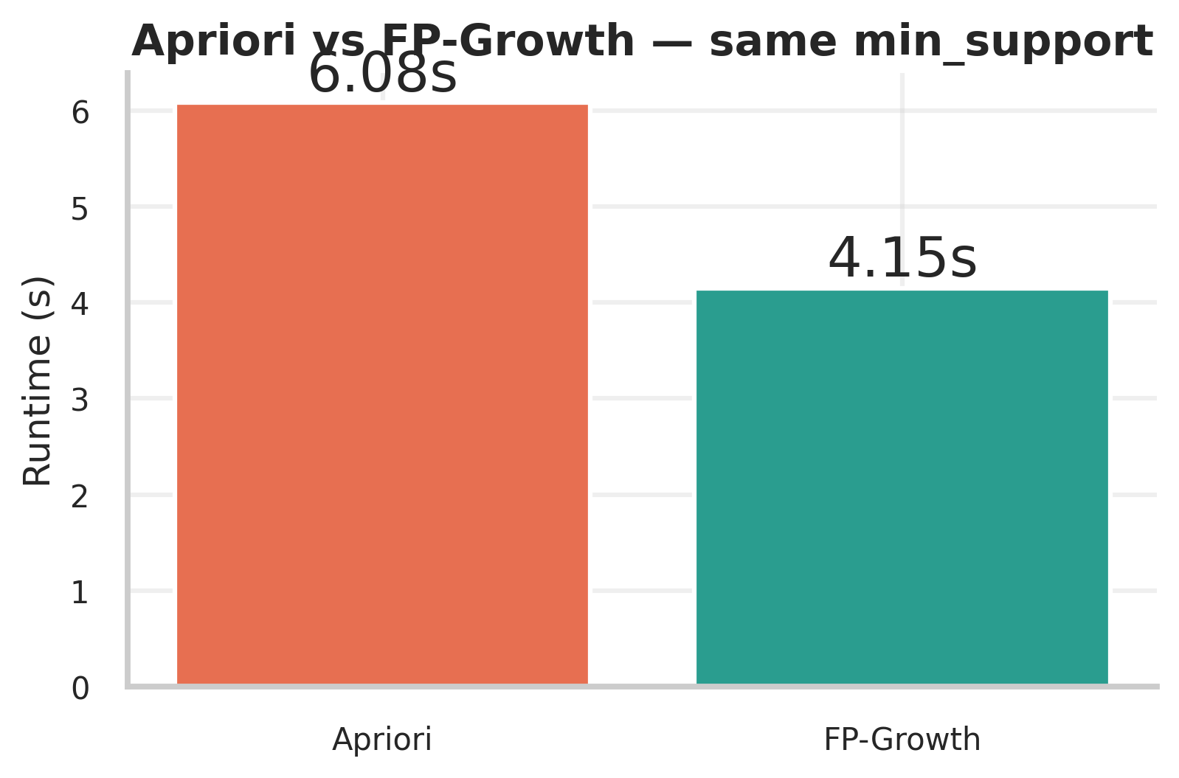
Market Basket — Apriori vs FP-Growth
Same 242 itemsets, 17 rules at lift ≥ 1.5 — FP-Growth 1.5× faster
Algorithm | Itemsets | Rules | Runtime (s)
Apriori | 242 | 17 | 7.15
FP-Growth | 242 | 17 | 4.25
Team 4 — Multi-Faceted Customer Intelligence (Online Retail II)
14 / 20

Slide 15
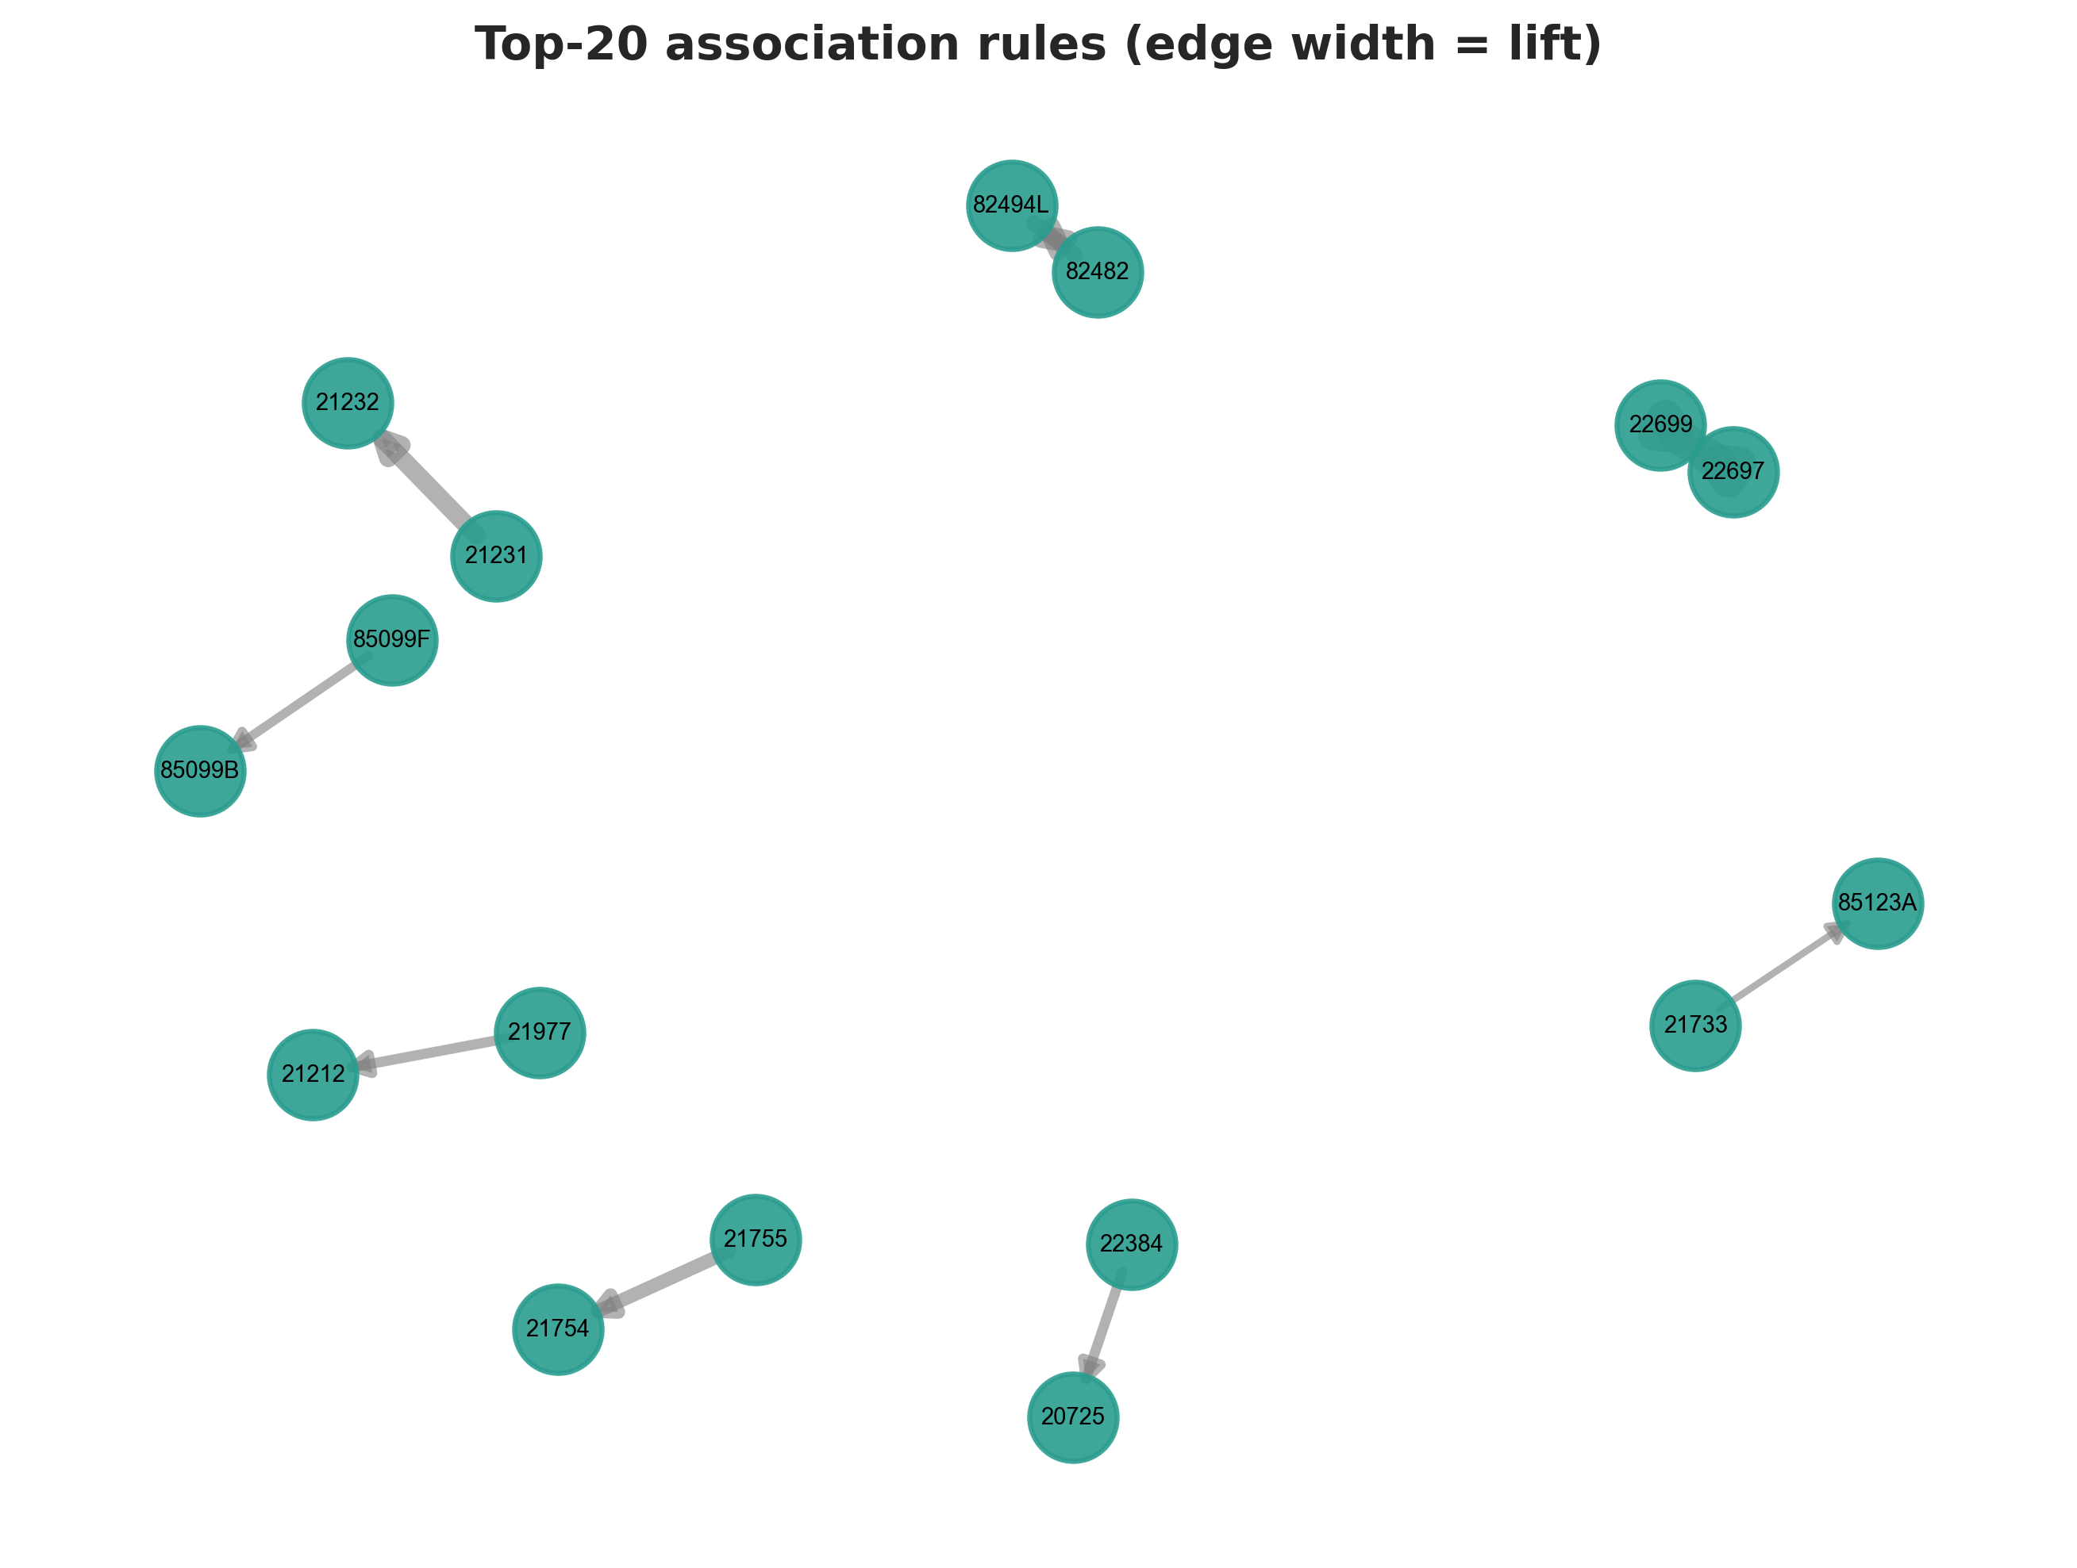
Top Association Rules
Strongest signals = collectible sets + color-variant pairs
Antecedent | Consequent | Conf. | Lift
ROSES REGENCY TEACUP AND SAUCER | GREEN REGENCY TEACUP AND SAUCER | 0.70 | 26.8
GREEN REGENCY TEACUP AND SAUCER | ROSES REGENCY TEACUP AND SAUCER | 0.80 | 26.8
SWEETHEART CERAMIC TRINKET BOX | STRAWBERRY CERAMIC TRINKET BOX | 0.73 | 13.9
WOODEN PICTURE FRAME WHITE FINISH | WOODEN FRAME ANTIQUE WHITE | 0.60 | 12.1
WOODEN FRAME ANTIQUE WHITE | WOODEN PICTURE FRAME WHITE FINISH | 0.56 | 12.1
Pattern: customers who buy one item from a colour or themed set frequently complete the set. Operational use: post-purchase recommendations and bundled retention offers. Rules are mined on customer-attributed invoices only — consistent with the per-segment rules, and excluding anonymous wholesale/bulk baskets.
Team 4 — Multi-Faceted Customer Intelligence (Online Retail II)
15 / 20

Slide 16
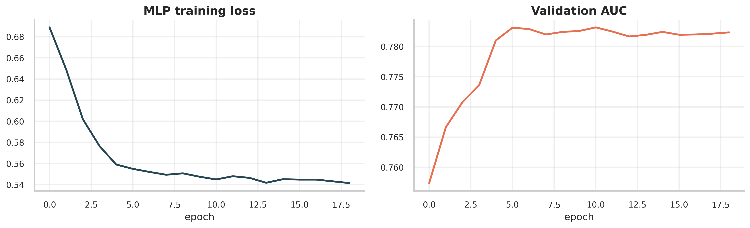
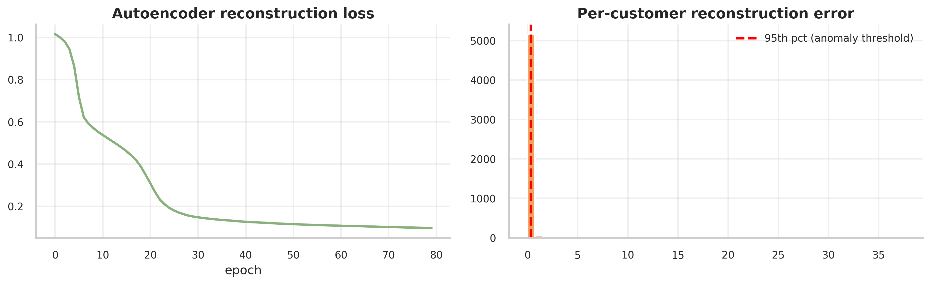
Deep Learning Extension
MLP for churn + Autoencoder for anomaly detection
MLP [64,32,16] with SMOTE + early stopping reaches test AUC 0.783 (F1 0.738, precision 0.756) — on par with the best classical model. Autoencoder (bottleneck=4) flags the top 5% of customers by reconstruction error as anomalies — candidates for VIP review or fraud screening.
Team 4 — Multi-Faceted Customer Intelligence (Online Retail II)
16 / 20

Slide 17
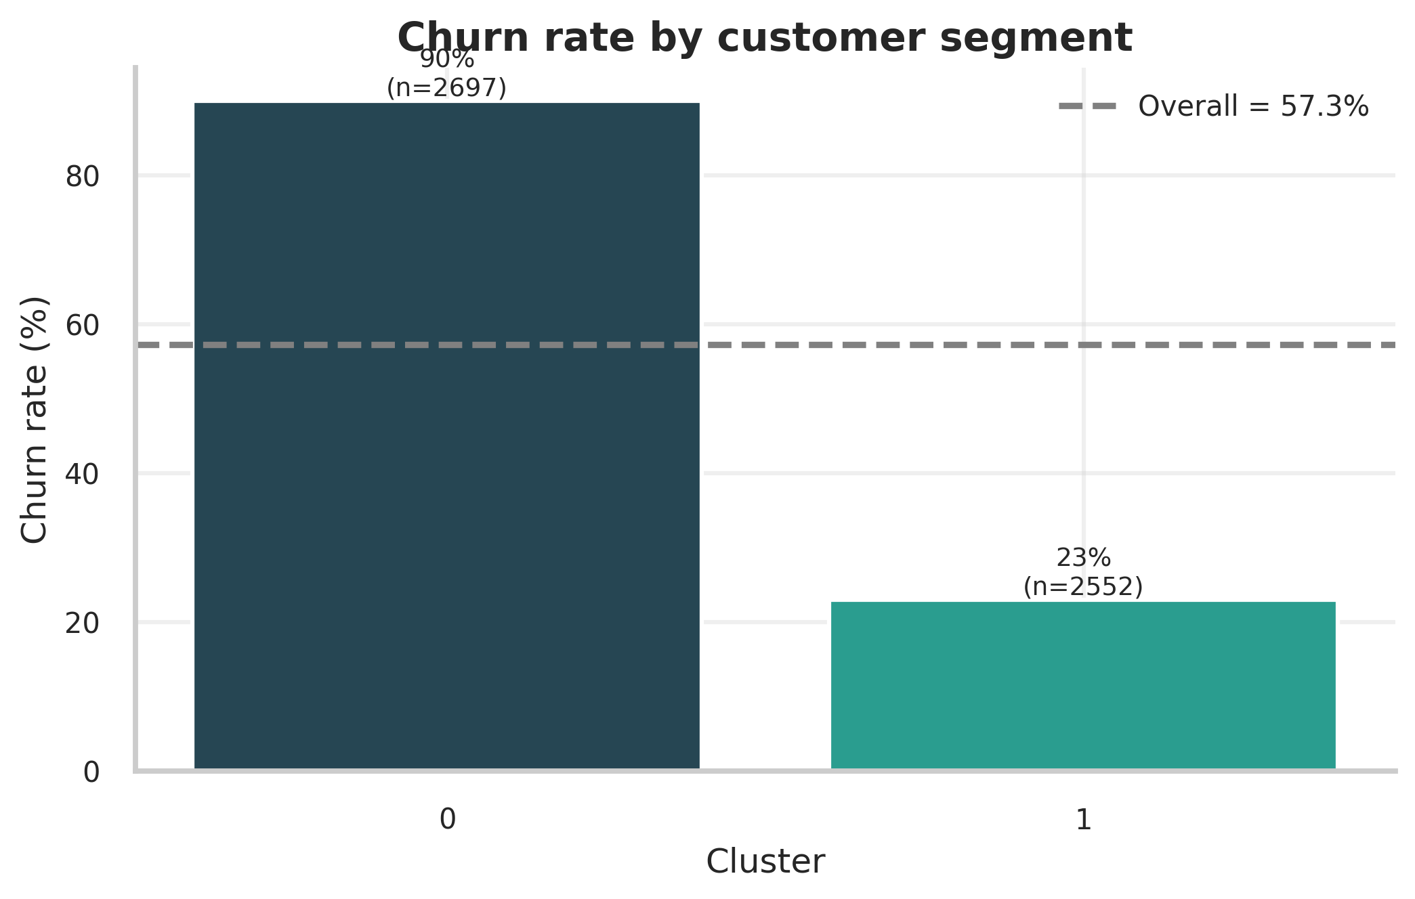
★ HEADLINE FINDING — Churn Rate by Segment
67-percentage-point gap between segments
Dormant
90%
Active loyal
23%
Segment | n | Churn % | Avg Recency | Avg Monetary (£)
Dormant | 2,697 | 90.0 | 367.9 | 519.5
Active loyal | 2,552 | 23.0 | 65.2 | 5,401.2
Overall | 5,249 | 57.4 | — | —
67-point churn gap → segment-aware retention works
Team 4 — Multi-Faceted Customer Intelligence (Online Retail II)
17 / 20
Notes:
This is THE slide. Pause here. Explain the gap is the synthesis insight.

Slide 18
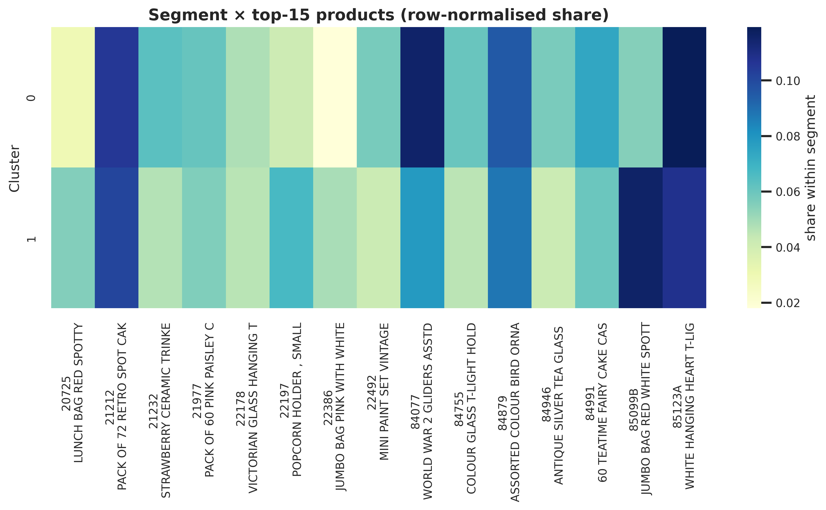
Loyal Segment Buys in Colour Pairs
Per-segment FP-Growth recovers cross-sell opportunities
• Pink Lunchbag → Red Lunchbag (lift 7.4)
• Pink Jumbo Bag → Red Jumbo Bag (lift 6.4)
• Red Heart T-light → White Heart T-light (5.3)
Recommendation: target the 23% churners in the loyal segment with colour-pair bundles. Use win-back campaigns (not bundles) for the dormant majority.
Team 4 — Multi-Faceted Customer Intelligence (Online Retail II)
18 / 20

Slide 19
Limitations & Future Work
Honest caveats — and where we'd go next
Limitations
Future Work
• Leakage fix: supervised features built strictly before 2011-09-01 — best AUC now a realistic 0.785 (full-history features were inflated)
• Recency dominant but not sufficient — ablation without it drops AUC to 0.75; baselines: majority 0.50, recency-only 0.75
• Single retailer, UK-centric, 2 yrs — generalisability untested
• No demographic attributes available
• Dormant segment too sparse for in-cluster rules
• Anomaly threshold purely percentile-based
• Transformer on purchase sequences (next-basket + churn jointly)
• Uplift modelling: who responds best to retention offers
• Cross-retailer transfer to test segment-rule stability
• Domain-labelled fraud / VIP ground truth for anomalies
Team 4 — Multi-Faceted Customer Intelligence (Online Retail II)
19 / 20

Slide 20
Conclusion & Thank You
Q&A — happy to discuss any slide
One pipeline, four course topics, one business insight.
• Segmentation: K-means k=2, Silhouette 0.42
• Classification: LogisticRegression AUC 0.785 · MLP AUC 0.783 (leakage-safe pre-cutoff features)
• Association: 17 rules, FP-Growth 1.5× faster, top lift 26.8
• ★ Synthesis: 67-pt churn gap → colour-pair retention bundles
Code, report & slides — Team 4 GitHub repository
Team 4 — Cuong · Danh · Dat · Dinh • UIT, VNU-HCM • 02 June 2026
Team 4 — Multi-Faceted Customer Intelligence (Online Retail II)
20 / 20

