Slide 1
P1 Progress Presentation
Nano-Mamba U-Net
A Spatio-Temporal Framework for Cardiac Motion Analysis
P1 Progress Presentation
Tong Siyuan Master of Artificial Intelligence Faculty of Computer Science and Information Technology, Universiti Malaya
Motivation
Problem
Methodology
Innovation
Tong Siyuan | 1/10

Slide 2
P1 Progress Presentation
Project Motivation and Scope
P1 focuses on the problem, literature, proposed methodology, and references
CMR Volume
RV / MYO / LV Masks
EDV, ESV, EF
Cardiac Review
Why segmentation matters
Ejection Fraction
CMR segmentation is needed before volume-based cardiac measurements.
Manual delineation is expert-dependent and difficult to scale.
A practical model should balance accuracy, model size, and inference cost.
EF = (VED − VES) / VED × 100%
P1 boundary: no P2 discussion/conclusion is presented here.
Tong Siyuan | 2/10

Slide 3
P1 Progress Presentation
Research Problem and Gap
The project targets the accuracy-efficiency trade-off
Problem 1 Local context
Problem 2 Computational cost
Problem 3 Anatomical variability
3D convolutions are locally constructed.
Small models may lose broader anatomical context.
Larger networks can improve capacity.
They also increase parameters and memory cost.
RV shape is variable.
MYO is thin and boundary-sensitive.
Pathology changes cardiac geometry.
Research gap
Can a compact Mamba-inspired bottleneck improve contextual feature processing while keeping the model lightweight?
Tong Siyuan | 3/10

Slide 4
P1 Progress Presentation
Objectives and Research Questions
How the project will be evaluated
Research objectives
Research questions
Implement a lightweight Mamba-inspired bottleneck inside a 3D U-Net-style network.
Evaluate RV, MYO, and LV segmentation using Dice.
Compare with baseline and ablation models.
Quantify efficiency using parameters and inference speed.
How can compressed 3D features be serialized and processed inside U-Net?
Does the proposed model achieve competitive validation Dice?
What accuracy-efficiency trade-off is observed?
Tong Siyuan | 4/10

Slide 5
P1 Progress Presentation
Literature Review and Design Rationale
The novelty is adaptation and integration, not claiming ownership of prior methods
U-Net 2015
3D U-Net / V-Net 2016
Attention / Residual 2016–2018
UNETR / Swin UNETR 2022
Mamba-style medical seg. 2024
Encoder-decoder + skips
Volumetric segmentation
Feature selection + trainability
Long-range token modeling
Efficient sequence modeling
Design rationale from literature
U-Net-style models preserve spatial detail through skip connections.
Sequence models motivate broader contextual processing.
This project combines both ideas in a lightweight bottleneck design.
Tong Siyuan | 5/10

Slide 6
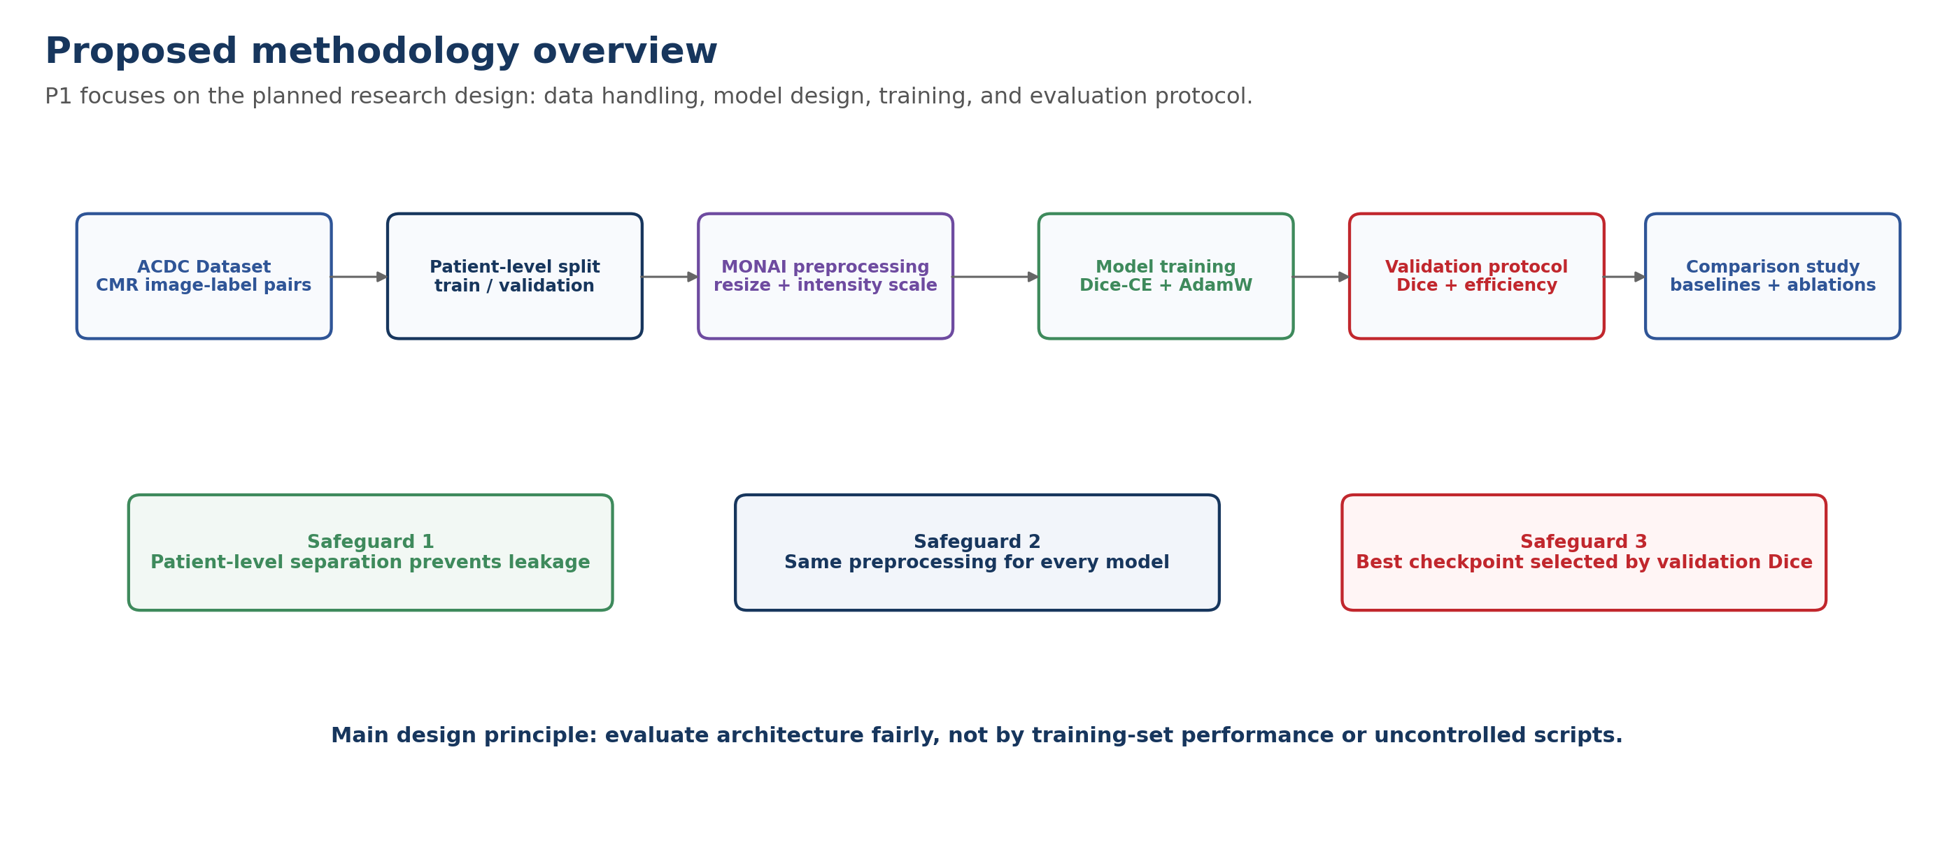
P1 Progress Presentation
Methodology Overview
A reproducible pipeline for fair model comparison
Tong Siyuan | 6/10

Slide 7
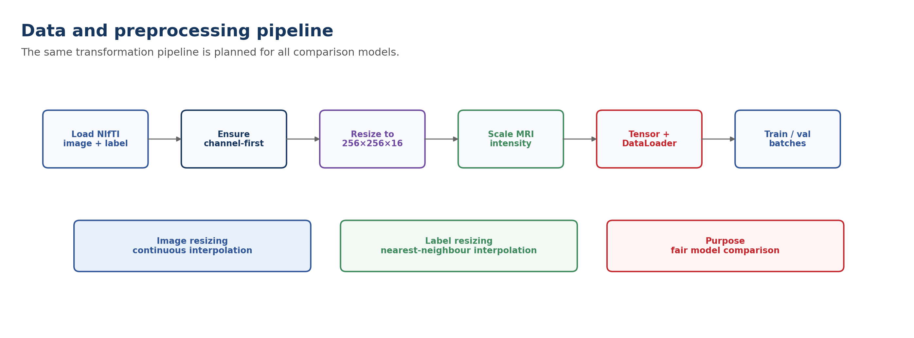
P1 Progress Presentation
Data Handling and Preprocessing
The preprocessing design controls variation before model comparison
Tong Siyuan | 7/10

Slide 8
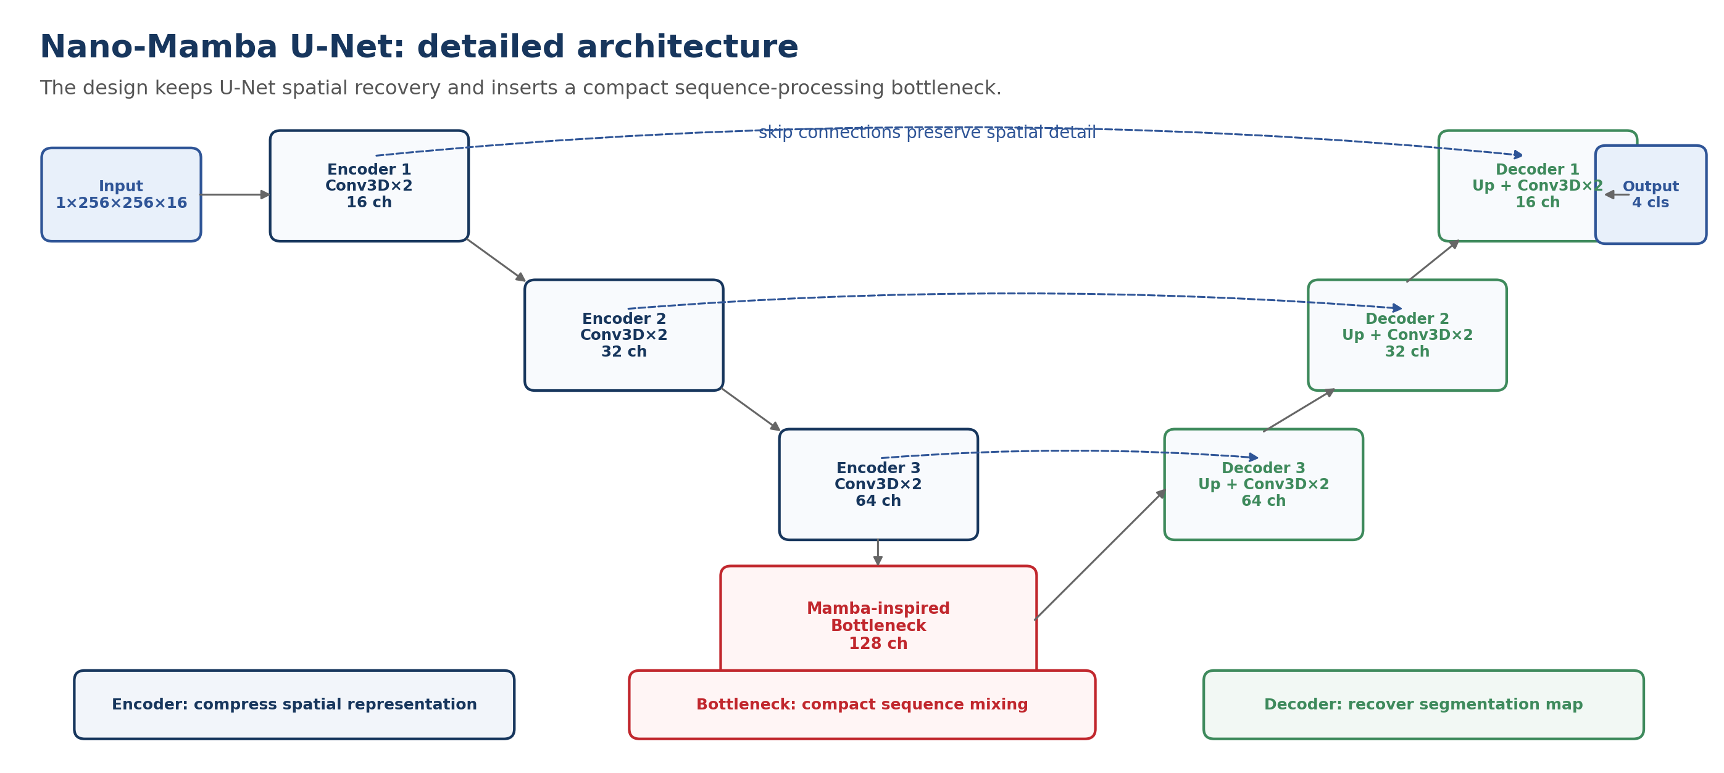
P1 Progress Presentation
Detailed Nano-Mamba U-Net Structure
Main architecture-level contribution
Tong Siyuan | 8/10

Slide 9
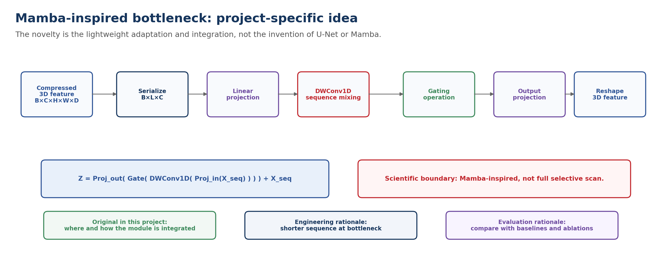
P1 Progress Presentation
Mamba-Inspired Bottleneck and Innovation
What is creative in this project?
Tong Siyuan | 9/10

Slide 10
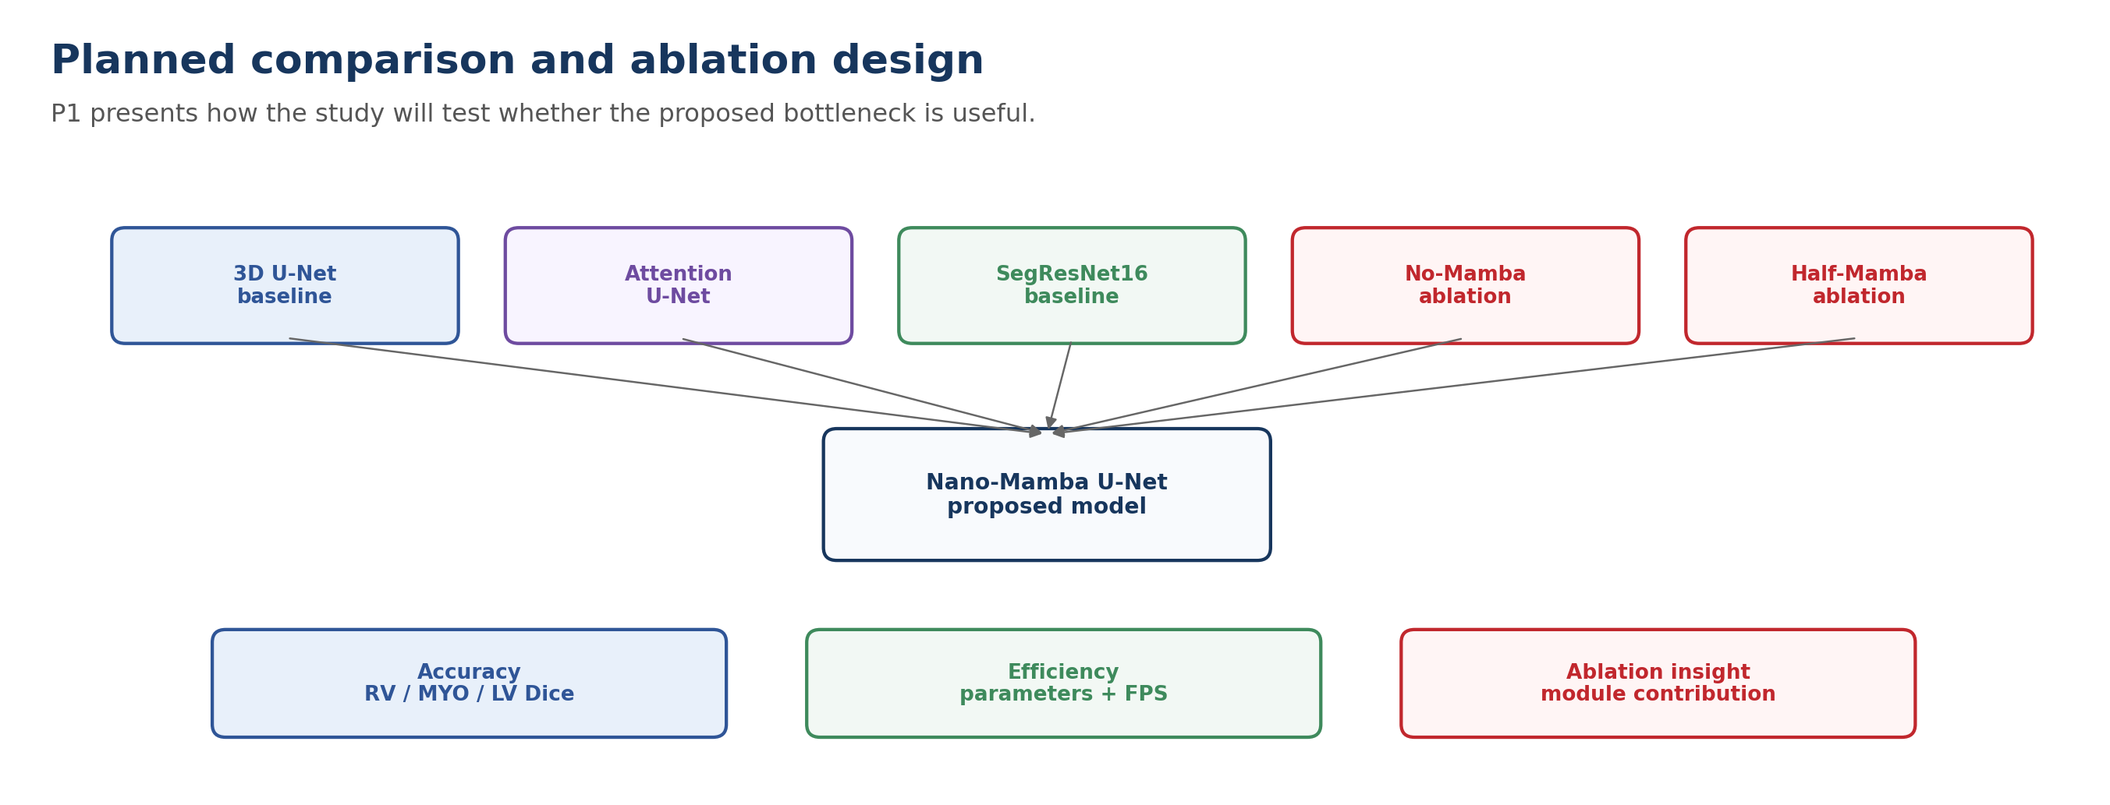
P1 Progress Presentation
Evaluation Plan and Expected Contribution
P1 endpoint: method is defined; P2 will report full results and discussion
Contribution statement
The project does not claim to invent U-Net or Mamba.
The innovation is a lightweight Mamba-inspired bottleneck integrated into a 3D U-Net pipeline.
The study evaluates whether this design improves the accuracy-efficiency trade-off for cardiac MRI segmentation.
Tong Siyuan | 10/10

