Slide 1
MASTER OF ARTIFICIAL INTELLIGENCE
Nano-Mamba U-Net:
A Spatio-Temporal Framework
for Cardiac Motion Analysis
3D segmentation
Full-cine function
Compact trade-off
P2 Final Defense
Tong Siyuan
Supervisor: Dr. Uzair Iqbal
Universiti Malaya · 2026
Notes:
Timing: 0:30
My project has two connected but distinct parts. First, Nano-Mamba U-Net performs compact spatial 3D cardiac segmentation. Second, the completed full-cine analysis applies that frozen spatial checkpoint to every cardiac phase and derives global functional and motion trajectories. I will keep those stages separate throughout the defense so I do not imply that the network learned temporal dynamics.
[Sources]
- paper_write/Universiti_Malaya_Thesis_Template/sample-abstract.tex
- SPATIOTEMPORAL_ANALYSIS.md
- evidence/spatiotemporal_cine/INDEPENDENT_AUDIT.json
[/Sources]

Slide 2
P2 FINAL DEFENSE
The framework has two distinct stages
Spatial 3D
segmentation
backbone
TRAINED STAGE
Labelled ED/ES 3D volumes; depth = anatomical slices
POST-HOC STAGE
Every cine frame → probabilities → fixed temporal fusion
OUTPUT
Native masks · volume curves · ED/ES · EF · global motion surrogates
Full cine is complete; learned temporal modeling and dense tissue motion are not claimed.
02
Notes:
Timing: 1:00
The trained task uses labelled end-diastolic and end-systolic 3D volumes. In these tensors, D means anatomical slice depth, not time. The full-cine stage is a post-hoc analysis: each 3D phase is segmented independently, then adjacent softmax probability maps are combined with fixed weights. From the native-grid masks I calculate chamber volumes, phase timing, ejection fraction and two global geometric motion surrogates. This is a genuine full-cycle analysis, but it is not a learned temporal Mamba model, optical flow, registration, dense deformation or strain estimation.
If asked whether the title is supported: yes, by the completed segmentation-derived full-cine function and global motion analysis. I explicitly bound the claim to avoid equating global geometric trajectories with tissue tracking.
[Sources]
- paper_write/Universiti_Malaya_Thesis_Template/sample-chap-methodology.tex
- SPATIOTEMPORAL_ANALYSIS.md
- SCIENTIFIC_BOUNDARIES.md
[/Sources]

Slide 3
P2 FINAL DEFENSE
One patient-level split protects the comparison
DISCOVER
SPLIT · SEED 42
EVALUATE
100 patients
80 / 20
160 / 40 cases
200 labelled ED/ES cases found; no invalid containers reported.
Patients are disjoint and cover patient001–patient100 exactly once.
One shared split for all models; best checkpoint selected by validation mean Dice.
Important: the same 20-patient validation set selects checkpoints and supplies the reported table—it is not an independent test set.
Source: audited split JSON and discovery report
3
Notes:
Timing: 0:55
The ACDC training cohort contains 100 patients. A fixed patient-level split with seed 42 assigns 80 patients to training and 20 to validation. Both ED and ES volumes from a patient remain in the same partition, so there is no patient leakage. The full-cine analysis uses those same 20 validation patients, 550 phases in total. Therefore it validates the completed pipeline on the held-out validation cohort, but it is not an independent test set and the same cohort was used for checkpoint selection.
[Sources]
- evidence/rigorous_patient_split/patient_split_seed42.json
- evidence/rigorous_patient_split/data_discovery_report.json
- evidence/spatiotemporal_cine/raw/run_provenance.json
- evidence/spatiotemporal_cine/raw/input_manifest.json
- evidence/spatiotemporal_cine/INDEPENDENT_AUDIT.json
[/Sources]

Slide 4
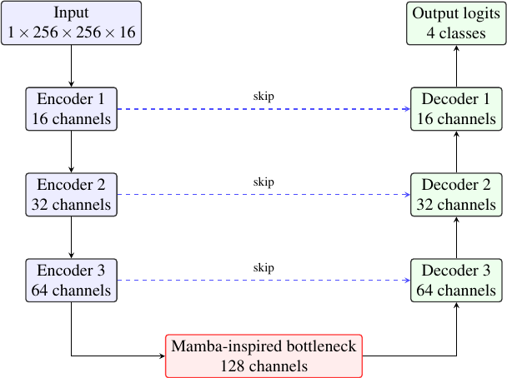
P2 FINAL DEFENSE
Nano-Mamba locally processes 2,048 spatial tokens
What the block does
• Bottleneck: B × 128 × 32 × 32 × 2
• 32 × 32 × 2 = 2,048 spatial tokens
• Kernel-3 depthwise 1D mix + scalar gate; no SSM scan or global interaction
Spatial tokens ≠ cardiac time; local gate ≠ full Mamba/SSM
Source: implementation-faithful thesis Figure 5.3 and nano_mamba_core.py
4
Notes:
Timing: 1:05
The architecture is a compact 3D encoder-decoder. At the bottleneck, 2,048 compressed spatial tokens are processed in a fixed raster order by a kernel-3 depthwise one-dimensional convolution, token-wise scalar gate, projections and a residual connection. This local block has no recurrent state-space propagation, selective scan, attention or direct global all-token interaction. Raster order also creates artificial adjacency where rows or slices meet. It is Mamba-inspired, not a reference Mamba or Visual State Space implementation, and it never scans cine time.
The reported parameter count is exactly 1,456,325. The convolutional control historically called No-Mamba contains zero Mamba operations: DoubleConv 64-to-128 followed by DoubleConv 128-to-128. Both it and Nano use batch size two, but the control is not parameter matched and has 2.288 million parameters. The 64-channel Mamba ablation uses the same local gate at 64 channels before expanding to 128; “Half” refers to that block width, not half of the full model.
[Sources]
- src/nano_mamba_core.py
- src/21_rigorous_experiment_pipeline.py
- paper_write/Universiti_Malaya_Thesis_Template/sample-chap-methodology.tex
- evidence/rigorous_patient_split/summary_metrics.csv
[/Sources]

Slide 5
P2 FINAL DEFENSE
Image processing is explicit at both stages
LOAD + SHAPE
INTERPOLATE + PREDICT
1 Load NIfTI / extract phase
2 Add channel axis
3 Resize: 256 × 256 × 16
MRI: trilinear + per-frame 0–1
Output: softmax probabilities
Mask: argmax + native nearest restore
GEOMETRY + POSTPROCESSING
Historical Dice uses the resized grid. Cine masks return to native array shape for physical volumes; no crop, connected components, registration, or deformation.
5
Notes:
Timing: 1:15
This is the exact image-processing pipeline. I load a NIfTI volume; for a full 4D cine I extract one phase at a time. I add the channel axis and resize each phase to 256 by 256 by 16. MRI intensities use trilinear interpolation and are independently normalized to zero-to-one using that phase's finite minimum and maximum. The network produces four-class softmax probabilities. Framewise inference uses those probabilities directly; temporal inference combines probability maps before argmax. The predicted labels are restored to the original array shape using nearest-neighbor interpolation, so class indices are not blended.
Historical endpoint Dice in the original experiment is measured on the resized grid. For the cine analysis, physical volumes use the native-grid mask and voxel volume from the NIfTI header spacings. There is no crop, connected-component filtering, registration, optical flow, dense deformation or hidden morphological cleanup. This distinction is why resized-grid and native-grid Dice are both reported.
[Sources]
- src/21_rigorous_experiment_pipeline.py
- src/23_spatiotemporal_cine_analysis.py
- paper_write/Universiti_Malaya_Thesis_Template/sample-chap-methodology.tex
[/Sources]

Slide 6
P2 FINAL DEFENSE
SegResNet16 leads Dice; Nano-Mamba is smallest
Model | Mean | RV | MYO | LV | Params
UNet3D | 80.83% | 78.35% | 74.57% | 89.59% | 4.809M
Nano-Mamba | 84.78% | 82.11% | 80.35% | 91.88% | 1.456M
Conv. control (No-Mamba) | 85.64% | 83.26% | 81.30% | 92.37% | 2.288M
64-ch Mamba (Half) | 84.95% | 82.41% | 80.46% | 91.99% | 1.638M
Attention U-Net | 74.78% | 69.43% | 72.38% | 82.53% | 5.909M
SegResNet16 | 86.70% | 84.30% | 82.76% | 93.03% | 4.701M
Highest Dice
Smallest reported size
Source: audited summary_metrics.csv; percentages rounded to two decimals for display
6
Notes:
Timing: 1:15
This table is the primary six-model comparison on the same 20-patient validation split. SegResNet16 has the highest mean Dice. The zero-Mamba convolutional control also exceeds Nano-Mamba, so I do not claim that the gated block improves accuracy. Nano-Mamba's defensible contribution is the lightweight operating point: 84.779 percent mean Dice, the lowest reported parameter count at 1.456 million, and competitive batch-one throughput on the recorded hardware. “Lightweight” does not mean that Nano leads every speed, memory or accuracy metric.
[Sources]
- evidence/rigorous_patient_split/summary_metrics.csv
- evidence/rigorous_patient_split/evidence_audit_report.json
- paper_write/Universiti_Malaya_Thesis_Template/sample-chap-results-p2.tex
[/Sources]

Slide 7
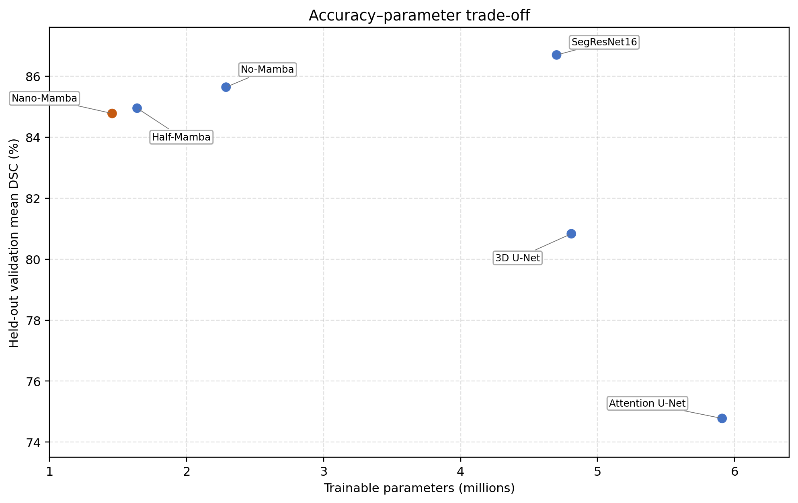
P2 FINAL DEFENSE
Nano-Mamba occupies a useful accuracy–parameter corner
+3.945 pp
vs UNet · CI [+2.83, +5.01]
−69.714%
reported parameters vs UNet3D
−1.918 pp
CI [−3.01, −0.88] vs Seg
Figure from summary CSV; paired CIs from six recovered per-case CSVs
7
Notes:
Timing: 1:10.
Use the graph to articulate the actual contribution: Nano-Mamba sits left because of compactness while retaining competitive validation Dice.
The recovered paired patient interval is +2.83 to +5.01 percentage points versus UNet3D and −3.01 to −0.88 versus SegResNet16.
These are post-hoc intervals on the validation patients used for checkpoint selection, not an independent test.
[Sources]
- Repository asset: figures/accuracy_parameter_tradeoff.png
- Repository: figures/quantitative_figure_provenance.json
- Repository: evidence/rigorous_patient_split/summary_metrics.csv
- Repository: evidence/rigorous_patient_split/evidence_audit_report.json
[/Sources]

Slide 8
P2 FINAL DEFENSE
The zero-Mamba control prevents a causal accuracy claim
85.64%
84.78%
+0.862 pp
Zero-Mamba conv. control
Nano-Mamba mean Dice
Interpretation
Nano − control CI: [−1.48, −0.23] pp. The zero-Mamba control is higher on this split but has 57.1% more parameters and a different bottleneck; no causal gate effect is isolated.
Source: summary CSV, six recovered per-case CSVs, and model definitions
8
Notes:
Timing: 1:10
Treat this as an important negative result. The paired Nano-minus-control interval is −1.48 to −0.23 percentage points on these validation patients. The control contains zero Mamba operations and its higher Dice is evidence against saying that adding this gated block raises Dice.
It is not a clean causal ablation: the control has a different convolutional bottleneck and 57.1 percent more parameters. Conversely, Nano uses 36.3 percent fewer parameters while retaining about 99.0 percent of the control's Dice and essentially the same recorded FPS. A parameter-matched, multi-seed ablation is needed to isolate the gate. The 64-channel Mamba ablation is only 0.17 percentage points above Nano and its paired interval crosses zero.
[Sources]
- evidence/rigorous_patient_split/summary_metrics.csv
- evidence/rigorous_patient_split/per_case_NanoMambaUNet.csv
- evidence/rigorous_patient_split/per_case_Ablation_NoMamba_UNet.csv
- evidence/rigorous_patient_split/per_case_Ablation_HalfMamba_UNet.csv
- src/21_rigorous_experiment_pipeline.py
[/Sources]

Slide 9
P2 FINAL DEFENSE
From segmentation to full-cine function
SPATIAL INFERENCE
TEMPORAL STEP
PHYSICAL OUTPUTS
550 cine frames
Fixed fusion
Native-grid measures
Each 3D phase → Nano-Mamba softmax probabilities
0.25 P(t−1) + 0.50 P(t) + 0.25 P(t+1), with circular phase boundaries
LV/RV/MYO curves; ED/ES; EDV, ESV, SV, EF; centroid and MYO radius
Post-hoc temporal regularization over a spatial checkpoint—not learned temporal Mamba, optical flow, deformation, or strain.
09
Notes:
Timing: 1:30
All 20 validation cines were processed, giving 550 three-dimensional phases. For each phase the frozen Nano-Mamba checkpoint outputs four-class softmax probabilities. The framewise path takes argmax directly. The temporal path applies a fixed circular three-phase filter: 0.25 times the previous probability map, 0.50 times the current map and 0.25 times the next map, then argmax. Circular boundaries connect the final phase to the first because the cardiac cycle is periodic.
After nearest-neighbor restoration to native array shape, class voxel counts are multiplied by dx times dy times dz from the NIfTI header to obtain millilitres. A circular three-point filter is used on the scalar LV-volume curve for stable phase detection. ED is the global maximum of the filtered LV curve and ES is its global minimum. Stroke volume is EDV minus ESV, and EF is 100 times stroke volume divided by EDV.
Global motion is summarized by the three-dimensional displacement of the LV centroid from ED and by the change in mean myocardial radius around that centroid. These are interpretable global geometric surrogates; they are not dense tissue correspondence or strain.
[Sources]
- src/23_spatiotemporal_cine_analysis.py
- src/cardiac_motion_metrics.py
- SPATIOTEMPORAL_ANALYSIS.md
- paper_write/Universiti_Malaya_Thesis_Template/sample-chap-methodology.tex
[/Sources]

Slide 10
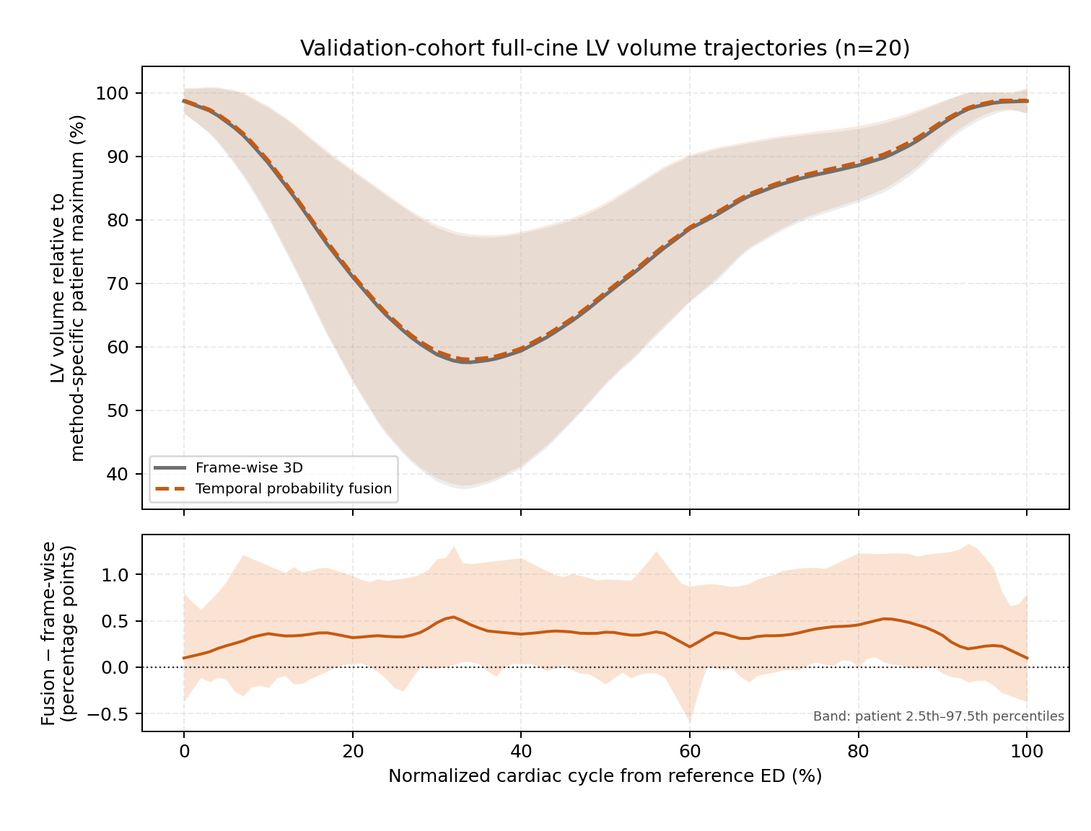
P2 FINAL DEFENSE
Temporal fusion smooths curves—not endpoint accuracy
19 / 20
patient LV curves were smoother
−0.001129
smoothness Δ · CI [−0.001950, −0.000511]
+0.014 pp
endpoint Dice Δ · CI [−0.063, +0.082] pp
Source: audited 20-patient, 550-frame cine result; paired bootstrap, 10,000 replicates
10
Notes:
Timing: 1:20
The supported temporal finding is smoother global LV-volume trajectories. The lower-is-smoother metric improved by 0.001129, and its paired 95 percent bootstrap interval is entirely below zero. Nineteen of twenty patients improved. By contrast, endpoint Dice changed by only plus 0.0144 percentage points and its interval crosses zero. Therefore I do not claim an accuracy gain from fixed fusion.
The upper chart aligns each patient to reference ED, normalizes each method by its own patient maximum, and shows both cohort means with mean plus or minus one between-patient standard deviation. The lower panel shows the paired fusion-minus-frame-wise difference and its pointwise patient 2.5th-to-97.5th percentile band. It makes the very small method difference visible without converting it into an accuracy claim.
[Sources]
- evidence/spatiotemporal_cine/raw/frame_metrics.csv
- evidence/spatiotemporal_cine/raw/patient_metrics.csv
- evidence/spatiotemporal_cine/raw/summary.json
- figures/spatiotemporal/population_lv_motion_curve_provenance.json
- evidence/spatiotemporal_cine/INDEPENDENT_AUDIT.json
[/Sources]

Slide 11
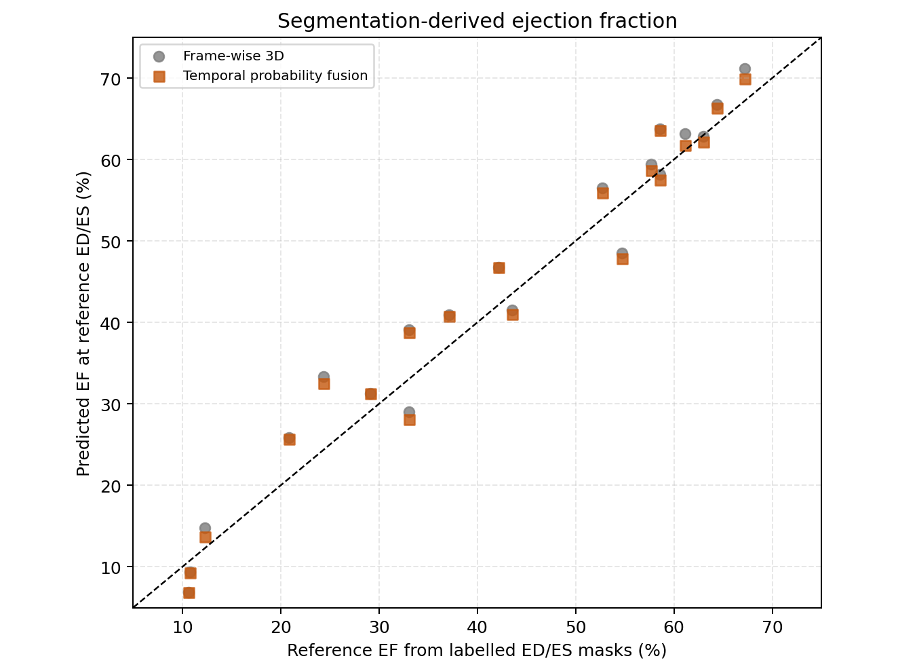
P2 FINAL DEFENSE
EF, phase timing, and global motion are quantified
Endpoint-validated function
• EF MAE: 3.329 pp; r = 0.9803
• ED exact / ±1: 55% / 80%
• ES exact / ±1: 55% / 85%
Global surrogates: median LV-centroid displacement 6.252 mm; mean MYO radius ED−ES 4.153 mm
Source: manual ED/ES masks, Info.cfg, patient_metrics.csv, and independent audit
11
Notes:
Timing: 1:20
Manual masks are available only at ED and ES, so those endpoints provide the anatomical validation. For the fused method, EF mean absolute error is 3.329 percentage points and Pearson r is 0.9803. Predicted ED is exact for 55 percent and within one phase for 80 percent; predicted ES is exact for 55 percent and within one phase for 85 percent.
The median maximum LV-centroid displacement from ED is 6.252 millimetres, and the mean change in myocardial radius from ED to ES is 4.153 millimetres. I call these global surrogates because without intermediate manual labels or registration I cannot verify local tissue trajectories. Patient 016 is the largest phase-timing outlier; patient 057 has the largest fused EF error, about 8.12 percentage points.
Six recovered public cines have affine metadata that differs from the standalone endpoint containers. Shape, header voxel sizes, endpoint pixel content and endpoint image-label alignment passed the gates. Physical volumes use header voxel sizes, and the pipeline does not use those inconsistent affines to assert world-coordinate tissue correspondence.
[Sources]
- evidence/spatiotemporal_cine/raw/patient_metrics.csv
- evidence/spatiotemporal_cine/raw/summary.json
- evidence/spatiotemporal_cine/raw/input_manifest.json
- evidence/spatiotemporal_cine/INDEPENDENT_AUDIT.json
[/Sources]

Slide 12
P2 FINAL DEFENSE
What the study supports—and still cannot claim
SUPPORTED
LIMITS
• 20/20 patients; 550/550 frames
• Endpoint identity + Dice reproduction
• EF, phase, volume, centroid + MYO-radius curves
• Fixed fusion: 19/20 smoother
• Same validation set selected checkpoint
• Intermediate frames lack manual masks
• No learned temporal model or dense motion/strain
• Single split/seed; no external test
Smoother global curves do not prove anatomically correct intermediate masks.
12
Notes:
Timing: 1:10
The completeness claim is operational: every expected validation patient and every expected cine phase was processed, endpoint identities and metrics reproduce, and the result package passes an independent audit. The central limits remain important. The validation cohort selected the checkpoint, intermediate phases have no manual masks, and a smoother volume curve cannot prove every intermediate contour is anatomically correct. There is one split and seed and no external cohort.
If asked why the analysis is still useful, it tests whether a compact spatial segmentation model can generate coherent whole-cycle global function and motion summaries. It does not replace a future learned temporal or registration-based study.
[Sources]
- evidence/spatiotemporal_cine/INDEPENDENT_AUDIT.json
- SCIENTIFIC_BOUNDARIES.md
- paper_write/Universiti_Malaya_Thesis_Template/sample-chap-results-p2.tex
[/Sources]

Slide 13
P2 FINAL DEFENSE
Contribution delivered; stronger temporal models next
DELIVERED
COMPLETED CINE
FUTURE VALIDATION
Compact backbone
Full-cycle analysis
Learned + dense
84.78% Dice with 1.456M reported parameters; local Mamba-inspired gate
550 frames; native masks; function, phase, global motion trajectories
Independent tests; learned temporal context; registration, correspondence, and strain
The title is supported by complete segmentation-derived cine analysis; dense tissue motion remains outside scope.
13
Notes:
Timing: 0:55
The completed contribution is a compact spatial segmentation backbone plus an audited full-cycle analysis that turns all 550 cine phases into native-grid masks, functional indices, phase timing and bounded global motion trajectories. The fixed fusion is a transparent baseline and improves curve smoothness, not endpoint accuracy. The next scientific step is an independent test cohort and a learned temporal model; dense motion would additionally require registration or correspondence and dedicated strain validation.
[Sources]
- paper_write/Universiti_Malaya_Thesis_Template/sample-chap-conclusion.tex
- SPATIOTEMPORAL_ANALYSIS.md
- evidence/spatiotemporal_cine/INDEPENDENT_AUDIT.json
[/Sources]

Slide 14
DEFENSIBLE CONCLUSION
Compact segmentation +
audited full-cine function
84.78%
1.456M
19/20
validation mean Dice
reported parameters
smoother LV curves
SegResNet16 leads Dice; fixed fusion does not resolve Dice/EF gains. Contribution = compact spatial model + bounded full-cine analysis.
Questions
Notes:
Timing: 0:30
In conclusion, Nano-Mamba is not the most accurate model and the fixed temporal fusion does not establish a Dice or EF gain. The defensible contribution is a compact 1.456-million-parameter spatial model at 84.78 percent validation Dice, together with a complete and independently audited 20-patient full-cine analysis whose strongest temporal result is smoother LV-volume curves in 19 of 20 patients.
[Sources]
- evidence/rigorous_patient_split/summary_metrics.csv
- evidence/spatiotemporal_cine/raw/summary.json
- evidence/spatiotemporal_cine/raw/patient_metrics.csv
- evidence/spatiotemporal_cine/INDEPENDENT_AUDIT.json
[/Sources]

