Slide 1
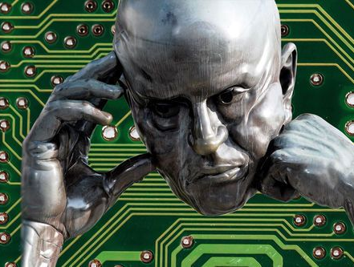
Image Captioning on Flickr8k Dataset
TEAM MEMBERS
Chanakya Dandamudi
Divya Gorijala
Mounika Bireddy
Vamshi Nandala

Slide 2
INTRODUCTION
Title: Image Captioning Using the Flickr8k Dataset with Encoder-Decoder Architecture
Introduction:
Overview: This project involves implementing an image captioning model using a deep learning approach based on the Encoder-Decoder architecture.
Relevance: Image captioning plays a crucial role in bridging computer vision and natural language processing. It is used in applications such as accessibility tools for visually impaired users, automatic image tagging, and content-based image retrieval systems.

Slide 3
MAIN POINTS
Key Findings:
Encoder-Decoder Architecture: Utilizes a Convolutional Neural Network (CNN) as the encoder to extract image features and a Recurrent Neural Network (RNN) as the decoder to generate captions from those features.
Training Data: The model is trained on the Flickr8k dataset, which consists of 8,000 images with five human-written captions for each image.
Preprocessing: Images are resized and normalized, while captions are tokenized and padded to ensure uniformity across the dataset.

Slide 4
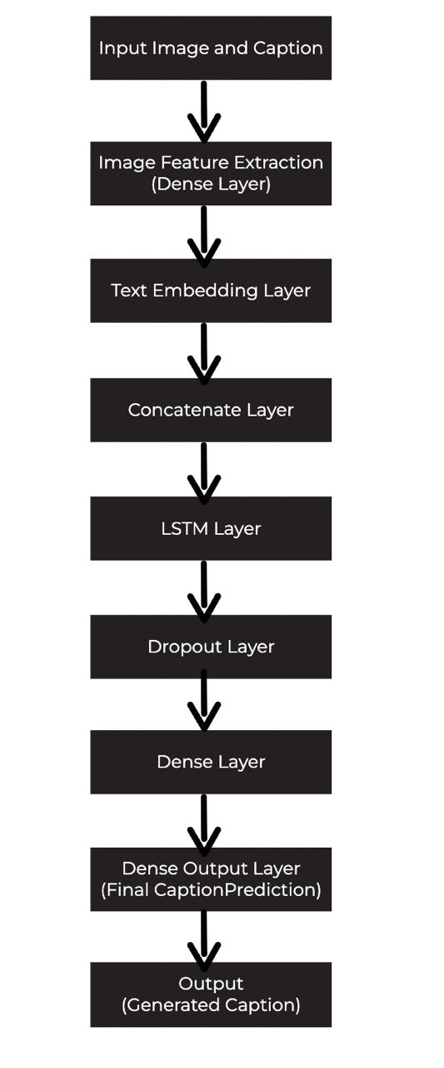
METHODOLOGY
Model Architecture:
Encoder: A CNN processes the image to extract features.
Decoder: An LSTM network takes the image features and generates a sequence of words that describe the image.
Data Pipeline:
Preprocessing: Images are resized and preprocessed; captions are tokenized and padded.
Training: The model is trained using the preprocessed data and evaluated based on loss and accuracy metrics.

Slide 5
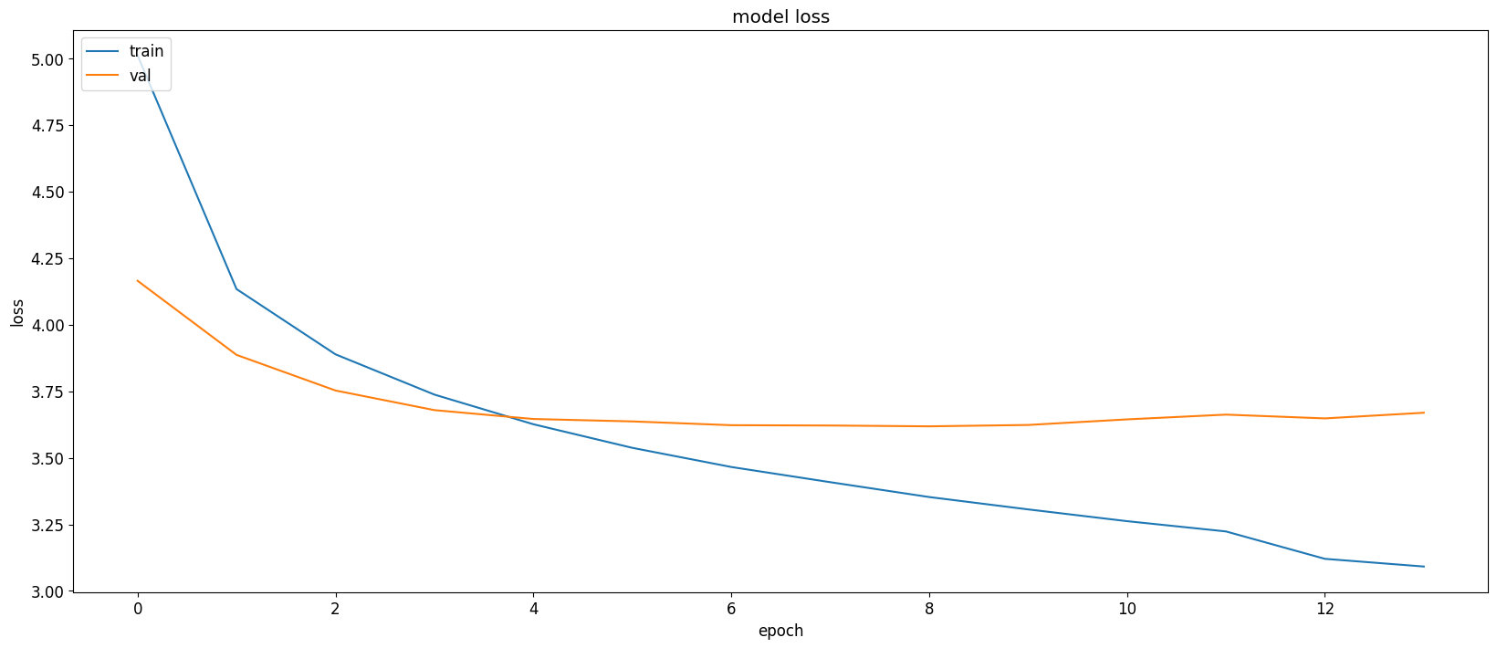
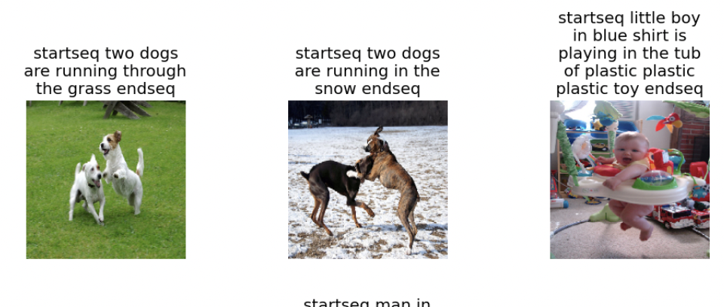
RESULTS
Model Loss:
Final Output

Slide 6
CONCLUSION
Summary: The image captioning model successfully generates meaningful captions for images by combining CNN for feature extraction and LSTM for text generation. Despite the model's ability to generate accurate captions, challenges remain in improving the contextual relevance and diversity of the generated captions.
Challenges: While the model performs well in identifying objects, it faces challenges in handling colors and tends to overfit on the training data.
Future Work: To address overfitting and improve caption quality, future work will focus on incorporating dropout layers, experimenting with more advanced architectures like attention mechanisms, and training the model with larger, more diverse datasets to improve generalization and enhance the accuracy of color predictions and overall caption diversity.
Demo: Demo link

Slide 7

THANK YOU

