Slide 1


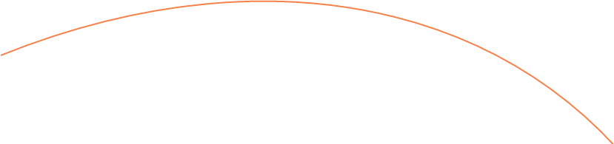
Singapore HDB Resale Price Analysis
A Database-Driven Analysis of Property and Transaction Characteristics
MH6142 Database Systems
Group Members
GROUP 4
• Ayushi Dixit— G2608390B
• Divyansh Chauhan — G2601183C
• Suhani Singhal — G2607395F

Slide 2
Research Question and Datasets
What property, location and transaction characteristics are associated with Singapore HDB resale prices and price per square metre?
HDB Resale Transactions
240,807 records
Contains key transaction variables including sale price, transaction month, town, flat type, floor area, storey range, and remaining lease duration.
HDB Property Information
13,357 records
Contains block-level information including block and street, completion year, residential indicators and dwelling-unit counts.
Source: Singapore Government Data, data.gov.sg | Period: January 2017 to September 2026

Slide 3
Database-Driven Workflow
cloud_download
code
dns
storage
STAGE 01
STAGE 02
STAGE 03
STAGE 04
Data.gov.sg
Python Preprocessing
Staging Schema
Core Schema
HDB source datasets
Clean, standardise and validate
Load processed source data
Store normalized relational tables
table_chart
terminal
insert_chart
STAGE 05
STAGE 06
STAGE 07
Analytics View
SQL Analysis
Python Visualisations
analytics.resale_enriched
Retrieve analysis-ready data
Produce charts and findings
After loading, PostgreSQL becomes the only data channel used for analysis. Python retrieves data through SQL instead of reading the original CSV files directly.

Slide 4
Data Preprocessing and Validation
Cleaning & Transformation
Validation Results
text_format
Text Formatting
Standardised text, capitalisation and whitespace
link
Address Matching
Created common address_key for dataset matching
240,807
Transactions retained
240,804
Transactions matched
99.9988%
Address match rate
calendar_today
Date Parsing
Converted month into valid database date
unfold_more
Storey Ranges
Parsed lower, upper and midpoint values
3
Unmatched transactions
1
Unmatched address
Flagged
Duplicates flagged, not deleted
schedule
Lease Duration
Converted remaining lease into total months
toggle_on
Boolean Indicators
Converted property Y/N to Booleans
ORIGINAL VALUE
PROCESSED VALUE
2017-01
2017-01-01
ANG MO KIO
ANG MO KIO
10 TO 12
Lower 10, Upper 12, Midpoint 11
61 years 04 months
736 months
The preprocessing approach standardised, parsed, validated and flagged records without silently deleting source data.

Slide 5
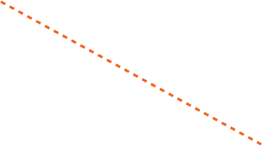


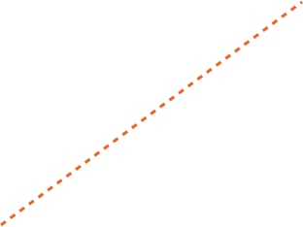
Normalized Database Design
core.hdb_block
core.town
block_id [PK]
address_key [UQ]
block
street
year_completed
town_id [PK]
town_name
1
Why normalization?
core.resale_transaction
1
• Reduces repeated category data
Eliminates redundant text strings.
• Enforces valid relationships
Foreign keys ensure integrity.
• Improves consistency
Single source of truth for entities.
• Simplifies maintenance
Easier updates and smaller storage.
∞
transaction_id [PK]
source_row_id [UQ]
town_id [FK]
flat_type_id [FK]
flat_model_id [FK]
block_id [FK]
month
floor_area_sqm
resale_price
core.flat_type
∞
flat_type_id [PK]
flat_type_name
1
∞
∞
core.flat_model
flat_model_id [PK]
flat_model_name
1
The central transaction table stores sales, while reusable property and category information is maintained in related tables.

Slide 6
PostgreSQL Implementation
Processed files → Staging → Core → Analytics view → SQL and Python analysis
dns1. STAGING SCHEMA
storage 2. CORE SCHEMA
analytics3. ANALYTICS SCHEMA
Purpose: Controlled landing area for processed files.
Purpose: Authoritative normalized relational database.
Purpose: Simple analysis-ready access.
Tables:
• staging.hdb_resale
• staging.hdb_property
• staging.load_audit
Tables:
• core.town & core.flat_type
• core.flat_model & core.hdb_block
• core.resale_transaction
Main View:
analytics.resale_enriched
240,807TRANSACTION ROWS
Staging tables preserve the processed file structure and support load validation.
View Includes:
• Town, flat type & flat model
• Property & transaction info
• Price per sqm and remaining lease
• Building age at sale & Duplicate flags
Key Features:
• Primary & Foreign keys [PK/FK]
• Unique & Check constraints
• Data-type validation
• Indexed frequent query fields
inventory_2 Reproducible Environment
Docker Compose runs the same local PostgreSQL database configuration for every group member. DBeaver can be used to inspect tables, relationships and query results.
The layered architecture separates data loading, relational storage and analytical access while maintaining one consistent source of truth.

Slide 7
Exploratory analysis -
We analysed the factors associated with HDB resale prices and price per square metre.
Time
How have resale prices changed over time?
Town
How does price per sqm differ across towns?
Flat type
How do resale prices differ by flat type?
Remaining lease
How does remaining lease relate to price per sqm?
*Analysis performed using SQL queries on analytics.resale_enriched, with Python used for visualisation.
Storey
How does storey range relate to resale price?
Building age
How does building age relate to price per sqm?
Question 5

Slide 8
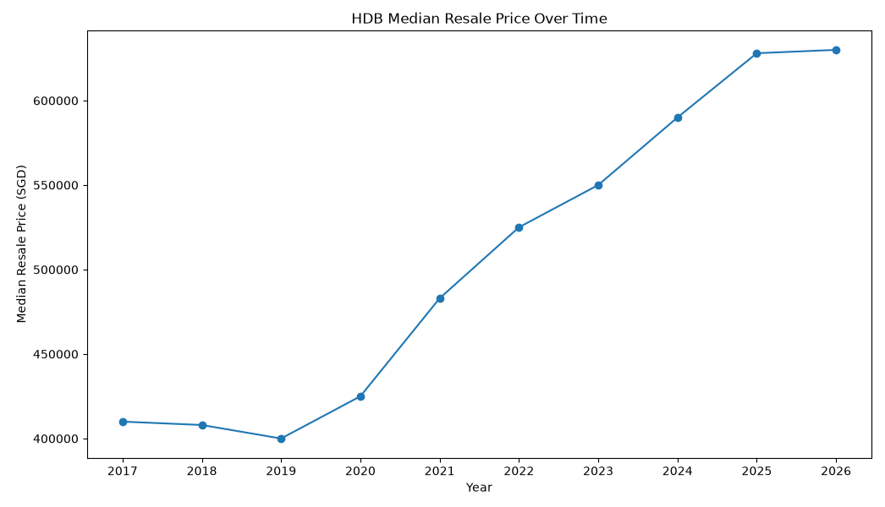
HDB Resale Price Trend Over Time
Observations:
Median HDB resale prices declined slightly from 2017 to 2019, reaching the lowest point in 2019.
From 2020 onwards, median resale prices increased consistently, with a particularly strong rise between 2020 and 2025.
The median price appears to level off between 2025 and 2026. However, 2026 only contains transactions up to September, so it is a partial-year figure.
Key takeaway: HDB resale prices show a clear upward trend after 2019.
Measure: Median resale price by transaction year
Period: 2017–Sep 2026
Possible contributing factors :
pandemic-related BTO construction delays may have pushed some buyers toward the resale market, while demand remained strong.

Slide 9
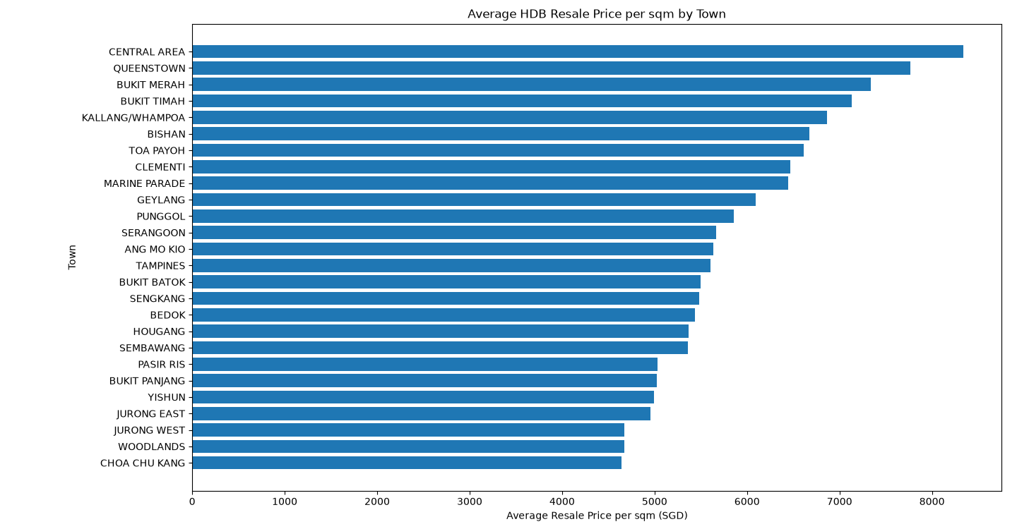
Resale Price per sqm by Town
Observations:
Central Area recorded the highest average resale price per sqm, followed by Queenstown and Bukit Merah.
The lowest average price per sqm was observed in towns such as Choa Chu Kang, Woodlands and Jurong West.
The sizeable difference between towns suggests that location is strongly associated with HDB resale value, even after adjusting for floor area.
Possible contributing factors :
Proximity to the city centre and employment/commercial areas.
Accessibility and transport connectivity, such as MRT links.
The mix of flat types, flat ages and remaining lease can also differ across towns and affect the average price per sqm.
Measure: Average resale price per sqm by town
Period: Jan 2017 – Sep 2026

Slide 10
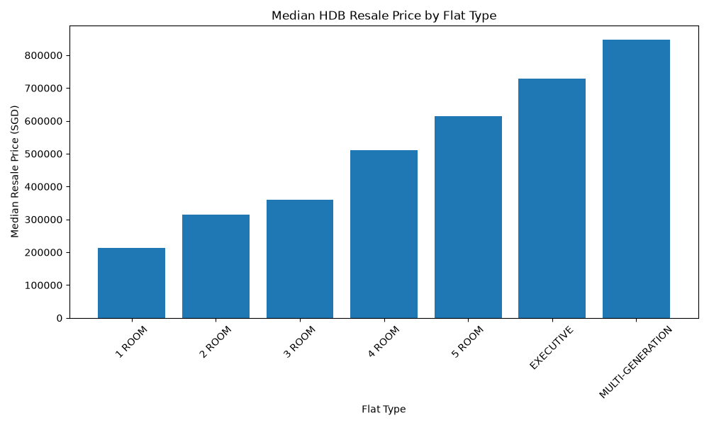
Resale Price by Flat Type
Observations:
The jump from 3-Room to 4-Room is visibly larger than the jump from 2-Room to 3-Room, suggesting resale prices do not increase evenly across flat categories.
Flat type is associated with total resale price, but this comparison should be interpreted together with floor area.
Possible contributing factors :
Larger flat types generally have greater floor area, which contributes to higher total resale prices.
Different flat types may also vary in location, age, storey and remaining lease, which can influence the observed price differences.
Some flat categories, such as Executive and Multi-Generation flats, are less common, which may also affect their observed median prices.
Measure: Median resale price by flat type
Period: Jan 2017 – Sep 2026

Slide 11
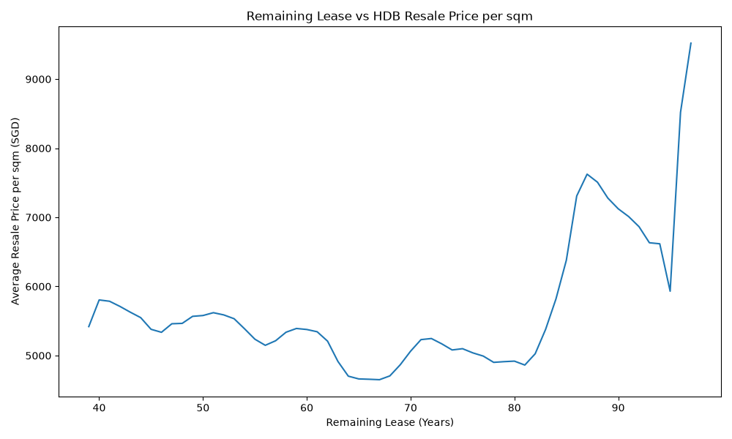
Remaining Lease vs Resale Price per sqm
Observations:
The relationship between remaining lease and price per sqm is non-linear. Prices remain relatively similar across roughly 40–60 years of remaining lease, before reaching a lower range around the mid-60s.
A much stronger increase appears once remaining lease exceeds approximately 80 years, with flats above 85 years generally recording substantially higher average price per sqm.
Possible contributing factors :
Flats with very long remaining leases are generally newer, so remaining lease is strongly related to building age.
Newer flats may also be disproportionately located in higher-priced towns or newer developments, meaning location may partly explain the observed increase.
Measure: Average resale price per sqm by remaining lease years
Period: Jan 2017 – Sep 2026

Slide 12
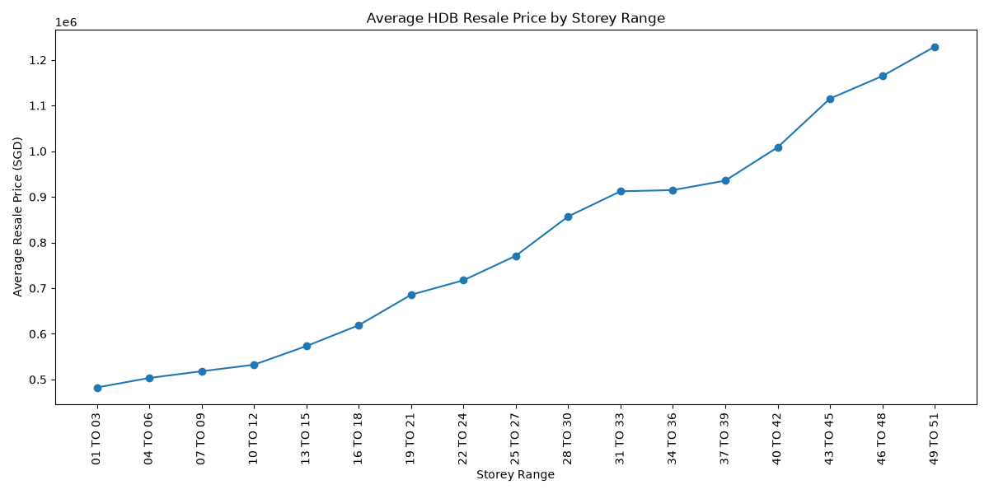
Storey Range vs Resale Price
Observations:
Average resale price shows a clear upward trend across higher storey ranges, with the highest storey groups recording the highest average resale prices.
The strongest increases appear in the upper storey ranges, suggesting that a storey premium may become more pronounced at very high floors.
Possible contributing factors :
Higher-floor units may attract a premium because of better views, more privacy and lower street-level noise.
Very high storeys are more common in certain newer or centrally located developments, so location and building type may partly explain the higher prices.
Higher-storey transactions may also involve different flat types and floor areas, so the observed trend should not be interpreted as a pure storey effect.
Measure: Average resale price by storey range
Period: Jan 2017 – Sep 2026

Slide 13
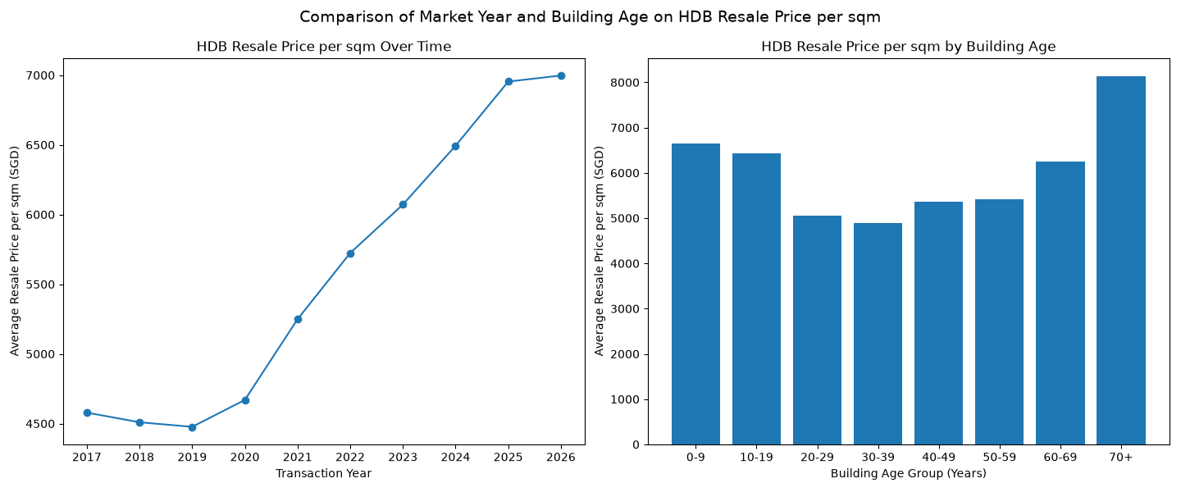
Building Age Analysis
Observations:
Average resale price per sqm increased strongly over the years, especially from 2020 onward.
Building age does not show a simple “older = cheaper” pattern. Some of the oldest buildings still recorded high price per sqm.
This may partly be because many older-building transactions occurred in later years, when overall HDB resale prices were already much higher than in 2017–2019.
Therefore, the high prices seen for older buildings may reflect a combination of building age and market-year effects, rather than age alone.
Measure: Average resale price per sqm by transaction year and building age group
Period: Jan 2017 – Sep 2026
Possible contributing factors :
Because prices increased substantially over time, some older-flat transactions may also have occurred during higher-price market years, inflating their observed average price per sqm.

Slide 14
Hedonic regression
Why a second-stage analysis was needed:
  The exploratory charts analyse one factor at a time, but HDB prices are influenced by several characteristics simultaneously.
Hedonic regression estimates the association of each characteristic with price while holding the others constant.

Slide 15
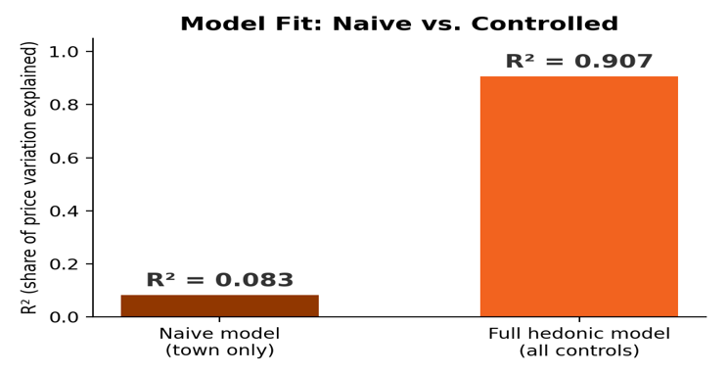
Introducing the Hedonic Model
Observations:
Every prior chart admitted town, type, area, lease, storey and age are entangled. A hedonic regression isolates each effect.
log(price) ~ town + flat_type + floor_area + storey + lease + age + year
Town alone explains 8% of price variation. Full controls explain 91%.
Model: OLS regression, log(resale_price) as outcome
Data: 240,807 transactions, Jan 2017–Sep 2026
Why this matters :
-Replaces every “possible contributing factors” guess in slides 9–14 with one measured, controlled answer.

Slide 16
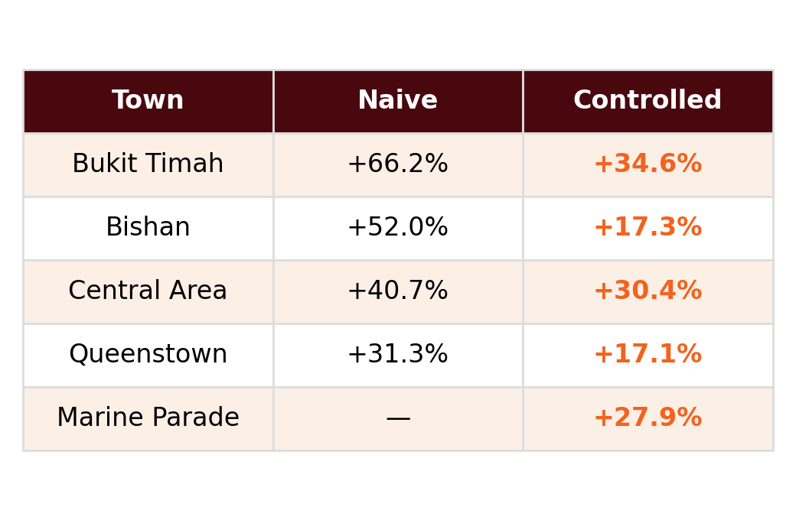
Town Premium: Naive vs Controlled
Observations:
Central Area and Bukit Timah keep a large premium even after controls — a genuine location effect.
Bishan's premium roughly halves once controlled (+52% → +17%).
Much of a town's apparent expensiveness is really bigger, higher-floor, newer flats — not location.
Measure: Premiums are measured relative to the model’s baseline town.
Period: Jan 2017 – Sep 2026
Reading the table :
“Controlled” holds flat type, floor area, storey, lease and age fixed across towns.

Slide 17
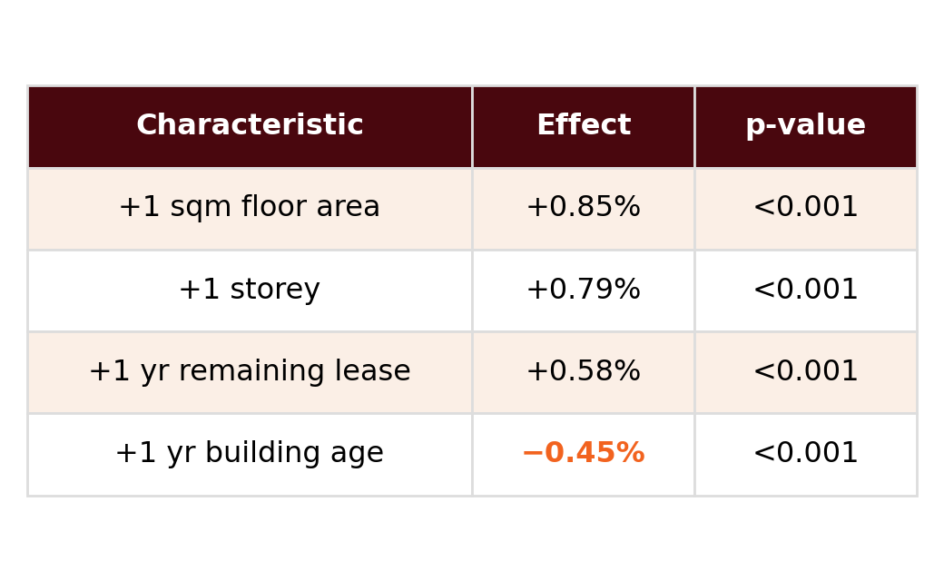
What Actually Moves Price
Observations:
Floor area, storey and lease all raise price, all p < 0.001.
Building age has a clean, significant NEGATIVE effect (−0.45%/yr) once transaction year is held fixed.
This resolves slide 14: the “older = sometimes pricier” pattern was a market-year confound, not noise.
Interpretation: Each value is the estimated percentage change in resale price for a one-unit increase, holding all other variables constant.
Model: Same controlled hedonic regression as slide 16
Sample: 240,807 transactions
Resolves slide 14 :
The “small-sample issue” hand-wave is replaced by a proven market-timing confound.

Slide 18
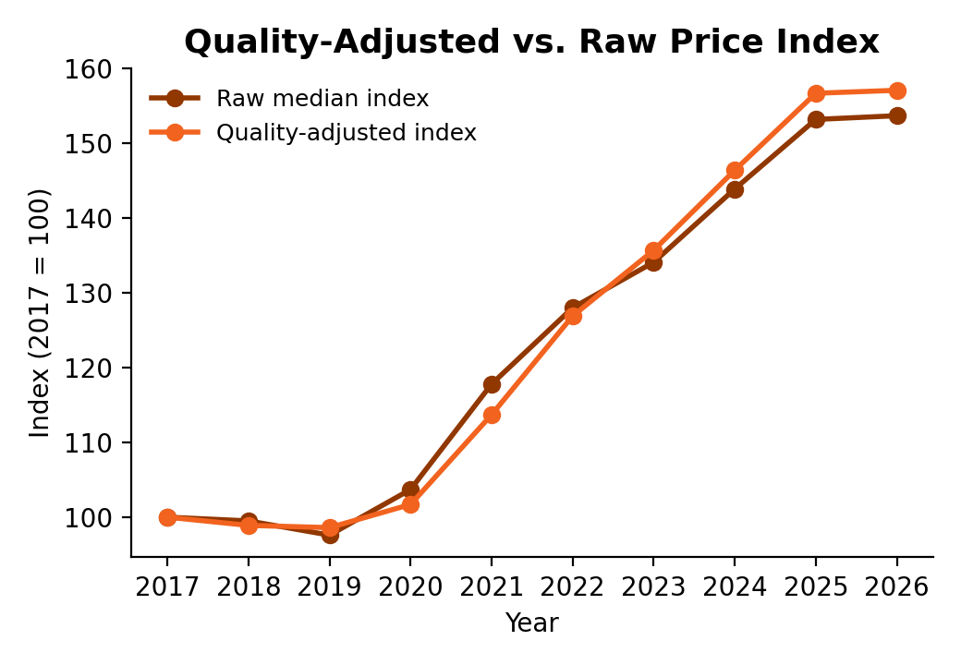
Quality-Adjusted Price Trend
Observations:
Holding flat mix constant (via the model's year effects) gives a quality-adjusted index vs. slide 9's raw median.
The two track closely but diverge in 2020–2021 — raw median rose faster.
That gap is composition change (buyers shifting to larger/better flats), not pure appreciation.
Measure: Index, 2017 = 100, quality-adjusted vs. raw median
Period: Jan 2017 – Sep 2026
Upgrades slide 9 :
A more careful answer to “how much did prices really rise.”

Slide 19
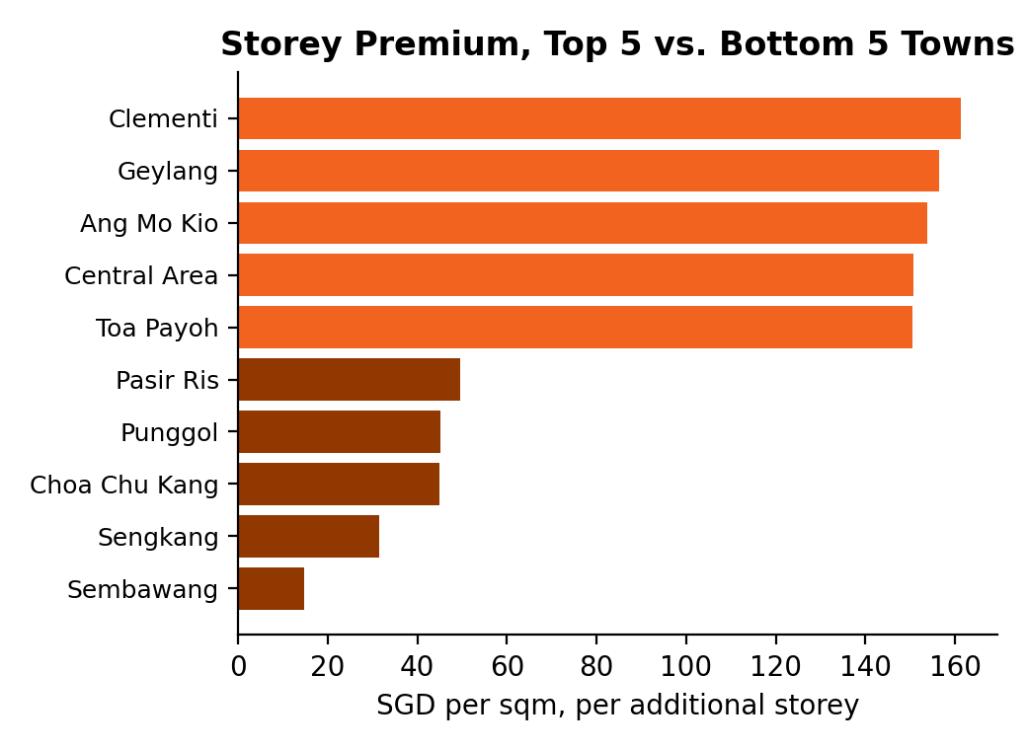
Storey Premium by Town
Observations:
Per-town storey→price regression via Postgres's built-in regr_slope / regr_r2 aggregates.
Clementi, Geylang, Ang Mo Kio: ~150–161 SGD/sqm per storey.
Sengkang, Sembawang: only ~15–32 SGD/sqm per storey — 5–10x lower.
Measure: SGD per sqm, per additional storey, by town
Period: Jan 2017 – Sep 2026
Interpretation :
Older, central towns show a steeper storey premium than newer estate towns — hidden by a single citywide chart.

Slide 20
Conclusion and Key Findings
Overall Market Trend
Factors Associated with Prices
Controlled Regression Findings
Median HDB resale prices declined slightly between 2017 and 2019.
Prices increased consistently from 2020 onward.
The 2026 result is based on transactions only up to September and represents a partial year.
Location: Central Area, Queenstown and Bukit Merah recorded high average prices per sqm.
Flat Size: Larger flat types have higher total prices due to floor area.
Storey: Higher-storey flats generally achieve higher resale prices.
Remaining Lease: Flats with more than 80 years remaining generally recorded higher prices per sqm.
Building Age: The relationship is influenced by location and transaction year.
~8%
~91%
Town-only model price variation explained
Full hedonic model price variation explained
The controlled model shows that resale prices reflect several characteristics simultaneously. Some apparent town premiums become smaller after controlling for flat type, floor area, storey, remaining lease, building age and transaction year.
HDB Resale Price Trajectory
Key Takeaway: Singapore HDB resale prices are associated with both location and property characteristics, while broader market conditions also contribute to changes over time.
Limitation Note: The results show statistical associations and should not be interpreted as proof of causation.
2017
2019
2022
2026*

