Slide 1
TEAM ASTROPHAGE
Quantifying Ion Energy Flux
Across Plasma Sheaths
Ajayaditya L · Nithisha V · Denistan B
WHAT WE HAVE ACHIEVED SO FAR
ACCURACY
96.0 %
we land within 3.99 % of the true value, on average
TOLERANCE
± 2.76 %
spread across ten repeat runs
CONFIDENCE
90 %
the error bar we quote
COVERAGE
8 of 10
runs where the truth fell inside it

Slide 2
THE PROBLEM
Ion energy flux decides how plasma hardware heats, erodes and lasts
At every boundary between a plasma and a solid surface, ions are accelerated across a thin charged layer called the sheath, and slam into the wall. How much energy they carry decides three things.
Heat
The wall gets hot. That sets the cooling limit, and so the most power the machine can run at.
Wear
The wall is chipped away atom by atom. This is the main reason plasma hardware eventually fails.
Waste
Energy that ends up in the wall is energy not doing the job, whether that is producing thrust or etching a wafer.
WHO HAS THIS PROBLEM TODAY
Satellite thrusters
The engine slowly eats its own walls. That is what limits how long a satellite can keep manoeuvring.
Chip factories
The energy of the ions decides how cleanly a circuit pattern is cut into the silicon wafer.
Fusion reactors
The inner wall absorbs the heat the plasma throws at it, and that caps how hard the reactor can be run.
All three need this number. None of them can measure it.
Team Astrophage · Techathon 2.0 (Naari Shakti)
02 / 07

Slide 3
THE GAP
The number that governs the surface cannot be measured at the surface
The energy the ions actually deliver to the wall. No instrument can point at it, so it has to be reconstructed from other measurements.
BULK PLASMA
SHEATH
Emission spectroscopy
how bright the plasma glows
Laser-induced fluorescence
how fast the ions are moving
the energy that actually lands
Put a probe in and you change the layer you are trying to measure. Leave it out and each optical method sees only one piece of the picture.
Thomson scattering
how hot the electrons are
Interferometry
how dense the plasma is
WALL
So we work backwards: measure what light can tell us, then use the physics to reconstruct the rest.
Team Astrophage · Techathon 2.0 (Naari Shakti)
03 / 07

Slide 4
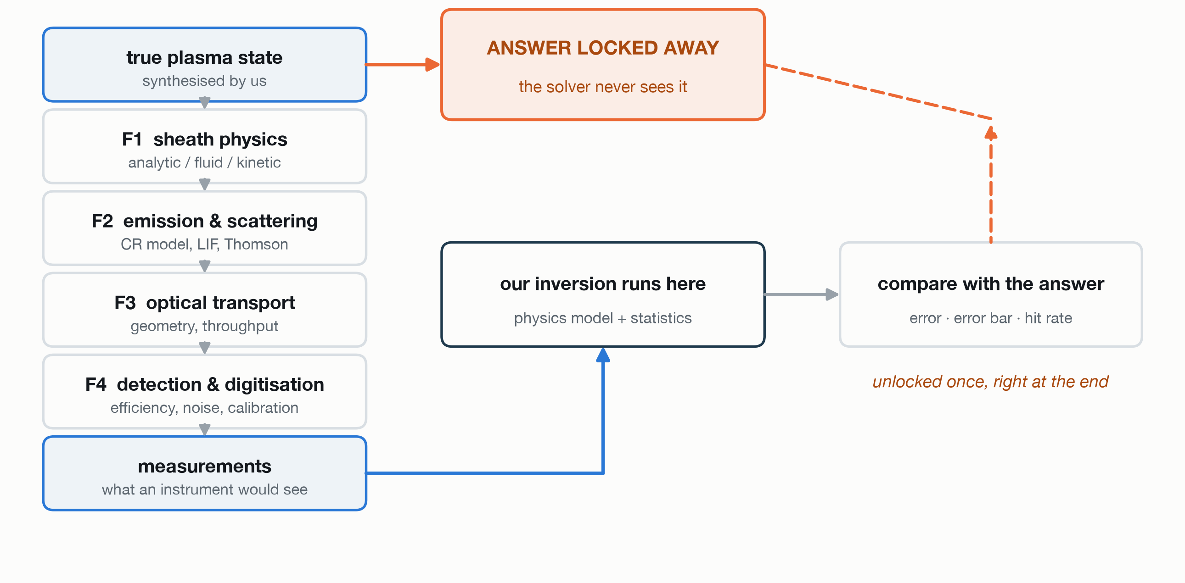
HOW WE TESTED IT
We marked our own homework, with the answer locked away
TWO RULES, BUILT INTO THE CODE
The camera never sees the plasma.
Our detector model only receives light. A real camera cannot know the plasma density, so ours is not allowed to either.
One piece of code, not two.
The part that makes the test data and the part that solves it share the same physics code, so they cannot quietly drift apart.
SHEATH PHYSICS, AT THREE LEVELS
L0 analytic: closed-form sheath equations
L1 fluid: solves the sheath numerically
L2 kinetic: tracks individual particles
WHICH LEVEL EACH TIER USES
T0 same level both sides, no noise
0.012 %
T1 same level both sides, with noise
0.050 %
T2 truth from L1, solved with L0
3.99 % our headline number
Team Astrophage · Techathon 2.0 (Naari Shakti)
04 / 07

Slide 5
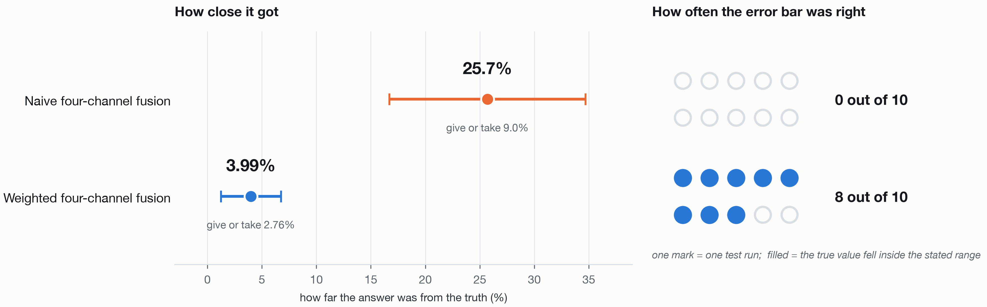
THE RESULT
Our first honest answer was wrong, and sure of itself
An error bar that misses the truth ten times out of ten means the method was confidently wrong. A per-channel audit showed one channel was overstating how good it was; weighting it down fixed the whole thing.
Ten repeat runs, hardest tier. True flux at the test point: 9.33 kW/m².
Every measurement here is simulated. This shows the method is sound. It does not yet show it works on real hardware.
Team Astrophage · Techathon 2.0 (Naari Shakti)
05 / 07

Slide 6
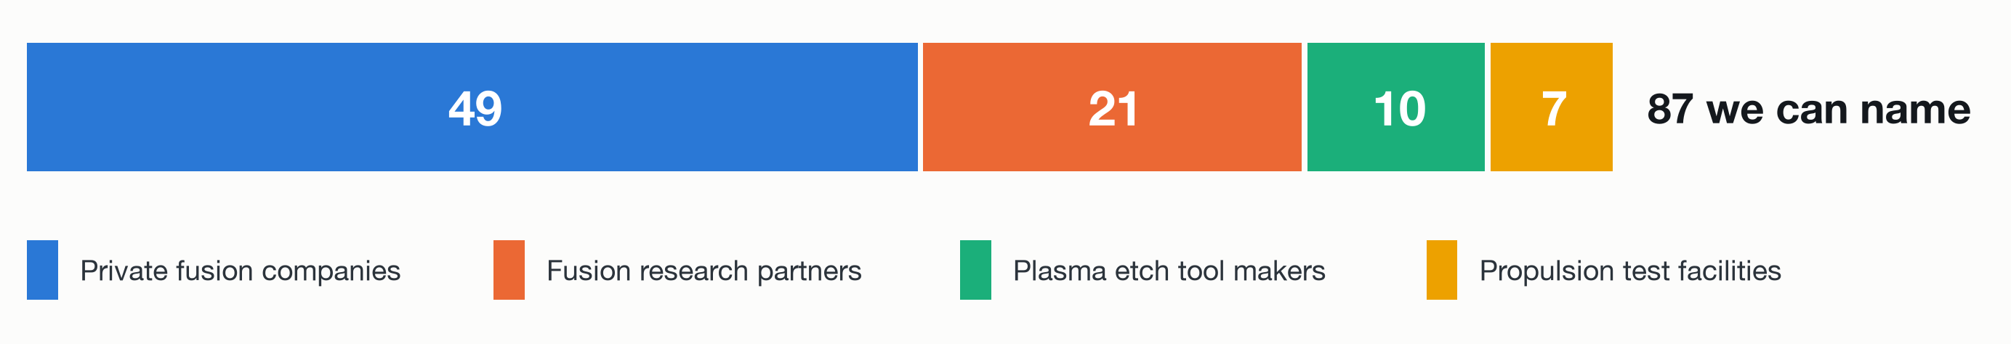
THE MARKET
A customer list we can name, in industries putting real money in
There is no analyst report for a plasma diagnostics market. We checked eight research houses and none publishes one, so we counted the buyers by hand.
WHAT IS BEING SPENT AROUND THEM
$4.48B
raised by fusion companies in the year to July 2026, on top of $13.26B of private money already in
$133B to $156B
semiconductor equipment sales, 2025 to a 2027 forecast, reported by SEMI
$415M
authorised through 2027 for the US fusion milestone programme
60 instruments
diagnostics planned on ITER alone, measuring 101 separate parameters
Those are the industries our customers sit in, not our own market. What we sell into is the 87.
Team Astrophage · Techathon 2.0 (Naari Shakti)
06 / 07

Slide 7
WHERE WE STAND
What we have done, and what comes next
PHASE 1
Build and test on simulated data
Write the framework, and check it against answers we already know.
PHASE 2
Optics on a real plasma source
Set up emission spectroscopy and interferometry, then add the laser work.
PHASE 3
First measurements on a real plasma
Run the same inversion on data that came from hardware, not a simulation.
PHASE 4
Check against a reference probe
Compare our answer, and our error bars, with a physical measurement.
PHASE 5
Scale up
Add Thomson scattering, run a partner pilot, turn it into a product.
DONE, shown today
WE ARE HERE
HOW MATURE IS THIS?
On NASA's readiness scale for software we have now met both evidence requirements at level 2: the code exists, and it has been tested on simulated data. Level 3 needs real laboratory data, and we have not attempted it yet.
47,840 lines of code · 37,620 lines of tests · 2,733 tests passing
WHAT WE ARE ASKING FOR
· Access to a plasma source with optical windows
· A reference probe to check our answer against
· Incubation and mentorship at AIC π-Hub
Team Astrophage · Techathon 2.0 (Naari Shakti)
07 / 07

