Slide 1

Presents Git & GitHUb Session

Slide 2

What Is Git ? Git is a distributed version-control system for tracking changes in source code during software development.

Slide 3
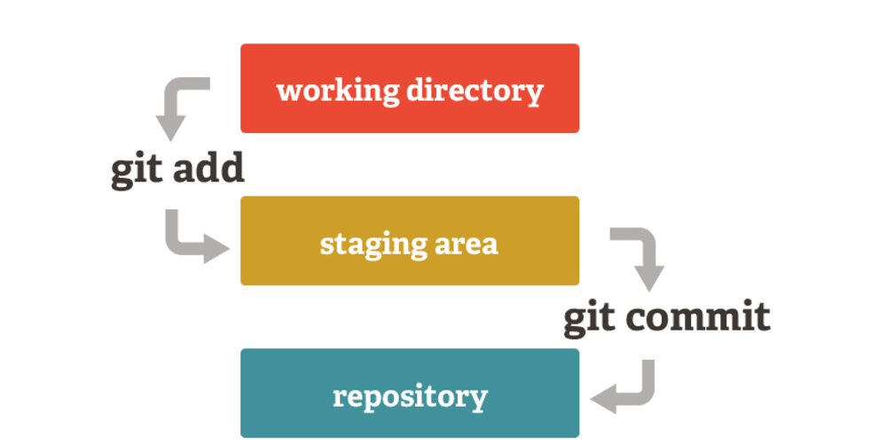

Slide 4
Git Commands:
git init : Initialize a git repository
git add : Add flies to staging.
git commit : Add files to repository.
git status : Check status of working directory.
git log : Show all logs with commits and SHA.
git branch <branchname> : Create a branch with this name
git checkout <branch name>: Move to specified branch

Slide 5

What Is GitHUB ? GitHub is an American company that provides hosting for software development version control using Git.

Slide 6
GitHub Related Commands:
git clone : Clone an existing git repository.
git remote : Set the remote directory.
git push origin master : Push changes to remote repository.

Slide 7

GitHub Student Developer Pack

Slide 8
That’s It For Today!
But We Are Not Done Yet!

Slide 9

Show Case Your Talent!

