Slide 1

ISLT
Irish Sign Language

Slide 2
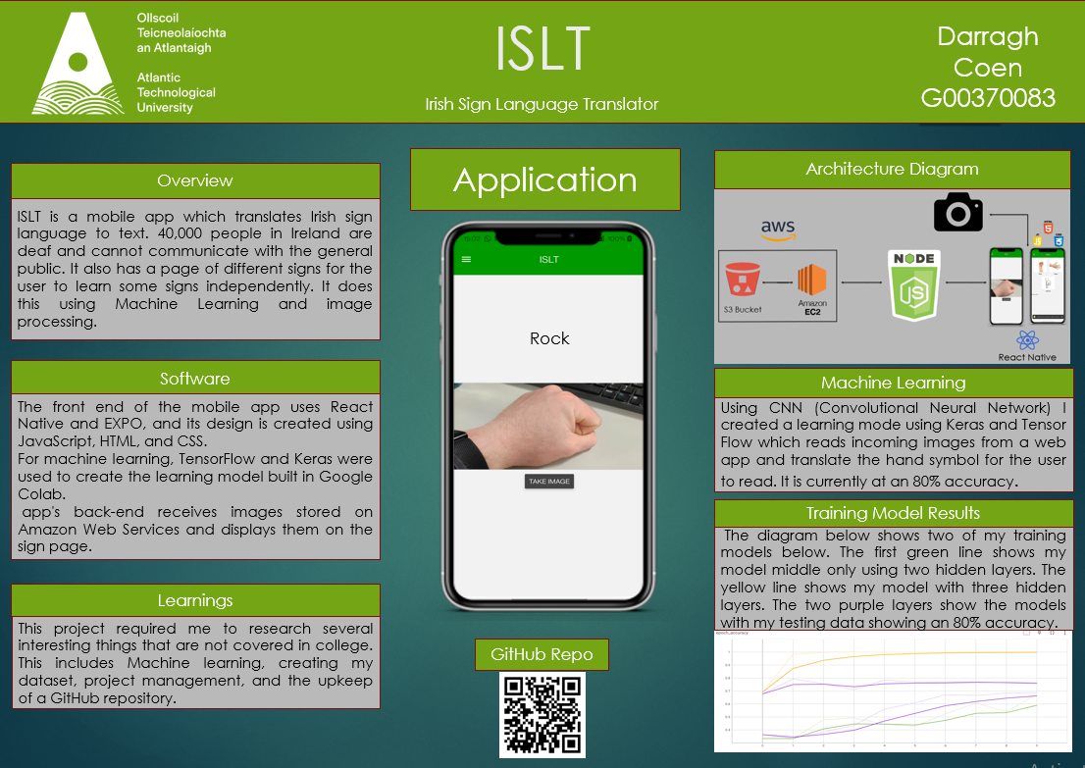

Slide 3
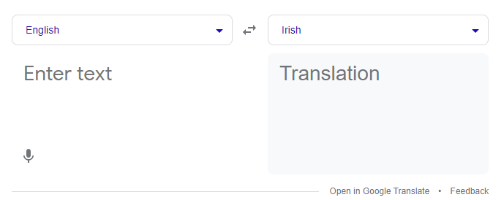
Why
Communicating is a lot easier in todays connected world
45,000 people in Ireland are deaf
Currently nothing in the market that solves this problem

Slide 4
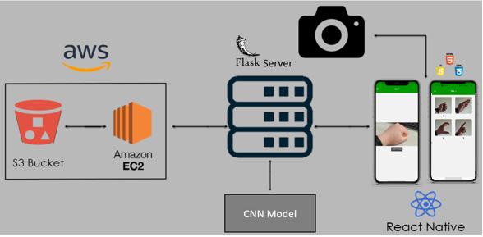


Mobile APP:
React Native App
Connects to the Camera Roll
Sends encode 64bit image to the server
Displays pages of ISL
Flask Server:
Loads the CNN model
Decodes the base 64bit images
Resizes the image for prediction
Applies Greyscale
Applies the CNN model to image
Sends back the prediction
CNN:
Convolution Neural Network
Deep learning model using convolutional layers and pooling layers
AWS:
Amazon Web Service S3 bucket
Stores images of ISL
Sends the images to the Signs page

Slide 5
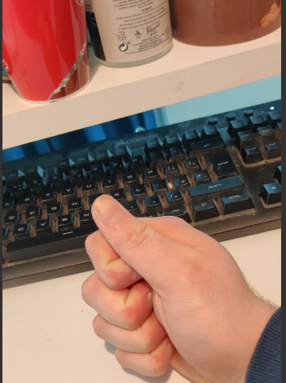
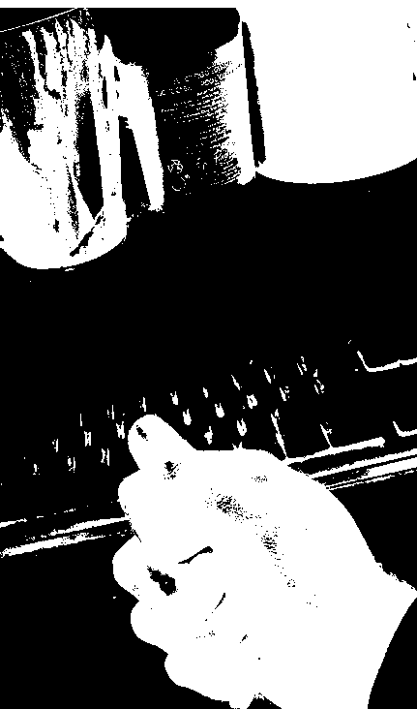
Data Set
As there is no ISL dataset I attempted to create my own
I decided to first attempt it with 2 signs A and B
This was very challenging and time-consuming
Was unable to create a data set clear enough
Dataset created was too small
Unable to properly greyscale images resulting in hard to read image for the model
Opted to use a tensorflow Rock Paper scissors dataset

Slide 6
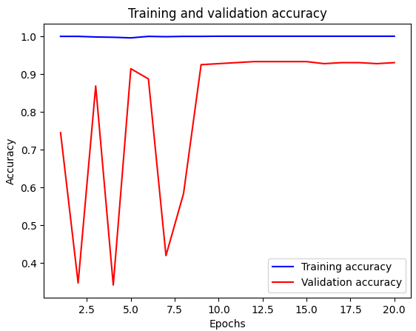
Training the Model
Split the dataset into training and testing images
Images get resized into 300 x 300 and greyscaled
Keras Tunner was used to test a series of different hyperparameters
I use the Adam optimizer which is an adaptive learning rate optimzer.
Best model is run against unseen images

Slide 7
Research
Amazon Web Service | MongoDB
Amazon DocumentDB can automatically scale up or down based on your workload | retrieve data in a flexible and dynamic manner
automatically scale up or down based on your workload, making it easier to handle sudden spikes in traffic | designed to scale horizontally
provides a number of security features, including encryption at rest and in transit | known for its high performance and ability to handle large amounts of data and traffic
Easy to integrate with other AWS services | more cost-effective than some other database technologies, especially if you have large amounts of data to store and manage
Machine Learning | Deep Learning
Requires human intervention | No human help needed
Uses algorithms to parse data learn from data and makes informed decisions on the data | Creates an “artificial neural network” that learns and makes intelligent decisions
Image Recognition
Pre-processing: Cropping, resizing and the formatting
Feature extraction: Recognize an object. Techniques like edge detection, texture analysis and colour histogram.
Training: Use machine learning algorithm to learn to recognize the object in images.
Testing: Test it on a separate set of images to evaluate its performance
Optimalization: Fine-tune the model or adjust the feature extraction process to improve its accuracy
Deployment: Can deploy it in your application or system
Building dataset
Clear Images
Simple clear/ plain background
Different images for training and testing
Need a big dataset of images with different angles and different hands as not all hands are the same.

Slide 8
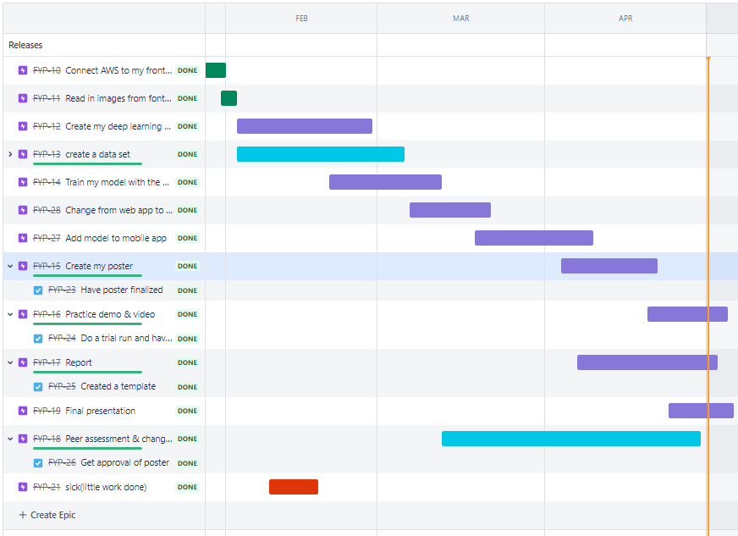
Time-Line

Slide 9
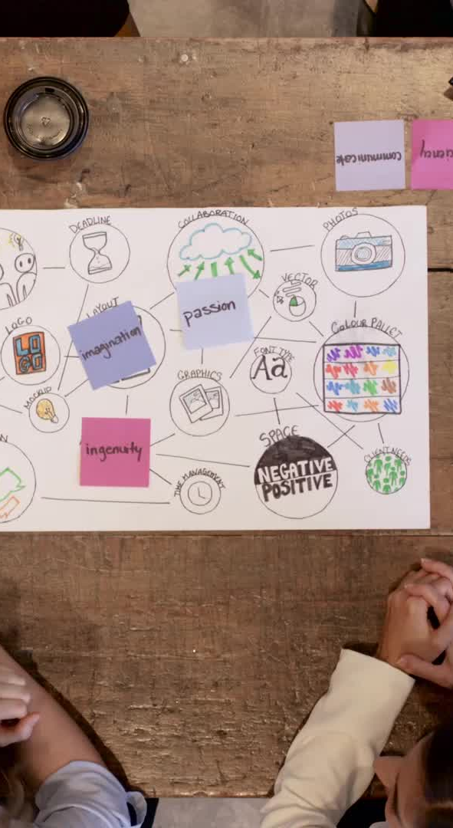
Team-Work
Took part in weekly stand-ups with ‘Lorcan’
Discussed deploying my ML agents with ‘Tan’ which was very helpful
Peer-reviewed ‘Lorcan’s’, ‘Cian’s’, and ‘Elaine’s’ Posters and slide decks.
Had practices presentations with ‘Cian’ and ‘Elaine’

Slide 10
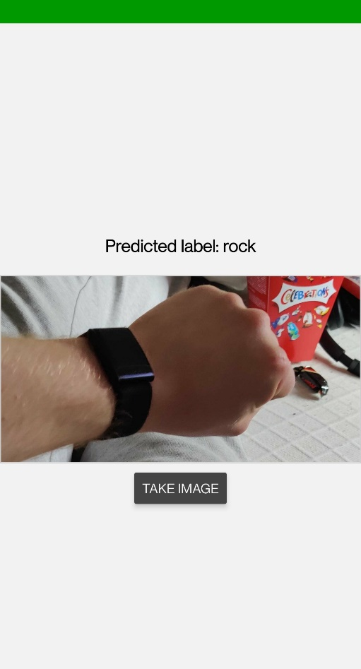
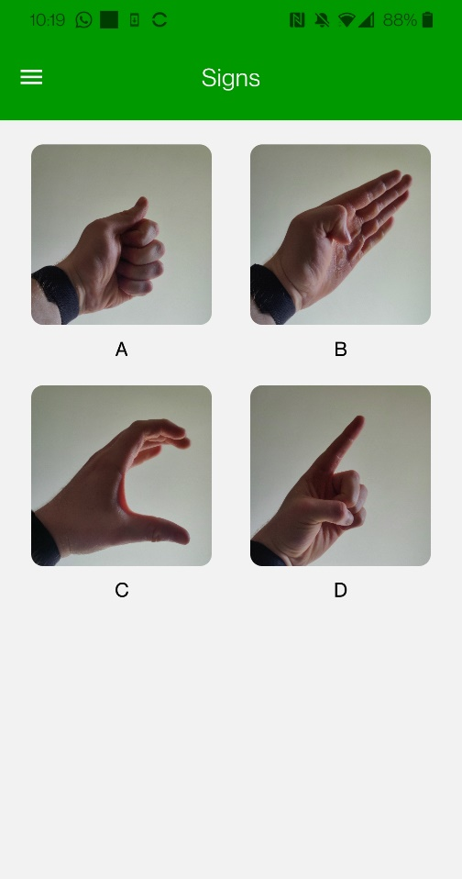
Conclusion
Challenges
Creating a Dataset
Time management
Changing from web app to mobile app
End Product
Functioning Mobile App
Reading images for Rock Paper or Scissors
Communication between the app and a server

Slide 11
Thanks for Listening

