Slide 1

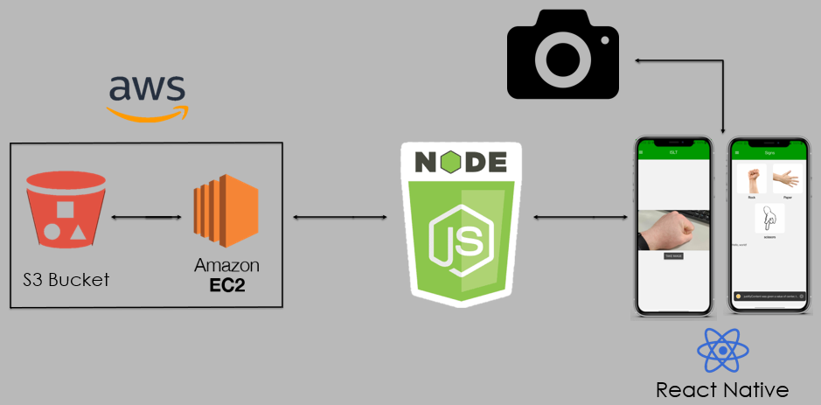
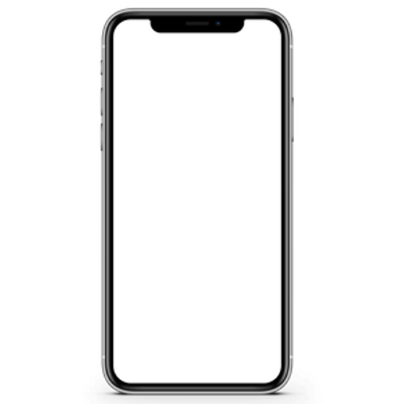
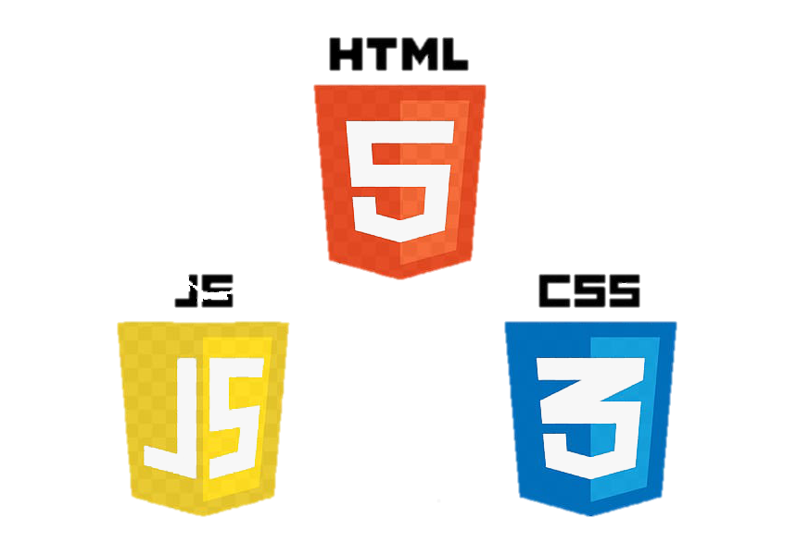
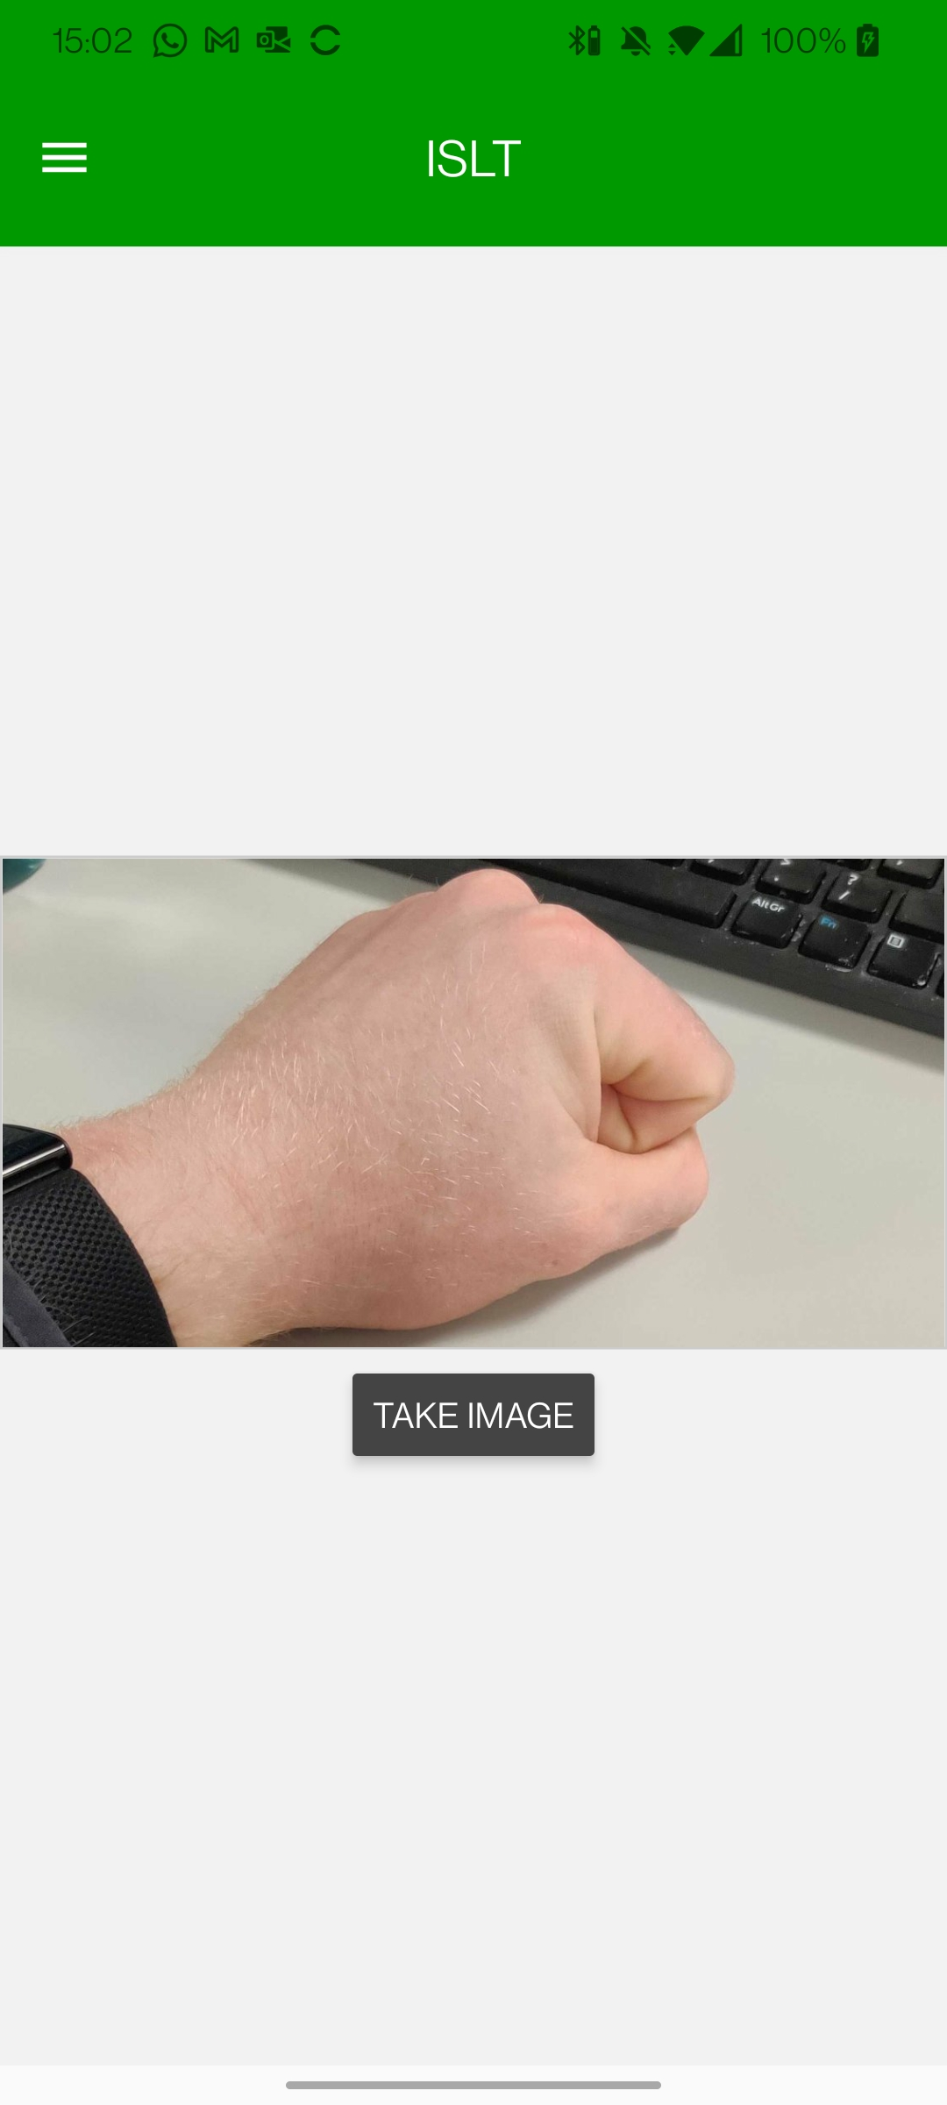
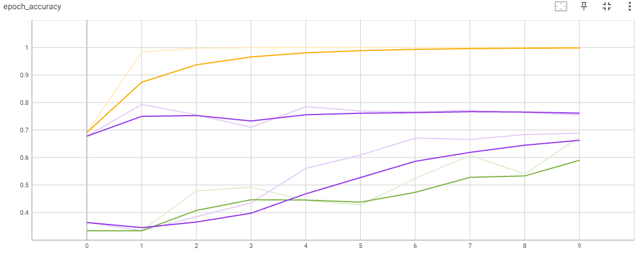
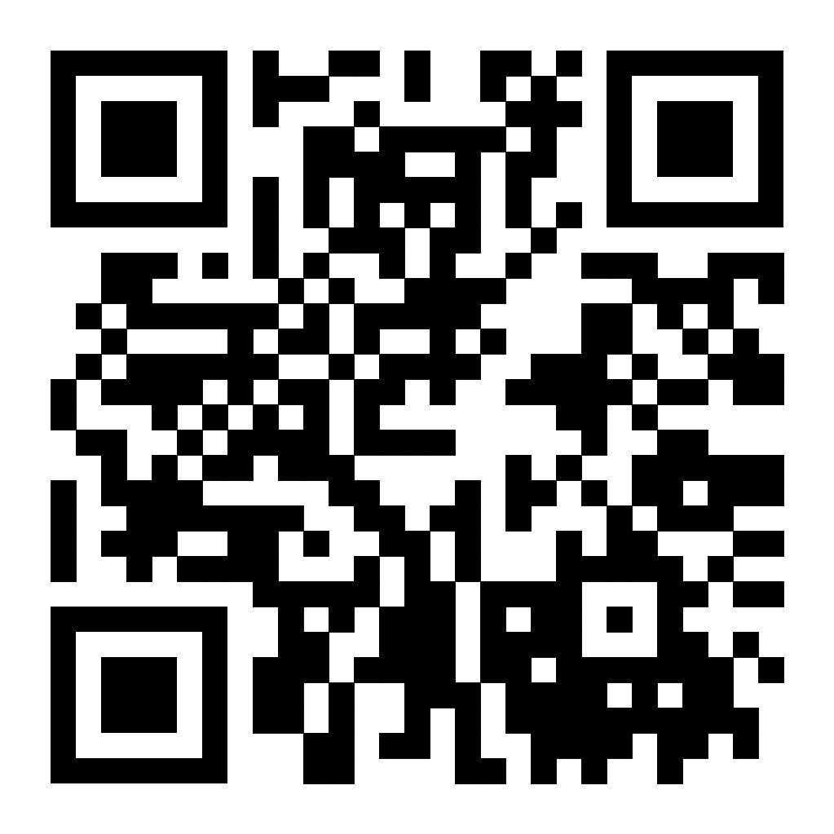
ISLT
Darragh Coen
G00370083
Irish Sign Language Translator
Overview
Application
Architecture Diagram
ISLT is a mobile app which translates Irish sign language to text. 40,000 people in Ireland are deaf and cannot communicate with the general public. It also has a page of different signs for the user to learn some signs independently. It does this using Machine Learning and image processing.
Rock
Software
Machine Learning
The front end of the mobile app uses React Native and EXPO, and its design is created using JavaScript, HTML, and CSS.
For machine learning, TensorFlow and Keras were used to create the learning model built in Google Colab.
app's back-end receives images stored on Amazon Web Services and displays them on the sign page.
Using CNN (Convolutional Neural Network) I created a learning mode using Keras and Tensor Flow which reads incoming images from a web app and translate the hand symbol for the user to read. It is currently at an 80% accuracy.
Training Model Results
The diagram below shows two of my training models below. The first green line shows my model middle only using two hidden layers. The yellow line shows my model with three hidden layers. The two purple layers show the models with my testing data showing an 80% accuracy.
Learnings
This project required me to research several interesting things that are not covered in college. This includes Machine learning, creating my dataset, project management, and the upkeep of a GitHub repository.
GitHub Repo

