Slide 1
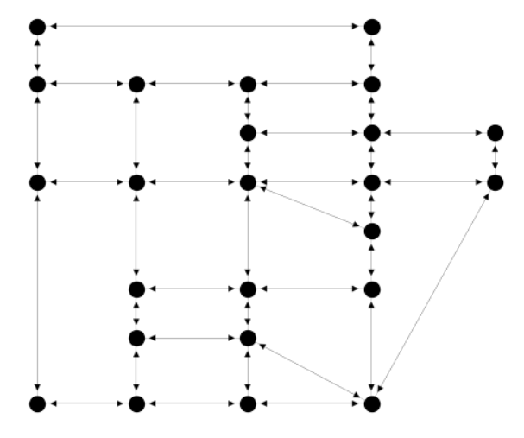
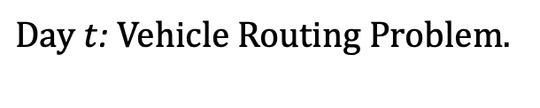
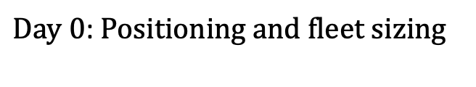
$Day 0$: Positioning and fleet sizing
$Day t$: Vehicle Routing Problem.
Notes:
The problem is dedfined over a Graph

Slide 2



$$v_{i}$$
($c,δ,t$)
$$v_{j}$$
Notes:
The problem is dedfined over a Graph

Slide 3

$$day 1$$
$$v_{i}$$
($c,δ,t$)
$$v_{j}$$
Notes:
The problem is dedfined over a Graph

Slide 4

$$day 2$$
$$v_{i}$$
($c,δ,t$)
$$v_{j}$$
Notes:
The problem is dedfined over a Graph

Slide 5

$$day i$$
$$v_{i}$$
($c,δ,t$)
$$v_{j}$$
Notes:
The problem is dedfined over a Graph

Slide 6
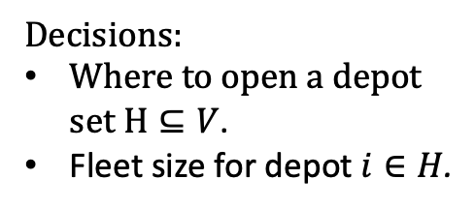

$$day 0$$
Positioning and fleet sizing
$$v_{i}$$
($c,δ,t$)
$$v_{j}$$
Decisions:
Where to open a depot set $H⊆V$.
Fleet size for depot $i∈H$.
Notes:
The problem is dedfined over a Graph

Slide 7
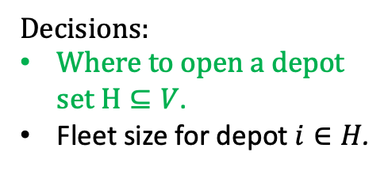
$$day 0$$
Positioning and fleet sizing
$$v_{i}$$
($c,δ,t$)
$$v_{j}$$
Decisions:
Where to open a depot set $H⊆V$.
Fleet size for depot $i∈H$.
Notes:
The problem is dedfined over a Graph

Slide 8
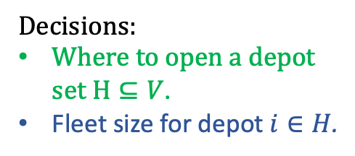

$$day 0$$
Positioning and fleet sizing
$$v_{i}$$
($c,δ,t$)
$$v_{j}$$
Decisions:
Where to open a depot set $H⊆V$.
Fleet size for depot $i∈H$.
Notes:
The problem is dedfined over a Graph

Slide 9
$$day i$$
Vehicle Routing Problem.
$$v_{i}$$
($c,δ,t$)
$$v_{j}$$
Notes:
The problem is dedfined over a Graph

Slide 10
$$day i$$
Vehicle Routing Problem.
$$v_{i}$$
($c,δ,t$)
$$v_{j}$$
Notes:
The problem is dedfined over a Graph

Slide 11
$$day i$$
Vehicle Routing Problem.
$$v_{i}$$
($c,δ,t$)
$$v_{j}$$
Notes:
The problem is dedfined over a Graph

Slide 12
$$day i$$
Vehicle Routing Problem.
$$v_{i}$$
($c,δ,t$)
$$v_{j}$$
Notes:
The problem is dedfined over a Graph

Slide 13

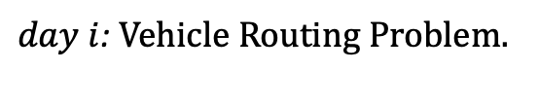
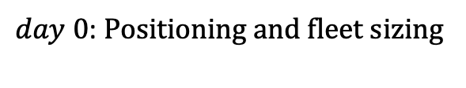
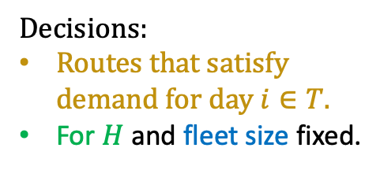
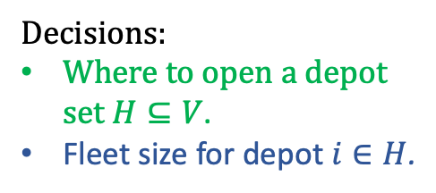
Vehicle fleet sizing, positioning and routing
$day 0$: Positioning and fleet sizing
$day i$: Vehicle Routing Problem.
$$T$$
Decisions:
Where to open a depot set $H⊆V$.
Fleet size for depot $i∈H$.
Decisions:
Routes that satisfy demand for day $i∈T.$
For $H$ and fleet size fixed.
Notes:
The problem is dedfined over a Graph

Slide 14

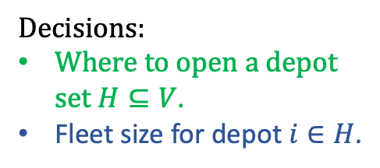
Vehicle fleet sizing, positioning and routing
$day 0$: Positioning and fleet sizing
$day i$: Vehicle Routing Problem.
$$T$$
Decisions:
Where to open a depot set $H⊆V$.
Fleet size for depot $i∈H$.
Decisions:
Routes that satisfy demand for day $i∈T.$
For $H$ and fleet size fixed.
Notes:
The problem is dedfined over a Graph

Slide 15


Vehicle fleet sizing, positioning and routing: Solution Scheme
Master problem
Subproblems
$H$ and fleet size.
$$T$$
Feedback.
Notes:
The problem is dedfined over a Graph

Slide 16
$$day i$$
Vehicle fleet sizing, positioning and routing: Solution Scheme
Notes:
The problem is dedfined over a Graph

