Slide 1
Challenges
Time and capacity constraints
Route generator
Gran red y computational time/efficiency
Generar escenarios y aprovechar las statistical properties de los datos historicos.
Acceleration strategies (ver esta slide)
Uncertain demand and the nature of the decisions
First y second stage con feedback.
Generar escenarios y aprovechar las statistical properties de los datos historicos.

Slide 2
Agenda
Problem description
Introducir la red
Datos de distancia (tiempo, costo)
Varios dias de demanda
Animación con distr de demanda
Se conocen el día anterior (they are unknown until the day before)
Cómo satisfacer la demanda para minimizar bla?
Where to open a depot
Fleet size for depot
Routes that satisfy daily demand
Dentro de tw
Capacidad del camión

Slide 3
Agenda
Solution strategy
Two stage stochastic programming approach
Diagrama con los components a grandes rasgos (irlos revelando)
Cajas (1st and 2nd stage)
First Stage (Facility location)
Decisiones (donde y cuantos)
Subset of potential depots by clustering
Todo lo del modelo (QR con info adicional)
Presentar el modelo matemático y animarlo a charlado
Second Stage
Decisiones (rutear en cada escenario)
Todo lo del modelo (QR con info adicional)
Pero qué rutas va a seleccionar?
Route generator
Relación entre etapas/modelos
Cortes
Scenario generation
Data analysis
Simulation
Scenario selection
Risk averse y risk neutral

Slide 4













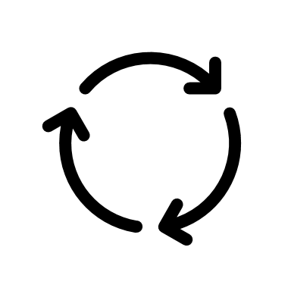







Icons

Slide 5
Agenda
Results
Scenario generation and selection
Particularmente a nuestros datos
TODO LO DE AQUÍ EN ADELANTE CON RISK AVERSE Y RISK NEUTRAL
First stage y second stage costs: # of depots selected
Ubicación de depots y fleet size
Ex-post ev
Second stage comp times

Slide 6
Agenda
Decision support tool
Implemented in AIMMS and oriented to the second stage decisions
Todo: Implementar first stage
Second Stage
Given the first stage decisions, the tool is particularly designed to bla for the realizations of the demand.
Inputs
Select solution strategy
Column Generation
Route recycler
Improve solution
Ver todas las metricas bla
Schedule
Delay
Resumen de lo cool que es nuestra herramienta en AIMMS y cómo con ella logramos costos de bla y nivel de servicio de bla

Slide 7
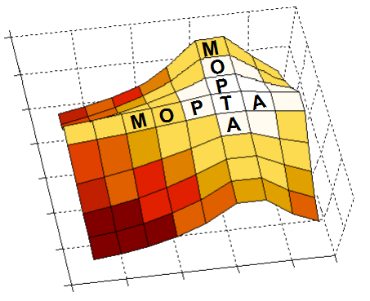

12th AIMMS-MOPTA COMPETITION Vehicle Fleet Sizing, Positioning and Routing
Team MαD CONDORS
María José Consuegra
Alfaima Solano
David Corredor
Advisor: Camilo Gómez, PhD

Slide 8
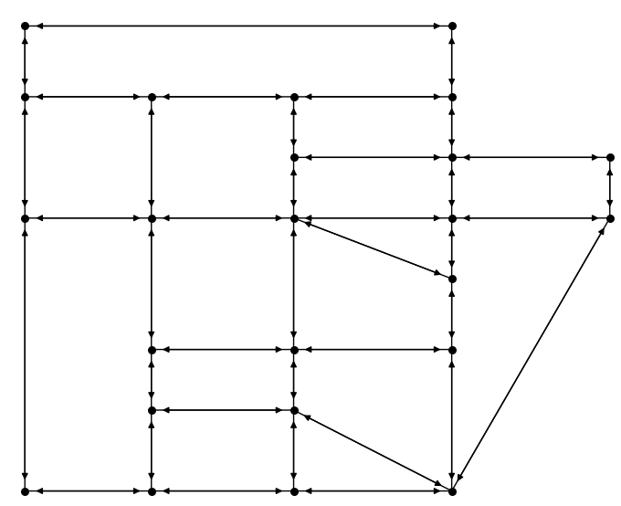
Motivation
Transportation network
Each node represents a potential client
Notes:
Let’s begin with a motivation of the problem that we aim to solve.
Imagine we own a delivery company in which our job is to deliver packages in the following state represented as a network, in which each node represents a potential client.

Slide 9
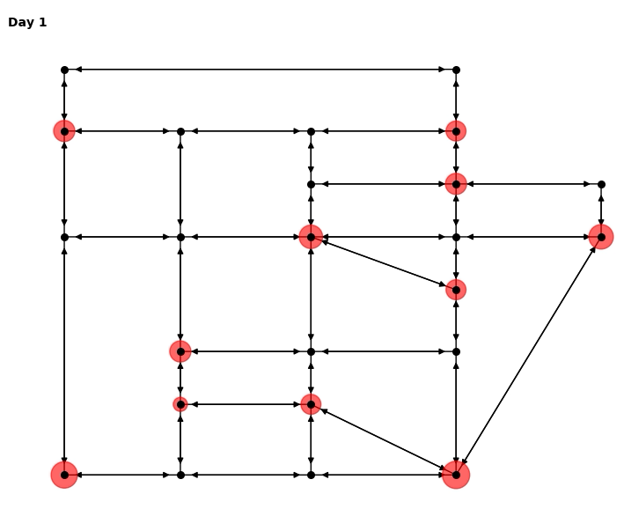
Motivation
Transportation network
Each node represents a potential client
Daily demand
Location
Size
Time window
Revealed the day before
Notes:
Each day there is a demand at each location that needs to be served within a specific time window.
These demands are only revealed the day before they need to be served.
We are currently redesigning our operation system in order to satisfy our clients’ demand at a minimum cost.

Slide 10
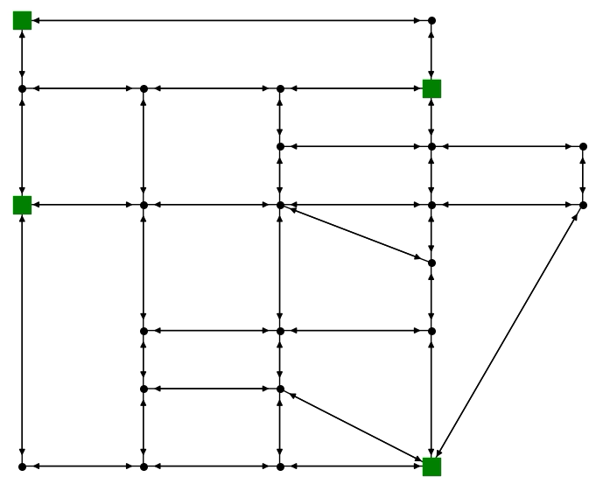
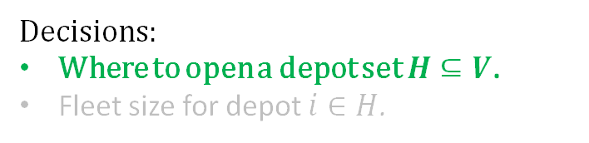

Day $0$: Positioning and fleet sizing
Decisions:
Where to open a depot set $H⊆V$.
Fleet size for depot $i∈H$.
Notes:
The first and most important decision we need to take is where to open a certain amount of depots (hubs) from where the packages will be sent to the demand locations each day.
We need to consider that at each location there is a different cost of locating a depot.

Slide 11
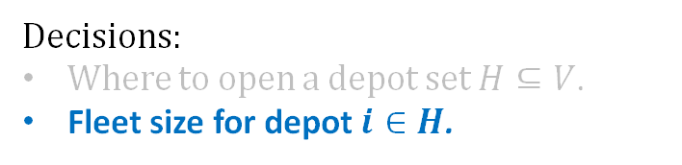
Day $0$: Positioning and fleet sizing
Decisions:
Where to open a depot set $H⊆V$.
Fleet size for depot $i∈H$.
Notes:
Additionally the number of vehicles assigned to each depot (hub) needs also to be decided. These vehicles remain in place for the entire duration of the problem, even if they have to remain idle on certain days.
There is a cost associated with locating and maintaining a depot.

Slide 12
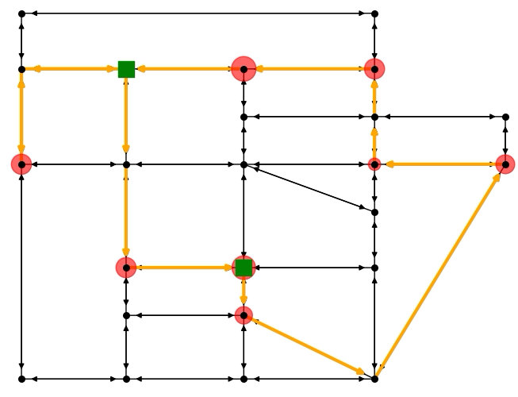


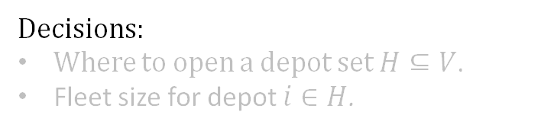


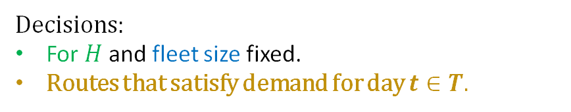
Day $0$: Positioning and fleet sizing
Day $t$: Vehicle Routing Problem.
$$⋯$$
$$⋯$$
$$⋯$$
Decisions:
Where to open a depot set $H⊆V$.
Fleet size for depot $i∈H$.
Decisions:
For $H$ and fleet size fixed.
Routes that satisfy demand for day $t∈T.$
Notes:
With these depot (hub) locations and its fleet size fixed, we should route the vehicles minimizing the transportation costs each day.
Theese routing needs to be done satisfying certain constraints. More specifically satisfying the vehicles capacity, and the specific timewindows for each demand location.

Slide 13
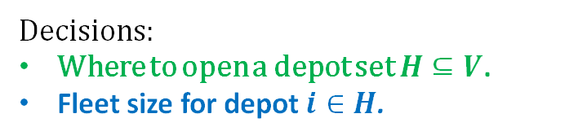
Day $0$: Positioning and fleet sizing
Day $t$: Vehicle Routing Problem.
$$⋯$$
$$⋯$$
$$⋯$$
Decisions:
Where to open a depot set $H⊆V$.
Fleet size for depot $i∈H$.
Decisions:
For $H$ and fleet size fixed.
Routes that satisfy demand for day $t∈T.$
Notes:
So to sum-up, the goal is to solve an optimal vehicle routing problem where in addition, the location of depots for the vehicles and its fleet size should be optimized.
Escribir esto en alguna parte (?)

Slide 14

Day $0$: Positioning and fleet sizing
Day $t$: Vehicle Routing Problem.
$$⋯$$
$
$
$
$$⋯$$
$$\min{ }$$
$$⋯$$
Decisions:
Where to open a depot set $H⊆V$.
Fleet size for depot $i∈H$.
Decisions:
For $H$ and fleet size fixed.
Routes that satisfy demand for day $t∈T.$

Slide 15

$
$
$
$$\min{ }$$
Notes:
Summary

Slide 16
Challenges
Time and capacity constraints
Route generator
Uncertain demand and the nature of the decisions
First y second stage con feedback.
Generar escenarios y aprovechar las statistical properties de los datos historicos.
Gran red y computational time/efficiency
Generar escenarios y aprovechar las statistical properties de los datos historicos.
Acceleration strategies (ver esta slide)

Slide 17



$$[$$
$$𝔼$$
$$[$$
$
$
$
$$\min{ }$$
Notes:
Summary

Slide 18
Scenario generation
First stage
Second stage
Notes:
Our solution strategy consists on a two stage stochastic program in which a set of scenarios for the second stage is carefully selected to capture the behavior of the demand during the planning horizon
Mencionar porque con un set of scenarios:
Computationaly trackable models
And robustness
We decompose the problem
Capturar la relacion de precedencia en bla
Capturar la incertidumbre de la demanda

Slide 19
First stage
Second stage
Notes:
At the core of our methodology lies the fact that a distinction is made between the strategic or first stage decisions and the reactive or second stage decisions.

Slide 20
First stage
Second stage
Strategic decisions
Full uncertainty
Where to locate depots
Fleet size at each depot
Notes:
The decisions taken at the strategic level are the location of the depots and the number of vehicles assigned at each depot.
These are made prior any revelation of uncertain events (demand) and once taken cannot be changed.

Slide 21

First stage
Second stage
Strategic decisions
Full uncertainty
Reactive decisions
Full knowledge of the realized scenario
Where to locate depots
Fleet size at each depot
Routes that satisfy the demand of each scenario
Notes:
Whereas the reactive decisions, taken with full knowledge of the realized scenario and a given first stage solution, consist on routing the vehicles to satisfy the demand.
The first and second stage of course need to be connected.

Slide 22
Solution
First stage
Second stage
Strategic decisions
Full uncertainty
Reactive decisions
Full knowledge of the realized scenario
Where to locate depots
Fleet size at each depot
Routes that satisfy the demand of each scenario
Notes:
The first stage queries possible depot and fleet size configurations with the second stage.

Slide 23
Solution
First stage
Second stage
Strategic decisions
Full uncertainty
Reactive decisions
Full knowledge of the realized scenario
Where to locate depots
Fleet size at each depot
Routes that satisfy the demand of each scenario
Feedback
Notes:
... the second stage evaluates each queried solution in each of the selected demand scenarios, and provides feedback of its second stage costs, namely the routing costs.
These two stages will be solved iteratively until a stopping cr is met.

Slide 24
Scenario generation
Data analysis
Simulation
Scenario selection
Solution
First stage
Second stage
Strategic decisions
Full uncertainty
Reactive decisions
Full knowledge of the realized scenario
Where to locate depots
Fleet size at each depot
Routes that satisfy the demand of each scenario
Feedback
Notes:
These set of scenarios are generated with the following methodology.
Explicar brevemete la importancia de estis escenarios:
Given that with this set of scenarios for the first stage solutions will be evaluated
What do we mean by capturing the behavior
Spatially distribution
Probaility distribution of demand

Slide 25
Scenario generation
Data analysis
Simulation
Scenario selection
Solution
First stage
Second stage
Demand per scenario
Strategic decisions
Full uncertainty
Reactive decisions
Full knowledge of the realized scenario
Where to locate depots
Fleet size at each depot
Routes that satisfy the demand of each scenario
Feedback
Notes:
Having selected the scenarios or possible realizations of the demand to be considered in our two stage stochastic program,
…the quantities demanded at each location on each scenario will be passed to the second stage where the vehicles will be routed.

Slide 26
Scenario generation
Data analysis
Simulation
Scenario selection
Solution
Weight per scenario
First stage
Second stage
Demand per scenario
Strategic decisions
Full uncertainty
Reactive decisions
Full knowledge of the realized scenario
Where to locate depots
Fleet size at each depot
Routes that satisfy the demand of each scenario
Feedback
Notes:
… and the weight assigned to each scenario, to the first stage. This weight represents the importance of each of the outcomes that are being considered and in this context, we use the probability of occurrence.
This means that slight changes have to be made to the model (?) of the first stage to consider the expected performance of each outcome under uncertainty.

Slide 27
Scenario generation
Data analysis
Simulation
Scenario selection
Solution
Weight per scenario
First stage
Second stage
Demand per scenario
Strategic decisions
Full uncertainty
Reactive decisions
Full knowledge of the realized scenario
Where to locate depots
Fleet size at each depot
Routes that satisfy the demand of each scenario
Feedback
Notes:
This is the big picture of our solution strategy, and now considering that we have limited time we would like to focus on the elements that we think are our main contribution.

Slide 28
Scenario generation
Data analysis
Simulation
Scenario selection
Solution
First stage
Second stage
Strategic decisions
Full uncertainty
Reactive decisions
Full knowledge of the realized scenario
Where to locate depots
Fleet size at each depot
Routes that satisfy the demand of each scenario
Feedback

Slide 29
Data analysis
Aja todo lo que encontramos…
Notes:
Independen scenarios

Slide 30
Scenario generation
Data analysis
Simulation
Scenario selection
Solution
First stage
Second stage
Strategic decisions
Full uncertainty
Reactive decisions
Full knowledge of the realized scenario
Where to locate depots
Fleet size at each depot
Routes that satisfy the demand of each scenario
Feedback

Slide 31
Simulation
¿Qué características usamos del análisis para generar los escenarios?
Etc…

Slide 32
Scenario generation
Data analysis
Simulation
Scenario selection
Solution
First stage
Second stage
Strategic decisions
Full uncertainty
Reactive decisions
Full knowledge of the realized scenario
Where to locate depots
Fleet size at each depot
Routes that satisfy the demand of each scenario
Feedback

Slide 33
Scenario selection
Mostrar como lo que no queremos de escenarios
Decir que entonces seleccionamos escenarios que estuvieran geográficamente distribuidos
Explicar brevemente lo que es el problemisho de optimización
¿Por qué escogemos escenarios? ¿Por qué no todos los días históricos?
Queremos aprovechar the statistical properties de los datos para ser más eficientes (why?) y capturar la aversion al riesgo de los decision makers and stakeholders al momento de la toma de las decisiones.
Now, qué cantidades de demanda agregada seleccionamos?
Aquí entra a ser relevante las características del decisor y de los stakeholders
Grafiquita de la distr de la demanda que hizo David más dormido que despierto y mostrar lo que representa un decisor averso al riesgo vs uno neutro

Slide 34
Scenario generation
Data analysis
Simulation
Scenario selection
Solution
Weight per scenario
First stage
Second stage
Demand per scenario
Strategic decisions
Full uncertainty
Reactive decisions
Full knowledge of the realized scenario
Where to locate depots
Fleet size at each depot
Routes that satisfy the demand of each scenario
Feedback

Slide 35
Scenario generation
Data analysis
Simulation
Scenario selection
Solution
Weight per scenario
First stage
Second stage
Demand per scenario
Strategic decisions
Full uncertainty
Column Generation
Master problem
Where to locate depots
Fleet size at each depot
Subproblems
Feedback
Notes:
The solution scheme for the second stage is a little bit more complicated.
For each demand scenario, a Multidepot vehicle routing problem needs to be solved. For this task, we use a column generation approach.

Slide 36
Second stage
Column Generation
Master problem
Subproblems
Notes:
This column generation approach consists of two models, one that generates feasible routes, and other that selects these routes such that the specific demand is covered at minimum cost.

Slide 37
Second stage
Column Generation
Chooses the combination of routes to satisfy the demand at minimum traveling cost
Master problem
Subproblems

Slide 38
Second stage
Column Generation
Chooses the combination of routes to satisfy the demand at minimum traveling cost
Generates feasible routes for the master problem
Master problem
Subproblems

Slide 39
Second stage
Column Generation
Chooses the combination of routes to satisfy the demand at minimum traveling cost
Generates feasible routes for the master problem
Master problem
Routes
Dual
variables
Subproblems

Slide 40
Second stage
Column Generation
Master problem
Subproblems

Slide 41
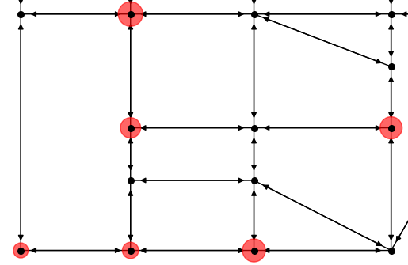
Vehicle Capacity
Time
Notes:
As the vehicle visits the nodes, it leaves the respective demanded units, and the amount of available units for departure inside de vehicle decreases

Slide 42
Vehicle Capacity
Time
Notes:
As the vehicle visits the nodes, it leaves the respective demanded units, and the amount of available units for departure inside de vehicle decreases

Slide 43
Vehicle Capacity
Time
Notes:
As the vehicle visits the nodes, it leaves the respective demanded units, and the amount of available units for departure inside de vehicle decreases

Slide 44
Vehicle Capacity
Time
Notes:
As the vehicle visits the nodes, it leaves the respective demanded units, and the amount of available units for departure inside de vehicle decreases

Slide 45
Vehicle Capacity
Time
Notes:
As the vehicle visits the nodes, it leaves the respective demanded units, and the amount of available units for departure inside de vehicle decreases

Slide 46
?
Vehicle Capacity
Time
?
Notes:
At one point the available units inside the vehicle are not enough

Slide 47
Vehicle Capacity
Time
Notes:
… and it needs to go back to the depot to recharge.

Slide 48
Vehicle Capacity
Time
Notes:
After this, the vehcle can keep on fufllin the demand of remaining demand nodes…

Slide 49
Vehicle Capacity
Time
Notes:
Until there is no more time for departing, and the vehicle needs to go back to the depot.

Slide 50
Vehicle Capacity
Time
Notes:
So in summary, a feasible route is a rout in which the vehicle capacity is met, and in which all the demand nodes are visited within their specific time window.

Slide 51
First Stage
Strategic decisions
Full uncertainty
Where to locate depots
Fleet size at each depot

Slide 52
Acceleration strategies
Training-no correr generacion
Covering de la firststage con la var w_i
Petal recicler
Time windows…???? Lunch breake
Route cleaning keep only good routes in the set of routes for each sp

Slide 53
Here goes the title

Slide 54
Here goes the title

