Slide 1
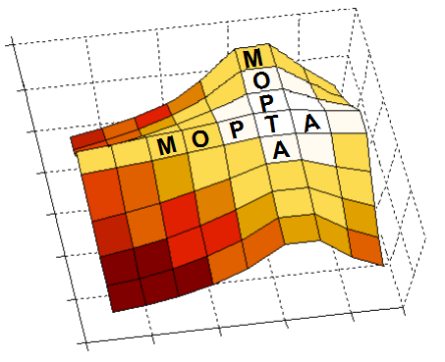

12th AIMMS-MOPTA COMPETITION Vehicle Fleet Sizing, Positioning and Routing
Team MαD CONDORS
María José Consuegra
Alfaima Solano
David Corredor
Advisor: Camilo Gómez, PhD

Slide 2
Agenda
Problem description
Introducir la red
Datos de distancia (tiempo, costo)
Varios dias de demanda
Animación con distr de demanda
Se conocen el día anterior (they are unknown until the day before)
Cómo satisfacer la demanda para minimizar bla?
Where to open a depot
Fleet size for depot
Routes that satisfy daily demand
Dentro de tw
Capacidad del camión

Slide 3
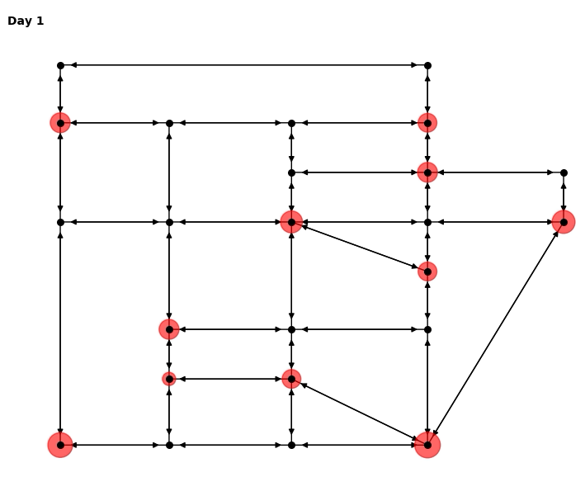
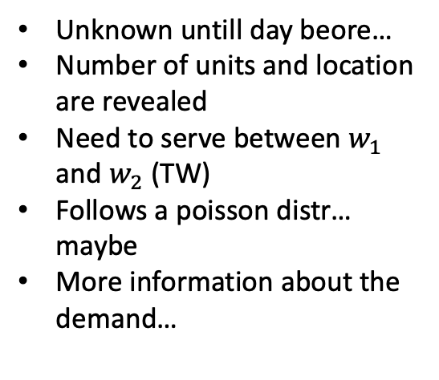
Demand description
Unknown untill day beore…
Number of units and location are revealed
Need to serve between $w_{1}$ and $w_{2}$ (TW)
Follows a poisson distr… maybe
More information about the demand…
Notes:
Demand description:

Slide 4
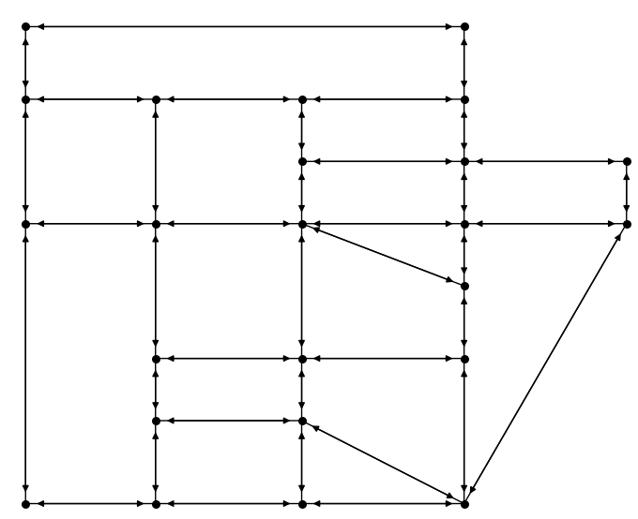

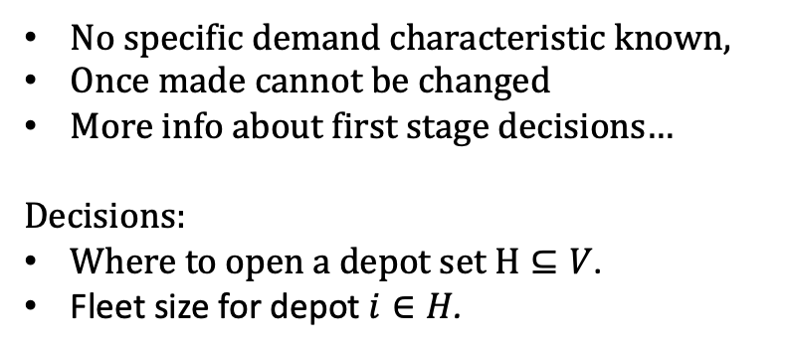
Positioning and fleet sizing
Day$0$
No specific demand characteristic known,
Once made cannot be changed
More info about first stage decisions…
Decisions:
Where to open a depot set $H⊆V$.
Fleet size for depot $i∈H$.
Notes:
Demand description:

Slide 5
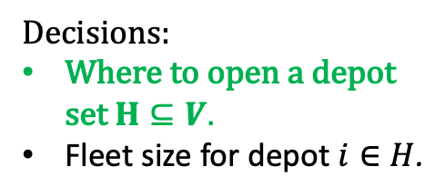
Positioning and fleet sizing
Day$0$
Decisions:
Where to open a depot set $H⊆V$.
Fleet size for depot $i∈H$.
Notes:
Demand description:

Slide 6
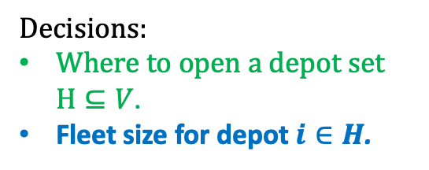
Positioning and fleet sizing
Day$0$
Decisions:
Where to open a depot set $H⊆V$.
Fleet size for depot $i∈H$.
Notes:
Demand description:

Slide 7
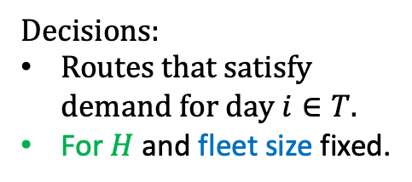

Vehicle Routing
Day$t$
Decisions:
Routes that satisfy demand for day $i∈T.$
For $H$ and fleet size fixed.
Notes:
On day t, with the depot location and the fleet size fixed,

Slide 8
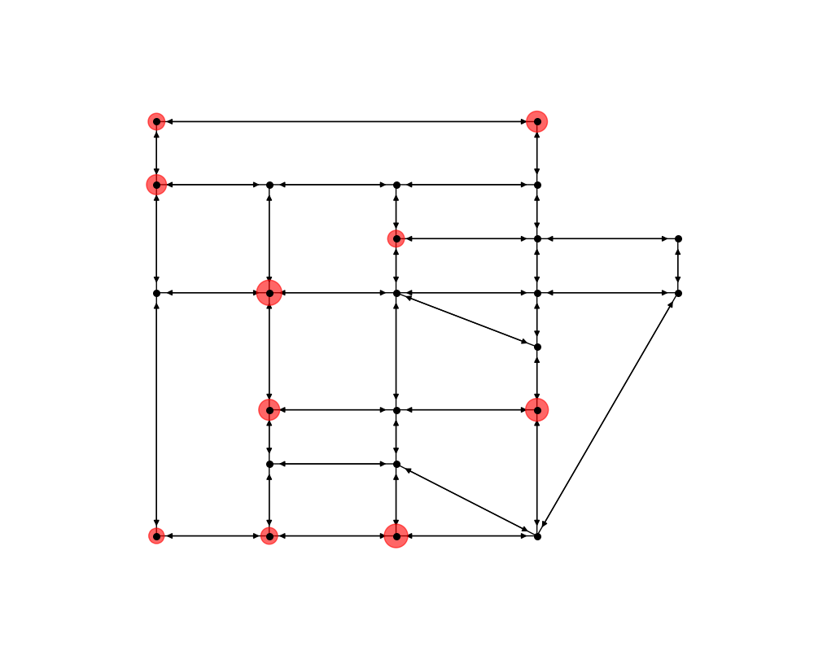
Vehicle Routing
Day$t$
Decisions:
Routes that satisfy demand for day $i∈T.$
For $H$ and fleet size fixed.
Notes:
That days demand is reveald and the vehicles need to be routed

Slide 9
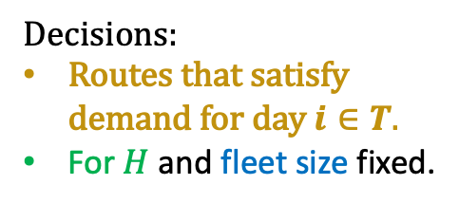
Vehicle Routing
Day$t$
Decisions:
Routes that satisfy demand for day $i∈T.$
For $H$ and fleet size fixed.
Notes:
That days demand is reveald and the vehicles need to be routed

Slide 10
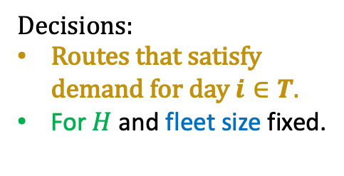
Vehicle Routing
Day$t$
Decisions:
Routes that satisfy demand for day $i∈T.$
For $H$ and fleet size fixed.
Notes:
That days demand is reveald and the vehicles need to be routed

Slide 11
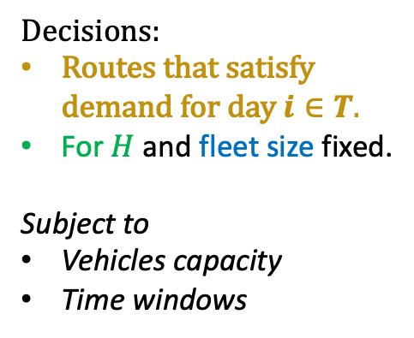
Vehicle Routing
Day$t$
Decisions:
Routes that satisfy demand for day $i∈T.$
For $H$ and fleet size fixed.
Subject to
Vehicles capacity
Time windows
Notes:
That days demand is reveald and the vehicles need to be routed

Slide 12
Vehicle Capacity
Time
Notes:
That days demand is reveald and the vehicles need to be routed

Slide 13
Vehicle Capacity
Time
Notes:
That days demand is reveald and the vehicles need to be routed

Slide 14
Vehicle Capacity
Time
Notes:
That days demand is reveald and the vehicles need to be routed

Slide 15
Vehicle Capacity
Time
Notes:
That days demand is reveald and the vehicles need to be routed

Slide 16
Vehicle Capacity
Time
Notes:
That days demand is reveald and the vehicles need to be routed

Slide 17
Vehicle Capacity
Time
Notes:
That days demand is reveald and the vehicles need to be routed

Slide 18
?
Vehicle Capacity
Time
?
Notes:
That days demand is reveald and the vehicles need to be routed

Slide 19
Vehicle Capacity
Time
Notes:
That days demand is reveald and the vehicles need to be routed

Slide 20
Vehicle Capacity
Time
Notes:
That days demand is reveald and the vehicles need to be routed

Slide 21
Vehicle Capacity
Time
Notes:
That days demand is reveald and the vehicles need to be routed

Slide 22
Vehicle Capacity
Time
Notes:
That days demand is reveald and the vehicles need to be routed

Slide 23
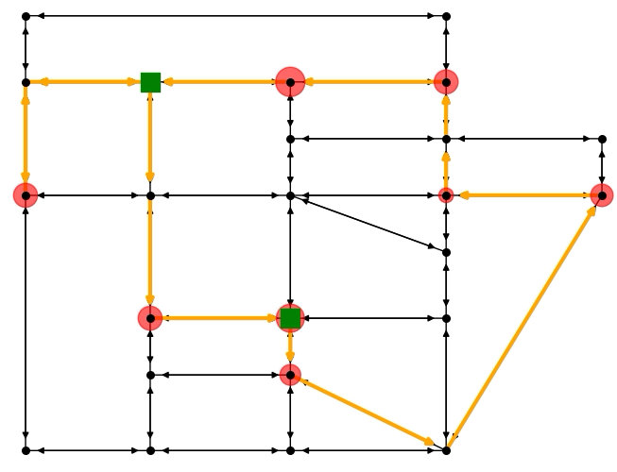
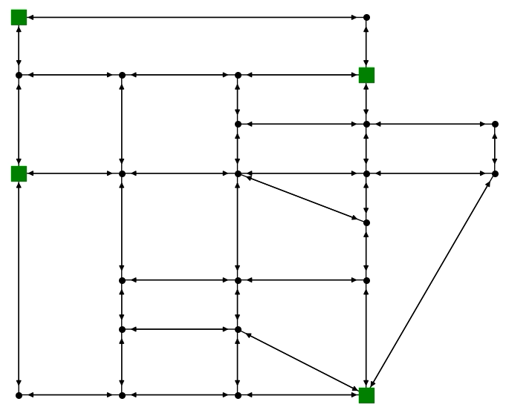


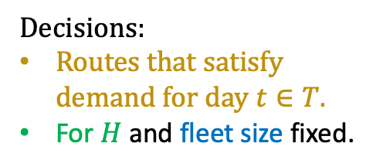

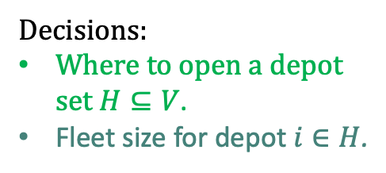


Day $0$: Positioning and fleet sizing
Day $t$: Vehicle Routing Problem.
$$⋯$$
$$⋯$$
$$⋯$$
Decisions:
Where to open a depot set $H⊆V$.
Fleet size for depot $i∈H$.
Decisions:
Routes that satisfy demand for day $t∈T.$
For $H$ and fleet size fixed.
Notes:
Summary

Slide 24
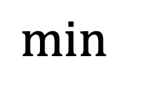
$
$
$
$$\min{ }$$
Notes:
Summary

Slide 25
$
$
$
$$\min{ }$$
Notes:
Summary

Slide 26



$$[$$
$$𝔼$$
$$[$$
$
$
$
$$\min{ }$$
Notes:
Summary

Slide 27
Agenda
Solution strategy
Two stage stochastic programming approach
Diagrama con los components a grandes rasgos (irlos revelando)
Cajas (1st and 2nd stage)
First Stage (Facility location)
Decisiones (donde y cuantos)
Subset of potential depots by clustering
Todo lo del modelo (QR con info adicional)
Presentar el modelo matemático y animarlo a charlado
Second Stage
Decisiones (rutear en cada escenario)
Todo lo del modelo (QR con info adicional)
Pero qué rutas va a seleccionar?
Route generator
Relación entre etapas/modelos
Cortes
Scenario generation
Data analysis
Simulation
Scenario selection
Risk averse y risk neutral

Slide 28
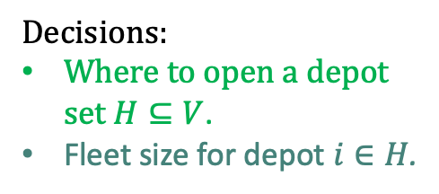

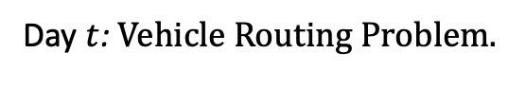
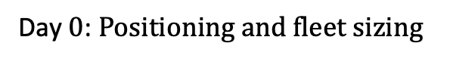



Day $t$: Vehicle Routing Problem.
Day $0$: Positioning and fleet sizing
$$⋯$$
Decisions:
Where to open a depot set $H⊆V$.
Fleet size for depot $i∈H$.
Decisions:
Routes that satisfy demand for day $t∈T.$
For $H$ and fleet size fixed.
$$⋯$$
$$⋯$$
Notes:
Summary

Slide 29
Here goes the title

Slide 30
Agenda
Results
Scenario generation and selection
Particularmente a nuestros datos
TODO LO DE AQUÍ EN ADELANTE CON RISK AVERSE Y RISK NEUTRAL
First stage y second stage costs: # of depots selected
Ubicación de depots y fleet size
Ex-post ev
Second stage comp times

Slide 31
Here goes the title

Slide 32
Agenda
Decision support tool
Implemented in AIMMS and oriented to the second stage decisions
Todo: Implementar first stage
Second Stage
Given the first stage decisions, the tool is particularly designed to bla for the realizations of the demand.
Inputs
Select solution strategy
Column Generation
Route recycler
Improve solution
Ver todas las metricas bla
Schedule
Delay
Resumen de lo cool que es nuestra herramienta en AIMMS y cómo con ella logramos costos de bla y nivel de servicio de bla

Slide 33
Here goes the title

