Slide 1
Select Agent Training
University of Kentucky
Department of Biological Safety

Slide 2
If you are taking this training:
You are considered Select Agent Program “registered personnel”, and are integral to the operation of the laboratory even though you might not have card access to the facility itself.
You are officially associated with the lab, have knowledge of the location of the lab and of the agent that is present, and/or have the ability to grant access or otherwise sensitive information to unregistered/unauthorized persons.

Slide 3
Objectives of this training:
To understand Select Agent regulations and penalties
To understand safety & security procedures
To understand emergency and exposure response
To understand basic symptoms and treatment for the agents used in UK’s Select Agent laboratory.
To know who UK’s Responsible Official and Alternate Responsible Official are

Slide 4
Some definitions
RO: responsible official for institution/entity
ARO: alternate responsible official
PPE: personal protective equipment
PI: principal investigator
HHS: Dept. of Health and Human Services (governmental agency)
CDC: Centers for Disease Control and Prevention (governmental agency)

Slide 5
Definition of Select Agent or Toxin
Select Agents / toxins are agents that HHS considers to have the potential to pose a severe threat to human health.
Could be used in biowarfare or bioterrorism
A list of these agents are found in the Select Agents regulation (42 CFR 73).
Notes:
http://www.selectagents.gov/FAQ_General.html#sec1q3
http://www.selectagents.gov/resources/42_cfr_73_final_rule.pdf

Slide 6
Timeline of Select Agent Regulations
Anti-terrorism and Effective Death Penalty Act of 1996
First list of Select Agents and Toxins
Regulated Transfers
Patriot Act of 2001
Possession of Select Agents and Toxins Regulated
Public Health Security and Bioterrorism Preparedness Act of 2002
Responsibilities placed upon institutions
Interim Rule 2003, Final Rule April 18, 2005
Regulated possession, use, and transfer of Select Agents and Toxins through the US Department of Health and Human Services
All individuals with access to Select Agents must be approved by HHS (after screening by FBI)
Notes:
http://www.selectagents.gov/Regulations.html

Slide 7
Who oversees the SA registration?
Department of Health and Human Services (DHHS), through the U.S. Centers for Disease Control and Prevention (CDC),
Animal Plant Health Inspection Service (APHIS), through the United States Department of Agriculture (USDA)

Slide 8

Criminal Penalties for Violations of Select Agent Regulations:
up to 5 years in prison and up to $250,000 fine for individuals
up to $500,000 fine for institutions

Slide 9
Criminal Penalties
Fines are per incident
One institution was fined $150,000 for shipping a viable organism. They thought they had killed the organism because it had not grown for 48 hrs in their laboratory so they shipped it out. The receiver of the organism was able to produce a viable culture from the shipped sample, so the shipping institution was fined for violation of the Federal regulations.

Slide 10
Access to Select Agents
Access is defined in the Final Rule 2005 as:
the ability to physically possess the agent
an agent locked in a cabinet, incubator, refrigerator, or freezer is not accessible

Slide 11
Responsible Official
Appointed by the University as responsible for the management of Select Agents at the institution
Ensures that Select Agent regulations requirements are met
Develops safety, security and emergency response plans
Provides appropriate training for safety, security, maintenance and emergency response workers
Reports all breaches of security, loss of select agents, inventory inconsistencies to CDC

Slide 12
Responsible Official
Provides appropriate training for safety, security, maintenance and emergency response workers
Ensures all visitors are informed of and follow security procedures
Visitors must be briefed on the select agent being utilized and associated hazards

Slide 13
University of Kentucky:
Responsible Official:
Holley Trucks 859-699-6082
Alternate Responsible Official:
David Hibbard 859-699-6083

Slide 14
Required Plans
Security Plan
Biosafety Plan
Incident Response Plan
These plans include all procedures regarding security, safety and incident response
Each plan is reviewed annually
Revised as needed
SOPs are drilled on an annual basis
Available to all CDC/FBI authorized personnel

Slide 15
Security & Incident Response Procedures
Risk assessments and procedures are site specific and consider the following factors:
Human element: internal vs. external terrorism
Natural disasters: fire, earthquakes, tornados, etc.
Utility outages
Lab accidents: spills, releases, exposures
Medical emergencies

Slide 16
UK Security Plan
Prevention of theft, loss or release of the agent by:
Inventory control procedures
Physical security
Information systems control

Slide 17
Posted outside facility:
RED ROOM
High Hazard Area
Under No Circumstances
May Entry Occur
Without Proper Escort
(Principal Investigator, Responsible Official
or Other Authorized Person)

Slide 18
SA Security Procedures
SA areas must be separated from public areas of buildings & locked 24/7.
Procedures to control access must be followed. Access cards must NEVER be shared.
All packages must be inspected by authorized personnel before entry or exit of SA areas.
Theft, loss, release, or altered inventory of the agent must be reported immediately to PI & RO.
Unauthorized, unescorted or suspicious persons in SA areas must be reported immediately
All incidents with potential for exposure to agent must be reported to PI & RO immediately
All transfers of the agent to external entities require prior CDC authorization

Slide 19
To Protect Everyone:
Facility is regularly inspected by:
Centers for Disease Control
Office of the Inspector General
There is additional coordination with:
Local Public Health Department
UK Hospital Emergency Department
UK Employee Health
Lexington Fire Department, Haz Mat
UK Police Department

Slide 20
To Protect Everyone:
Facility staff train and drill in:
emergency procedures, both medical and disaster
most facility staff have first aid & CPR training
accidental exposures
accidental spills, especially that of the agent
decontamination procedures
power failure
security breach

Slide 21
To Protect Everyone:
All work with cultures takes place solely in the biological safety cabinet
There are extensive procedures for chemical decontamination in case of a spill
Two types of disinfectants used in laboratory- Bleach and Quaternary Ammonium
All SOPs & Plans are reviewed at least annually

Slide 22
The BL3 Facility is designed to protect personnel and the University community
This is accomplished with:
Effective personnel protective equipment (PPE)
Proper safety equipment
Evaluation and testing of Standard Operating Procedures
Annual facility verification and inspection
Proper facility design
Extensive preventive maintenance

Slide 23
Facility Features To Protect Everyone:
Negative air flow
Exhaust HEPA filtered
Redundant exhaust fans
Alarm systems indicate air flow problems
Emergency electrical backup for
exhaust
biological safety cabinets
Decontamination shower
Can be decontaminated with gas or vaporized hydrogen peroxide

Slide 24
Maintenance of Facility
Preventative maintenance in facility done once a year:
after all work ceases,
facility is decontaminated
during official “shut down”
PPE not usually needed during this time
PPE is always required to enter the facility when the agent is present and in use.

Slide 25
Entering SA Facility
When the agent is present and in use (not in “shut down”), individuals without card access to the lab, who enter the Select Agent Laboratory areas for cleaning, maintenance, repairs, etc. must :
Be escorted by authorized personnel at all times when the agent is present in the facility
Entry must be recorded on the entry log in the anteroom of the BSL3
Be trained in the security, entry/exit requirements and hazards of agent (training will be documented).
Wear appropriate PPE as instructed by escort
Will allow authorized escort to decontaminate any object(s) taken out of the lab
WILL NOT open any refrigerator, freezer, incubator without permission of escort

Slide 26
Entering SA Facility
It is very unlikely authorized support personnel would have to enter the facility when not in “shut down” mode. However, if entry is required when the agent is present and in use, you must be aware of entry requirements.

Slide 27
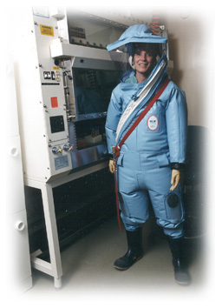
Do I have to wear THAT?!!
No. The PPE required for entry is dependent on the situation and is determined according to the risk involved.

Slide 28

To Protect Yourself
Wear the appropriate personal protective equipment (PPE).
Your escort will help you with this.
In most cases, a disposable gown, and shoes covers will be required.

Slide 29
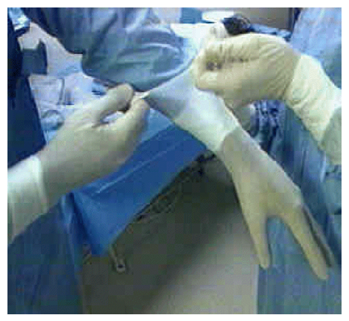
To Protect Yourself
Double gloves are also required. This allows for removal of the outer glove in the case they rip or you should need a clean pair.

Slide 30
To Protect Yourself
It is likely you will also require respiratory protection. Your escort will also help you with this.
There are two choices for respirators:

Slide 31
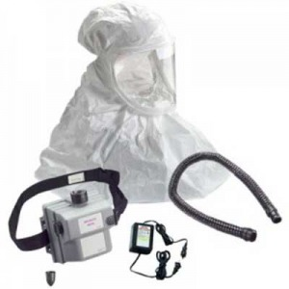
To Protect Yourself
PAPR (Purified Air Powered Respirator)
Your escort will show you how to test the powered air pack prior to donning and how to put on the PAPR.

Slide 32
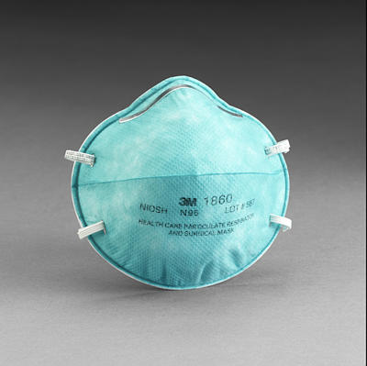
To Protect Yourself
N95 respirator
This is not to be confused with a surgical mask. To use a N95, you must be fit tested on an annual basis by UK Dept. of Occupational Health & Safety. A face shield must be worn in conjunction with the N95

Slide 33
It is important to realize:
Infection with the Select Agent utilized at the University of Kentucky can be prevented or treated with common antibiotics.
UK Employee Health and the UK Emergency Department is fully equipped to handle illness resulting from this infectious agent.

Slide 34
In the case of potential or accidental exposure:
Stay calm. Infection is cured by common antibiotics.
An authorized person/escort will:
decontaminate your outer clothing,
dispose of it, and
clean exposed skin with soap & water
If eyes or mouth: rinse with tepid water for 15 min.

Slide 35
In the case of potential or accidental exposure:
Authorized Personnel/Escort will call:
PI & RO
Employee Health/University Health
Workers Care
Immediately proceed to UK Employee Health (during weekday working hours) or UK Emergency Department (after hours and weekends) to be evaluated and to start antibiotics. Take “Exposure Packet”, which is located in the BSL3 anteroom with you to give to the doctor.

Slide 36
If there is no known exposure but you develop symptoms within 7 days of working in the facility:
Example: high fever of 102+ F that does not respond to antipyretics (aspirin, ibuprofen) or other flu-like symptoms
Contact your supervisor
Obtain an “Exposure Packet” from PI, RO, ARO to take with you when you visit your health care provider

Slide 37
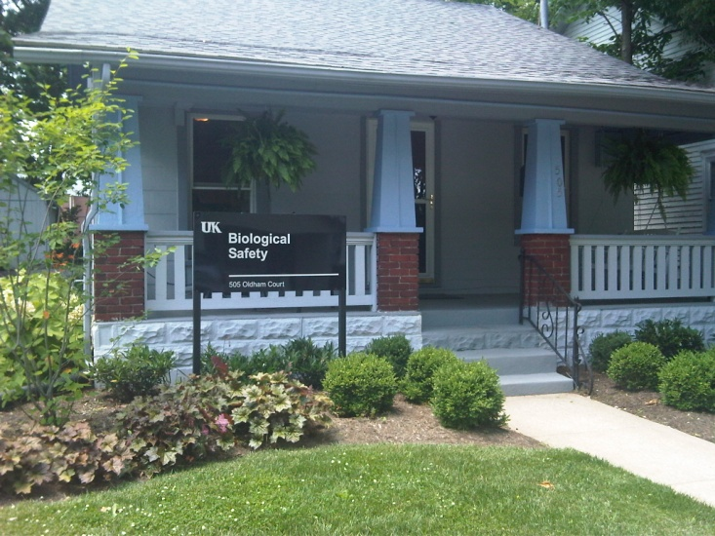
Contact Information
Holley Trucks
Acting Biological Safety Officer
Responsible Official
Office: (859) 257-8655
Fax: (859) 323-3838
Cell: (859) 699-6082
hmtr222@uky.edu

