Slide 1

Select Agent Training
University of Kentucky
Department of Biological Safety

Slide 2
Training Objectives :
Gain familiarity with Select Agent and Toxin regulations and penalties
Be able to identify UK’s Responsible Official and Alternate Responsible Official
Gain familiarity with Select Toxins and exempt quantities
Understand notification process in the event that Select Toxins are collected

Slide 3
Definitions:
RO: responsible official for institution/entity
ARO: alternate responsible official
HHS: Dept. of Health and Human Services
CDC: Centers for Disease Control and Prevention

Slide 4
Definition of Select Agent or Toxin:
Select Agents/Toxins are agents that the Federal Government considers to have the potential to pose a severe threat to human, plant or animal health with a significant impact on global public health or agriculture.
These agents may have historically been used in biowarfare or bioterrorism or are good candidates for this purpose.
A list of these agents are found in the Select Agents regulation (42 CFR 73).

Slide 5
Timeline of Select Agent Regulations:
Anti-terrorism and Effective Death Penalty Act of 1996
First list of Select Agents and Toxins
Regulated Transfers
Patriot Act of 2001
Possession of Select Agents and Toxins Regulated
Public Health Security and Bioterrorism Preparedness Act of 2002
Responsibilities placed upon institutions
Interim Rule 2003, Final Rule April 18, 2005
Regulated possession, use, and transfer of Select Agents and Toxins through the US Department of Health and Human Services
All individuals with access to Select Agents must be approved by HHS (after screening by FBI)

Slide 6

Criminal Penalties for Violations of Select Agent Regulations:
up to 5 years in prison and up to $250,000 fine for individuals
up to $500,000 fine for institutions

Slide 7
Criminal Penalties:
Fines are per incident
One institution was fined $150,000 for shipping a viable organism. They thought they had killed the organism because it had not grown for 48 hrs in their laboratory so they shipped it out. The receiver of the organism was able to produce a viable culture from the shipped sample, so the shipping institution was fined for violation of the Federal regulations.

Slide 8
Responsible Official:
Appointed by the University as responsible for the management of Select Agents at the institution
Ensures that regulations requirements are met
Develops safety, security and incident response plans
Provides appropriate training for safety, security, maintenance and emergency response workers
Reports all breaches of security, loss of select agents, inventory inconsistencies to CDC

Slide 9

Responsible Official:
University of Kentucky
Responsible Official:
Brandy Nelson 859-550-0333
Alternate Responsible Official:
David Hibbard 859-699-6083
Alternate Responsible Official:
Holley Trucks 859-699-6082

Slide 10

Select Toxins:
There is a subset of the Select Agents and Toxins list, the Select Toxins, which may be used without compliance with Select Agent regulations in exempt quantities.
You may encounter these as hazardous waste.

Slide 11
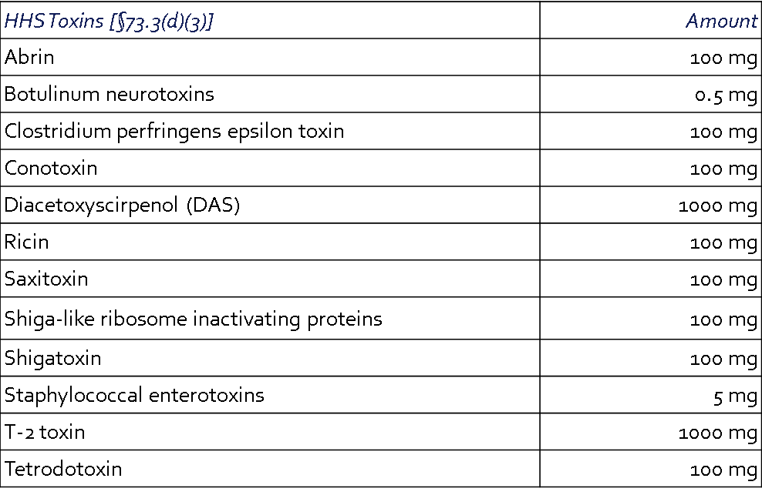
Permissible Select Toxin Amounts:
The following toxins are not regulated if the amount under the control of a principal investigator, treating physician or veterinarian, or commercial manufacturer or distributor does not exceed, at any time, the amounts indicated in the table below.

Slide 12
Toxicity and LD50 of Select Toxins:
Toxin | LD50 (per kg) | Toxicity
Abrin | 300 ng | Toxic
Botulinum Neurotoxins | 1 ng | Highly Toxic
Clostridium perfringens Epsilon Toxin | 0.1 μg | Toxic
Conotoxins | 0.01 – 0.025 mg | Toxic
Diacetoxyscirpenol (DAS) | 1.3 – 12 mg | Highly Toxic
Ricin | 500 ng | Acutely Toxic
Saxitoxin | 8 μg | Toxic
Shiga-like ribosome inactivating proteins | 3 – 20 μg | Toxic
Shigatoxin | 3 – 20 μg | Toxic
Staphylococcal Enterotoxins | 20 ng | Toxic
T-2 Toxin | 0.24 – 0.94 mg | Highly Toxic
Tetrodotoxin | 1 – 10 μg | Highly Toxic

Slide 13
Notification Process:
Receipt of Waste Ticket for Select Toxin
Contact RO, ARO or Biosafety Officer
RO/ARO will provide any guidance related to special disposal or handling.
Typical waste disposal procedure and tracking is going to be adequate in the majority of cases.

Slide 14
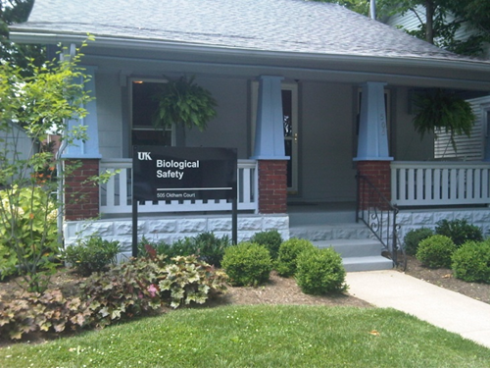

Questions?
Contact us at 257-1049

