Slide 1

Hazard Communication OSHA 29 CFR 1910.1200 Globally Harmonized System (GHS) Update
Training provided by
University of Kentucky
Occupational Health and Safety Department
Notes:
The Hazard Communication Standard (HCS) 2012 is an update to the HCS 1914 to align with the Globally Harmonized System of Classification and Labeling of Chemicals (GHS). This update to the Hazard Communication Standard (HCS) will provide a common and coherent approach to classifying chemicals and communicating hazard information on labels and safety data sheets.

Slide 2
GHS updates to the Hazard Communication Standard
Hazard classification:
Provides specific criteria to address health and physical hazards as well as classification of chemical mixtures.
Labels:
Provide a label that includes a signal word, pictogram, hazard statement.
Safety Data Sheets:
The new format requires 16 specific sections.
Information and training:
Covered employees must be trained.

Slide 3
Objectives of HazCom Standard
To provide employees with easily understandable information on appropriate handling and safe use of hazardous chemicals by
Establishment of a Written Hazard Communication Program
Training
Safety Data Sheets
Labeling

Slide 4
Who is covered by HCS?
All employees and students of the University who work with hazardous chemicals are covered by the HCS.
This also includes visiting professors and volunteers

Slide 5









What is a hazardous chemical?
Hazardous chemical:
any chemical which is classified as a physical hazard or a health hazard, a simple asphyxiant, combustible dust, pyrophoric gas, or hazard not otherwise classified.

Slide 6
What is a health hazard?
Health hazard – a chemical with one or more of the following:
acute toxicity (any route of exposure);
skin corrosion or irritation;
serious eye damage or eye irritation;
respiratory or skin sensitization;
germ cell mutagenicity;
carcinogenicity;
reproductive toxicity;
specific target organ toxicity (single or repeated exposure); or
aspiration hazard.
More information about health hazards can be found in APPENDIX A TO §1910.1200– HEALTH HAZARD CRITERIA
See Section 2 of Safety Data Sheets for specific health hazard information
Notes:
Health Hazard: a chemical with one or more of the following properties:

Slide 7
What is a physical hazard?
Physical hazard – a chemical with one or more of the following :
explosive;
flammable (gases, aerosols, liquids, or solids);
oxidizer (liquid, solid or gas);
self-reactive;
pyrophoric (liquid or solid);
self-heating;
organic peroxide;
corrosive to metal;
gas under pressure; or
in contact with water emits flammable gas.
More information about physical hazards can be found in APPENDIX B TO §1910.1200 - PHYSICAL HAZARD CRITERIA
See Section 2 of Safety Data Sheets for specific physical hazard information

Slide 8
Written Hazard Communication Program
OSHA requires that a written HCP be developed, implemented and maintained at each workplace. The HCP can be developed for each department, shop or unit depending upon how chemicals are utilized in specific work operations.

Slide 9
Written Hazard Communication Program (cont’d)
The written program must address at a minimum how the following requirements will be met:
Labels and other forms of warning for containers of hazardous chemicals
Safety Data Sheets (SDS)
Employee information and training
The methods the employer will use to inform employees of the hazards of non-routine task and the hazards associated with chemicals contained in unlabeled pipes in their work areas
The manner in which contractors in the facility will be informed of the hazards to which their employees may be exposed
Notes:
Formatted forms to provide assistance

Slide 10
Written Hazard Communication Program (cont’d)
A template to assist you in developing a written HCP has been established at the University of Kentucky and is available at UK Hazard Communications Program
Copies of the written HCP must be available in the work area for review by all employees.

Slide 11
Responsibilities of Environmental Health and Safety Division (EHS)
EHS is responsible for developing, implementing and monitoring the HCP to include:
Collaborating with faculty and staff to develop and implement a comprehensive, workplace - specific HCP
Providing general Hazard Communication training
Training departmental trainers about the potential hazards from chemicals and protective measures and work practices that may be used to reduce these hazards
Conducting job hazard analysis and exposure assessments
Providing technical assistance concerning Personal Protective Equipment (PPE)
Remaining current on rules and regulations concerning HCP requirements
Notes:
OHS is here to provide assistance. If you have questions please let us know.
The University of Kentucky is committed to providing a safe and healthful environment for all persons associated with the institution. The university intends to be a role model for the Commonwealth in its environmental stewardship, health protection and safety standards and its compliance with all laws and regulations relating to the environment, health and safety. Management, faculty, staff, students, and visitors are asked to support these goals in all university activities and the University administration will provide the necessary resources to achieve these goals.
A vast array of educational activities and research is conducted at the university, and hazardous chemicals are often an integral part of these vital functions. The cooperation of all parties involved is crucial to ensure the safety and integrity of workers, students, the community and the environment.

Slide 12
Responsibilities of Employing Department (Deans, Directors, Heads of Academic and Administrative Units)
Responsible for the health and safety of their staff, students, and visitors. Specific responsibilities include:
Understanding and enforcing the provisions of the HCP
Informing and training employees concerning chemical safety as required by the HCP
Ensuring that training is conducted as soon as an employee is assigned to the work area, when a new hazardous chemical is introduced into the work area, and when a non-routine task presents a chemical hazard
Maintaining a current inventory of hazardous chemicals in the workplace

Slide 13
Responsibilities of Employing Department (cont’d)
Ensuring labels are provided for all hazardous chemicals as required by the HCP
Making SDS's immediately available for all chemicals in inventory
Ensuring the availability and enforcing the use of the proper required PPE
Maintaining dated training records for those employees supervised

Slide 14
Responsibilities of employee, student, and visitors
Attending training provided by the supervisor and EHS
Following all health and safety rules and regulations related to the workplace activities
Properly wearing and utilizing required PPE
Reporting any unsafe conditions or activities to the supervisor immediately

Slide 15
Responsibilities of employee, student, visitor (cont’d)
Requesting information or training when unsure how to use equipment or do a task
Reporting any job related injury or illness to the supervisor and seeking treatment immediately Reporting Your Accident

Slide 16
Container Type and Required Labeling
Notes:
Container labeling can be a very effective method to communicate the physical and health hazards of chemicals used in the workplace. The information on a container label will vary depending on the type of container, and its intended use. We'll discuss the various labeling requirements in this module.

Slide 17
Four Types of Containers
Primary containers
Secondary containers
Stationary containers
Portable containers
Notes:
First we'll take a look at the labeling requirements for each of the four types of containers referred to in the HCS:

Slide 18

Primary Container
Incoming container typically shipped from the manufacturer
Examples include
Drums, Crates, Large Bags, etc…
Notes:
Primary container are typical

Slide 19
Primary Container Labeling
The chemical manufacturer or importer is required to label, tag or mark the following information for hazardous chemicals leaving their facility:
Product identifier;
Signal word;
Hazard statement(s);
Pictogram(s);
Precautionary statement(s); and,
Name, address, and telephone number of the chemical manufacturer, importer, or other responsible party.
Notes:
The chemical manufacturer, importer, or distributor shall ensure that each container of hazardous chemicals leaving the workplace is labeled, tagged or marked. Hazards not otherwise classified do not have to be addressed on the container.

Slide 20
Primary Container Labeling (cont’d)
Signal Word
Indicates the relative level of severity of hazard.
Danger = Severe hazards
Warning = Less severe hazards

Slide 21
Primary Container Labeling (cont’d)
Hazard Statement
A statement assigned to a hazard class and category that describes the nature of the hazard(s) of a chemical, including, where appropriate, the degree of hazard.

Slide 22
Primary Container Labeling (cont’d)
Hazard Pictograms
The HCS requires pictograms on labels to alert users of the chemical hazards.
Each pictogram represents a distinct hazard(s).
The pictogram on the label is determined by the chemical hazard classification.

Slide 23
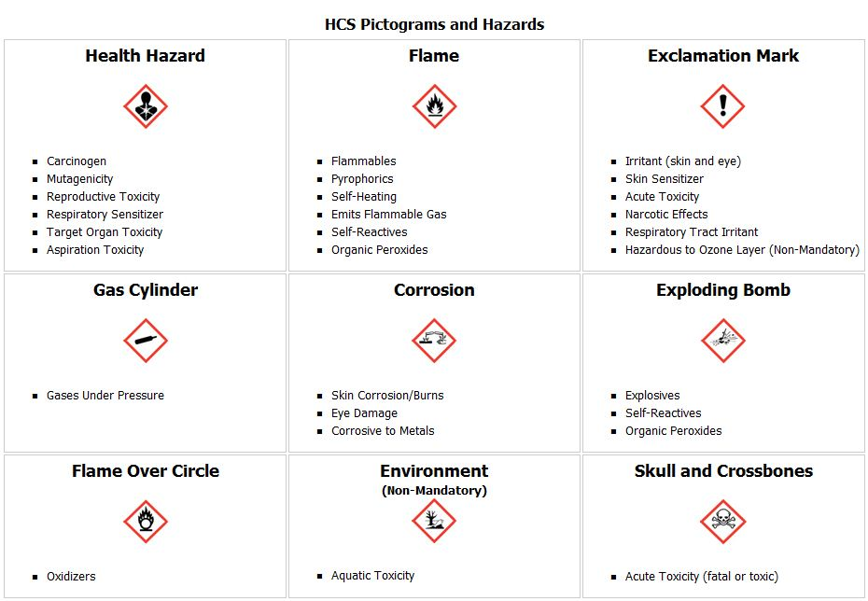
Examples of Pictograms

Slide 24
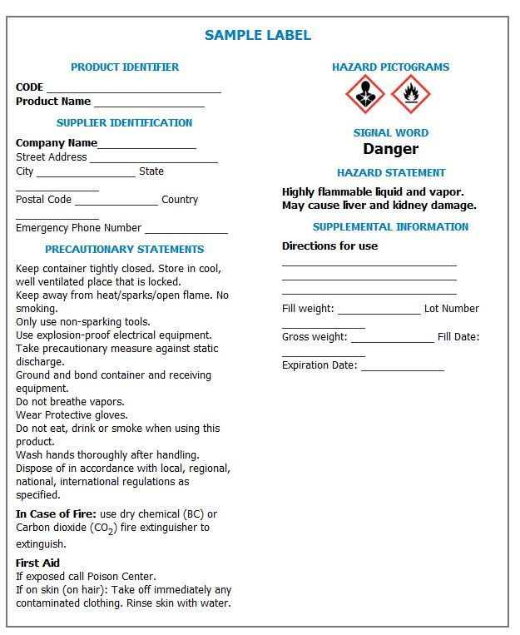
Example of a Primary Container Label

Slide 25
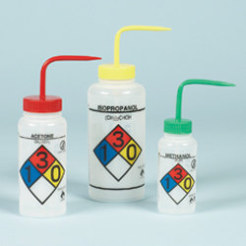

Secondary Container Labeling
A secondary container is a container that is used to store smaller quantities of a chemical from the primary container.
Examples of secondary containers
Coffee cans
Drums
Plastic jugs
Spray bottles

Slide 26
Secondary Container Labeling (cont’d)
Each secondary container of hazardous chemicals in the workplace shall be labeled, tagged or marked with at least the following information:
Identity of the hazardous chemical(s)
Appropriate hazard warnings, or words, pictures, and/or symbols which provide information regarding the hazards of the chemicals.

Slide 27
Labeling Methods
The two most common types of labeling systems utilized are:
NFPA 704 (National Fire Protection Association)
HMIS (Hazardous Materials Identification System)

Slide 28
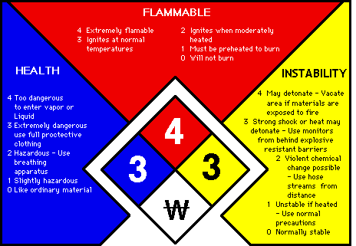
NFPA Labeling
Notes:
The NFPA system uses a diamond-shaped diagram of symbols and numbers to indicate the degree of hazard associated with a particular chemical or material. These diamond shaped symbols are placed on containers of chemicals or materials to identify the degree of hazard associated with the chemical or material.

Slide 29
NFPA Labeling (cont’d)
Special Hazard Information
An open space at the bottom of the NFPA diagram can be used to indicate additional information about the chemical or material. Some examples of those are below:
OX or OXY indicates a material that is an oxidizer
W indicates a material that is water reactive
ALK indicates a material that is alkali
COR indicates a material that is corrosive
RAD indicates a material that is radioactive

Slide 30
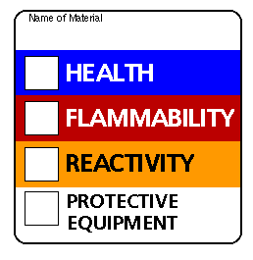
HMIS Labeling
The HMIS labeling system operates on the same principle as the NFPA diamond.
Each category uses a 0-4 scale
0 = Less severe
4 = More severe
* in health = chronic health hazard
Specific coding is provided for PPE

Slide 31
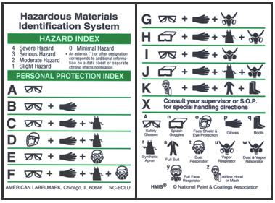
HMIS Labeling (cont’d)
Personal Protection
HMIS® uses the white section to indicate what PPE should be used when working with the material.
Each letter corresponds to a required level of PPE for use of chemical.

Slide 32
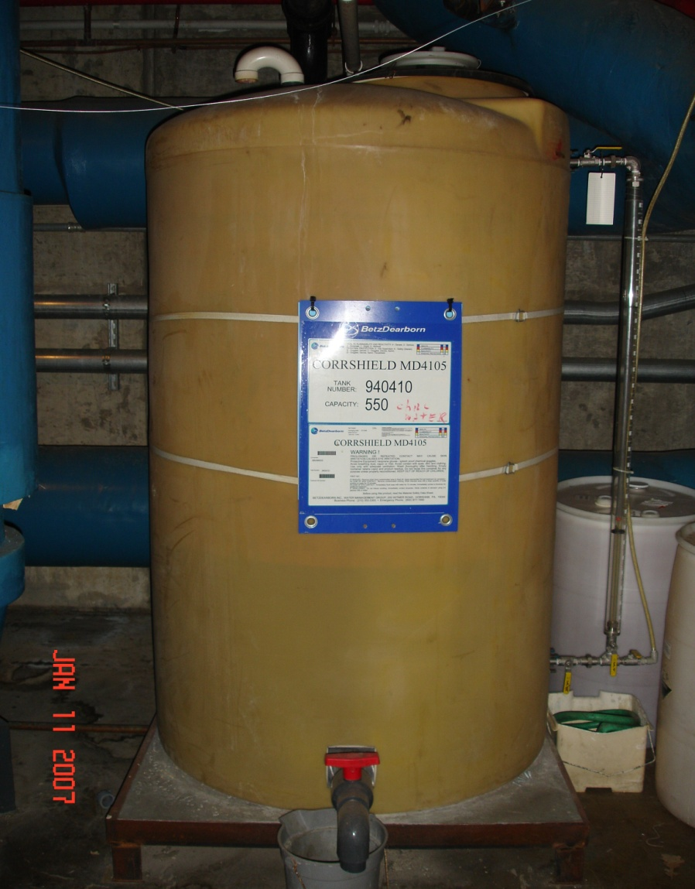
Stationary Process Container Labeling
The employer may use signs, placards, process sheets, batch tickets, operating procedures, or other written materials in lieu of affixing labels to individual stationary process containers, as long as the alternative method identifies the containers to which it is applicable and conveys the information required on secondary containers.

Slide 33

Portable Container Labeling
Used to transfer hazardous chemicals from labeled containers
Only allowed for immediate use by employee performing transfer
Does not require a label
Notes:
Portable containers are used to transfer hazardous chemicals from labeled containers, and are intended only for the immediate use of the employee who performs the transfer. The employer is not required to label portable containers. For purposes of this section, drugs which are dispensed by a pharmacy to a health care provider for direct administration to a patient are exempted from labeling.

Slide 34
Additional Labeling Requirements
Must accurately communicate the hazards of their associated chemicals.
Keep labels in good condition at all times.
Do not remove or deface existing labels on incoming containers of hazardous chemicals,
If label is removed or defaced, the container shall immediately be marked with the required information.
Ensure that labels or other forms of warning are:
legible, in English,
prominently displayed on the container, or
readily available in the work area throughout each work shift

Slide 35
Safety Data Sheets SDS
Required for each hazardous chemical in the workplace and must be available for review in the work area during the work shift
Utilized to inform employees of the hazards associated with the chemical's use, storage, and disposal
Provides information regarding procedures for first aid, spills, fires, and other emergencies

Slide 36
Safety Data Sheets SDS (cont’d)
Copies of the SDS for most chemicals may be obtained from MSDS Online or directly from the manufacturer or importer of the chemical
Paper copies of the SDS should be maintained in a notebook or other collection device if electronic methods are not used
If access is by computer, the computer must be available during the work shift and employees must be trained in how to the use the system

Slide 37
Safety Data Sheets SDS (cont’d)
SDS Format
Section 1 Identification;
Section 2 Hazard(s) identification;
Section 3 Composition/information on ingredients;
Section 4 First-aid measures;
Section 5 Fire-fighting measures;
Section 6 Accidental release measures;
Section 7 Handling and storage;
Section 8 Exposure controls/personal protection;
Section 9 Physical and chemical properties;
Section 10 Stability and reactivity;
Section 11 Toxicological information
Section 12 Ecological information;
Section 13 Disposal considerations;
Section 14 Transport information;
Section 15 Regulatory information; and
Section 16 Other information, including date of preparation or last revision.
More information about the specific content of each section of the SDS can be found in Appendix D to §1910.1200--Safety Data Sheets
Notes:
The safety data sheets shall be in English and includes at least the following section numbers and headings, and associated information under each heading, in the order listed.

Slide 38
Employee Training
The departmental supervisor or their designee is responsible for ensuring employees receive the required training
The employee shall be provided with workplace specific training on hazardous chemicals that are located in their work area
Training shall be provided to the employee at the time of their initial assignment and whenever a new physical or health hazard is introduced into the work area. The workplace specific training is required in addition to the completion of this online training module.

Slide 39
Employee Training (cont’d)
The workplace specific training must inform employees of:
How to locate a copy of the work place - specific written HCP.
How to access the master list of hazardous chemicals.
How to access an SDS for each chemical in the master list.
An explanation of the labeling system used in the work place.
The physical and health hazards of the hazardous chemicals in the work area.
Special precautions to follow when working with hazardous chemicals.
How to reduce or prevent overexposure to hazardous chemicals
Steps that the department has taken to reduce or prevent exposure to hazardous chemicals.

Slide 40
Employee Training (cont’d)
Methods and observations employees may use to detect the presence of a hazardous chemical.
Procedures to follow if employees are exposed to hazardous chemicals
The health hazards, symptoms, first aid and emergency procedures to follow, in case of overexposure
Procedures to follow when a spill or leak occurs.
How and when to use PPE. UK PPE Program and Hazard Assessment
How to provide outside contractors the information about chemical hazards in the work place.
The potential hazards associated with non routine tasks, and the control measures used to ensure worker safety. Non routine tasks are those which are not a part of the normal day-to-day activities.

Slide 41
Controlling Physical and Health Hazards
There are a number of ways to prevent overexposure to hazardous chemicals. One of the most effective is to follow the safe work practices as recommended by manufacturer's guidelines when using these products.
Other ways to safeguard your health and safety when using hazardous materials include the following:
Product substitution
Use proper engineering controls
Knowing how to work with the material safely
Use the proper PPE as it is intended to be used
Notes:
Knowing how to work with the material safely This is the reason for safety training, safety discussions, written programs and procedures to follow when working with chemicals. The employee has a responsibility to use these resources as well as the skills and knowledge of the job they have. The most important rule is to ask your supervisor if you do not know or are not sure how to work with a hazardous material.
Product substitution If possible, select chemicals that are less hazardous yet can do the same job.
Follow safe work practices as recommended by the manufacturer Use the product in an area that is well ventilated without spark hazards. Do not mix chemicals unless you are sure they are compatible. Review the MSDS to determine appropriate working conditions and compatibility with other chemicals.
Use proper engineering controls An example would be to utilize local exhaust ventilation to remove chemicals out of your breathing zone.
Use the proper PPE as it is intended to be used Remember, PPE is only protective if the right type is used at the correct time and in the correct manner. PPE is the last resort in working safely with most hazardous chemicals.

Slide 42

Personal Protective Equipment (PPE)
A PPE Hazard Assessment must be conducted by the supervisor with an explanation on the use and care of the PPE. Information and forms to conduct this assessment can be found within the UK PPE Program and Hazard Assessment
PPE including gloves, safety glasses, aprons, and other protective clothing is available from the employee's supervisor.

Slide 43
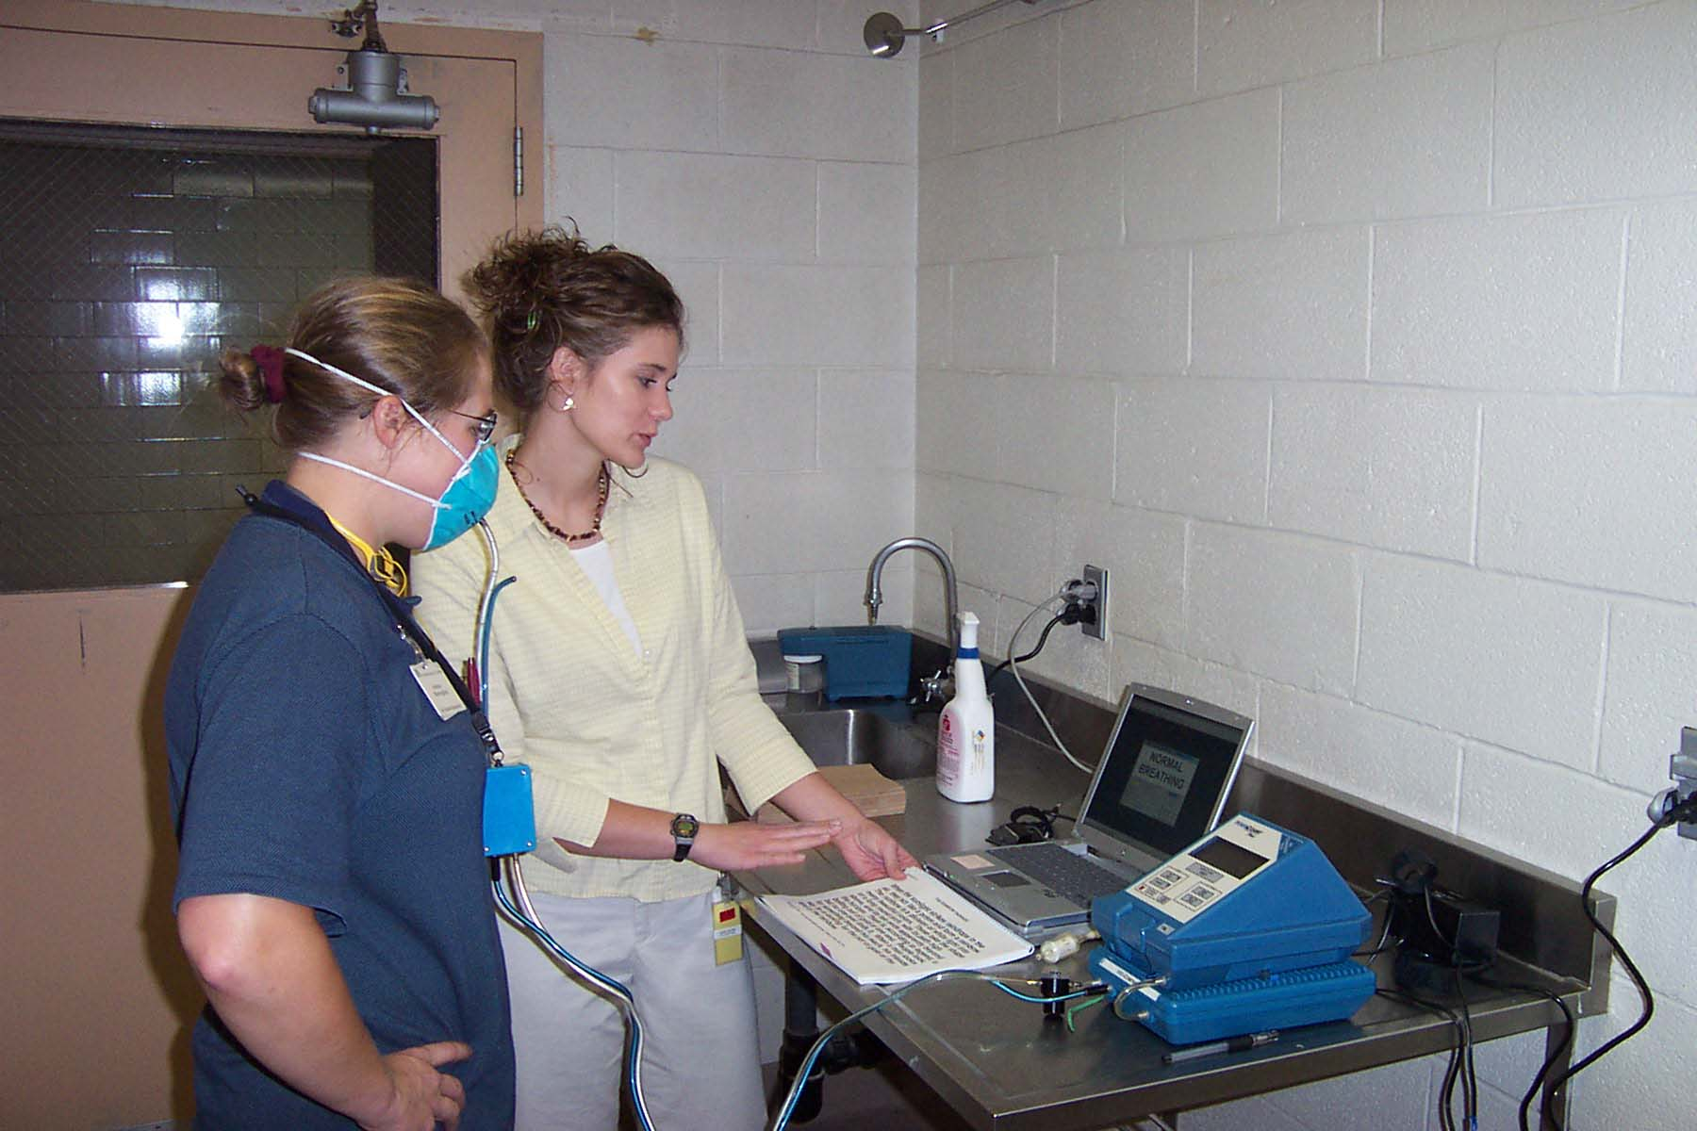
Personal Protective Equipment (cont’d)
If the use a of respirator is required for specific tasks, employees are required to be medically approved, fit-tested and given specific instructions about the use, care, and limitations of their respirators (PRIOR TO USE) Contact OHS at 257-7600 or visit our Respiratory Protection page for information.

Slide 44
Chemical Release
Spills and releases of hazardous materials in other than insignificant amounts should call Environmental Management
Between 8:00 a.m. - 5:00 p.m. (323-6280)
After Hours: 911 (from on-campus phones) or 257-UKPD (8573)
If a spill involves a biological material then follow Biological Safety’s Spill Plan

Slide 45
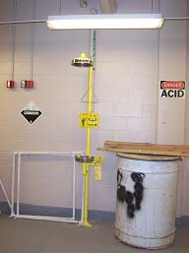
Emergency Eye Wash/Safety Showers
OSHA requires that suitable means for flushing and quick drenching of the eyes and body be available in any area where toxic and/or corrosive materials are in use.-
In cases of an exposure, the initial first aid treatment is to flush affected area with water for a minimum of 15 minutes.
For more information about Emergency Eye Wash/Safety Showers please view Eyewash Training

Slide 46
Questions/Comments
Michael Turner
Safety Specialist
University of Kentucky
Michael.turner1@uky.edu
(859) 257 -3862

