Slide 1

Plant Biological Safety Training Rev. 2012-0314
Department of Biological Safety
﻿An Equal Opportunity University

Slide 2
Biosafety Goals for Plant Research
Biological materials utilized in plant-related research typically don’t present a hazard to people, but they do present a hazard to the surrounding environment
Primary goal of biosafety in regards to plant research is CONTAINMENT of transgenic and/or pathogenic materials
﻿An Equal Opportunity University

Slide 3

Identification of Biohazards
Biohazardous materials may include, but are not limited to:
Infectious agents
Recombinant nucleic acids
Infected animal blood and/or tissues
Human blood, blood products, or fluids
Human derived cell lines or tissues
Live vaccines
﻿An Equal Opportunity University

Slide 4
Infectious Agents
Viruses – ex: Tobacco mosaic tombamovirus, Bean pod mottle virus
Bacteria – ex: Pseudomonas syringae, Ralstonia solanacearum
Fungus – ex: Phytophthora infestans, Rhizoctonia solani
Parasites – ex: Pratylenchus penetrans, Hoplolaimus galeatus
﻿An Equal Opportunity University

Slide 5
Recombinant Nucleic Acids
Transformation via Agrobacterium tumefaciens
Use of Gene Gun
Transgenic plants
﻿An Equal Opportunity University

Slide 6
How do you manage risk of exposure when working with biohazardous materials?
1st step is identification of risk
Is it a pathogenic bacteria? What are its characteristics?
Is there a potential for release of transgenic material?
2nd step is risk assessment
Determining the amount of risk based upon materials, manipulations planned, facility design, etc.
﻿An Equal Opportunity University

Slide 7
Questions to Consider
Source and nature of introduced DNA
Exotic infectious agent or pathogenic organism
Recipient organism
Mode and ease of dissemination
Invasiveness
Noxious weed or able to interbreed with noxious weeds
Potential for outcrossing
Potential for detrimental impact on natural or managed ecosystems
﻿An Equal Opportunity University

Slide 8
Questions to Consider
Nature of expressed protein
Vertebrate toxin or potential or known allergen
Toxic to other organisms in local environment
Local Environment
Nature and importance of nearby crops
Presence of sexually compatible wild or weedy species
Experimental Procedures
Transport to/from greenhouse
Necessary containment measures
﻿An Equal Opportunity University

Slide 9
Result of Risk Assessment
After thorough risk assessment, determine appropriate level of containment
As potential risk to the environment increases, so must containment requirements
﻿An Equal Opportunity University

Slide 10
Suggested Criteria for Assigning Biosafety Levels
Criteria | Transgenic Plants | Transgenic Microbes |  | Transgenic Arthropods and Microbes
 |  | Exotic | Non-Exotic
Not a noxious weed or cannot outcross with one | BL1-P
Not easily disseminated |  |  | BL1-P
No detriment to environment |  | BL2-P or BL1-P+ | BL1-P | BL2-P or BL1-P+
Noxious weed or can interbreed with weeds | BL2-P or BL1-P+
Contains complete genome of non-EIA | BL2-P or BL1-P+
Contains genome of EIA | BL3-P or BL2-P+
Treated with an EIA | BL3-P or BL2-P+
Detriment to environment |  |  | BL2-P or BL1-P+ | BL3-P or BL2-P+
EIA w/ detriment to environment | BL3-P or BL2-P+
May reconstitute genome of infectious agent in planta | BL3-P or BL2-P+
Contains vertebrate toxin | BL3-P | BL3-P | BL3-P
Select Agent plant pathogens | BL3-P | BL3-P | BL3-P | BL3-P+ or BL4-P
Source: A Practical Guide to Containment
﻿An Equal Opportunity University

Slide 11
Containment Strategies
What are we trying to contain?
Plants
Microbes
Insects
Types of Containment
Physical
Biological
﻿An Equal Opportunity University

Slide 12
Plant Containment
Physical Plant Containment
Primary Containment: Greenhouse, Growth Chamber
Standard Operating Procedures (SOPs): Cover/remove flower/seed heads, harvest plant material before sexual maturity, control of flowering time, use of male sterile lines, ensure cross-fertile plants not within pollen dispersal range
﻿An Equal Opportunity University

Slide 13
Plant Containment
Biological Plant Containment
Use genetic engineering techniques that localize transgenes in non-propagative plant parts, prohibit plant propagules from surviving, or confer plant sterility
Control time of flowering so that pollen shed does not coincide with receptive period of nearby sexually compatible plants
﻿An Equal Opportunity University

Slide 14
Microbe Containment
Physical Microbe Containment
Use of Biological Safety Cabinet
Avoid creating aerosols when inoculating plants
Provide adequate distance between infected plants and susceptible host(s)
Treat runoff water to kill living organisms
Eliminate vectors for insect-borne microbes
﻿An Equal Opportunity University

Slide 15
Microbe Containment
Biological Microbe Containment
Choose microbes having an obligate association with the host plant
Genetically disable microbe to minimize survival and reproduction
﻿An Equal Opportunity University

Slide 16
Insect Containment
Physical Insect Containment
Conduct experiments during time of year when survival of escaped organisms is impossible
Treat/evaporate runoff water to destroy viable eggs/larvae
Avoid use of small insects in greenhouse cages
Destroy all pollinating insects in cages after pollen transfer
﻿An Equal Opportunity University

Slide 17
Insect Containment
Biological Insect Containment
Choose or create non-flying, flight-impaired, or sterile strains
Choose organisms that have obligate association with plant not found in vincinity
﻿An Equal Opportunity University

Slide 18
Containment Strategies
Controlled Access
Greenhouse, Growth Chambers, Laboratories
Use of dedicated lab coats
Use of disposable gloves
Washing hands after removing gloves
﻿An Equal Opportunity University

Slide 19
Containment Equipment
Biological Safety Cabinet (BSC)
Primary containment device which utilizes HEPA filtered directional airflows to contain potentially infectious materials during experimental procedures
Provides protection for environment, personnel and product
Laminar Flow Bench (LFB)
AKA clean bench. Provide aseptic environment for experimental work by passing HEPA filtered air across work surface
Provides protection for product
Does NOT provide containment
More information available here
﻿An Equal Opportunity University

Slide 20

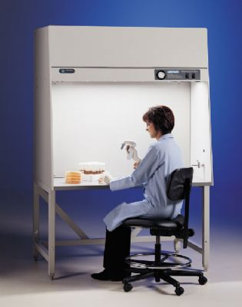
Containment Equipment
Which of these is a biological safety cabinet (BSC), and which is a laminar flow bench (LFB)? Can you tell the difference?
BSC
LFB
﻿An Equal Opportunity University

Slide 21
Use of BSCs
Do not store materials/equipment inside BSC
Clean/disinfect BSC before and after each use
Place all necessary work items inside BSC before beginning work
Disinfect all items taken out of BSC
Do not block air intake/exhaust grills or slots
Minimize arm movements in/out of cabinet
More information available here
﻿An Equal Opportunity University

Slide 22
Storage and Handling of Materials
Coolers, freezers, and growth chambers equipped with locks are recommended for storage
Transgenic seed should be clearly identified and stored in a locked cabinet
Seed stored/handled outside of containment area (cabinet, potting bench, etc.) should be kept in spill-proof container
﻿An Equal Opportunity University

Slide 23
Transfer of Materials
NIH Guidelines specify requirements for transporting experimental materials to/from greenhouses BL2-P – BL4-P
Transgenic material transferred in closed, non-breakable containers
﻿An Equal Opportunity University

Slide 24
Termination of Experiment
Experimental materials must be rendered biologically inactive (devitalized) before disposal
Devitalization Methods:
Heat via steam, autoclave, hot water, incineration
Chemical treatment
Freezing
Composting
Desiccation
﻿An Equal Opportunity University

Slide 25
Use of Autoclave
When operating autoclaves, wear buttoned lab coat, eye protection, close-toed shoes, and heat resistant gloves
Place autoclave bag in appropriate autoclave pan/bin
Do not crowd items in autoclave
Never leave biohazardous waste for autoclave unattended
﻿An Equal Opportunity University

Slide 26
Use of Autoclave
Be sure to select the correct autoclave cycle:
Temperatures between 121-124ºC
Total processing time 60-120 minutes
Exposure time greater than 20 minutes
Minimum pressure 15 PSI
Select liquid or slow exhaust cycle
Complete autoclave user log as required
Verify cycle conditions were met before unloading
Allow contents to cool before removing
More information available here
﻿An Equal Opportunity University

Slide 27
Guidelines
NIH Guidelines for Research Involving Recombinant DNA Molecules
A Practical Guide to Containment: Plant Biosafety in Research Greenhouses
﻿An Equal Opportunity University

Slide 28
NIH Guidelines
Published by Department of Health & Human Services, the National Institutes of Health, Office of Biotechnology Activities
Specifies practices for constructing and handling:
rDNA molecules, and
Organisms and viruses containing rDNA molecules
﻿An Equal Opportunity University

Slide 29
NIH Guidelines
rDNA:
Molecules that are constructed outside living cells by joining natural or synthetic DNA segments to DNA molecules that can replicate in a living cell, or
Molecules that result from the replication of those described above, or
Synthetic DNA segments which are likely to yield a potentially harmful polynucleotide or polypeptide
﻿An Equal Opportunity University

Slide 30
NIH Guidelines: Compliance
UK received over $100 million from the NIH in 2011
As a condition of NIH funding, institutions must ensure that research conducted at/sponsored by the institution, irrespective of funding source, shall comply with the NIH Guidelines
In other words, ALL rDNA research conducted at UK must comply with NIH Guidelines
﻿An Equal Opportunity University

Slide 31
NIH Guidelines: Compliance
Non-compliance may result in…
Suspension, limitation, or termination of financial assistance for the non-compliant NIH-funded research project and of NIH funds for OTHER rDNA research at the institution, or
Requirement for prior NIH approval of any and/or all rDNA projects at the institution
﻿An Equal Opportunity University

Slide 32
NIH Guidelines contain…
Safety Considerations (Section II)
Risk Assessment
Risk Groups
Containment
Experiments covered by the NIH Guidelines (Section III)
Roles & Responsibilities (Section IV)
Institution, Institutional Biosafety Committee (IBC), Biological Safety Officer, Principal Investigator
﻿An Equal Opportunity University

Slide 33
The Regulations Require…
There are 2 levels of IBC registration…
Registration Only
Full IBC review and approval not required
Online registration and biosafety audit are required
Includes: NIH exempt rDNA, human cell/tissue culture, human source materials, RG1 infectious agents
IBC Registration & Approval
Full IBC review and approval required
Online registration and biosafety audit are required
Includes: RG2, RG3 or RG4* agents, work non-exempt by NIH Guidelines
*Work with RG4 agents is not conducted at the University of Kentucky
﻿An Equal Opportunity University

Slide 34
A Practical Guide to Containment
Originally published in 2001 as A Practical Guide to Containment: Greenhouse Research with Transgenic Plants and Microbes
Expanded to contain information regarding research with exotics, pathogens, insects, and genetically engineered plant-manufactured pharmaceuticals and industrial compounds, and on high containment for quarantined organisms (including those on Select Agent List)
﻿An Equal Opportunity University

Slide 35
A Practical Guide to Containment
Addresses…
Biosafety containment levels
Physical and biological strategies
Modifications to achieve containment
Greenhouse management
Handling of biological materials
Guidance for developing or renovating facilities
﻿An Equal Opportunity University

Slide 36
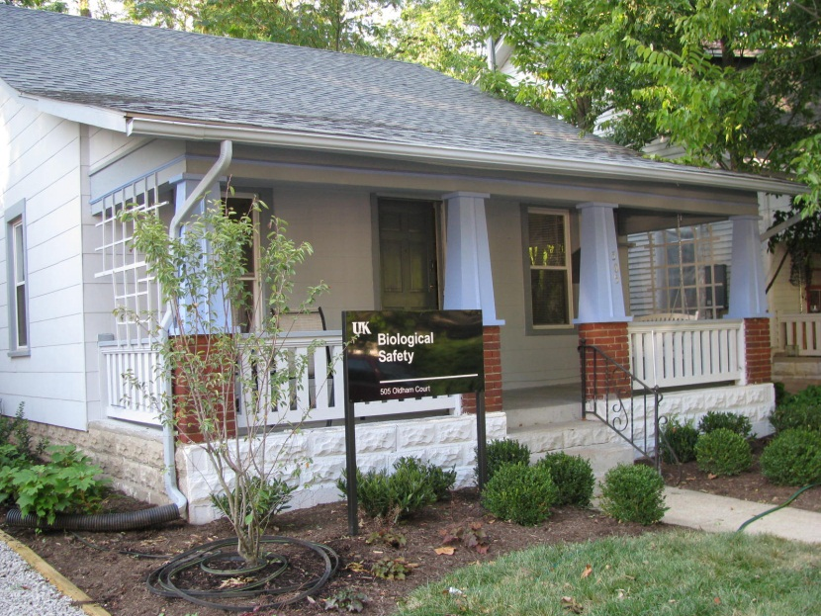
Department of Biological Safety
For further information…
http://ehs.uky.edu/biosafety/
505 Oldham Court
Lexington, KY 40502
Phone: (859) 257-1049
Fax: (859) 323-3838
﻿An Equal Opportunity University

