Slide 1

Biological Safety Training Rev. 2012-0222
Department of Biological Safety
﻿An Equal Opportunity University

Slide 2

Identification of Biohazards
Biohazardous materials may include, but are not limited to:
Infectious agents (plant, animal, or human)
Recombinant nucleic acids
Infected animal blood and/or tissues
Human blood, blood products, or fluids
Human derived cell lines or tissues
Live vaccines
Synthetic nucleic acids
﻿An Equal Opportunity University

Slide 3
Infectious Agents
Viruses – ex: Influenza virus, Hepatitis B
Bacteria – ex: Staphylococcus aureus, Pathogenic Escherichia coli
Fungus – ex: Aspergillus niger, Candida albicans
Parasites – ex: Ascaris lumbricoides, Toxoplasma gondii
Prions – ex: Bovine spongiform encephalopathy (BSE), Creutzfeldt-Jakob disease (CJD)
﻿An Equal Opportunity University

Slide 4
Recombinant Nucleic Acids
Plasmids with inserts
Viral Vectors – Adenoviral vector, Lentiviral vector
Some viral vectors are capable of integrating into your genome, increasing risk
Transgenic Animals
Transgenic microorganisms
﻿An Equal Opportunity University

Slide 5
Infected animal blood/tissues
Samples of animal blood and/or tissues known to be harboring an infectious agent
Ex: Samples of equid tissue received from veterinary diagnostic laboratory known to be infected with equine herpes virus; Samples of wild-caught raccoons likely to harboring rabies infection
﻿An Equal Opportunity University

Slide 6
Human Source Materials
Human blood or blood products
Serum, plasma, etc.
Other Potentially Infectious Materials (OPIM)
Human bodily fluids: semen, vaginal secretions, cerebrospinal fluid, unfixed human tissue, etc.
Human derived cell lines or tissues
Including immortalized human cell lines
﻿An Equal Opportunity University

Slide 7
Live Vaccines
A vaccine containing an agent that resembles a pathogenic microorganism
Often made from weakened or dead forms of a microbe, its toxins, or surface proteins
﻿An Equal Opportunity University

Slide 8
How do you manage risk of exposure when working with biohazardous materials?
1st step is identification of risk
Is it a pathogenic bacteria? What are its characteristics?
2nd step is risk assessment
Determining the amount of risk based upon materials, manipulations planned, facility design, etc.
﻿An Equal Opportunity University

Slide 9
Risk Assessment
Initial risk assessment made by investigator based on Risk Group (RG)
Agents are classified according to relative pathogenicity for health adults
Risk Group 1 (RG1) | Not associated with disease in healthy adults
Risk Group 2 (RG2) | Associated with human disease which is rarely serious and for which preventive or therapeutic interventions are often available
Risk Group 3 (RG3) | Associated with serious or lethal human disease for which preventive or therapeutic interventions may be available (high individual risk, low community risk)
Risk Group 4 (RG4) | Likely to cause serious or lethal human disease for which preventive or therapeutic interventions are not usually available (high individual risk, high community risk)
﻿An Equal Opportunity University

Slide 10
Risk Assessment
Laboratory Hazards:
Aerosol generating procedures
Transgenic animals or microorganisms
Use of sharps
High concentrations or large quantities of microorganisms
﻿An Equal Opportunity University

Slide 11
Aerosols
Sonicating, blending, vortexing, centrifuging, pipetting, loading syringes, injections, animal inoculations, homogenizers, cell sorters, etc.
Aerosol generating procedures should be
Performed in a Biological Safety Cabinet (BSC), or
Plan to increase PPE
Respiratory protection may be required
﻿An Equal Opportunity University

Slide 12
Transgenic Animals
Know the source and background of all transgenic animals that you plan to work with
For the most part, transgenic animals pose no greater risk than non-transgenic animals, however…
Some transgenic animals may have different needs as compared to non-transgenic animals
Work with DLAR staff to ensure proper housing and handling
﻿An Equal Opportunity University

Slide 13
Transgenic Microorganisms
Microorganism with foreign genes inserted into its genome
Transgenic microorganisms may have…
Antibiotic resistance
Expanded host range
Enhanced pathogenicity
Includes use of attenuated E. coli to produce recombinant proteins, use of viral vectors to establish gene expression or knock-down
﻿An Equal Opportunity University

Slide 14
Use of Viral Vectors
Fundamental molecular biology tool, may present additional risk (even replication-deficient viral vectors)
Lentiviral vectors and amphotropic Retroviral vectors may integrate into the host genome (insertional mutagenesis)
Type of gene expressed may increase risk – oncogenes, tumor suppressors, toxins
﻿An Equal Opportunity University

Slide 15
Use of Sharps
Needles, razor blades, scalpels, etc.
Dispose of in designated hard-sided sharps container
Do not overfill sharps container
Do not re-shield, bend, or break needles
Sharps used with animals presents greater risk
Animals must be restrained (physical restraint, anesthesia)
﻿An Equal Opportunity University

Slide 16
Cultures of High Concentrations and/or Large Quantities
Scaling a process up to higher concentrations or larger volumes of culture may change risk assessment
Large scale > 10L
High concentrations
Risk assessment differs when using 10³ concentration of virus versus 10¹⁰ concentration
﻿An Equal Opportunity University

Slide 17
Result of Risk Assessment
Once a risk assessment has been completed, the Biological Safety Level (BSL) is determined
Four Biological Safety Level designations: BSL1, BSL2, BSL3, BSL4
BSL is combination of:
Agent
Work practices/procedures
Safety equipment
Facilities
﻿An Equal Opportunity University

Slide 18
Risk Mitigation
Once you have identified and assessed biohazardous risks based on agent and manipulations planned, how do you mitigate these risks?
Standard Microbiological Practices, Biological Safety Cabinet (BSC), and Personal Protective Equipment (PPE)
﻿An Equal Opportunity University

Slide 19
Standard Microbiological Practices
Essentially, good laboratory technique that leads to worker protection and good scientific results
Common to all laboratories working with biohazardous materials
﻿An Equal Opportunity University

Slide 20
Standard Microbiological Practices
Access to laboratory is restricted to trained personnel
Laboratory doors locked when unoccupied
Laboratory doors are properly labeled to indicate presence of biohazardous materials and provide emergency contact information
﻿An Equal Opportunity University

Slide 21
Standard Microbiological Practices
Prohibited in laboratory:
Eating
Drinking
Smoking
Use of smokeless tobacco products
Chewing gum
Handling contact lenses
Applying cosmetics (including lip balm)
Storing food/drink for human consumption
﻿An Equal Opportunity University

Slide 22
Standard Microbiological Practices
Personnel wash hands:
After work with potentially hazardous materials
After removing gloves
When soiled
Before leaving the lab
Mouth pipetting is prohibited
﻿An Equal Opportunity University

Slide 23
Standard Microbiological Practices
Plasticware is substituted for glassware whenever possible
Broken glass is not handled directly. Broken glass should be removed with broom/dustpan, tongs, or forceps
Glass slides may be disposed of as sharps waste
﻿An Equal Opportunity University

Slide 24
Standard Microbiological Practices
Work surfaces are decontaminated:
When work is finished
After any spill or splash
Appropriate disinfectant utilized based on susceptibility of biohazardous agent(s) in use
Liquid biohazardous waste decontaminated prior to disposal in sanitary sewer
﻿An Equal Opportunity University

Slide 25
Use of Disinfectant
Choose disinfectant based on agent susceptibility
Recommended Disinfectants:
0.5% Sodium Hypochlorite (10% household bleach)
Follow manufacturer’s instruction regarding dilution and required contact time
Organic material can inactivate disinfectants and should be cleaned from surfaces prior to disinfection
﻿An Equal Opportunity University

Slide 26
Standard Microbiological Practices
Solid biohazardous waste is decontaminated via autoclave
Waste is placed in orange/clear autoclave bag designated for biohazardous waste, sealed when 2/3 full and autoclaved prior to disposal in regular trash
﻿An Equal Opportunity University

Slide 27
Use of Autoclave
When operating autoclaves, wear buttoned lab coat, eye protection, close-toed shoes, and heat resistant gloves
Place autoclave bag in appropriate autoclave pan/bin
Do not crowd items in autoclave
Never leave biohazardous waste for autoclave unattended
﻿An Equal Opportunity University

Slide 28
Use of Autoclave
Be sure to select the correct autoclave cycle:
Temperatures between 121-124ºC
Total processing time 60-120 minutes
Exposure time greater than 20 minutes
Minimum pressure 15 PSI
Select liquid or slow exhaust cycle
Complete autoclave user log as required
Verify cycle conditions were met before unloading
Allow contents to cool before removing
More information available here
﻿An Equal Opportunity University

Slide 29
Biological Safety Cabinet
BSC – Primary containment device which utilizes HEPA filtered directional airflows to contain potentially infectious materials during experimental procedures
Provide protection of the surrounding environment, research personnel, and research materials
Used to contain potentially infectious aerosols, splashes, spills, etc.
﻿An Equal Opportunity University

Slide 30
Use of BSCs
Do not store materials/equipment inside BSC
Clean/disinfect BSC before and after each use
Place all necessary work items inside BSC before beginning work
Disinfect all items taken out of BSC
Do not block air intake/exhaust grills or slots
Minimize arm movements in/out of cabinet
More information available here
﻿An Equal Opportunity University

Slide 31
Ultraviolet Light
Some BSCs have ultraviolet (UV) lights installed to aid in disinfection of BSC surfaces
UK Biological Safety, NIH, CDC, NSF/ANSI, and ABSA agree that use of UV light is neither recommended or necessary
UV irradiation must only be used as a SECONDARY method of disinfection
﻿An Equal Opportunity University

Slide 32
Ultraviolet Light
UV light ineffective if microbial organisms protected by dust, dirt, or organic matter
Fan must be turned off, sash should be closed (if possible) when UV light is on
Exposure to UV light can cause painful eye and skin burns
UV lamp should NEVER be on while an operator is working in the cabinet
More information available here
﻿An Equal Opportunity University

Slide 33
Personal Protective Equipment (PPE)
Clothing and other accessories designed to create a barrier against biological hazards
Used in combination with engineering controls – BSCs, centrifuge containment devices, laboratory ventilation, containment animal caging, etc.
﻿An Equal Opportunity University

Slide 34
Personal Protective Equipment (PPE)
Face protection – Protects mucous membranes (eyes, nose, mouth) from potential splashes, spills, etc.
Body protection – Protects user’s body; also prevents spread of contaminant outside of laboratory space (i.e. office, classroom, home, etc.)
Respiratory protection – Protects user from inhalation hazards
﻿An Equal Opportunity University

Slide 35
Personal Protective Equipment (PPE)
Face protection – Protective eyewear, Face shield
Body protection – Lab coat, disposable lab gown
Respiratory protection – N95, Powered Air Purifying Respirator (PAPR)
Use of respiratory protection requires specific training, the completion of a medical evaluation, and fit-testing
﻿An Equal Opportunity University

Slide 36
Regulation of Biohazardous Materials
Center for Disease Control and Prevention’s Biosafety in Microbiological and Biomedical Laboratories
NIH Guidelines for Research Involving Recombinant DNA Molecules
﻿An Equal Opportunity University

Slide 37
CDC: Biosafety in Microbiological and Biomedical Laboratories (BMBL)
Code of practice for biosafety
Covers fundamentals of containment:
Microbiological practices
Safety equipment
Facility safeguards
Designed to protect laboratory workers, the environment, and the public from exposure to infectious microorganisms handled/stored in the laboratory
﻿An Equal Opportunity University

Slide 38
CDC: Biosafety in Microbiological and Biomedical Laboratories (BMBL)
Biological Risk Assessment (Section II)
Principles of Biosafety (Section III)
Laboratory Biosafety Level Criteria (Section IV)
Vertebrate Animal Biosafety Level Criteria for Vivarium Research Facilities (Section V)
Principles of Laboratory Biosecurity (Section VI)
Occupational Health and Immunoprophylaxis (Section VII)
Agent Summary Statements (Section VIII)
﻿An Equal Opportunity University

Slide 39
NIH Guidelines
Published by Department of Health & Human Services, the National Institutes of Health, Office of Biotechnology Activities
Specifies practices for constructing and handling:
rDNA molecules, and
Organisms and viruses containing rDNA molecules
﻿An Equal Opportunity University

Slide 40
NIH Guidelines
rDNA:
Molecules that are constructed outside living cells by joining natural or synthetic DNA segments to DNA molecules that can replicate in a living cell, or
Molecules that result from the replication of those described above, or
Synthetic DNA segments which are likely to yield a potentially harmful polynucleotide or polypeptide
﻿An Equal Opportunity University

Slide 41
NIH Guidelines: Compliance
UK received over $100 million from the NIH in 2011
As a condition of NIH funding, institutions must ensure that research conducted at/sponsored by the institution, irrespective of funding source, shall comply with the NIH Guidelines
In other words, ALL rDNA research conducted at UK must comply with NIH Guidelines
﻿An Equal Opportunity University

Slide 42
NIH Guidelines: Compliance
Non-compliance may result in…
Suspension, limitation, or termination of financial assistance for the non-compliant NIH-funded research project and of NIH funds for OTHER rDNA research at the institution, or
Requirement for prior NIH approval of any and/or all rDNA projects at the institution
﻿An Equal Opportunity University

Slide 43
NIH Guidelines contain…
Safety Considerations (Section II)
Risk Assessment
Risk Groups
Containment
Experiments covered by the NIH Guidelines (Section III)
Roles & Responsibilities (Section IV)
Institution, Institutional Biosafety Committee (IBC), Biological Safety Officer, Principal Investigator
﻿An Equal Opportunity University

Slide 44
The Regulations Require…
All rDNA research conducted at UK must be registered with the Institutional Biosafety Committee (IBC), even that which is exempt from the NIH Guidelines
Research worthy of registration may include, but is not limited to:
Infectious agents
Recombinant nucleic acids
Infected animal blood and/or tissue
Human blood, blood products, or fluids
Human derived cell lines or tissues
Live vaccines
﻿An Equal Opportunity University

Slide 45
The Regulations Require…
There are 2 levels of IBC registration…
Registration Only
Full IBC review and approval not required
Online registration and biosafety audit are required
Includes: NIH exempt rDNA, human cell/tissue culture, human source materials, RG1 infectious agents
IBC Registration & Approval
Full IBC review and approval required
Online registration and biosafety audit are required
Includes: RG2, RG3 or RG4* agents, work non-exempt by NIH Guidelines
*Work with RG4 agents is not conducted at the University of Kentucky
﻿An Equal Opportunity University

Slide 46
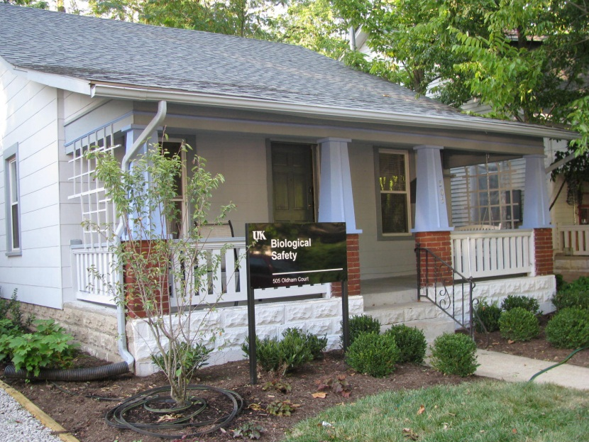
Department of Biological Safety
For further information…
http://ehs.uky.edu/biosafety/
505 Oldham Court
Lexington, KY 40502
Phone: (859) 257-1049
Fax: (859) 323-3838
﻿An Equal Opportunity University

