Slide 1

Bloodborne Pathogens for Occupational Exposures
OSHA 29 CFR 1910.1030 http://ehs.uky.edu/ohs/bb_pathogens.php
University of Kentucky
Health & Safety

Slide 2
Why do I need bloodborne pathogens training?
The Occupational Safety and Health Administration (OSHA) requires that all employees with the potential for occupational exposure to human blood or other potentially infectious materials (OPIM) must be provided with certain protections by their employer.
  These protections are outlined in detail within OSHA's Bloodborne Pathogens Standard, 29 CFR 1910.1030.
  The University of Kentucky must follow the requirements set forth by OSHA to ensure the safety of its own employees.

Slide 3
What will I learn from this program?
The purpose of this online training program is to provide general awareness regarding the precautions you should be taking if you are an employee, student, or other individual working with blood or other potentially infectious materials (OPIM).
If your potential exposure is in the course of your research please refer back to the “Researchers Only” module. It is specifically designed for you!

Slide 4
What will I learn from this program?
  Additionally, supervisors and administrators will learn about their responsibilities to ensure the protection of employees and students.
  This course is only part of a comprehensive BBP training program
    Worksite - specific training will still need to be conducted by the supervisor or other responsible individual(s).
    This specific training should include the precautions and procedures that are unique to your work area and operations.

Slide 5
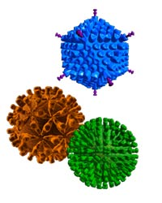
Definitions
Bloodborne Pathogens:
  Pathogenic microorganisms that are present in human blood and can cause disease in humans
  These pathogens include, but are not limited to, human immunodeficiency virus (HIV) and hepatitis B virus (HBV)

Slide 6
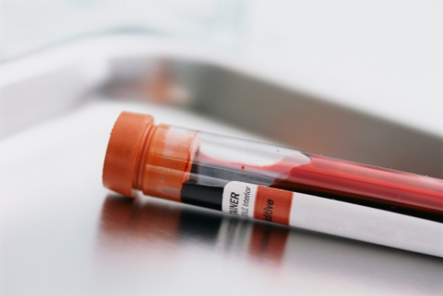
Definitions
Blood:
  Human blood
  Human blood components
  Products made from human blood
  This includes plasma and products derived from plasma such as human serum albumin (HSA)
  This definition also includes human umbilical cord blood cells (hUCB)

Slide 7

Definitions
Other Potentially Infectious Material (OPIM)
  The following human fluids are considered potentially infectious:
    Semen
    Vaginal Secretions
    Cerebrospinal Fluid
    Pleural Fluid
    Pericardial Fluid
    Peritoneal Fluid
    Amniotic Fluid
    Saliva in dental procedures
    Any body fluid visibly contaminated with blood
    All body fluids when it is difficult or impossible to differentiate between body fluids
Notes:
- Cerebrospinal fluid (CSF) is a clear, colorless bodily fluid found in the brain and spine.
- Pleural Fluid is found in lung lining
- Pericardial fluid is a liquid that acts as a lubricant for the movement of the heart
- Peritoneal fluid is a liquid that is made in the abdominal cavity to lubricate the surface of the tissue that lines the abdominal wall and pelvic cavity and covers most of the organs in the abdomen
- Amniotic fluid is a clear, slightly yellowish liquid that surrounds the unborn baby (fetus) during pregnancy.

Slide 8

Definitions- OPIM continued
Other Potentially Infectious Material (OPIM)
  Any unfixed tissue or organ (other than skin) from a human (living or dead)
  HIV-containing cell or tissue cultures, organ cultures
  HIV- or HBV-containing culture medium or other solutions
  Blood, organs or other tissues from experimental animals infected with HIV or HBV

Slide 9
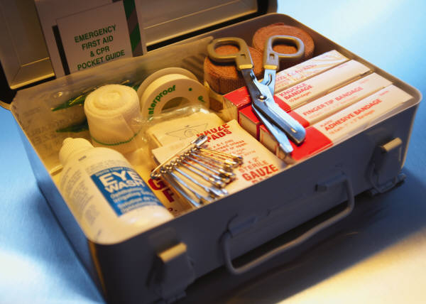
Definitions
Exposure Incident:
  A specific eye, mouth, other mucous membrane, non-intact skin, or parenteral contact (needle-stick) with blood or OPIM that results from the performance of an employee’s duties

Slide 10
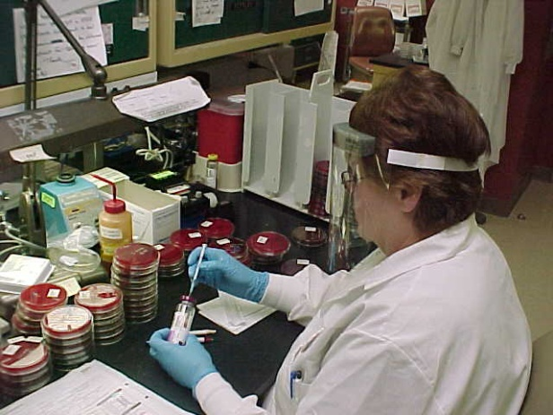
Definitions
Occupational Exposure:
  Reasonably anticipated skin, eye, mucous membrane, or parenteral contact with blood or OPIM that may result from the performance of the employee’s duties

Slide 11
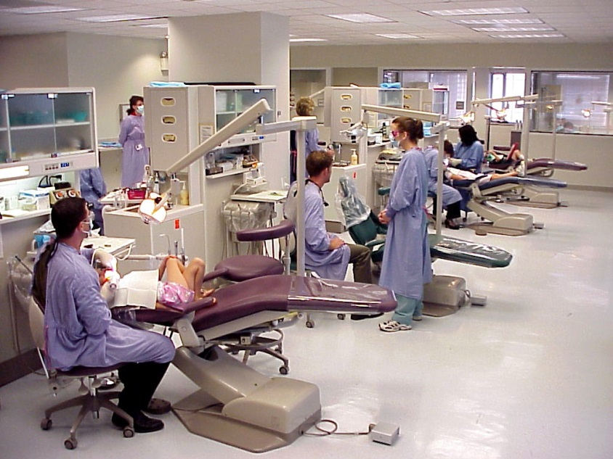
Definitions
Contaminated / Contamination:
  The presence or reasonably anticipated presence of blood or OPIM on an item or surface

Slide 12
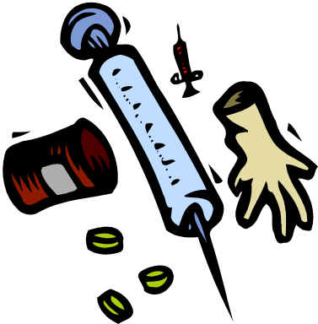

Definitions
Regulated Medical Waste:
  Liquid or semi-liquid blood or OPIM
  Contaminated items that would release blood or OPIM in a liquid or semi-liquid state if compressed
  Items that are caked with dried blood or OPIM and are capable of releasing these materials during handling
  Contaminated sharps
  Pathological and microbiological wastes containing blood or OPIM

Slide 13



Definitions
Contaminated Sharps:
  Any contaminated object that can penetrate the skin including, but not limited to, needles, scalpels, broken glass, broken capillary tubes, and exposed ends of dental wires.
  This includes serological pipets and pipet tips contaminated with other potentially infectious materials such as human cell and tissue cultures.
http://www.uspinc.com/pipettips.htm
www.coleparmer.ca

Slide 14
What are some diseases caused by bloodborne pathogens?
Bloodborne pathogens are disease causing agents present in blood or OPIM.
There are many diseases caused by BBPs, such as herpes, syphilis, malaria, babesiosis, brucellosis, leptospirosis, arboviral infections, and cytomegalovirus.
However, acquired immunodeficiency syndrome (AIDS) and hepatitis are the bloodborne diseases that cause the most concern in occupational settings. The information that follows is essential in understanding how human immunodeficiency virus (HIV) and various hepatitids are transmitted, and how to prevent exposure at work.
Notes:
Babesiosis is a malaria-like parasitic disease
Symptoms from brucellosis can last months and years
Leptospirosis can cause bleeding in the lungs or malaria
Arboviral infections can disrupt the automatic breathing function of the brain
Cytomegalovirus can cause deafness and learning disabilities

Slide 15
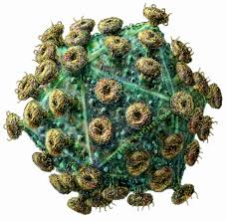
How does HIV cause AIDS?
HIV destroys a certain type of blood cells -- CD4⁺ T cells (helper cells)--which are crucial to the normal function of the human immune system.
Loss of these cells in people with HIV is an extremely powerful predictor of the development of AIDS, and reducing the amount of virus in the body with anti-HIV drugs can slow this immune destruction.

Slide 16
How does HIV cause AIDS?
The Centers for Disease Control and Prevention’s clinical definition of AIDS:
  Fewer than 200 CD4⁺ T cells per mm³ blood
  Any of 26 clinical conditions that do not normally affect healthy people (opportunistic infections):
    Tumors or infections caused by bacteria, viruses, fungi, or parasites which infrequently cause infection in persons with healtly immune systems
    Opportunistic infections are typically the cause of death for AIDS patients

Slide 17
What are the symptoms of AIDS?
In some individuals, a flu-like illness occurs within 1 to 6 weeks after exposure to the virus.
After a long, symptom-free (latent) period of up to 7 to 10 years, HIV-infected individuals become symptomatic. The symptoms include, but are not limited to:
  Enlarged Lymph Nodes
  Malaise
  Headache
  Diarrhea
  Night Sweats
Opportunistic infections (see previous slide)

Slide 18
How Is HIV Transmitted?
HIV is spread through human body fluids, most commonly blood and semen.
It is transmitted less frequently by vaginal secretions and breast milk.
Though HIV has been isolated from saliva, tears, and urine, these fluids have not been implicated in the transmission of HIV. Saliva in dental procedures is considered infectious because of the inevitable presence of blood.

Slide 19
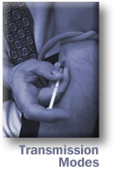
How Is HIV Transmitted?
Transmission occurs when blood/OPIM contaminated with HIV enters the bloodstream of an uninfected person
  Needle sticks or other percutaneous exposure
  Splash exposures to mucous membranes (eyes, mouth, nose) or non-intact skin
HIV cannot penetrate intact skin

Slide 20
How Is HIV Treated?
There is currently no “cure” for AIDS, and no vaccine available to prevent HIV infection
  Reverse transcriptase inhibitors inhibit an early stage of viral replication
  Protease inhibitors inhibit a later stage of viral replication
  Combination of these is called Highly Active Antiretroviral Therapy (HAART)
  Reduces circulating viral titer and prolongs life, but many deleterious side effects

Slide 21
What is My Risk of Becoming HIV Infected at Work?
The probability of becoming infected following a work-related exposure to a known HIV-positive source:
  0.3% following percutaneous exposure
  0.09% following mucous membrane exposure
If the probability of infection is this low, why all these precautions?
  While the onset of AIDS may be delayed through drug therapy and opportunistic infections may be treatable, AIDS is at this time incurable and fatal.

Slide 22
Preventing HIV infection at work
The cornerstone of protection against bloodborne pathogens is Universal Precautions.
  Universal precautions is the practice of treating all human blood and certain human body fluids as if they are known to be infectious for HIV, Hepatitis B, and other bloodborne pathogens.
Strict adherence with universal precautions is the only line of defense against work-related infection with HIV, because there is currently no vaccine.

Slide 23
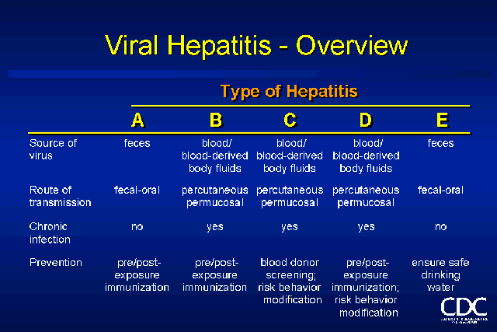
Bloodborne Viral Hepatitis
Like HIV, Hepatitis B virus (HBV), hepatitis C virus (HCV), and hepatitis D virus (HDV) are transmitted by percutaneous and mucosal exposures to blood and OPIM.
Exposure to Hepatitis A or Hepatitis E is usually associated with unsanitary conditions (fecal – oral route).
  HAV and HEV are not bloodborne pathogens and thus are not included in OSHA’s Bloodborne Pathogens Standard.

Slide 24
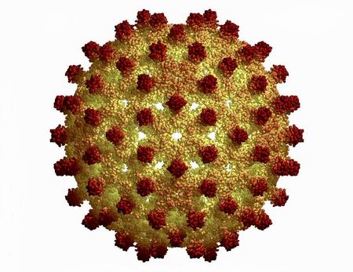
Hepatitis B: the strain of greatest concern in the occupational setting
There is a relatively high risk of becoming infected following an exposure to HBV:
  Exposure to a known contaminated source results in a 37–62% likelihood of infection.
  The chance of developing clinical hepatitis following exposure is 22–31%.
Nearly 1/3 of the world’s population has been or is actively infected with HBV. This high prevalence leads to great potential for infection following exposure to blood or OPIM.

Slide 25
Hepatitis B: the strain of greatest concern in the occupational setting
Like HIV, HBV is most efficiently transmitted through percutaneous (e.g. needle stick) exposure.
However, unlike HIV, HBV can readily be transmitted through surface contact with dried blood or OPIM.
HBV has been demonstrated to survive in dried blood at room temperature on environmental surfaces for at least 1 week.
  The potential for HBV transmission through contact with environmental surfaces has been demonstrated in investigations of HBV outbreaks among patients and staff of hemodialysis units.

Slide 26

What are the clinical symptoms of Hepatitis B?
Symptoms of hepatitis B include:
  Headache
  Malaise
  Loss of Appetite
  Nausea
  Fever
  Jaundice
  Dark Urine
The incubation period, or the time period from initial infection to the onset of symptoms is 4 – 28 weeks.
Initial infection may have few or no symptoms but can develop into a chronic infection leading to cirrhosis, chronic active hepatitis, and liver cancer.

Slide 27
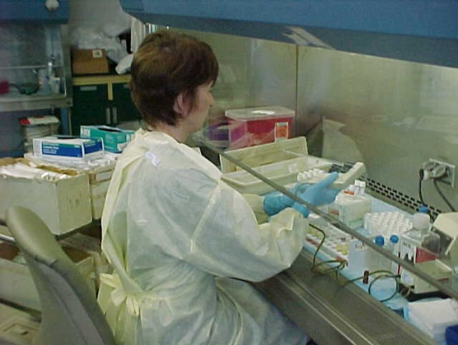
Preventing HBV infection at work
Unlike HIV, there is a vaccine for HBV. The primary measure for prevention of hepatitis B is immunization.
Hepatitis B can be prevented using either pre-exposure prophylaxis (preventive treatment) with hepatitis B vaccine or post-exposure prophylaxis with hepatitis B immune globulin (HBIG) and hepatitis B vaccine.
The OSHA bloodborne pathogens standard requires that all employees with occupational exposure, or “the reasonably anticipated skin, eye, mucous membrane, or parenteral contact with blood or other potentially infectious materials”, must be offered the vaccine at no cost.

Slide 28
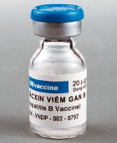
Preventing HBV infection at work
The vaccine is safe and effective. There is no evidence to indicate that the hepatitis B vaccine can cause chronic illnesses.
Although the vaccine will impart immunity in over 95% of individuals who receive it, no vaccine is 100% effective. Thus, adhering to universal precautions is also fundamentally important.

Slide 29
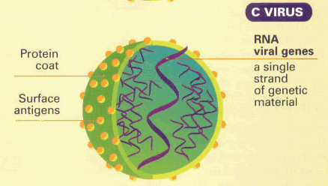
Other hepatitids: HCV and HDV
There is also a risk of infection with Hepatitis C virus (HCV) and Hepatitis D virus (HDV) for employees who have occupational exposure to blood or OPIM.
Like HBV, HCV and HDV can result in acute or chronic infection.
Thus, prevention of HCV infection through strict observance of universal precautions is critical.
No vaccine available for Hepatitis C:
  Current treatment is combination of antivirals (Interferon and Ribavirin) plus alcohol abstention
  Liver transplant required in the most severe cases

Slide 30
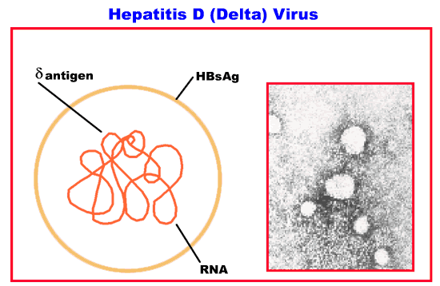
Other hepatitids: HCV and HDV
HDV infection is dependent on HBV for replication.
Therefore, immunization to prevent HBV infection, through either pre- or post-exposure vaccination, can also prevent HDV infection.

Slide 31
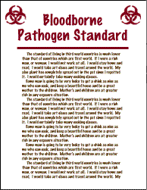
What do I need to know about OSHA’s Bloodborne Pathogens Standard?
If you are a supervisor, PI, or other responsible individual, you must:
  know the general requirements of the standard, and
  see that these requirements are implemented in the workplace.
If you are an employee or student, you must understand and follow all workplace rules and policies implemented to prevent exposure to BBP.

Slide 32
What do I need to know about OSHA’s Bloodborne Pathogens Standard?
To accomplish these objectives, each workplace must have a written Exposure Control Plan (ECP).
An ECP is a comprehensive, workplace–specific document that outlines in detail all measures that will be taken to eliminate or minimize employee exposure.
An ECP is a manual for how to work safely with blood and OPIM.

Slide 33
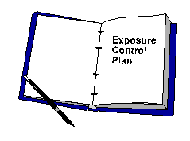
What do I need to know about OSHA’s Bloodborne Pathogens Standard?
The ECP is a “living document”:
  It must reflect what is actually occurring in the workplace, from the broadest departmental policies to the most specific work practice instructions.
Supervisors must make the workplace ECP available to employees, and review the plan as a part of employee training.

Slide 34
What are the fundamental components of an ECP?
The five fundamental components of an ECP are:
  Exposure Determination
  Methods of Compliance
  Hepatitis B Vaccination
  Communication of Hazards
  Post Exposure Evaluation and Follow Up.
Examples of each component will be provided in the following slides

Slide 35
Exposure Determination
An exposure determination is simply a listing of all employees with Occupational Exposure (those who may become exposed to blood or OPIM), and the tasks and procedures in which exposure may occur.
Example as it should appear in the ECP. Please consult your workplace ECP for the actual exposure determination.
Employees or Job Titles with Occupational Exposure | Tasks / Duties
PI / Lab Supervisor | List all tasks that may involve exposure to blood or OPIM
Research Assistants | List all tasks that may involve exposure to blood or OPIM
Lab Technicians | List all tasks that may involve exposure to blood or OPIM
First Aid Responders | List all tasks that may involve exposure to blood or OPIM

Slide 36
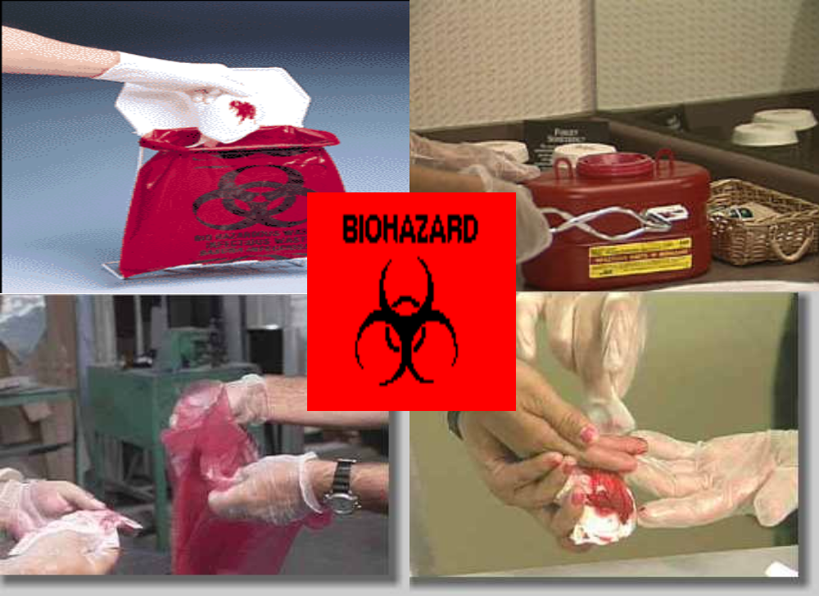
Methods of Compliance
Methods of compliance are all protective work practices, policies, rules, and controls, from the broadest to the most specific.
Broad policies include a statement within the ECP that all employees will follow universal precautions, or that eating, drinking, storing food, mouth pipetting, smoking, applying lip balm, cosmetics, or contact lenses in the work area is prohibited.

Slide 37
Methods of Compliance: Task-Specific
Task-specific methods are also required in the ECP:
  How / when to wear personal protective equipment (PPE) – example at right
  Please consult your workplace ECP for actual PPE / task specifications.
All contaminated PPE must be discarded before leaving the work area.
  If contaminated PPE is not disposable, it must be placed in a contaminated laundry receptacle.
PPE | Task(s)
Gloves, Lab Coat | All laboratory activities. Always wear gloves while in work areas.
Splash Goggles / Facial Sheld | pipetting, vortex mixing of unsealed containers, and decanting liquids
Utility Gloves, Apron | Cleaning spills of blood or OPIM; Cleaning contaminated broken glass or other contaminated sharps.
Gloves, Microshield | Providing first aid / CPR.

Slide 38
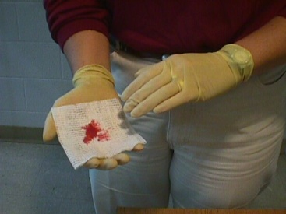
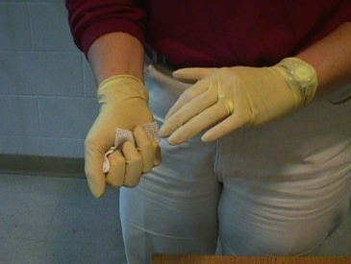
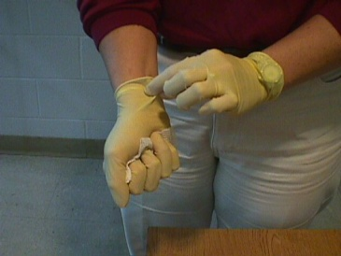
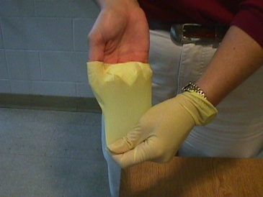
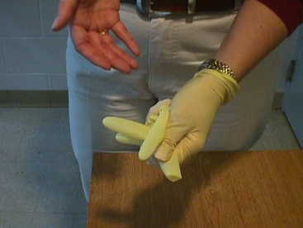
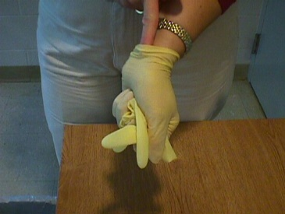
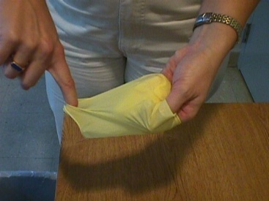
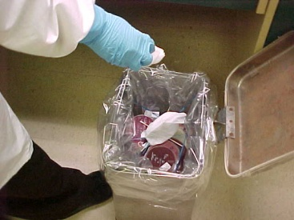
Methods of Compliance: Task-Specific
How to dispose of small amounts of regulated waste and remove gloves:
Before removing disposable gloves, gather any contaminated materials used in providing first aid and/or clean up and hold them in one hand.
2. Strip off the glove containing the contaminated materials from the wrist, turning it inside out so the "clean" side is on the outside.
3. Place that glove in the other hand and strip off the glove on that hand, turning it inside out.
4. Dispose of the gloves/material in a regulated waste container.
5. Wash hands with soap and water

Slide 39

Methods of Compliance: Task-Specific
How to dispose of larger amounts of regulated waste:
  Before removing disposable gloves, gather all contaminated materials together and put them in a biohazard (red) bag. These bags should be labeled with the universal biohazard symbol.
  Make sure the bag is intact and that there is no danger of leaking. If the bag is torn or punctured or is contaminated on the outside, place the bag inside a second biohazard bag.
  Strip off disposable gloves from the wrist, turning them inside out so that the "clean" side is on the outside. Drop them into the red bag along with the other contaminated materials. Close the bag by handling only the clean outside surfaces. DO NOT throw the biohazard bag into the regular trash.
  Wash hands with soap and water.
  Inform your supervisor so he/she can make arrangements to properly dispose of the biohazard bag.

Slide 40
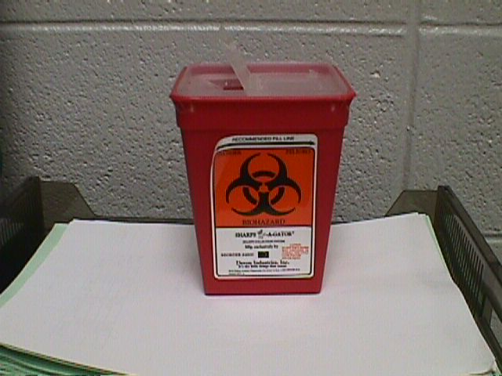
Methods of Compliance: Task-Specific
How to dispose of contaminated sharps:
  Use a hard-walled, labeled container approved for disposal of contaminated sharps
  Do NOT recap needles!
  Inform your supervisor if you have placed contaminated material into a sharps container so he/she can make arrangements to properly dispose of it.

Slide 41
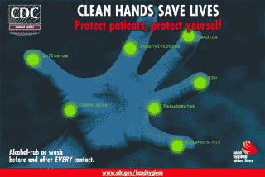
Methods of Compliance: Task-Specific
Proper hand washing:
  One of the most important infection control measures for employees working with blood or OPIM.
  Hand washing facilities must be made available to all employees with occupational exposure.

Slide 42
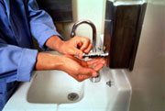
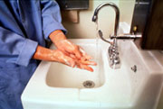
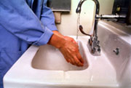
Methods of Compliance: Task-Specific
The following is an example of a uniform hand washing procedure that should be outlined within the ECP:
  Wet both hands and wrists. Lather with soap and warm water.
  Spread the lather to the back of the hands and wrists. Clean the finger tips and between the fingers. Washing time should be at least 15 seconds.
  Rinse hands and wrists well to remove all soap.
    For additional information about handwashing and hand antisepsis in health-care settings, and specific recommendations regarding hand-hygiene practices, see the CDC Guideline for Hand Hygiene in Healthcare Settings

Slide 43
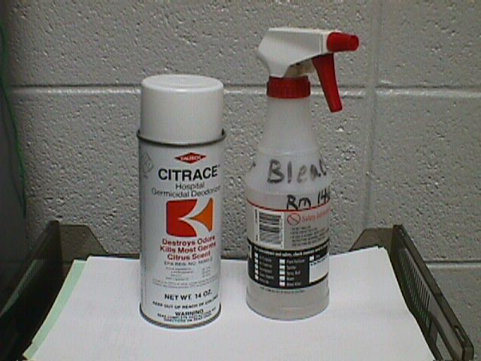
Methods of Compliance: Task-Specific
How to conduct routine cleaning and decontamination:
  For routine cleaning, apply an EPA registered tuberculocidal sterilant onto contaminated surfaces and allow ten minutes before wiping. One part bleach in 10 parts water is effective.
  When using any commercial sterilant, be sure to read the directions on the label for additional use instructions.
  The ECP should have a schedule for routine cleaning of potentially contaminated surfaces or equipment in the workplace.

Slide 44
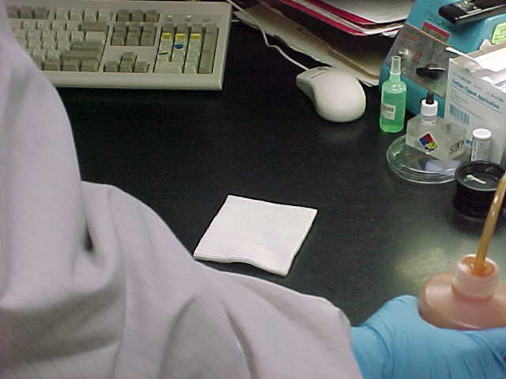
Methods of Compliance: Task-Specific
How to clean spills or contaminated surfaces:
  The appropriate PPE must always be used when cleaning potentially contaminated surfaces.
  The first step is to contain the spill. For small spills, gauze or paper towels should be placed over the blood or OPIM for containment and absorption.

Slide 45
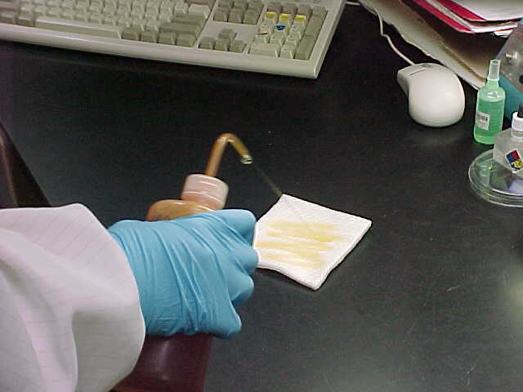
Methods of Compliance: Task-Specific
How to clean spills or contaminated surfaces:
  Next, apply a disinfectant. This can be a 1:10 dilution of bleach and water, or other commercially available EPA registered tuberculocidal sterilants. Powdered bleach or other absorbent chemicals can be used in place of gauze or towels to absorb the spill.
  Use paper towels or a dust pan and broom to remove the materials.

Slide 46
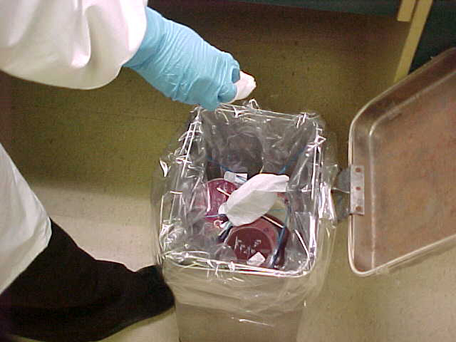
Methods of Compliance: Task-Specific
How to clean spills or contaminated surfaces:
  Dispose of the contaminated materials in a properly labeled, closable regulated waste container.
  When cleaning larger amounts of blood or OPIM, work slowly and carefully to avoid splashing.
  If the contaminated area involves a volume of blood or OPIM that cannot be safely handled by employees, call UK Environmental Management at 323-6280.

Slide 47
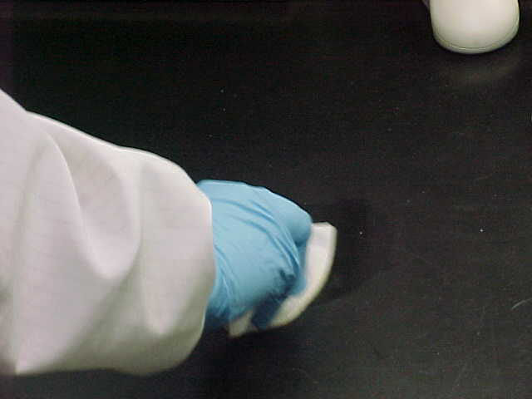
Methods of Compliance: Task-Specific
How to clean spills or contaminated surfaces:
  Once contaminated materials are removed from the surface, reapply the sterilant and allow ten minutes before wiping again.

Slide 48
Hepatitis B Vaccination
This component of the ECP should describe the steps the employer must take to ensure the successful completion of the Hepatitis B vaccination series for all employees with occupational exposure.
For example, the general information on the following slides should be included:

Slide 49
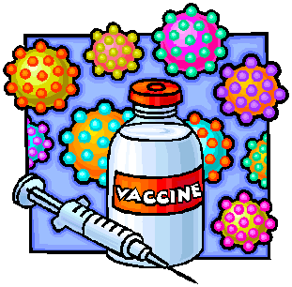
Hepatitis B Vaccination
The vaccine is given in three stages:
  The initial injection
  A second injection one month later
  A third injection 6 months after the first injection
All three injections are necessary to ensure immunity.
There is no evidence that the vaccine has ever caused Hepatitis B, and the incidence of side effects is low.

Slide 50
Hepatitis B Vaccination
Some possible side effects are:
  Tenderness and redness at the site of the injection
  Low grade fever
  Rash, nausea, joint pain, and mild fatigue have been reported on rare occasions
Persistent side effects that do not go away after 48 hours should be reported to your doctor.
The HBV vaccine must be provided at no cost to employees.
You may refuse the vaccine. If you choose to do so, then you must sign the appropriate declination form.

Slide 51
Hepatitis B Vaccination
Additionally, specific instructions about how to receive the vaccine should be included in the ECP.
The example on the following slide is an acceptable procedure for obtaining the hepatitis B vaccination series for UK employees, and can be used in any UK worksite - specific ECP:

Slide 52
Hepatitis B Vaccination
Receiving the HBV Vaccination
  All employees with occupational exposure are eligible to receive the Hepatitis B vaccination free of charge.
University of Kentucky Employees and Students
  University Health Services administers the HBV vaccination. Coordinate appointment and payment with your individual department.
  UHS operating hours
    M & F from 8-11:30am
    W from 1-4:30pm
  After you receive your shot, ask the nurse for the healthcare professional’s (HCP) written opinion. Bring the HCP’s written opinion to your supervisor.

Slide 53

Communication of Hazards
This part of the ECP describes labeling and training requirements. The biohazard legend must be placed on all containers of blood or OPIM.

Slide 54
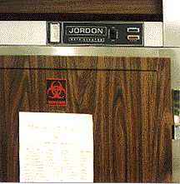
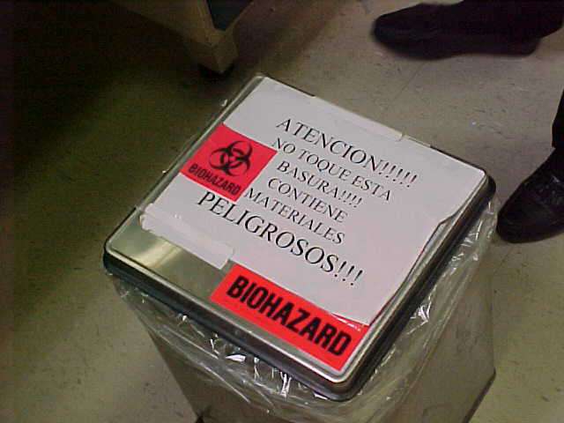
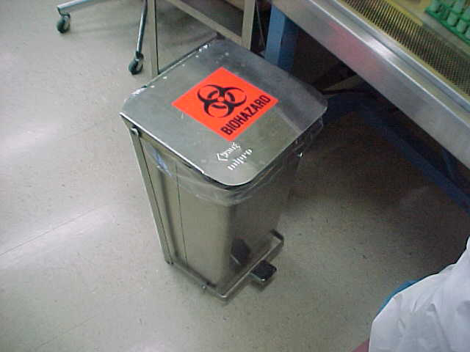
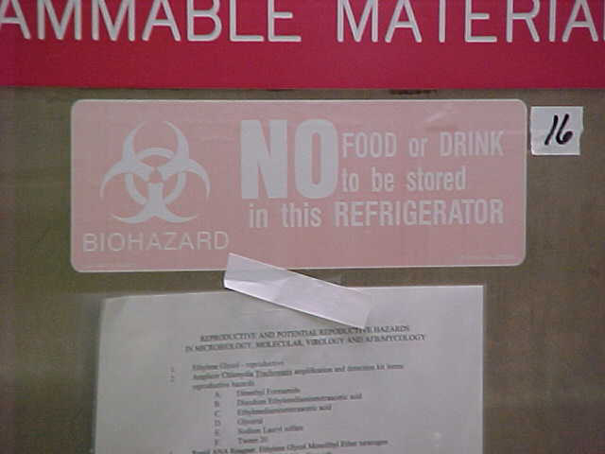
Communication of Hazards

Slide 55
Post-Exposure Evaluation and Follow-Up
An exposure incident is a specific eye, mouth, other mucous membrane, non-intact skin, or parenteral (e.g. needle stick) contact with blood or OPIM that results from the performance of an employee’s duties.
If an exposure incident occurs, it is essential to ensure the proper medical evaluation and follow up for the exposed individual.
The ECP should have a listing of procedures to be followed, and a responsible person listed to ensure implementation of the procedures.

Slide 56
Post-Exposure Evaluation and Follow-Up
The following example is a viable post–exposure follow up procedure for UK employees, and can be used in a UK worksite-specific ECP:
  Immediately wash the exposed skin with soap and water and flush the other areas with water.
  Notify your supervisor immediately after washing.
  Your supervisor should call UK Workers’ Care at 1-800-440-6285. They will schedule an appointment for a post-exposure examination.

Slide 57
Post-Exposure Evaluation and Follow-Up
Additionally, an evaluation must be conducted by supervisors to ensure that the exposure incident is not repeated.
An example of a form prepared for evaluating an exposure incident is included on the last page of the template UK Bloodborne Pathogens Exposure Control Plan.

Slide 58

Questions?
UK Health & Safety
252 East Maxwell Street
Lexington, KY 40506-0314
http://ehs.uky.edu
Brent Webber
Industrial Hygienist Senior
Phone: 859-257-7600
Cell: 859-967-6397
brent.webber@uky.edu

