Slide 1
2017 Chemical Hygiene Plan/Laboratory Safety Annual Refresher
Prepared by Jan Eggum, Laboratory Safety Specialist
Reviewed by the Chemical Safety Committee

Slide 2
Agenda
Training Requirements
Compressed Gas Cylinder Safety
Risk Assessment

Slide 3
Training Requirements
Training Type | Frequency
Chemical Hygiene Plan/Laboratory Training | Once
Chemical Hygiene Plan/Laboratory Safety Annual | Annually
Hazardous Waste | Annually
Fire Extinguisher Use | Annually
Lab Specific Training | Initially, then when process or chemical changes in lab
Above are the minimum requirements for initial entry into a laboratory at the University of Kentucky. This is for all personnel working in the laboratory.
Additional training might be required, based on the materials utilized in the laboratory. Review the Laboratory Safety Training Checklist for additional information.

Slide 4
Chemical Inventory
An updated chemical inventory is required for all laboratories.
UK has an online chemical inventory system called, Chematix.
See the training videos for help with Chematix.
For questions, please contact the following person:
Robert Thomas
Email: trobert@uky.edu
Phone: 257-4016

Slide 5
Compressed Gas Cylinders
General Transport Recommendations
Transport cylinders by hand truck, do not roll, drag or slide cylinders
Secure cylinders to hand truck
Move cylinders with valve caps in place
Move extremely toxic chemical during off hours if possible

Slide 6
Compressed Gas Cylinders
General Storage of Cylinders
Secure cylinders to a wall or immovable object at all times
Secure cylinders upright, with either a valve cap or gauge on the cylinder
Store cylinders in well-ventilated areas
Separate empty and full cylinders
Secure cylinders according to compatibilities

Slide 7
Compressed Gas Cylinders
General Use of Cylinders
Match regulator with the cylinder
Use the appropriate tubing
Use appropriate personal protective equipment when needed
Other Considerations
Contact manufacture for information on use, compatible materials, and appropriate regulator
For storage and use of flammable gasses, contact the Fire Marshal’s Office, 7-6326.

Slide 8
Risk Assessment
A risk assessment is a thorough look at the workplace to identify situations, processes, etc. that may cause harm, particularly to people.
The process entails
Identifying Hazards
Analyzing or evaluating the risk associate with the hazard
Determining appropriate ways to eliminate or control the hazard
What is the goal of a risk assessment?
The aim of the risk assessment process is to remove a hazard or reduce the level of its risk by adding precautions or control measures.

Slide 9
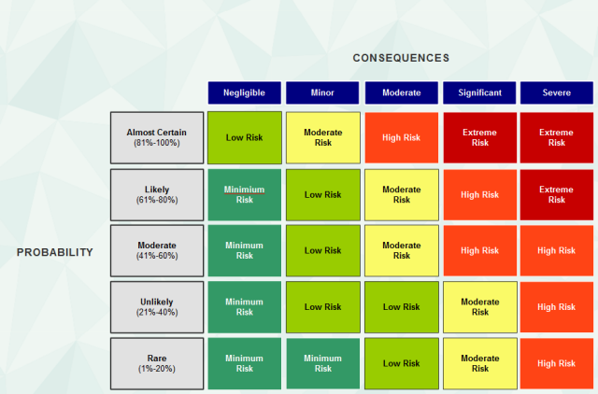
Risk Matrix Chart
Risks are based on likelihood and consequences. This chart illustrates that as the likelihood increases, the severity of the consequences increases.
This chart is a tool to help the research rank the risk of the steps of the procedures.

Slide 10
Risk Assessment
Begin a risk assessment by evaluating the process and the hazard.
Example – Dissolving sodium chloride pellets in boiling water using a stirring rod.
One of the recognized hazard would be boiling water

Slide 11
Risk Assessment
The next step would be to use the Matrix to see were the recognized hazard would land.
In this example a splash would have a moderate probability and a moderate consequence (a burn)

Slide 12
Risk Assessment
The next step would be determine a way to control or eliminate the risk.
For the example, a couple of control methods could be used.
A stir plate instead of a stirring rod
Use room temperature water
Combination of the two
Other ideas would include, PPE worn or can the chemical be substituted, could the stir vessel be closed??? – All of these would be questions to ask.

Slide 13
5 Key Questions
Another tool for risk assessment is the 5 Key Questions Method. This method will take you through the process of identifying, evaluating and controlling the hazard.
When using this method, document all answers to the questions.

Slide 14
Question 1
What specific chemical or physical reactivity hazard are associated with the way I’m using these chemicals?
Research the information available about the chemical or Physical Hazard
The SDS may not have all the needed information, other resources will need to be utilized.
Resources for Chemical Safety

Slide 15
Question 2
What type of Ventilation do I need?
Can the materials be manipulated on the benchtop or do you need a Fume Hood or another type of Engineering Control?
In the SDS, look for Phrases “Well-Ventilated Space” in the Precautionary Statements
For most operations, the Fume Hood should Provide protection for the Vapors, however, if you are unsure, Contact Occupational Health and Safety.

Slide 16
Question 3
What Personal Protective Equipment (PPE) do I need?
What PPE is Required for the Chemical and the Process?
Consider the following for PPE Selection
Fit – Size Matters. Make Sure the PPE has a good fit. Otherwise it will not offer any protection, nor will it be comfortable to wear.
Type – This will be dependent on the Materials being utilized. Will safety Glasses be okay, verses Safety Googles?
Material – Not all Materials protect against all Chemicals. Choose the materials that will Offer Protection Against the Chemicals

Slide 17
Question 4
What Emergency Response protocols will be needed if Something Goes Wrong?
Before the Experiment, Know how to use the Safety Equipment in the laboratory, such as the Fire Extinguisher, eyewash and Safety Shower.
Plan for the “oh Crap” moment when something goes Wrong – Know how to handle a spill or release of the Chemical or Physical Hazard of the Experiment

Slide 18
Question 5
What Will I do with the Waste Generated?
Containers must be completely closed with a tight fitting lid at all times, except when adding waste
Containers must be labeled with the words, “Hazardous Waste”
Containers contents must be written on the container
Containers must not be dated during use buy only when they have Been filled and are Ready for pick-up
Incompatible wastes must not be placed in the same container

Slide 19
Resources on RISK Assessment
Basic RISK Assessment
Five Questions
Canadian Centre for Occupational Health and Safety
Risk Assessment Specific to Research Laboratories
American Chemical Society Hazard Assessment in Research Laboratories
Identifying and Evaluating Hazards in Research Laboratories

Slide 20
For additional information about the Content presented in this training, please contact:
Jan Eggum
jghamo2@email.uky.edu
257-3242

