Slide 1
Emergency Eye/Face Wash Training
Training Provided by
University of Kentucky
Occupational Health & Safety Department

Slide 2
Introduction:
All employees must be familiar with the location and use of eye wash and safety showers even if their job does not involve working directly with toxic or corrosive chemicals.
Why? You may be called upon to aid a fellow employee who has had an exposure.
The distance from the location of the employee and safety device should not exceed 10 seconds walking distance. The path to the safety shower or eye wash must be unobstructed.

Slide 3
Introduction:
The path to the eye wash or safety shower cannot involve opening a door unless:
  There is always another employee present that can open the door.
  The exposed employee can exit the room without having to manually manipulate a door knob (i.e. push bar).
The location of all eye washes and safety showers must be clearly marked with a highly visible sign. The area around the safety shower and eye wash must be well lit.
The temperature of the water delivered should be between 60º and 95º F.

Slide 4
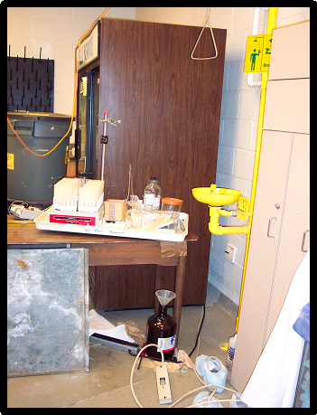
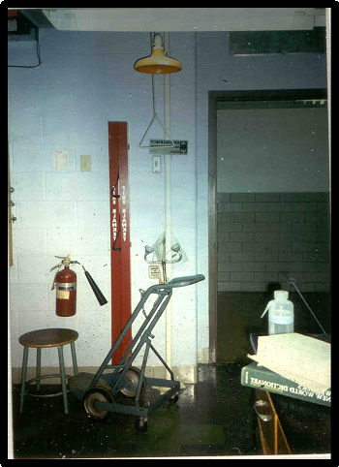
Examples of Violations:

Slide 5
Using An Eye Wash Station
During An Emergency:
Hold eyelids open using the thumb and index finger to help ensure that effective rinsing has occurred behind the eyelid. Video Clip
It is normal to close eyes tightly when splashed, but this will prevent water or eye solution from rinsing and washing the chemical out. Eyelids must be held open.
Practice of this procedure is encouraged to help familiarize potential users with the feel of rinsing.
It will also make it easier for the user to react both promptly and properly to an emergency situation.

Slide 6
Eye/Face Washing Procedures:
Always wash from the outside edges of the eyes to the inside; this will help to avoid washing the chemicals back into the eyes or into an unaffected eye.
Water or eye solution should NOT be directly aimed onto the eyeball, but aimed at the base of the nose.
Velocity of the stream of water must be such that injury to the eye is avoided.

Slide 7
Procedure Continued:
Flush eyes and eyelids with water or eye solution for a minimum of 15 minutes. “Roll” eyes around to ensure full rinsing.
Contact lenses must be removed as soon as possible to ensure that chemicals are not trapped behind the lenses and then the eyes can be completely rinsed of any harmful chemicals.
Medical attention should be sought immediately! Ideally another person in the lab should make contact with responders or dial 911. The sooner medical attention can be given, the chances of not sustaining permanent damage or blindness is greatly improved.

Slide 8
Regulations:
OSHA requires that suitable means for flushing and quick drenching of the eyes and body be available in any area where toxic and/or corrosive materials are in use.
In cases of an exposure, the initial first aid treatment is to flush affected area with water for a minimum of 15 minutes.
The ANSI (American National Standard Institute) requires that control valves be located so that they can easily be turned on and remain on until manually shut off.

Slide 9
Regulations Continued:
The control valve must also:
  Designed to ensure flow of water without requiring the user’s hand.
  Go from “off” to “on” within 1 second.
  Remain in the “on” position until manually shut off.
  Resistant to corrosion that may inhibit the operation of the valve.

Slide 10
Eye Wash Requirements:
Velocity of the stream of water must be such that injury to the eye is avoided.
Controlled flow must be provided to both eyes simultaneously.
The nozzles must be covered to prevent contamination and covers must automatically open when the unit is activated.
User must have enough room to hold both eyes open while in the stream of water.

Slide 11
Eye Wash Requirements:
Plumbed and self contained units
  Minimum flow rate of 0.4 gallons per minute (gpm), water nozzles 33 – 45 inches above the floor, and 6 inches from wall obstruction.
  Plumbed units should be activated once a week to flush lines.
  Self-contained units should be activated in accordance with the manufacturer’s directions.

Slide 12
Safety Showers Requirements:
The water column must be between 82 and 92 inches with a minimum of 20 inches diameter of column and 60 inches above the surface.
Water delivered must be a minimum of 20 gallons per minute (gpm).
If an enclosure is used there must be an unobstructed minimum diameter of 34 inches.
Must be identified with a highly visible sign located in a well lit area.

Slide 13
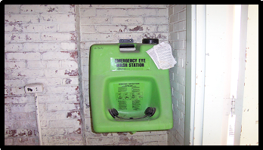
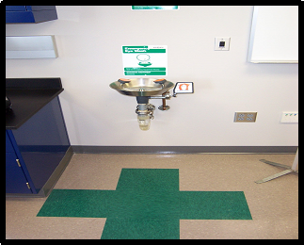
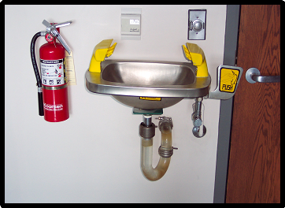
Examples Of Emergency Equipment at University of Kentucky:
Eye Washes
A device used to irrigate and flush both the face and the eyes.

Slide 14
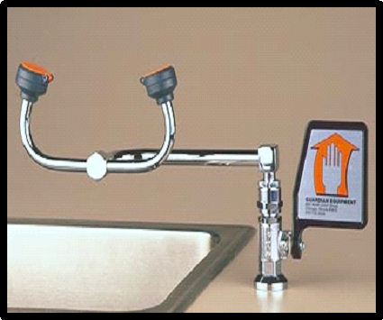
Counter Mounted Eye Wash
Plumbed eye wash unit.
Must be between 33 to 45 inches from the floor. Minimum distance of 6 inches from the wall or other obstructions.

Slide 15
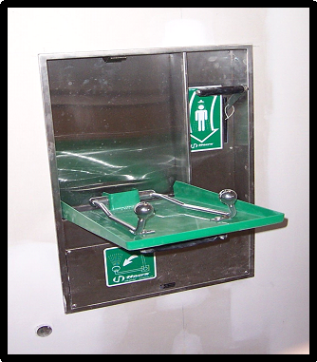
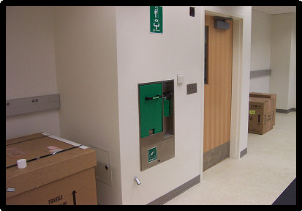
Plumbed Eye Wash
This unit is built into the wall. To activate, the handle is pulled down and valve is activated. Video Clip

Slide 16
Self Contained Eye Wash
This unit must hold enough water to dispense a minimum of 0.4 gallons per minute (gpm) for a minimum of 15 minutes.
Typically contain additives to protect against bacteria, fungus, and algae available.
Manufacturer’s fluid change-out schedules shall be rigidly followed.

Slide 17
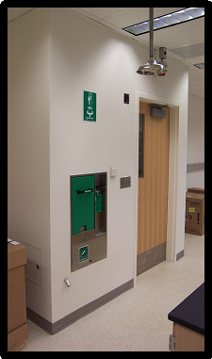
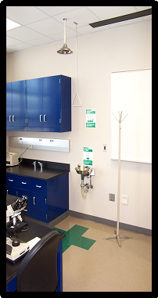
Equipment at University of Kentucky:
Showers
An assembly consisting
of a shower head controlled by a stay open valve and
operated by an approved
control valve actuator.
Remove contaminated clothing.
Allow copious amounts
of water on affected area for a
minimum of 15 minutes.

Slide 18
Plumbed Shower Units
Again, this unit is built into the wall. To activate the shower, the lever to the right is pushed down activating the shower overhead.

Slide 19
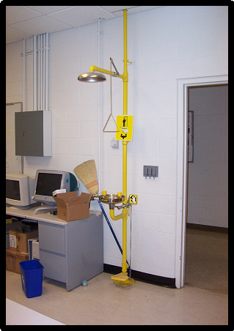
Equipment at University of Kentucky:
Combination units
Interconnected assembly of emergency equipment (eye wash and safety shower) supplied by a single source of flushing fluid.

Slide 20
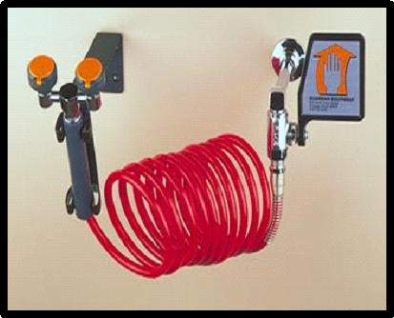
Equipment at University of Kentucky:
Drench hoses
This unit is a typical drench hose design but has been modified with dual nozzles and other features to meet eyewash standards.
Typical drench hoses are:
  Hand Held and single spray nozzle
  Designed to be a secondary safety device-treatment. Does not replace the need for an eye wash.
  Must deliver a minimum of 3 gallons per minute for a minimum of 15 minutes.

Slide 21
Prevention of Accidents:
Know the chemicals that you are working with. Read the Material Safety Data Sheets (MSDS) and ask questions.
Know the location of the eye wash and safety shower.
Know how to operate the safety equipment, you may need to use it yourself or assist others.
Always wear required personal protective equipment (PPE).

Slide 22
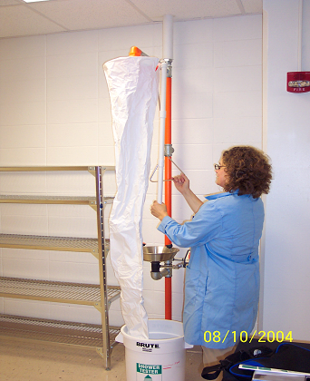
Maintenance Of Eye Wash and Safety Shower:
All shower units must be tested to verify operation. It is recommended that showers be activated monthly to verify operation and to flush lines. Video Clip

Slide 23
Maintenance Of Eye Wash and Safety Shower:
Eye wash units should be activated weekly to verify operation and to flush lines. Video Clip

Slide 24
Resources:
For more information contact the Occupational Health and Safety Department at: (859) 257-2924
Web site at http://ehs.uky.edu
ANSI installation checklist http://ehs.uky.edu/ohs/eyewash.html

