Slide 1
On Line Fire Extinguisher Training
University of Kentucky
Office of the Fire Marshal
By
Greg Williamson
Fire Marshal

Slide 2
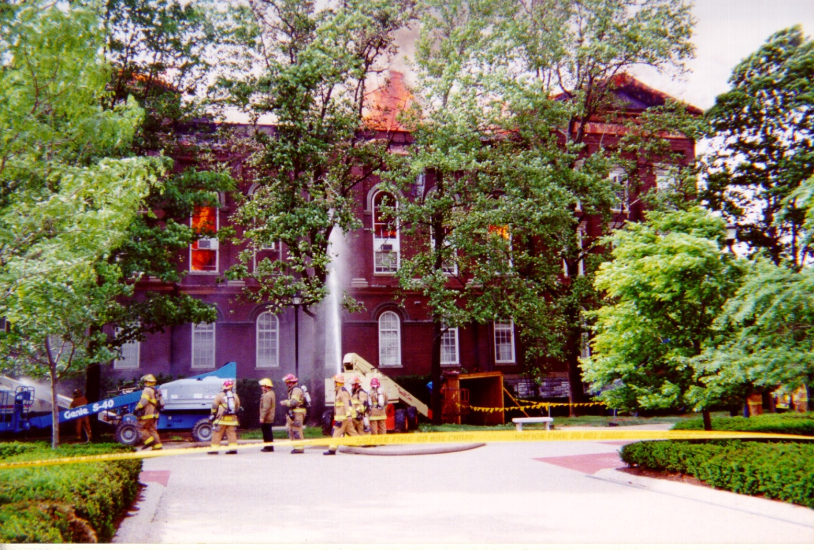
This is not the time to try and use a fire extinguisher!!

Slide 3
Purpose for Training
To make people aware of how fire extinguishers work.
To make people aware that sometimes it is better that they do not use an extinguisher.
What people should do when they choose to use an extinguisher.
How to report a fire incident.

Slide 4
You are NOT required to use a fire extinguisher on a fire.
Your responsibilities in a fire situation are:
  Recognize a fire condition.
  Activate the fire alarm system.
  Evacuate the building.
  Call 911 to report the fire condition and to make sure help is on the way.
  Remember you are not a trained fire fighter. You should never put your life in danger.

Slide 5
Steps to take in a Fire Situation
Recognize a fire
Activate the Fire Alarm System
Contain the fire by closing doors
Evacuate the Building
Call 911
Use the Fire Extinguisher if you feel comfortable and have been trained.

Slide 6
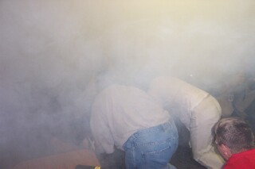
Recognize a Fire Condition
Do you see or smell smoke?
Does equipment or electrical cords feel hot to the touch?
Do you see flames?

Slide 7
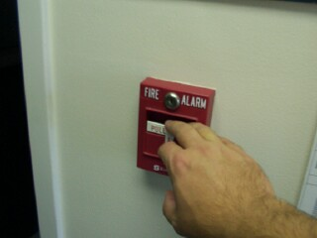
Activate the Fire Alarm
Pull the nearest Fire Alarm Pull station to start the evacuation of the building.

Slide 8
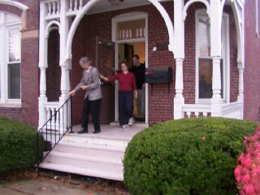
Emergency Evacuation

Slide 9
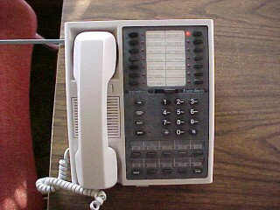
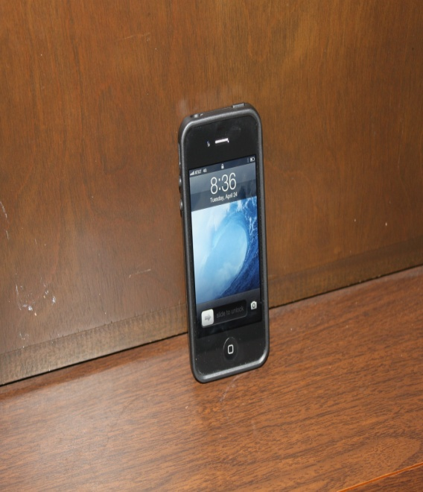
Dial 911
Call 911 to make sure help is on the way.
  If you call on a campus phone the call will be received by the UK Police.
  If you use a cell phone the call will be answered by the Lexington Fayette County Dispatcher. Be specific with information.

Slide 10
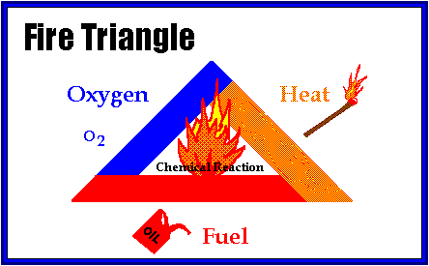
How Does a Fire Work?
Three components
  Oxygen
  Heat
  Fuel
Need all three components to start a fire
Fire extinguishers remove one or more of the components

Slide 11



Types of Fires
Class A - Wood, paper,cloth, trash
Class B - Flammable liquids, oil, gas, grease
Class C - Electrical
Class D - Combustible metals

Slide 12
Different Kinds of Extinguishers
The common type fire extinguishers:
  Pressurized Water (wood,paper,trash)
  Carbon Dioxide (electrical)
  Multi-Purpose Dry Chemical (ABC)

Slide 13
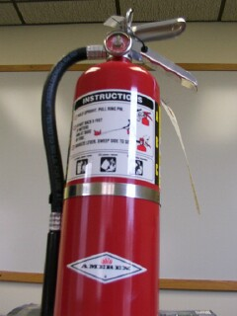
ABC (Multi-purpose) is the most common type Extinguisher on UK’s Campus

Slide 14
Operation of an extinguisher Remember PASS
P = Pull the pen.
A = Aim the nozzle at the base of the fire.
S = Squeeze the handle.
S = Sweep from side to side.
The PASS Method will work on all types of extinguishers.

Slide 15
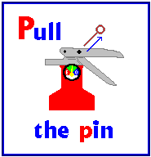
P.A.S.S. Method
Pull the pin
This will allow you to squeeze the handle in order to discharge the extinguisher

Slide 16
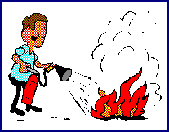
P.A.S.S. Method
Aim at the base of the fire
Aiming at the middle will do no good.
The agent will pass through the flames.

Slide 17
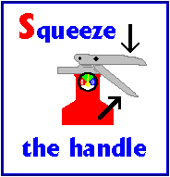
P.A.S.S. Method
Squeeze the handle
This will release the pressurized extinguishing agent

Slide 18
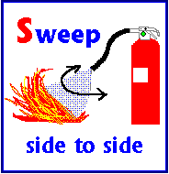
P.A.S.S. Method
Sweep side to side
Spray the extinguisher at the base of the fire.
Cover the entire area that is on fire. Continue until fire is extinguished. Keep an eye on the area for
re-lighting.

Slide 19
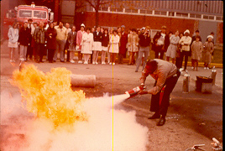
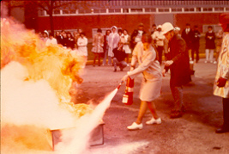
Safety Precautions when fighting a fire
Stay upwind of to the fire.
Stay low, never try to work over top the fire.

Slide 20
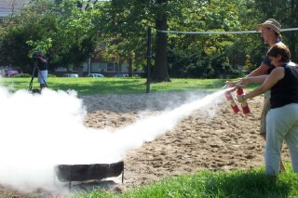
Safety Precautions when fighting a fire
Spray the extinguisher at the base of the fire.

Slide 21
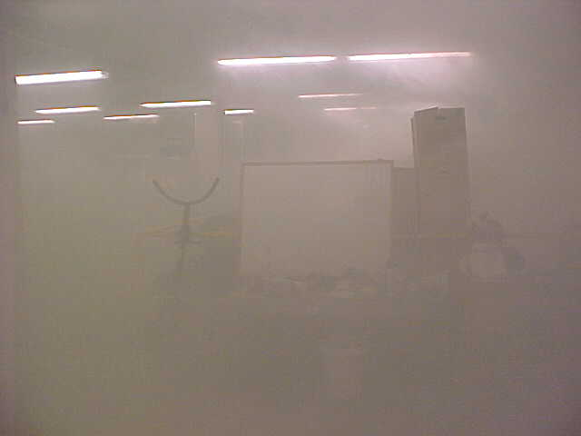
Safety Precautions when fighting a fire
Never allow the fire to get between you and a route to escape.

Slide 22
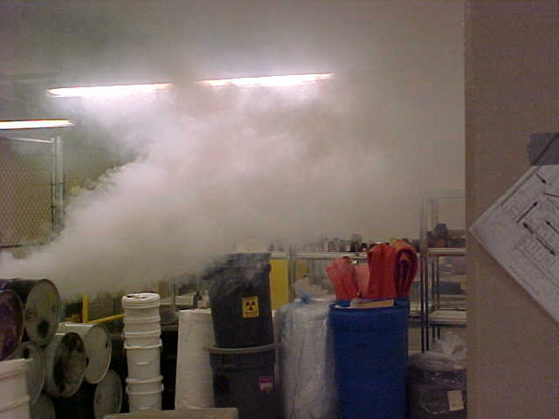
Safety Precautions when fighting a fire
Never go into a unknown area to fight a fire.

Slide 23
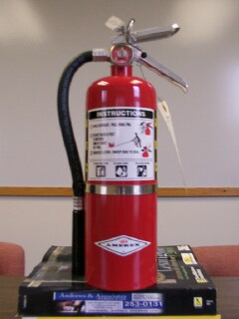
Make sure your extinguisher can be used in an emergency.
The extinguisher should be mounted on the wall.
The area in front of the extinguisher shall be clear. No obstructions
The pressure gauge should be in the green zone
The inspection tag should show that the extinguisher has been inspected within the last year.

Slide 24
Any Questions
Greg Williamson
Fire Marshal
  257-8590
Jason Ellis, Assistant Fire Marshal
  257-6326
Brandon Ernest, Fire Extinguisher Manager
  257-6326

Slide 25
Thank You!!!!
Fire Prevention Its Your Responsibility!!!

