Slide 1

Biological Safety… It’s in Your Hands The NIH Guidelines at UK
University of Kentucky
Department of Biological Safety

Slide 2
Biosafety Training
NIH Guidelines & UK
NIH Guidelines for Research Involving rDNA Molecules
Purpose, Applicability and Compliance of NIH Guidelines
Roles & Responsibilities under NIH Guidelines
Institution, IBC, BSO and PI
Experiments covered by the NIH Guidelines
The NIH Guidelines at UK
UK Institutional Biosafety Committee

Slide 3


NIH Guidelines
Published by Department of Health & Human Services, the National Institutes of Health, Office of Biotechnology Activities
Available online http://oba.od.nih.gov/oba/rac/guidelines_02/NIH_Gdlnes_lnk_2002z.pdf

Slide 4
NIH Guidelines: Purpose
Section I-A
The purpose of the Guidelines is to specify practices for constructing and handling:
rDNA molecules, and
organisms and viruses containing rDNA molecules

Slide 5
Recombinant DNA
Defined by the Guidelines as:
Molecules that are constructed outside living cells by joining natural or synthetic DNA segments to DNA molecules that can replicate in a living cell, or
Molecules that result from the replication of those described above, and
Synthetic DNA segments which are likely to yield a potentially harmful polynucleotide or polypeptide

Slide 6
NIH Guidelines: Compliance
As a condition of NIH funding for rDNA research, institutions shall ensure that such research conducted at or sponsored by the institution, irrespective of the source of funding, shall comply with the NIH Guidelines
What does this mean?
ALL rDNA research conducted at an institution receiving NIH funds must comply with NIH Guidelines.

Slide 7
NIH Guidelines: Compliance
Non-compliance may result in…
Suspension, limitation, or termination of financial assistance for the non-compliant NIH-funded research project and of NIH funds for other rDNA research at the institution, or
The requirement for prior NIH approval of any and/or all rDNA projects at the institution

Slide 8
NIH Guidelines Contain…
Safety Considerations (Section II)
Risk Assessment
Risk Groups
Containment
Experiments covered by the NIH Guidelines (Section III)

Slide 9
Risk Assessment: Section II-A
Initial risk assessment made by investigator based on Risk Group (RG)
Risk Group Classification (Appendix B)
Agents classified according to relative pathogenicity for healthy adult humans
Risk Group 1 (RG1) | Not associated with disease in healthy adult humans
Risk Group 2 (RG2) | Associated with human disease which is rarely serious and for which preventive or therapeutic interventions are often available
Risk Group 3 (RG3) | Associated with serious or lethal human disease for which preventive or therapeutic interventions may be available (high individual risk, low community risk)
Risk Group 4 (RG4) | Likely to cause serious or lethal human disease for which preventive or therapeutic interventions are not usually available (high individual risk, high community risk)

Slide 10
Containment: Section II-B
Standard practices
Special procedures, equipment, laboratory installations for physical barriers (Appendix G)
Biological barriers (Appendix I)
Limited infectivity of vector or vehicle for specific hosts
Dissemination and survival in environment

Slide 11
Containment: Section II-B
Appendix G specifies physical containment
for standard laboratory experiments, including
small animals
Appendix P describes plant specific biosafety levels
(BL1-P through BL4-P)
Appendix Q describes large animal specific biosafety levels (BSL-1N through BSL-4N)

Slide 12
Experiments Covered by NIH Guidelines
Section III-A: Require IBC Approval, RAC Review, and NIH Director Approval before initiation
Section III-A-1: Major Actions
Section III-A-1-a: Deliberate transfer of drug resistance trait to microorganisms not known to acquire the trait naturally, if acquisition could compromise used of the drug to control disease agents in humans, veterinary medicine, or agriculture.

Slide 13
Experiments Covered by NIH Guidelines
Section III-B: Require NIH/OBA and IBC Approval before initiation
Section III-B-1: Experiments involving the cloning of toxin molecules with LD₅₀ of less than 100 nanograms per kg body weight
Section III-C: Require IBC Approval, IRB Approval, and RAC Review before initiation
Section III-C-1: Deliberate transfer of rDNA, or DNA/RNA derived from rDNA, into one or more human research participants.

Slide 14
Experiments Covered by NIH Guidelines
Section III-D: Require IBC Approval before initiation
Section III-D-1: RG2, RG3, RG4, or Restricted Agents as Host-Vector Systems
Section III-D-2: DNA from RG2, RG3, RG4, or Restricted Agents is cloned into nonpathogenic prokaryotic or lower eukaryotic host-vector system
Section III-D-3: Use of infectious DNA or RNA viruses or defective DNA or RNA viruses in the presence of helper virus in tissue culture system
Section III-D-4: Experiments involving whole animals
Section III-D-5: Experiments involving whole plants
Section III-D-6: More than 10L of culture
Section III-D-7: Experiments involving influenza viruses

Slide 15
Experiments Covered by NIH Guidelines
Section III-E: Require IBC notice simultaneous with initiation
III-E-1: Formation of rDNA molecules containing no more than 2/3 of the genome of any eukaryotic virus
III-E-2: Experiments involving whole plants
III-E-3: Experiments involving transgenic rodents

Slide 16
Experiments Exempt from NIH Guidelines Section III-F
The are a number of rDNA experiments which are exempt from NIH Guidelines (Section III-F)…
However, registration with the IBC is required at the University of Kentucky for all rDNA research, regardless of whether or not it is exempt from the NIH Guidelines

Slide 17
NIH Guidelines: Appendices
Appendix A: Exemptions: Natural Exchangers
Appendix B: Human Risk Groups
Appendix C: Exemptions: “do not present a significant risk to health or environment”
Appendix D: Major Actions of NIH
Appendix E: Certified Host-Vector Systems
Appendix F: Molecules Toxic to Vertebrates
Appendix G: Physical Containment (BL1-4)

Slide 18
NIH Guidelines: Appendices
Appendix I: Biological Containment
Appendix J: Biotechnology Research Subcommittee
Appendix K: Large Scale
Appendix M: Human Gene Transfer
Appendix P: Plant Containment
Appendix Q: Animal Containment

Slide 19
Roles & Responsibilities
Institution
Section IV-B
IBC
Section IV-B-2
BSO
Section IV-B-3
PI
Section IV-B-7

Slide 20
Institutional Responsibility: Section IV-B
Research conducted in full conformity with provisions of Guidelines
Establish, implement policies for safe conduct of rDNA research
Establish IBC with appropriate expertise & training
Appoint BSO
Ensure appropriate training
Establish, maintain health surveillance program for personnel
Report any significant problems, violations, research related accidents/illnesses

Slide 21
IBC Responsibility: Section IV-B-2
NIH mandate to IBCs…
Ensure rDNA research does not endanger the safety of:
Researchers
Technicians
Research Subjects
Community
Environment

Slide 22
Biosafety Officer Responsibility (BSO): Section IV-B-3
Mandated by NIH if institution:
Conducts rDNA research at BSL3/4
Large-scale research (>10L)
Administrator for IBC
Advises IBC on biosafety & compliance issues
Conducts periodic lab inspections

Slide 23
Principal Investigator (PI) Responsibility: Section IV-B-7
Determine what experiments are covered by NIH Guidelines
Full compliance with NIH Guidelines
Register with IBC prior to initiation of experiments and report changes in research protocols
Adhere to IBC approved emergency plans
Ensure integrity of containment
Train & supervise lab staff
Report incidents involving rDNA

Slide 24
PI Roles & Responsibilities: Train and supervise lab staff
PI’s are responsible for…
instructing and training laboratory staff in
Practices and techniques required to ensure safety
Procedures for dealing with accidents
Informing laboratory staff of the reasons and provisions for any precautionary medical practices
Supervising safety performance of lab staff
Laboratory Specific Training Checklist available http://ehs.uky.edu/ehs/docs/pdf/training_checklist.pdf

Slide 25
PI Roles & Responsibilities: Incident Reporting
Section IV-B-7-a-(3)
Report any significant problems, violations of the NIH Guidelines, or any significant research-related accidents and illnesses to the BSO, IBC, NIH/OBA, and other appropriate authorities within 30 days.
Failure to do so may jeopardize NIH funding!
Go to http://ehs.uky.edu/ehs/ohs/accident.html
for more information on accident reporting.

Slide 26

The NIH Guidelines at UK: UK Institutional Biosafety Committee
Research worthy of registration may include, but is not limited to:
Infectious agents (viral, bacterial, fungal, parasitic, or prion)
Recombinant nucleic acids (ex: plasmids with inserts, viral vectors, etc. or whole animals with introduced recombinant materials, including siRNAs)
Infected animal blood and/or tissues
Human blood, blood products, or fluids
Human derived cell lines or tissues
Live vaccines

Slide 27
UK Institutional Biosafety Committee
All rDNA research conducted at UK must be registered with the IBC, even that which is exempt from the NIH Guidelines!

Slide 28
UK Institutional Biosafety Committee
There are 2 levels of IBC Registration…
Registration Only
Full IBC review and approval not required
Online registration and biosafety audit are required
Includes: NIH Exempt rDNA (Section III-F), human cell/tissue culture, BSL-1/ABSL-1/BSL-1P infectious agents, BBP/OPIM
IBC Registration & Approval
Online registration and biosafety audit are required
Full IBC review and approval required
Includes: BSL 2, 3, or 4 agents, work non-exempt by NIH Guidelines

Slide 29
Need More Information?
For more information on the topics covered in this training check out these websites:
UK Department of Biological Safety
http://ehs.uky.edu/biosafety/
Biosafety in Microbiological and Biomedical Laboratories
http://www.cdc.gov/biosafety/publications/bmbl5/index.htm
NIH Guidelines for Recombinant DNA
http://oba.od.nih.gov/oba/rac/guidelines_02/NIH_Gdlnes_lnk_2002z.pdf

Slide 30

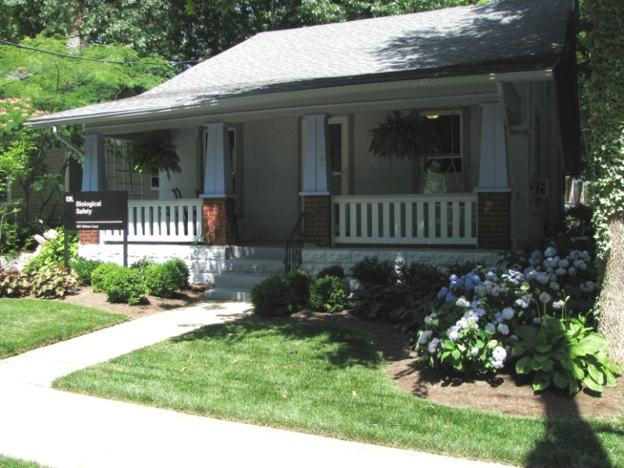
Questions
Marcia Finucane
Biological Safety Officer
Department of Biological Safety
505 Oldham Court
Lexington, KY 40502-0473
Phone: 859-257-1049
Cell: 859-619-1553
mfinu2@uky.edu
http://ehs.uky.edu/ehs/

