Slide 1
Resumption of Research Phased Plan
University of Kentucky
Office of the Vice President for Research

Slide 2
UK Resumption of Research Phased Plan
This plan places public health and safety as top priorities during any phase of resumed research.
The phased approach to resuming research activity will concur with all UK guidelines during the COVID-19 pandemic and will include new safety measures.
There will be supplemental information related to specific areas of human research made available through online training and website materials; please see https://www.research.uky.edu/resources/covid-19-guidance-researchers. Information on this website will be updated on a regular basis.

Slide 3
Guiding Principles for All Phases:
Social distancing (physical distance), defined as 6 ft. separation of distance between individuals in a workspace, will be employed whenever possible when performing all research activities and during each phase.
When 6ft distance is not possible for some research activities, these activities must be undertaken for as short of a period of time as possible. The need for social distancing takes priority over the percent of normal research activity within any one phase.
Appropriate Personal Protective Equipment (PPE), cleaning and disinfection procedures, consistent with UK guidelines (https://www.uky.edu/coronavirus/), must be available and employed within each Phase.
Performing remote research activities, whenever possible, will remain as the first-choice option for all research personnel throughout these phases until further notified by the Office of the Vice President for Research (OVPR).

Slide 4
Definition and Justification for Phased Approach:
We will use a phased approach to resume research activity, as premature repopulation of buildings to an unsafe level could cause a rebound in infection rates.
We have chosen four phases, with varying percentages of research activity within each phase.
This gradual resumption will decrease the likelihood of possible surges of infection and enable time for obtaining needed materials to resume more normal levels of research.
Percent research activity within each phase is intended as a guide to gradually ramp up research and to assist investigators to develop their individualized plans.
Local conditions and state government recommendations will affect transitions from one phase to another. We have provided below examples of external conditions that can influence phased research activity. The VPR, working with senior university leadership, will provide directives and effective dates for phase transitions which will be communicated to faculty, staff and students.

Slide 5
Definition and Justification for Phased Approach:
Phases of resumed research activity are defined in terms of percent activity and are as follows:
Phase 1 represents access restricted to only the maintenance of essential and critical research capability (15-20% of normal access). Social distancing guidelines, defined above, take priority over percent workspace occupation during this and subsequent phases. We have been in phase 1 since March 20.
Phase 2 represents 20-50% of prior research activity, with new safety measures in place.
Phase 3 represents 50-70% of prior research activity.
Phase 4 represents a return to research activities (at 70-100% of prior activity).

Slide 6
Phase 1:
EXTERNAL CONDITIONS | PERCENT RESEARCH ACTIVITY | SUGGESTIONS AT EACH PHASE | TIME PERIOD (subject to adjustment)
Situation unknown and changing COVID-19 hospitalizations on the rise Testing limited PPE shortages | 15-20% | Only essential research activities allowed on campus (for definition of essential research see https://www.research.uky.edu/resources/covid-19-guidance-researchers). Limited human subjects and animal research defined as essential on campus allowable activities. On site staffing is minimal. Waivers required to perform either COVID-19 research or for essential on campus activities (https://www.research.uky.edu/resources/covid-19-guidance-researchers). | 3/16/20 – Tentative late May

Slide 7
Phase 2:
EXTERNAL CONDITIONS | PERCENT RESEARCH ACTIVITY | SUGGESTIONS AT EACH PHASE | TIME PERIOD (subject to adjustment)
Local and national restrictions becoming more relaxed Plateau for COVID-19 hospitalizations locally Testing and PPE shortages determine the specific range of ramped-up activity levels within this phase | 20-50% | Time-sensitive or critical research activities, graduate students close to degree completion prioritized as time-sensitive. Activities needed to ramp up research (i.e., breeding non-commercial animals, restoring previously frozen cell lines, preparing research materials on site). Seasonal data collection (field research) or research subject to external schedules. Core facilities activity increases according to demand. Personnel onsite only when necessary. New safety measure regarding PPE, social distancing, screening and testing will be in place. | Tentative late May – July

Slide 8
Phase 3:
EXTERNAL CONDITIONS | PERCENT RESEARCH ACTIVITY | SUGGESTIONS AT EACH PHASE | TIME PERIOD (subject to adjustment)
COVID-19 hospitalizations on the decline Testing capabilities increase PPE shortages determine the specific range of ramped-up activity levels within this phase | 50-70% | Consistent with Office of Research Integrity (ORI) guidelines, currently paused observational, clinical, behavioral, population and interventional research ramps up under controlled conditions (e.g., face-to-face interactions in controlled facilities. Special consideration to graduate students and other trainees. Special consideration to early career faculty needs to resume research. Core facilities open according to customer demand. Attention to deadline-driven research needs. New safety measures regarding PPE, social distancing, screening, and testing will be in place. | Tentative July – September

Slide 9
Phase 4:
EXTERNAL CONDITIONS | PERCENT RESEARCH ACTIVITY | SUGGESTIONS AT EACH PHASE | TIME PERIOD (subject to adjustment)
Sufficient testing capacity PPE widely available COVID-19 hospitalizations decline to low levels | 70-100% | Maintain social distancing, PPE and cleaning/disinfection procedures. On campus research activities at prior levels, while following social distancing (e.g., shifts, hours/week, etc.). Core facilities operational according to demand. Building density monitored by Chairs, Center Directors and Associate Deans for Research. For specifics on animal or human research refer to the appropriate regulatory office. New safety measures regarding PPE, social distancing, screening, and testing will be in place. | Tentative September

Slide 10
Guidance for Resuming Research Operations to Minimize COVID-19 Transmission Key Points (all phases):
If you have signs or symptoms of COVID-19, do not come to campus. Please seek medical attention. Contact your supervisor to arrange for backup coverage of essential research tasks. Guidelines for testing will be provided by UK HealthCare and instructions forthcoming.
Every person is assumed to be a possible asymptomatic carrier of COVID-19 during the community transmission phase of this ongoing pandemic.
Safe distancing of at least 6 ft. between persons in the same workspace (and other areas, including restrooms and elevators) is important in reducing risks of transmission and exposure to COVID-19.

Slide 11
Guidance for Resuming Research Operations to Minimize COVID-19 Transmission Key Points (all phases):
It is the responsibility of each Principal Investigator (PI) to implement COVID-19 transmission risk reduction strategies that best fit their specific research workspace in order to minimize the probability of COVID-19 transmission. It is recognized that variabilities in workspace size, function, and focus may require adapting variances from the baseline recommendations, which will be included in the template and reviewed by Chairs, Center Directors and Associate Deans for Research. The guidance and reference list in this document are suggested to help PIs achieve that goal.
Continuity of research operations requires that all research personnel assure their own safety and that of their coworkers by taking appropriate steps to minimize transmission of COVID-19 (person-to-person, person-to-surface, and surface-to-person) when working. Surface disinfectant procedures are described below.
Plans need to be flexible enough to enable the swift ramp down of research to an earlier phase in response to changing circumstances and as directed by the Vice President for Research. Ramp down contingency plans will be included in the template that is approved by Chairs, Center Directors and Associate Deans for Research.
Refer to https://www.uky.edu/coronavirus/ for the most up-to-date institutional information.

Slide 12
Specific Guidance for Research Workspaces:
Maximize Spatial Distancing in Research Workspace. Continue minimum 6 ft. separation between researchers for all Phases. Follow guidelines by the University and state regarding maximum occupancy in any room. Options on how to achieve are as follows:
Establish 6 ft. distancing zones in research workspace.
Examples:
Create alternating workspaces: Where laboratory benches within a bay have researchers in close proximity with chair backs facing each other, close down alternate workspace on each bench to create a staggered workspace across the laboratory. Avoid placing personnel directly across benches from one another.
Place markers (colored tape) on the floor and benches to identify 6 ft. separation; particularly in common areas where multiple individuals may need to access shared equipment.
For research workspace with more than one entrance: Consider designating one entrance for ingress and one entrance for egress and establish traffic flow patterns to minimize close proximity to others during entry and exit.

Slide 13
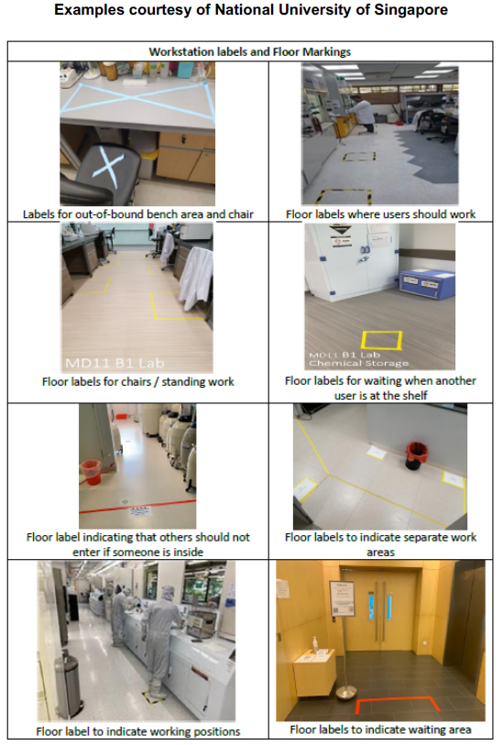
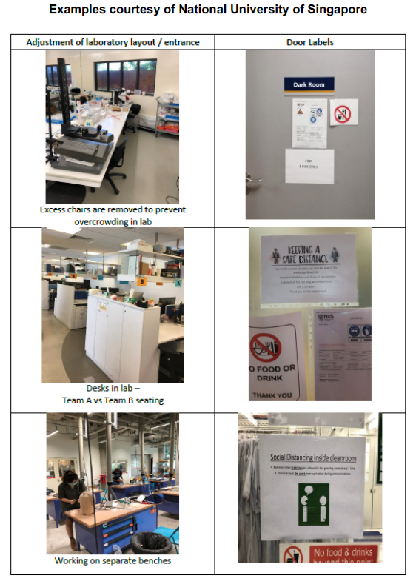

Slide 14
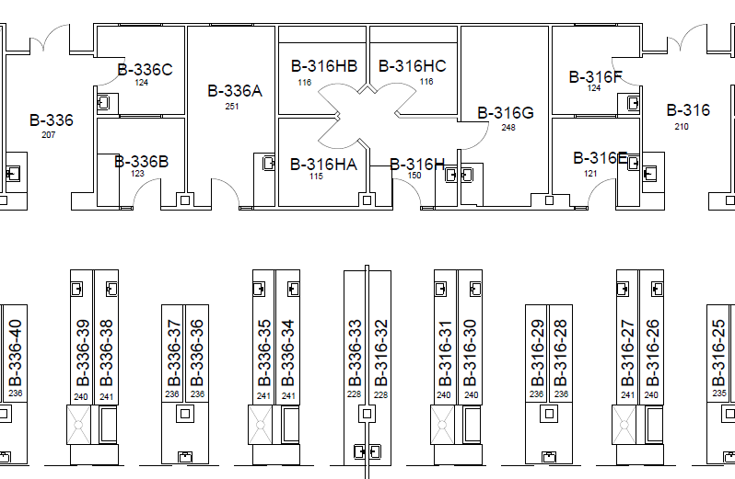



Maximizing Spatial Distancing in Research Workspaces:
BBSRB as an example open lab environment.
Floor markings at 6ft distances are helpful.
Special purpose rooms may only be able to accommodate one person and should be managed by scheduling.
Maintain space with staggered stations.
Do not work directly across from another person.

Slide 15
Specific Guidance for Research Workspaces:
Minimize Time Together In Research Workspace: Stagger or split staffing to reduce overlap presence in research workspace.
Examples:
Implement start time staggering for different teams to start and end work to minimize contact time and avoid peak hours of arrival/departure.
Implement split team arrangements for research workspace usage, e.g. Team A and Team B to work on alternate days or half day shifts in on campus space, working alternate days/times remotely.
Institute check-ins if working alone to prevent a lack of response under emergency situations.

Slide 16
Specific Guidance for Research Workspaces:
Exposure Reduction in Research Workspace: Diligently take appropriate steps to minimize transmission of COVID-19 (person-to-person, person-to-surface, and surface-to-person) when working.
Do not come to campus if you have signs or symptoms of COVID-19 (https://www.uky.edu/coronavirus/faqs).
Seek medical attention.
Contact your supervisor to arrange for backup coverage of essential research tasks.
Use of Masks: If not working alone, wear an appropriate mask to minimize risk of potential COVID-19 droplet spread, especially if 6 ft. distancing is not always an option (possible asymptomatic carrier is assumed).
Respirators will be worn if previous hazard assessments for the research indicate their use.
Employees can bring their own cloth face mask or covering, and/or masks will be provided by their supervisor or business officer, who can reach out to UK Supply Center at https://auxweb.ad.uky.edu/UKSupplyCenter/.
Proper donning/doffing of masks is demonstrated at https://youtu.be/SfZmWJOUEh0.

Slide 17
Specific Guidance for Research Workspaces:
Wash Hands Regularly:
Wash hands with soap and water before and after research work, and between procedures after potentially contaminated gloves are removed.
If soap and water is not readily available: Use hand sanitizer placed at strategic locations if available. If alcohol-based gel hand sanitizer is not available, 70% ethanol (commonly used in laboratories) may be used with care.
Take care to avoid breaking down skin/irritation: Good hand hygiene requires a careful approach during these challenging times. Using good sense to balance hand hygiene techniques can help to reduce skin irritation and excessive dryness.
Avoid overuse of hand sanitizers when soap and water is available.
Use barrier protection such as disposable gloves and/or paper towels (if available in ample supply) to handle common touch points that may be sources of contamination to avoid the need to wash hands, particularly when soap and water is not available.
Use of an effective skin conditioner when away from the workspace may offer some protection against dry skin and irritation.
Proper handwashing technique is demonstrated at https://youtu.be/d914EnpU4Fo.

Slide 18
Specific Guidance for Research Workspaces:
Surface Disinfection: Ensure regular disinfection of all touch points, such as door handles, faucet handles at workspace sinks, light switches, workstations, keyboards and other common equipment. Surface disinfection will occur before and after use to assure disinfection is complete.
All disinfectants registered with the EPA as efficacious for SARS-CoV-2 can be found at https://www.epa.gov/pesticide-registration/list-n-disinfectants-use-against-sars-cov-2.
10% Bleach, 70% Ethanol, and other common lab disinfectants work very well.
Remember that a clean surface is more effectively decontaminated than a soiled surface, disinfectants are not necessarily detergents.

Slide 19
Specific Guidance for Research Workspaces:
Assigned Workspaces: Assign work areas such as a desk or bench to specific individual staff or trainee. Each researcher must use only their assigned work area during alternating occupation of the workspace. Plan for workspace utilization will be included in the template and approved by the Chair, Center Director and Associate Dean for Research.
Assigned Work Tasks: During alternating occupation of the workspace, change work processes, assigning specific tasks to the same person to restrict people movement across laboratories and to minimize the number of users (and contamination spread potential) of specific equipment, such as confocal microscopy, cell culture, etc.

Slide 20
Specific Guidance for Research Workspaces:
Controlled Access to Common/Core Rooms and Equipment:
Determine the maximum occupancy allowed at a particular time allowing for social distancing (6 ft. distancing).
Implement a booking system with specific blocked periods for use and ensure sufficient time for surface cleaning and disinfection between occupants using of the workspace before the next person can use the equipment to prevent physical encounter of the two persons. This also applies for activities or equipment that are unable to be physically separated for operational reasons.
Restrict visitors to essential service providers.
Reminders and updates of these guidelines are sent to staff on a regular basis.

Slide 21
Exposure Reduction Outside of Research Workspace:
Be self-aware and take appropriate steps to minimize exposures to COVID-19.
Follow current stay at home orders (local, state, CDC, etc.); when necessary to travel to and from the workspace to conduct essential research workspace functions:
Follow the 6 ft. distancing rule.
Wear a mask – consistent with current CDC guidance; especially where 6 ft. distancing from others cannot be assured. Cloth facial coverings (masks) will be worn by all individuals when on campus performing research, and when interacting with subjects within a study. Examples may include entrances to buildings, elevators, restrooms, or some laboratories due to their unique layout and function, such as instrument laboratories.
Use good handwashing techniques (minimum 20 sec., consistent with CDC guidelines), especially after touching public touch points (elevator buttons, door handles, etc.).
If available, use hand sanitizers placed at strategic locations, especially after touching items in high traffic common use areas such as elevator and copier buttons, light switches, phones, and door handles.
Research Offices: The size/area of most offices in research buildings do not readily accommodate 6 ft. distancing and will be used by only one person.

Slide 22
Process for Resumption of Research (all phases):
PIs are required to develop an individual plan for their workspace using the standardized template (https://www.research.uky.edu/resources/covid-19-guidance-researchers) for resumption of research.
The completed template will be submitted for approval by their Chair or unit Director (e.g., Centers or Institutes), as appropriate.
Plans must be approved prior to the resumption of research activity beyond what was approved in Phase 1.
Plans will include choice of research members to return to work and rotation schedules and will be discussed with all research personnel before submission to the Chair or unit Director.

Slide 23
Process for Resumption of Research (all phases):
Chairs will develop an overall plan for their unit, taking into consideration issues such as social distancing in open laboratory designs housing several unit PIs, support staff within the unit, building density, special consideration to trainees, operations of shared use and common use research areas and how they will be used, availability of PPE and other supplies and other issues related to Department functions.
Associate Deans for Research will review and approve coordinated overall unit plans that involve their investigators.
Deans will have final authority over resumption of research within their academic unit.

Slide 24
Plan Considerations:
Choice of research members who return to work: Each PI must think carefully about which research members will be allowed to return to work during the 4 phases and this information will be included in their specific template plan to be approved by the Chair, Center Director and Associate Dean for Research:
Trainees (PhD students and postdocs) will be given high priority due to the need to complete their research projects in a timely fashion and meet a thesis deadline, a paper submission, or a grant submission.
Priority will be given to research staff who volunteer willingly to return and as determined by research priorities.
Consider occasional replacement of personnel in the schedule with new people, to allow as many research staff as possible to enjoy some progress in their projects.
Undergraduate or high school volunteers will not be allowed in research workspaces for the duration of the pandemic. However, undergraduates who are staff on grants or contracts, or taking research for course credit, can be considered during more relaxed phases of operation (phase 3, 4).

Slide 25
Plan Considerations:
Changes in operating mode: Plans will include calendars and/or shift work to maintain social distancing, responsibilities and process for cleaning and disinfecting specific pieces of equipment used by many research personnel both before and after use, size and mode of research or research-related meetings, assigning specific responsibilities to personnel to avoid duplication and need for several people to be in limited space areas (e.g., DLAR rooms, cell culture hoods, etc.).
When moving from one phase to the next, you must adhere to social distancing, using shift work or scheduling to accommodate more research activity by investigators within your workspace who were not prioritized in earlier phases.

Slide 26
Plan Considerations:
Communications: We encourage investigators to communicate with research teams as soon as possible and provide at least 48 hrs lead time to determine any concerns they have about starting or restarting research projects.
Some participants may wish to postpone a face-to-face interview in the clinic or a group session in the community.
Investigators can develop strategic “workarounds” or conduct research remotely to accommodate such concerns, communicating with their research teams or mentors, sponsors, and other colleagues.

Slide 27
High-risk (language used by CDC) Populations:
We encourage investigators to consider in their individualized plans for phased resumption of research the impact of their plans on high-risk populations who participate in the research.
As much as possible, this group will resume research activities during later phases of research resumption.
If a staff member is concerned about returning to the working environment due to a high-risk medical condition, they should contact the Office of Intuitional Equity and Equal Opportunity for information regarding ADA accommodations at 859-257-8927 or https://www.uky.edu/eeo/ada-compliance.
For specific (non-work-related) issues regarding high-risk populations, we refer individuals to Employee Health (https://ukhealthcare.uky.edu/university-health-service/employee-health).

Slide 28
Concerns:
We also remind personnel of the ability to provide anonymous feedback through the Office of Research Integrity research hotline (see https://www.research.uky.edu/research-misconduct) or through UKHC compliance (see https://ukhealthcare.uky.edu/staff/corporate-compliance).

Slide 29
Adherence:
It is the responsibility of all personnel engaged in research to adhere to the general underlying principles within this document and the approved PI individual plan for resumption of their research.
Unannounced visits or checks on activity will be performed by appropriate Chairs and/or ADR, in conjunction with personnel from Environmental Health and Safety, to assure adherence to approved plans.

