Slide 1
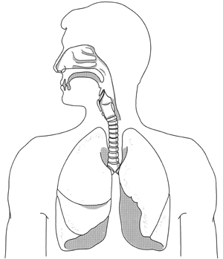
Respiratory Protection Training
OSHA 29 CFR 1910.134
University of Kentucky
Health and Safety

Slide 2

Why am I required to take this course?
Your workplace has been identified as having potential respiratory hazard(s) that could result in an employee exposure*
*An employee exposure is an exposure to an airborne contaminant that would occur if the employee were not using respiratory protection

Slide 3

What will I learn from this course?
Respirators protect workers by preventing exposures to harmful airborne chemical and biological agents
However, a respirator that is not used properly will fail to provide adequate protection, and may even cause certain hazardous conditions

Slide 4
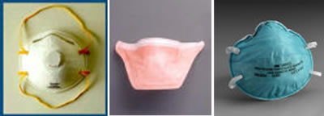
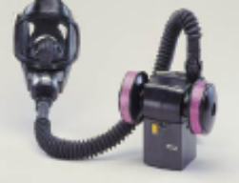

What will I learn from this course?
This training program is intended to teach you the basic information you need to know in order to use a respirator correctly and safely
At a later date, this online training course will be supplemented with hands-on training using the specific respirator selected for you to use

Slide 5
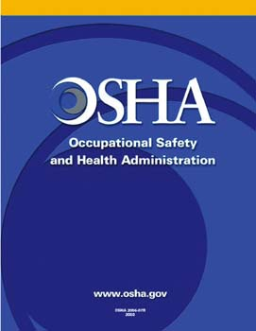
Why do I need a respirator?
If your job involves the potential for exposure to atmospheric contaminants, UK Health and Safety policy requires that certain controls must be implemented
This policy is driven by the University's obligation to comply with the Occupational Safety and Health Administration (OSHA) Respiratory Protection Standard, 29 CFR 1910.134

Slide 6
Why do I need a respirator?
A respirator is one type of control often selected when ventilation controls such as local exhaust or enclosure are not feasible or sufficient
Respirators are designed to protect the respiratory system from inhalation of atmospheric hazards by either:
  removing contaminants from the air before they are inhaled, or
  supplying an independent source of "clean" air

Slide 7
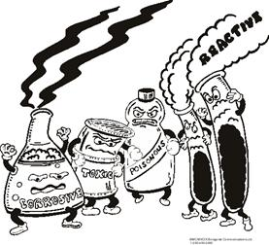
What are atmospheric hazards?
In order to answer this question, we must first review some basic properties of hazardous substances. These can exist in many states, including:
    Gases
    Vapors
    Particles

Slide 8
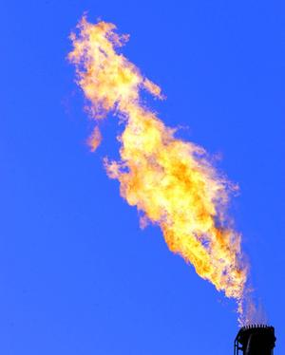
Gases
Gas is one of the three basic phases of matter (along with liquids and solids)
Gases (like liquids) are fluids:
  Ability to flow
  Viscosity, but does not resist deformation
Unconstrained gases (unlike liquids) do not occupy a fixed volume, but expand to fill their space

Slide 9

Vapors
A vapor is the gaseous state of a substance which under ordinary conditions exists as a liquid or solid
Temperature and pressure changes can convert solids and liquids into vapors

Slide 10

Particles
A particle is a very small speck of solid or liquid matter
Several types of air contaminants are particles, such as:
  Smoke
  Mist
  Fume
  Dust
  Infectious agents

Slide 11
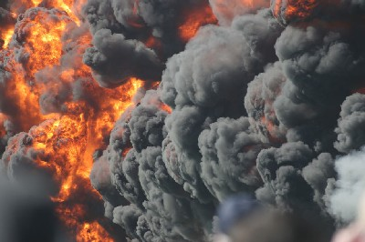
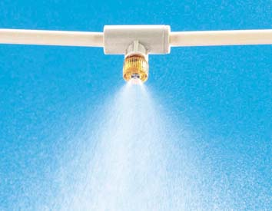

Particles: Smoke and Mist
Smoke is a suspension in air of small particles resulting from incomplete combustion of a fuel
Mist is a collection of liquid droplets suspended in air
  A mist can be formed when spraying or splashing a liquid
  It can also be formed when a vapor condenses into liquid droplets in the air, as with fog

Slide 12
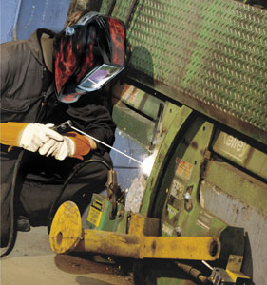
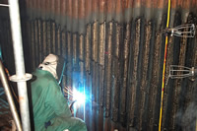
Particles: Fume
A fume is a solid particle that has condensed from the vapor state
Example: metal in welding or cutting processes can vaporize, then condense into tiny particles, or metal fumes

Slide 13
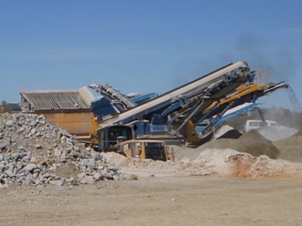
Particles: Dust
Dust refers to dry particles that are often the product of disintegration, scouring, crushing, or grinding of larger solid material
Some dusts can travel limited distances on air currents

Slide 14
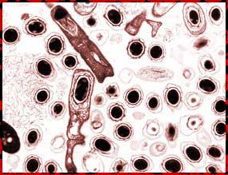
Particles: Infectious Agents
Infectious agent particles include certain types of bacteria, viruses, prions, protozoa, fungi, etc.
These are often generated as aerosols: solid or liquid droplets suspended in a gas such as air
Like dusts, aerosols can travel limited distances on air currents

Slide 15

Particles: Infectious Agents
Many laboratory procedures can generate infectious agent aerosols, including:
  Pipetting; blowing out pipettes
  Removing stoppers
  Breaking culture containers
  Intranasal inoculation of animals
  Flaming inoculating needles, loops or slides
  Inserting a heated loop into a culture
  Streaking inoculum
  Harvesting infected materials
  Stirring liquids
  Freeze-drying specimens
  Animal cage cleaning and bedding change
  Careless glove removal

Slide 16
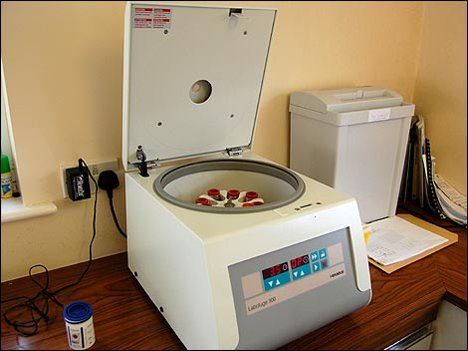
Particles: Infectious Agents
Many laboratory devices can generate infectious agent aerosols, especially when used incorrectly:
  Vortexers and blenders
  Bottles, flasks, and stoppers
  Cell sorters
  Centrifuges
  French press
  Homogenizers
  Needles and syringes
  Vacuum and aspirating equipment
  Pipettes
  Pressurized vessels
  Shakers
  Sonicators

Slide 17
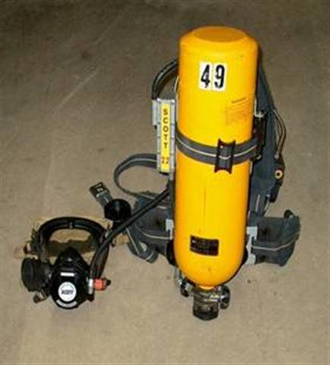
Oxygen Deficiency: Another Atmospheric Hazard
Normal oxygen level in the air is ~20.9%
  Oxygen can rapidly deplete in confined spaces or other poorly-ventilated atmospheres
Symptoms of hypoxia occur at approximately 16% oxygen
Oxygen-deficient environments require an atmosphere-supplying respirator such as a Self-Contained Breathing Apparatus (SCBA)

Slide 18
Why is it important to understand the different states of atmospheric hazards?
The type of respirator and filtering media you select is determined based on the type of contaminant in your work environment

Slide 19
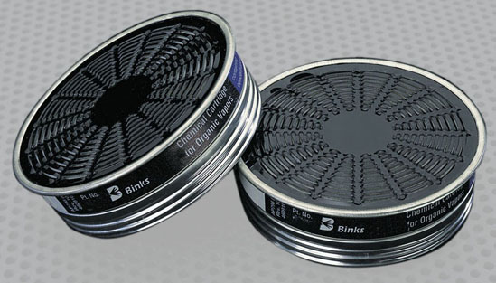
Why is it important to understand the different states of atmospheric hazards?
Gases and vapors are adsorbed using activated charcoal
    Adsorption is a surface area bonding phenomenon
Dusts, mists, and fumes are absorbed using a filtering material
    Absorption is a volume-based uptake of material

Slide 20
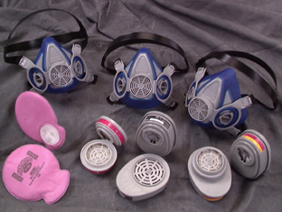
Why is it important to understand the different states of atmospheric hazards?
Many respirators have interchangeable media cartridges installed onto the facepiece depending on the anticipated contaminants in the work environment
  The wrong type of filtering material can negate the benefits of wearing a respirator
Some respirators may use a combination activated charcoal and filtering media when particles and vapors / gases are anticipated

Slide 21
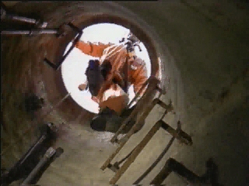
REMEMBER!
An atmosphere-purifying respirator will not protect you in an oxygen deficient environment!
If the oxygen concentration is unknown, you must have an SCBA respirator to enter the atmosphere
  SCBA respirators must also be used if the concentration of a hazardous air contaminant is unknown, but entry into the hazardous atmosphere must be made, as in a hazardous chemical release or other emergency. Never presume that an entry into a hazardous atmosphere is safe!

Slide 22
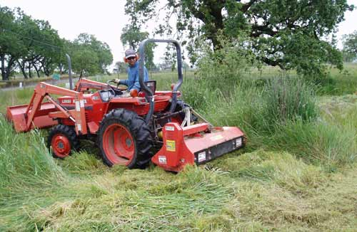
What if I wish to wear a respirator in the absence of typical atmospheric hazards?
Example: persons who have allergies and work outside with exposures to pollen and grasses
This training module still applies to you!
You still need to be aware of the limitations and certain use factors for respirators

Slide 23
What if I wish to wear a respirator in the absence of typical atmospheric hazards?
The use of a respirator by someone who doesn't understand these limitations and use factors could lead to dangerous conditions even in the absence of atmospheric hazards
  Medical clearance to wear a respirator is required; there are certain medical conditions that could cause you to be physically unable to do your job while wearing a respirator
  Another potential problem unrelated to atmospheric hazards is surface contamination: if routinely used respirators are not cleaned and disinfected regularly, unhealthful conditions and infections could result

Slide 24
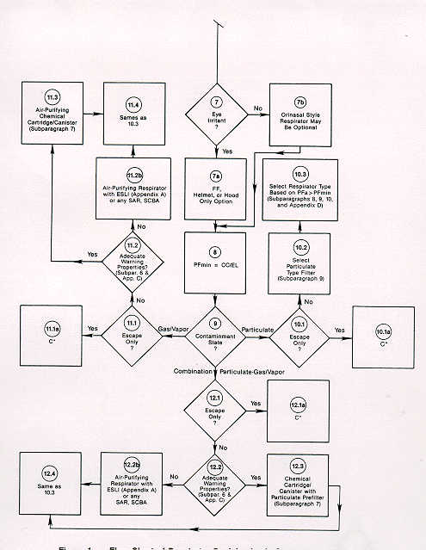
What type of respirator will I need?
Large variety of respirator types available
Each is designed based on the specific contaminant(s) encountered, the characteristics of the work environment, and the needs of the user

Slide 25
What type of respirator will I need?
A commonly used type is the air-purifying respirator (APR)
Tight-fitting facepieces or coverings produce a protective seal around the face of the user
Air is purified when it passes through a filtering media at the inlet cover of the facepiece

Slide 26
What type of respirator will I need?
Tight fitting coverings, or "facepieces", come primarily in two basic configurations:
    half-mask
    full facepiece
Half-mask respirators cover the facial area from the bridge of the nose to just below the chin

Slide 27
What type of respirator will I need?
Full facepiece respirators cover the same facial area as the half-mask, but feature a supplemental seal around the perimeter of the face and a protective see-through shield

Slide 28
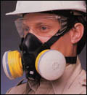
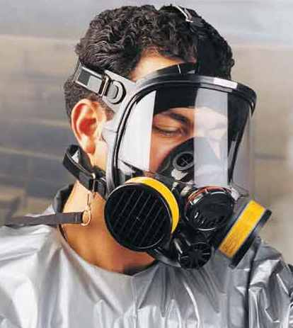
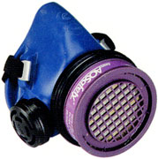
Tight-Fitting Facepieces
Half-mask APR with twin cartridges
Full facepiece APR
The rarely-seen quarter-mask APR, which seals above the chin and below the mouth and has a single cartridge

Slide 29
Half mask APRs
These can be used for protection against gases, vapors, or particulates.
Cartridges contain a filtering and / or adsorbing media that removes contaminants from the air. Thus the type of cartridge is selected based on the anticipated contaminant(s) in the work environment.
Cartridges attach to the respirator inlets, so air entering the facepiece is purified before it is inhaled by the respirator wearer.
On the front of the mask is an exhalation outlet with a one-way valve that allows air to leave the facepiece.

Slide 30
Full Facepiece APRs
Full facepiece respirators are used when a higher level of respiratory protection is needed, or when protection of the eyes and face is important
Examples:
  Hazardous waste bulking, in which there may be high atmospheric concentrations of vapors
  Jobs involving chemicals that are irritating to the eyes
  Pesticide or herbicide spraying, where overspray may contact the eyes
  Research animal care, where allergens can affect the eyes as well as the respiratory system
Like the simpler half-face respirator, full facepieces have interchangeable cartridges that are selected on the basis of anticipated respiratory hazard(s)

Slide 31
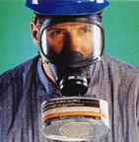
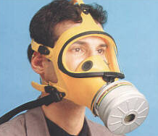
“Canister” Respirators
Canisters are sometimes used instead of cartridges for gas and vapor respirators, because more sorbent material can fit in a canister
These tend to be heavier than cartridge-using APRs, and are not widely used at UK

Slide 32
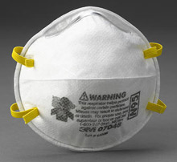
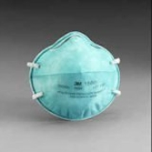
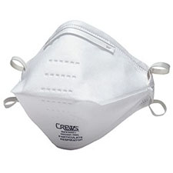
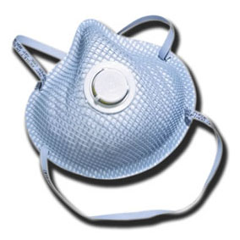
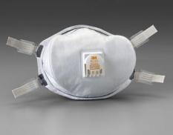
Disposable Filtering Facepiece Respirators
This is another type of APR, which is used once and discarded; these are popular in healthcare settings and research laboratories
Filtering facepiece respirators are intended to protect against particles, although some models may contain an activated charcoal media to control odors or vapors; however, this type of respirator is not recommended if you have potential exposure to gases or vapors

Slide 33
Disposable Filtering Facepiece Respirators
These respirators are described based on their resistance to oil, and their collection efficiency with 0.3 micron test particles
Oil resistance is indicated by N, R, or P:
  "N" means that the respirator is not resistant to oil
  “R” is more resistant to oil
  “P” is most resistant, and is often considered “oil-proof”

Slide 34
Disposable Filtering Facepiece Respirators
Filtration efficiency is listed by the numerical percent of test particles (0.3μm) that are filtered
  This number is listed after the N, R, or P
N-95 is the minimum level of efficiency that is acceptable for protection against hazardous particulates
  Respirators with greater filtration efficiency are available (e.g. N-97 and N-100, R-97 and R-100, P-97 and P-100)
  An N -, R-, or P-100 filter is also called a High Efficiency Particulate Air (HEPA) filter because it is nearly 100% effective at filtering test particles

Slide 35
Disposable Filtering Facepiece Respirators
N-95 or higher disposable respirators are effective for hazard reduction when working with infectious agents
  Greater levels of protection might be required for specific agents or protocols
Eye and face protection can be worn with disposable filtering facepiece respirators
  E.g. goggles and/or face shield worn with disposable respirator in Biosafety Level 3 facilities

Slide 36
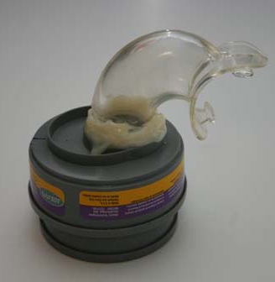
NIOSH-Certified Respirators
All respirators used in the workplace must bear the certification of the National Institute for Occupational Safety and Health (NIOSH)
  Ref: 29 CFR 1910.134(d)(1)(ii)
NIOSH certification is for the intact respirator unit, with all parts in place, operational, and from the same manufacturer
  “Mixing and matching” parts from different brands of respirators invalidates the NIOSH certification
  Homemade and shop-made respirators or alterations
    are NOT approved

Slide 37
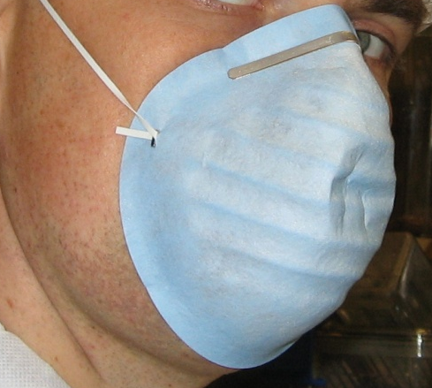
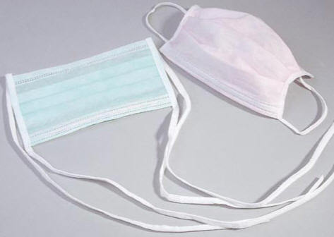
NIOSH-Certified Respirators
Some disposable masks are not “respirators” at all, since they are not NIOSH certified
  These are often recognizable by their use of thin paper rather than a rated filtering material, or a single strap; NIOSH-certified filtering facepiece respirators will always have two straps
  Paper masks and “surgical” masks have their uses, but they are not respirators!
  Do not use these for tasks where a real respirator is needed, and do not expect these to provide any level of respiratory protection

Slide 38
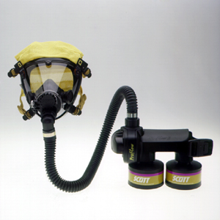
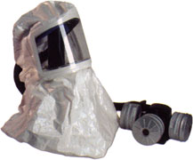
Powered Air-Purifying Respirator (PAPR)
PAPRs are useful for work environments where traditional full facepiece respirators are not acceptable
  Example: if the work environment is hot with high humidity, then the face shield on a traditional full facepiece respirator may fog up rapidly, causing discomfort and obstructed vision.
PAPRs utilize a battery powered blower motor to pull air through a purifying element (cartridge or canister), then push the air into the full facepiece

Slide 39
Powered Air-Purifying Respirator (PAPR)
Air is circulated through the facepiece producing a cooling effect that improves comfort and reduces fogging
  Additionally the blower motor does the work of pulling air through the filtering media, resulting in less physical stress on the user.
When maximum comfort and communication ability is needed, a loose-fitting covering or hood can be used with a PAPR blower motor and air purifying element

Slide 40
How do I determine the protection level that a specific respirator type will provide?
A respirator's protective capacity is rated based on Assigned Protection Factors, or APF's
  APFs are assigned by OSHA and legally enforceable
The higher the concentration of airborne contaminants, the greater the need for a high APF
APF's are numerical ratings that express the respirators anticipated protective ability against a given contaminant; the higher the APF, the greater the protection provided by the respirator

Slide 41
How do I determine the protection level that a specific respirator type will provide?
Occupational Exposure Limit x APF = maximum airborne contaminant concentration in which respirator can be used
Example: If the established occupational exposure limit for a particular chemical is 10 ppm (parts of the contaminant vapor per million parts of air), a full facepiece respirator, with an APF of 50, can safely be used in airborne concentrations of up to 500 ppm

Slide 42
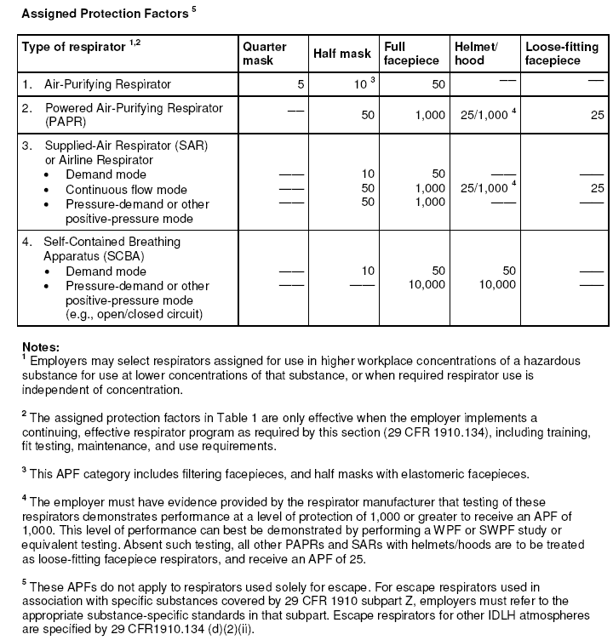
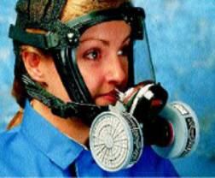
This is a copy of the official OSHA APF Table. Ref: 29 CFR 1910.134(d)(3)(i)(A)
APF = 10
APF = 50
APF = 1000

Slide 43
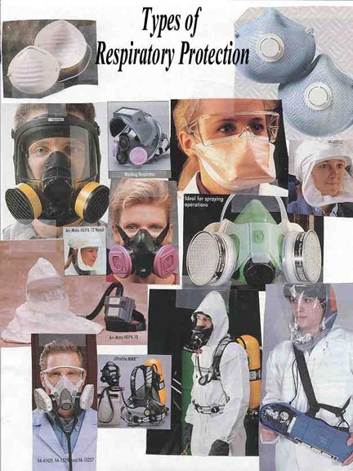
Do I have to know about all respirator types, even if I will only use one certain type in my job?
This is necessary only to the extent that knowledge of other respirator types helps you or your supervisor make the correct choice regarding the best type of respirator for your work environment

Slide 44
Do I have to know about all respirator types, even if I will only use one certain type in my job?
Example:
  You initially select a half-mask respirator and then a new contaminant is introduced to the work environment, one that causes a need to protect the eyes and face
  At that point, a general awareness of the protective capacity and general uses of full facepiece respirators will help you to realize that there is a better, more protective choice in respirators for your work environment

Slide 45
I have asthma. Will this cause a problem when I am wearing a respirator?
Possibly. In fact, there are a number of conditions that could cause potential adverse health effects for respirator wearers, including:
  respiratory diseases
  history of heart attack or stroke
  claustrophobia
  high blood pressure
Each of these conditions may adversely affect the health of some employees who wear respirators

Slide 46
I have asthma. Will this cause a problem when I am wearing a respirator?
A physician or other licensed health care professional operating within the scope of his/her practice needs to medically evaluate employees to determine under what conditions they can safely wear respirators
Thus, it is necessary to ensure that you are physically capable of wearing a respirator

Slide 47
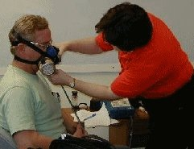
How will I know if my respirator is fitting properly?
Fit testing is an OSHA requirement, and is conducted to determine proper respirator fitting
Even the best designed and manufactured respirator will not protect the wearer if there is an improper match between facepiece and wearer or improper wearing practices by the user

Slide 48
How will I know if my respirator is fitting properly?
With different brands of a particular type of facepiece available, it is important to determine which one fits best
It is also important to know how to correctly wear your respirator
Choosing the correct respirator and knowing how to wear it are accomplished by fit testing

Slide 49
How will I know if my respirator is fitting properly?
It is important to remember that no single respirator type / model will fit everyone
Therefore, more than one brand of a given type of respirator should be purchased to take advantage of the different characteristics of each type, and to ensure a correct fit for everyone
Also, having more than one facepiece to choose from gives a better chance to find a respirator that is comfortable while providing good protection

Slide 50
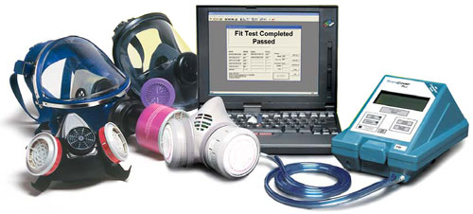
Quantitative Fit Testing (QNFT): the preferred method for determining proper fit
QNFT is conducted using sophisticated equipment by trained personnel, in order to detect facepiece leakage
QNFT does not rely on subjective responses, and is highly sensitive and assures correct fit. This is especially important when working in highly hazardous atmospheres which can be immediately dangerous to life or health

Slide 51
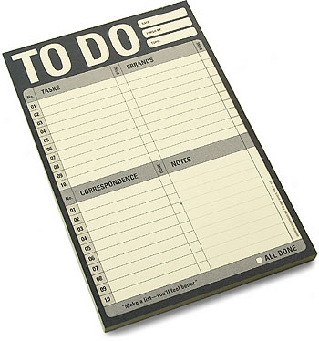
After the initial fit test, how do I know if my respirator continues to function correctly?
To ensure that your respirator is functioning correctly and is safe to use, meticulous respirator MAINTENANCE is vital, and includes the following:
  Inspection
  Cleaning
  Proper Storage

Slide 52
Respirator Maintenance
Manufacturers' instructions for caring for your respirator should be followed to ensure correct function.
Poorly maintained or malfunctioning respirators do not protect the wearer and can be more dangerous than not wearing a respirator at all
Maintenance guidelines may change due to the needs of your facility and how often you are using respirators and for what purpose

Slide 53
Respirator Maintenance: Tailoring
In a large respirator program in which respirators are used routinely, they should be exchanged daily for cleaning and inspection
However, in a small program involving only occasional respirator use, this period could be weekly or monthly
It is important to evaluate your specific needs regarding respirator use to determine the best maintenance program

Slide 54
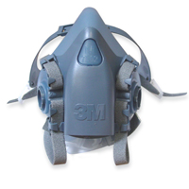
Respirator Maintenance: Inspection
The facepiece of a routinely used respirator should be checked before and after each use for:
  Excessive dirt
  Cracks, tears, holes, or distortion from improper storage
  Inflexibility (stretch and massage to restore flexibility)
  Cracked or badly scratched lenses in full facepieces

Slide 55
Respirator Maintenance: Inspection
The facepiece of a routinely used respirator should be checked before and after each use for:
  Incorrectly mounted full-facepiece lens or broken or missing mounting clips, and
  Cracked or broken air-purifying element holder(s), badly worn threads, or missing gasket(s) (if required)

Slide 56
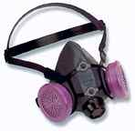
Respirator Maintenance: Inspection
The head straps or head harness of a routinely used respirator should be checked before and after each use for:
  Breaks
  Loss of elasticity
  Broken or malfunctioning buckles and attachments, and
  Excessively worn serrations on the head harness which might permit slippage (full facepieces only)

Slide 57

Respirator Maintenance: Inspection
The air-purifying elements of a routinely used respirator should be checked before and after each use for:
  Incorrect cartridge, canister, or filter for the hazard
  Incorrect installation, loose connections, missing or worn gaskets, or cross-threading in holder.
  Expired shelf-life date on cartridge or canister
  Cracks or dents in outside case of filter, cartridge, or canister, and
  Evidence of prior use of adsorbent cartridge or canister, indicated by absence of sealing material, tape, foil, etc., over inlet.

Slide 58
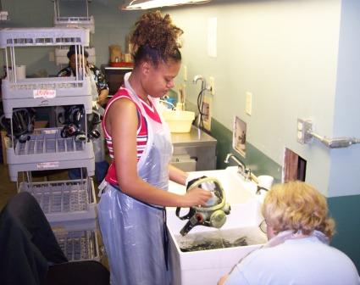
Respirator Maintenance: Cleaning
OSHA states that "routinely used respirators shall be collected, cleaned, and disinfected as frequently as necessary to insure that proper protection is provided" and that emergency use respirators "shall be cleaned and disinfected after each use"

Slide 59
Respirator Maintenance: Cleaning
If the respirator is dirty, it should be washed with detergent in warm water using a brush.
If the respirator is not visibly soiled, it may still need to be disinfected using a solution of one part bleach to 10 parts water.
- Place the respirator in the bleach solution for no less than 10 minutes, then rinse it thoroughly in clean water (140°F maximum) to remove all traces of detergent or bleach. This is very important to prevent exposure that could lead to dermatitis.

Slide 60
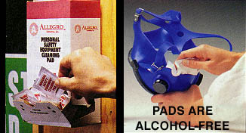
Respirator Maintenance: Cleaning
Alcohol-free cleaning pads can be used for cleaning non-disposable respirators that are not visibly soiled
The use of rubbing alcohol should be avoided because alcohols will cause the rubber components of the facepiece to degrade

Slide 61
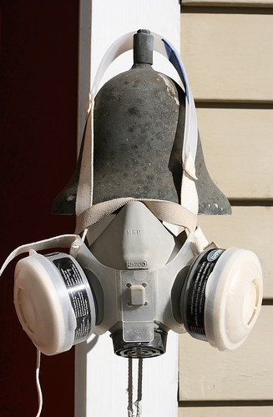
Respirator Maintenance: Cleaning
Drying of your respirator should be on a clean surface
Respirators may also be hung to dry, but care must be taken not to damage the facepiece or stretch/distort the head straps
Do not place the respirator back into an airtight container or storage bag until it is completely dry or mold growth could result

Slide 62
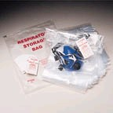
Respirator Maintenance: Storage
Storage of your respirator should be done in a clean, dry place free of hazards
The respirator should be able to dry where it is stored and respirator storage must protect against:
  Dust
  Sunlight
  Heat
  Extreme cold
  Excessive moisture, and
  Damaging chemicals

Slide 63
Respirator Maintenance: Storage
Clean, dry respirators should be placed in reusable plastic bags or other clean, sealable containers
They should be stored in a clean, dry location away from direct sunlight
They should be stored in a single layer with the facepiece and exhalation valve in a more or less normal position to prevent the rubber or plastic from taking a permanent distorted "set"

Slide 64
Can I wear a respirator if I have facial hair?
A tight-fitting respirator must have a good seal around the face to ensure maximum protection; facial hair that lies along the sealing area of the respirator, such as beards, sideburns, moustaches, or even a few days of stubble are NOT permitted when wearing a respirator
Facial hair between the wearer's skin and the sealing surfaces of the respirator will prevent a good seal; the wearer should be cleanly shaven when wearing a tight-fitting respirator
The only exception would be a small moustache that does not lie beneath the sealing surface of the respirator

Slide 65
Can I wear a respirator if I have facial hair?
Respirators with loose-fitting facepieces (such as the PAPR pictured below) are an option for personnel who cannot shave or maintain a tight face-facepiece seal
Consult UK Health & Safety if you are interested in a loose-fitting respirator for a reason related to fit or comfort

Slide 66
Can I wear a respirator if I wear eye glasses?
Ordinary eye glasses should not be used with tight-fitting full facepiece respirators; they can be worn under loose fitting PAPRs
Eye glasses with bars or straps that pass through the seal of the respirator will prevent a good seal
Special corrective lenses can be mounted inside a tight-fitting full facepiece respirator and are available from all manufacturers of full facepiece respirators
When wearing a half-mask respirator, glasses MAY be permitted because they do not pass through the seal

Slide 67
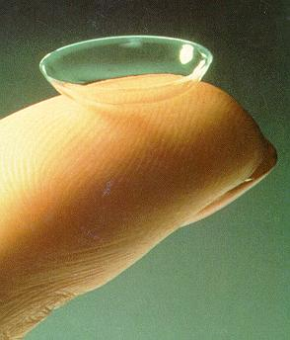
Can I wear a respirator if I wear contact lenses?
There are several factors that limit the use of contact lenses while wearing any type of respiratory device, especially air-supplying respirators
With full facepiece respirators, incoming air directed toward the eye can cause discomfort from dirt, lint, or other debris lodging between the contact lens and the pupil
It is not recommended that contact lenses be worn while using a respirator and that other means be used such as special corrective lenses that are mounted inside a full facepiece respirator

Slide 68

Questions?
UK Health & Safety
252 East Maxwell Street
Lexington, KY 40506-0314
http://ehs.uky.edu
Derek Bocard
Senior Industrial Hygienist
Phone: 859-257-7600
Cell: 859-967-6397
djboca2@uky.edu

