Slide 1
Laboratory Safety Training for Contractors
Jan Eggum, MPH
Occupational Health and Safety
Phone: 859-257-3242
Email: jghamo2@email.uky.edu

Slide 2
Entering the Laboratory
Door Signs
Provides information about hazards in the laboratory.
Hazards such as
Biologicals
Chemicals
Radiation
Lasers
Strong Magnetic Fields

Slide 3
Laboratory Information
Carefully read all door signs on laboratory doors.
Emergency Contact information for Principal Investigator
Understand the hazards associated with each symbol.

Slide 4
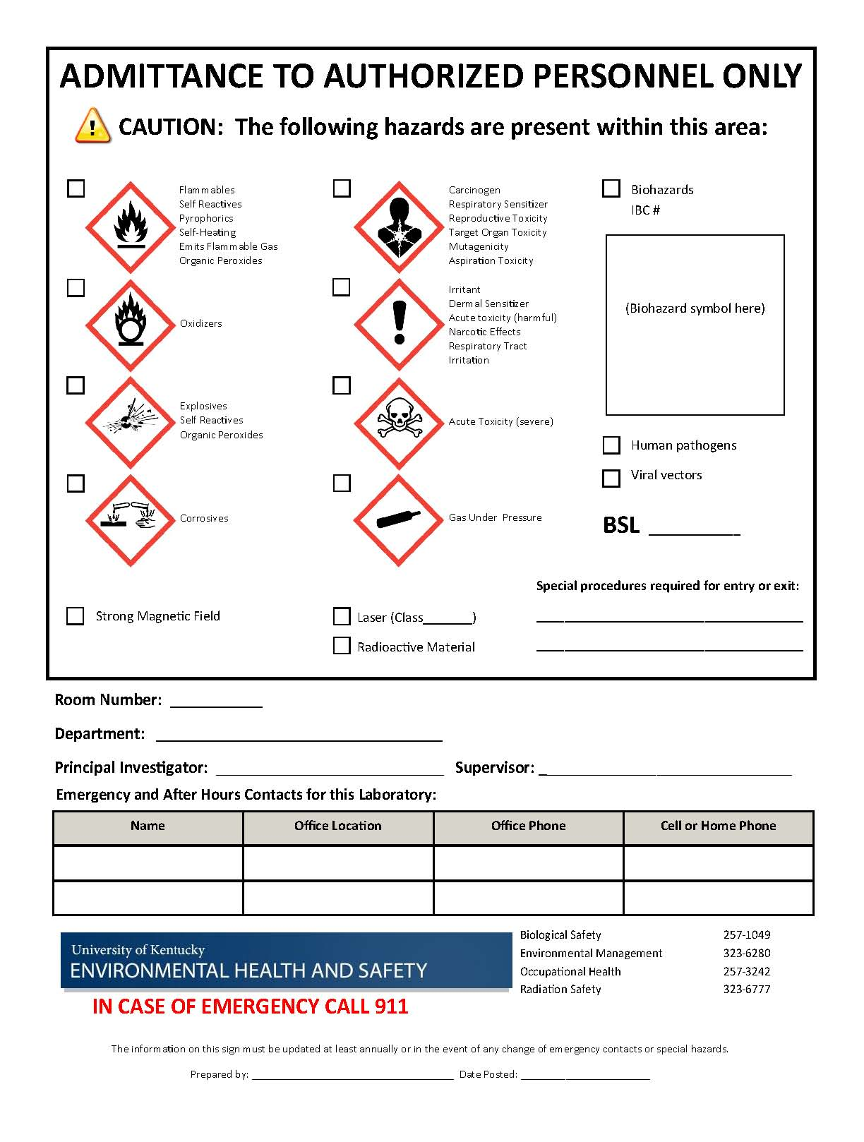

Slide 5
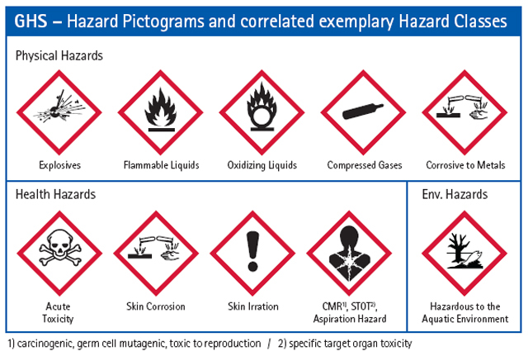
Door Signage Pictograms

Slide 6
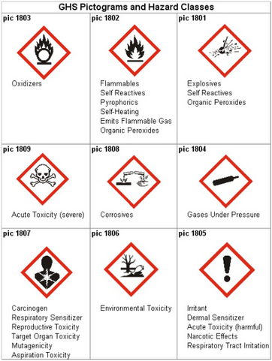

Slide 7

Biological Hazard Sign

Slide 8
Biological Hazards
Biological hazards, also known as biohazards, refer to biological substances that pose a threat to the health of living organisms, primarily that of humans. This can include medical waste or samples of a microorganism, virus or toxin (from a biological source) that can impact human health. It can also include substances harmful to animals. The term and its associated symbol is generally used as a warning, so that those potentially exposed to the substances will know to take precautions

Slide 9
Biological Hazards
All biological materials should be put away when work is taking place.
Do not touch anything marked with a biological hazard symbol.
If a spill of a biological material occurs, contact your supervisor and the contact information on door.

Slide 10

Radiation

Slide 11
Radiation
Radiation is defined as particles or energy given off by radioactive material
Radioactivity is the capacity of a material to emit radiation.
Types of radiation
Ionizing – alpha, beta, gamma, x-ray
Non-ionizing – microwave, UV light, infra-red

Slide 12
What that means to you
Do not touch anything that is marked as radioactive.
Will be defined by radioactive sticker both on door of laboratory and in area.
If a spill did occur, contact your Supervisor and contact information on door.

Slide 13
Magnetic Energy

Slide 14
Magnetic Fields
Not allowed in room
Person with cardiac pacemakers, implantable cardioverter defibrillators or magnetic implants
No loose metal objects or magnetic media
Hearing aids, cell phones
ATM/Credit cards
Minimize ferrous metals in area

Slide 15
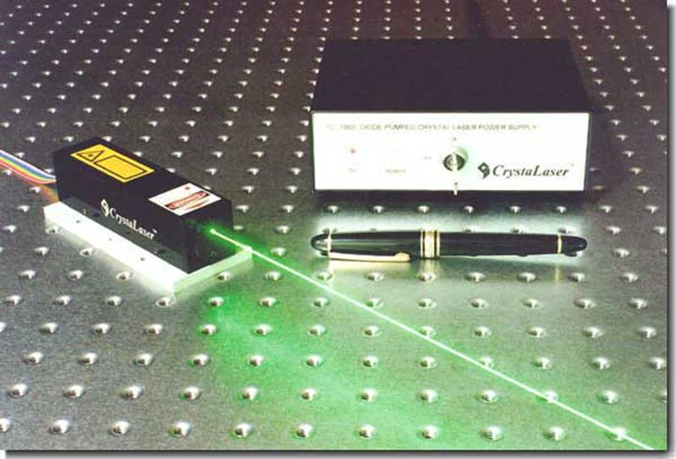
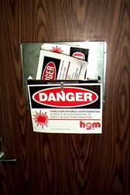
Lasers

Slide 16
Lasers
Should not be on while in the laboratory
If on, will see the green flashing light through the door window.
Could cause eye damage if look into laser
Do not enter the laboratory, if the laser is on.

Slide 17
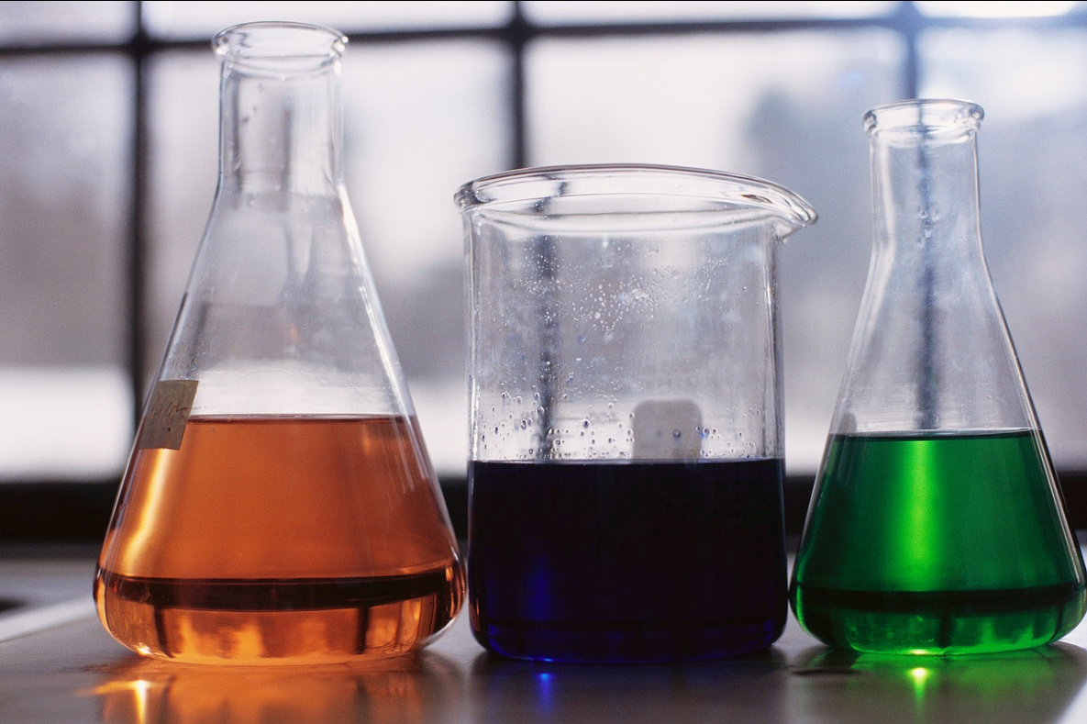
Chemicals

Slide 18
Chemicals
All chemicals should be put away when work is being done in laboratory.
Do not touch any chemicals/ glassware/ boxes, etc.
If a spill does occur, contact supervisor and contact on the door.

Slide 19
In Case of an Emergency

Slide 20
Emergency Safety Equipment
The eyewash and shower in the laboratory can be used in case of an emergency.
Take a few minutes to familiarize yourself with the location and use of the eyewash and shower in the laboratory.
Keep area Clear!

Slide 21
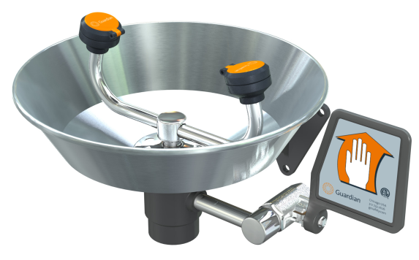
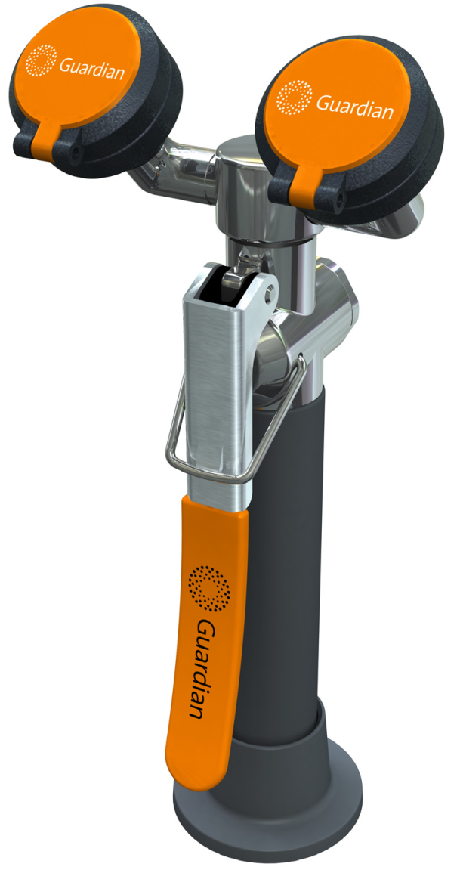
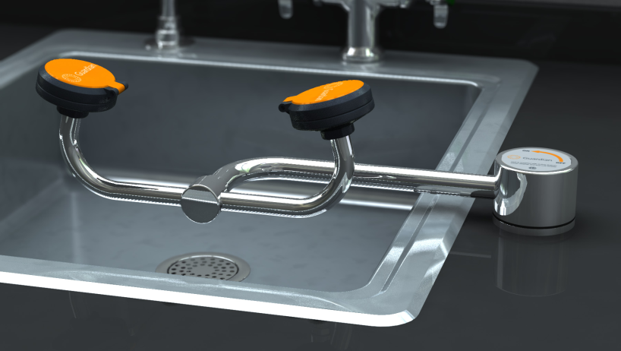
Emergency Eyewash Station

Slide 22
Using an Eye Wash Station
Hold eyelids open using the thumb and index finger to help ensure the effective rinsing has occurred behind the eyelid.
It is normal to close eyes tightly when splashed, but this will prevent water or eye solution from rinsing and washing the chemical out. Eyelids must be held open.

Slide 23
Using an Eye Wash Station
Flush eyes and eyelids with water or eye solution for a minimum of 15 minutes.
“Roll” eyes around to ensure full rinsing.

Slide 24
Using an Eye Wash Station
Contact lenses must be removed as soon as possible.
Medical attention should be sought immediately!

Slide 25
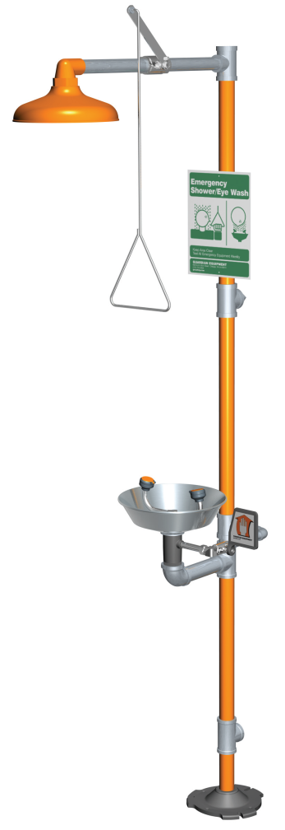
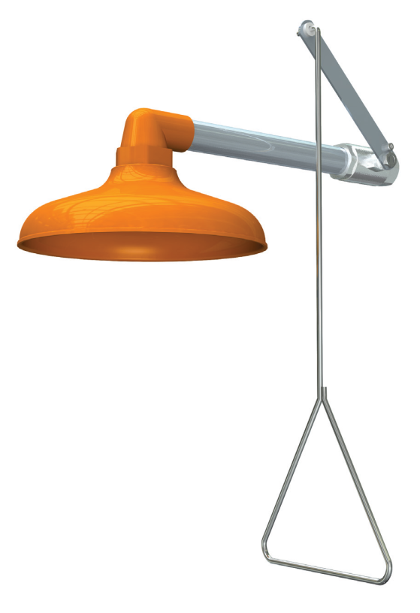
Emergency Shower Stations

Slide 26
Using a Safety Shower
Pull handle to activate shower
Remove contaminated clothing
Allow copious amounts of water on affected area for a minimum of 15 minutes
Turn shower off, by pushing up handle

Slide 27
Using a Safety Shower
Medical attention should be sought immediately!
Ideally another person in the lab should make contact with responders or dial 911.

Slide 28
Proper Attire in Laboratory
Safety Glasses
Long Pants
Covered Shoes

Slide 29
Hazard Communication
Be Aware: Any chemical could be in the laboratory at anytime.
Contact Lab Safety Specialist- 257-3242
MSDS - http://www.ilpi.com/msds/

