Slide 1
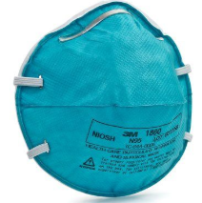
Voluntary Use
Respirator Training
University of Kentucky
Environmental Health & Safety

Slide 2

Voluntary Use Defined as
The use of respirators due to the absence of known or probable respiratory hazards, but an employee wishes to wear a disposable dust-mist-fume respirator such as an N-95 filtering facepiece

Slide 3
Voluntary Respirator Use Requirements
The employee must read, sign and store an accessible copy of Appendix D of the OSHA Respiratory Protection Standard
http://ehs.uky.edu/docs/pdf/ohs_resp_appendix_d.pdf
Employees must complete the online quiz for voluntary respirator use

Slide 4
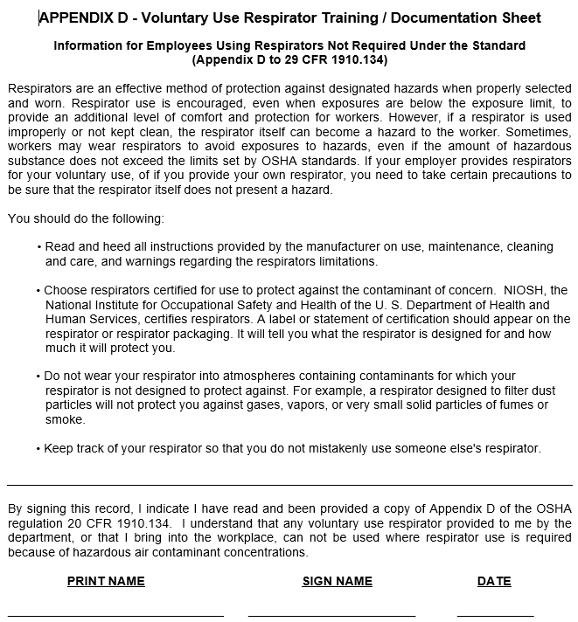
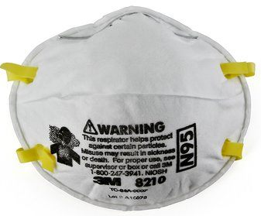
Please read and understand
http://ehs.uky.edu/ohs/respgate.php

Slide 5

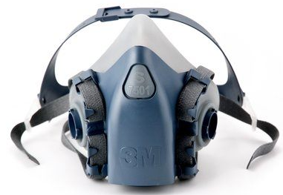
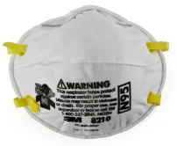
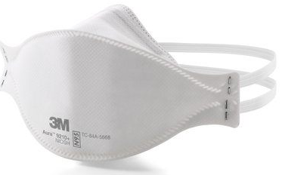
Voluntary use respiratory protection limited to filtering facepieces "dust masks" only
UK approved voluntary use "dust masks"
  N95
  R95
  P95
  N100
  R100
  P100
The following respirators can't be used as voluntary
  Elastomeric half-face
  PAPR

Slide 6
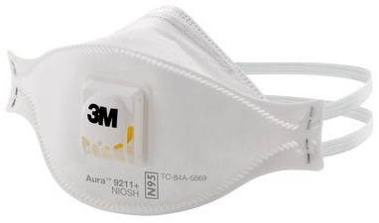
Voluntary Use N95 Examples
N95 filtering “dust masks”
  1860
  1860S
  8210
  8210S
  8247
  9210
  9211
Voluntary “dust mask” requirements
  The employee must read and sign a copy of Appendix D of the OSHA Respiratory Protection Standard

Slide 7
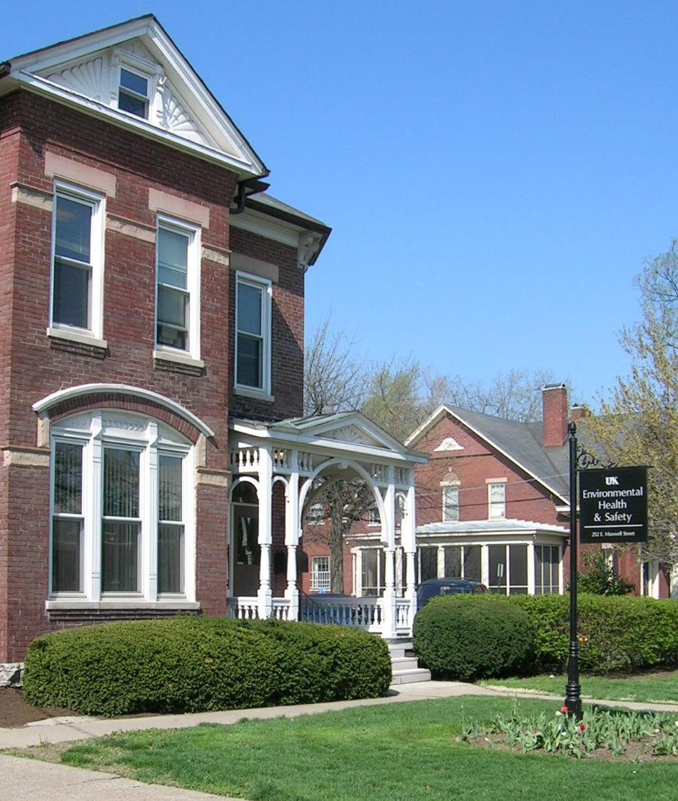
Questions?
UK Health & Safety
252 East Maxwell Street
Lexington, KY 40506-0314
http://ehs.uky.edu
Derek Bocard
Senior Industrial Hygienist
Phone: 859-257-7600
Derek.Bocard@uky.edu

