Slide 1



By Group 3

Slide 2
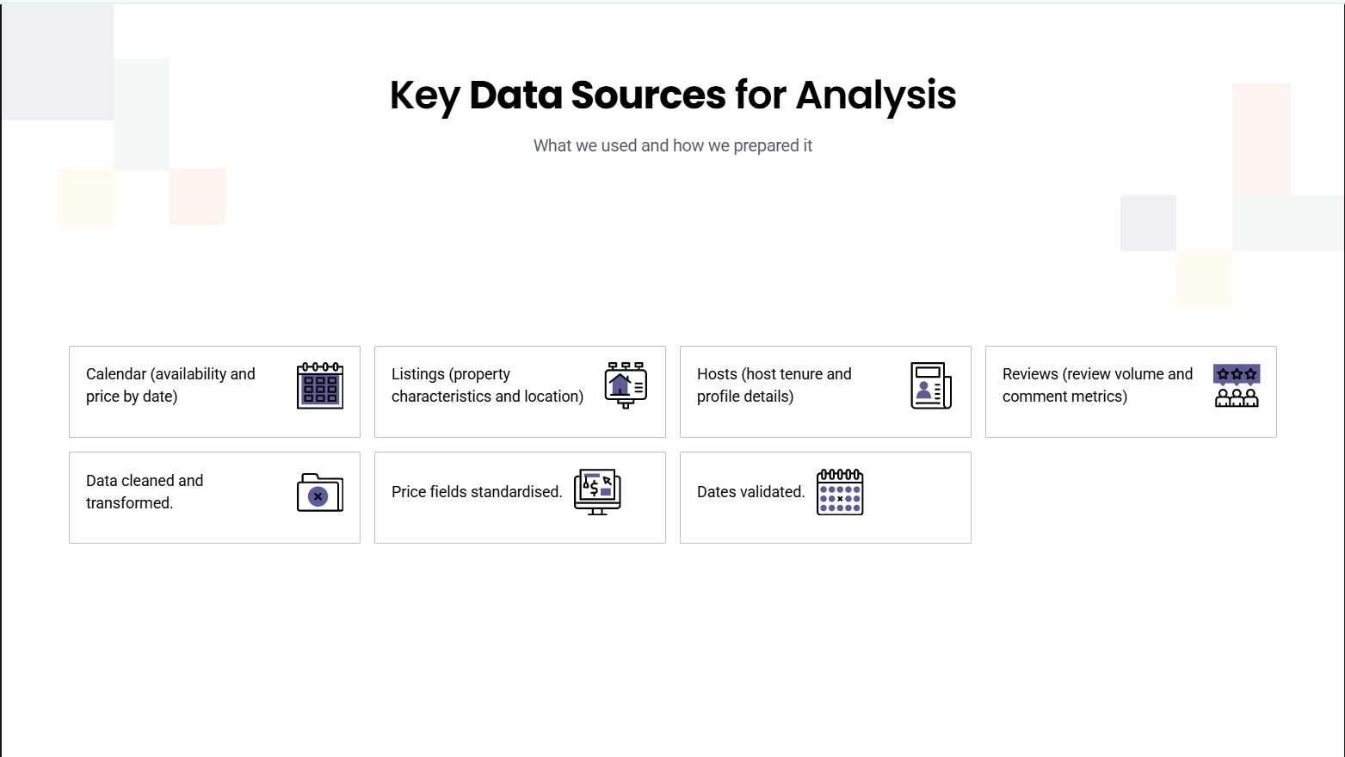

Slide 3
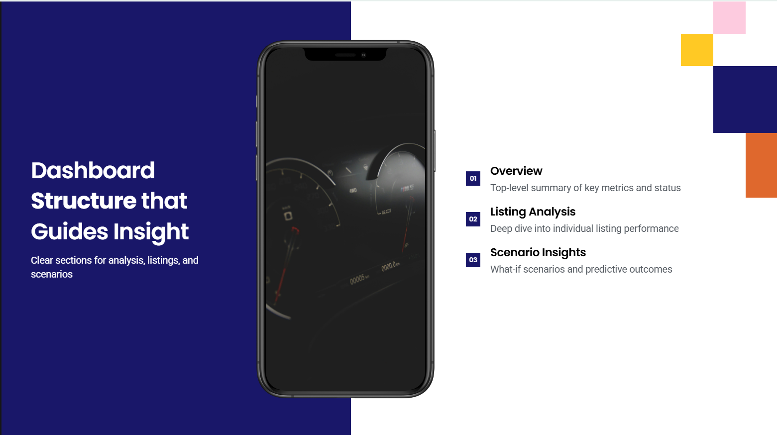

Slide 4
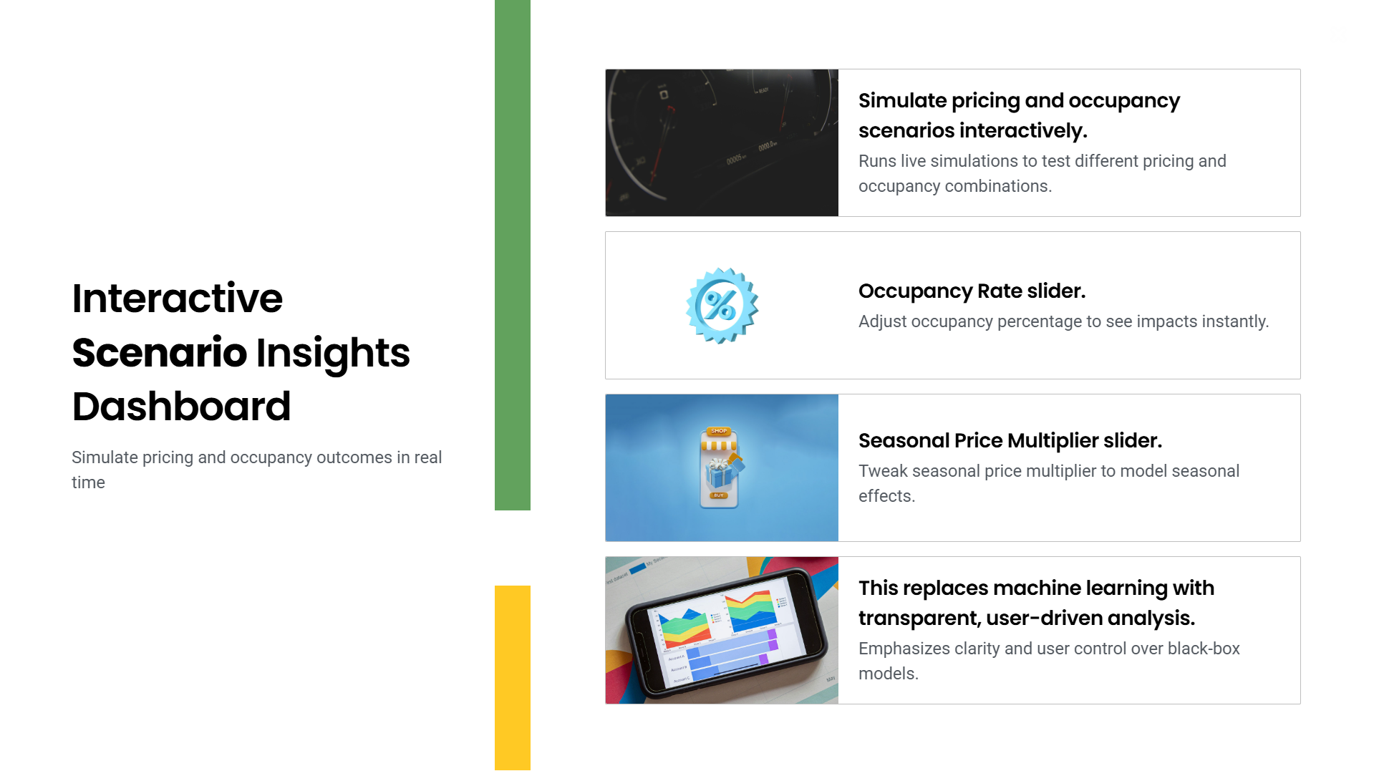

Slide 5

Leverage Reviews and Host Experience to Build Pricing Power
Focus on High-Performing Property Segments and Amenities
Improve Availability and Occupancy Strategy to Maximize Revenue
Use Dynamic, Seasonally Adjusted Pricing Instead of Flat Rates

Slide 6
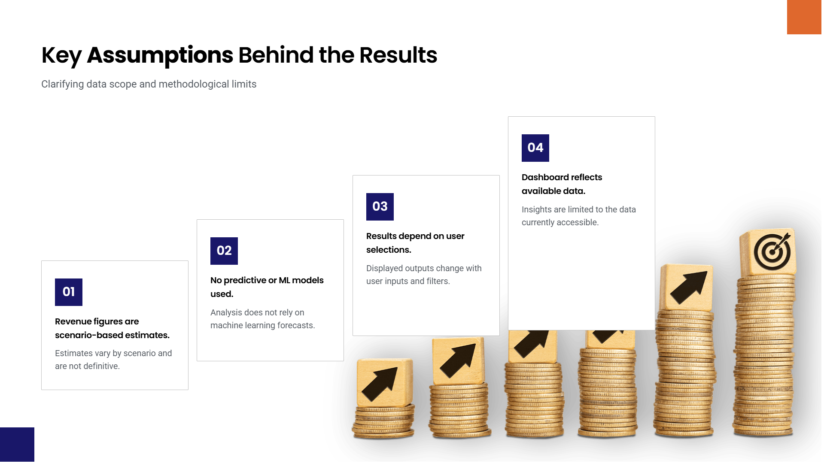

Slide 7
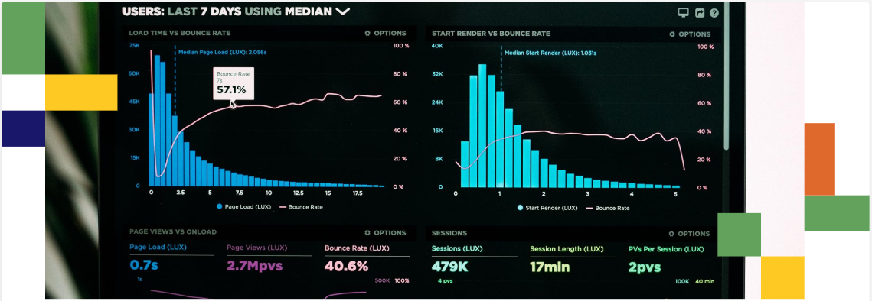
This project delivers a self-service Power BI dashboard that transforms Airbnb data for Antwerp into clear, actionable insights.
This Power BI solution empowers Airbnb stakeholders in Antwerp to analyse performance today and plan revenue strategies for tomorrow.
Final Takeaway
Closing Statement

Slide 8


