Slide 1
Content audit workshop
DRAFT June 2023

Slide 2
Introductions

Slide 3
Hello, welcome

Slide 4
This workshop will last
no longer than 1 hour

Slide 5
What we’ll do today
What is a content audit and why is it important to Defence? (10 mins)
How to do an audit on your content (30 mins)
Notes:
{and we’ll wrap up by talking through the next steps]

Slide 6
By the end of the session,
you will know:
what a content audit is
why we need to audit content
how to use the content toolkit

Slide 7
1. What is a content audit?

Slide 8
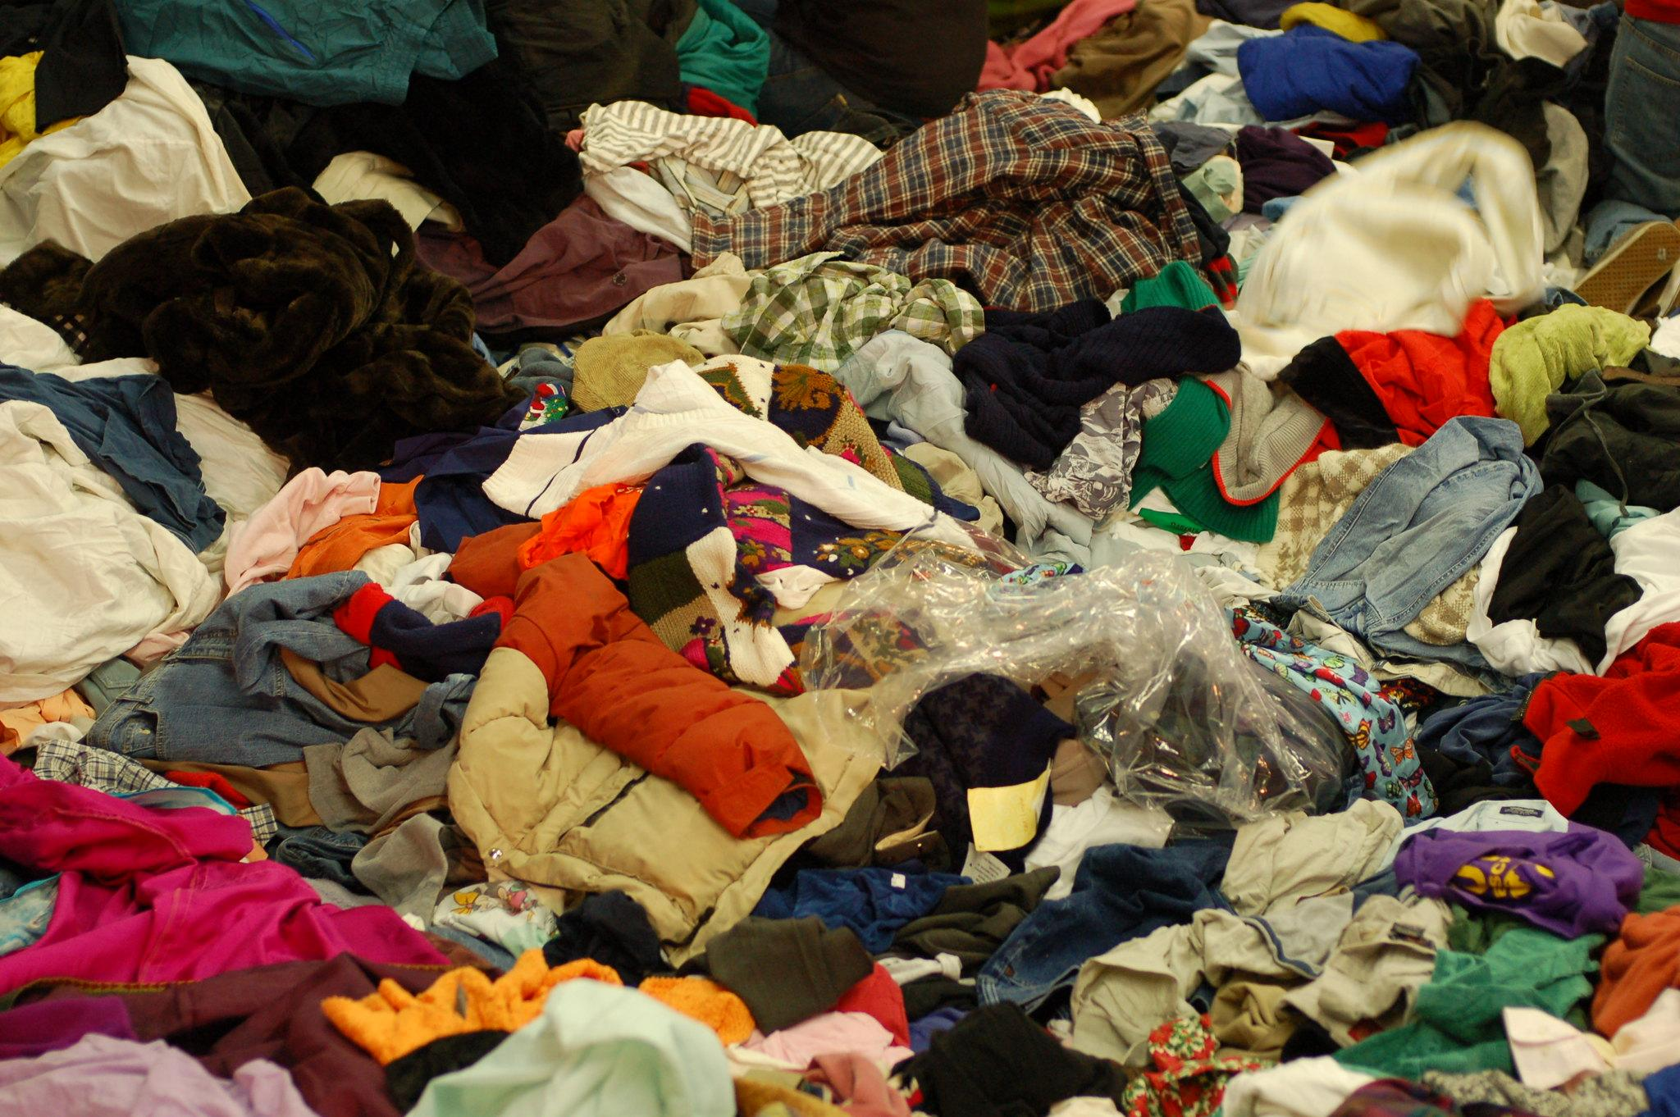
An audit helps us know how much content we’ve got, so we can get rid of things we no longer need
Pic: Andrew Otto

Slide 9
Everyone in MOD struggles to find the content they need.

Slide 10
There is too much old content, on platforms not everyone can access.

Slide 11
Content is rarely designed around the needs of users.

Slide 12
Audits help us understand our content, so we can:
improve the quality of content
manage content more easily and efficiently
make search better

Slide 13
An audit is the foundation for better content

Slide 14
2. How to do an audit on your content

Slide 15
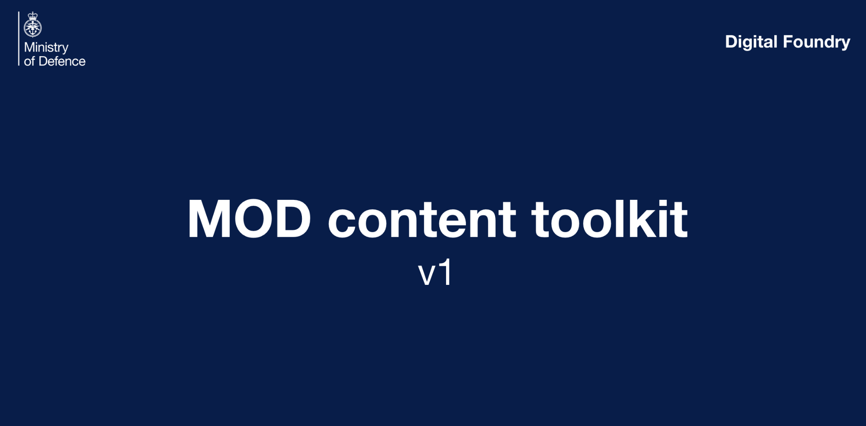
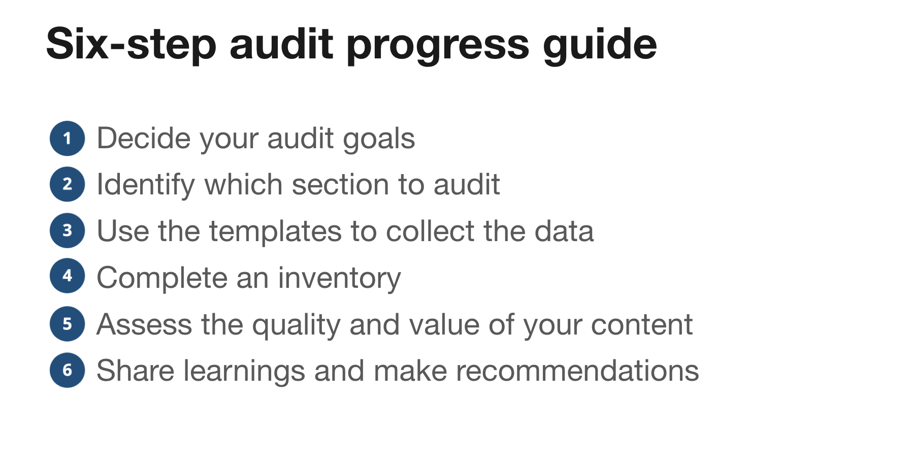
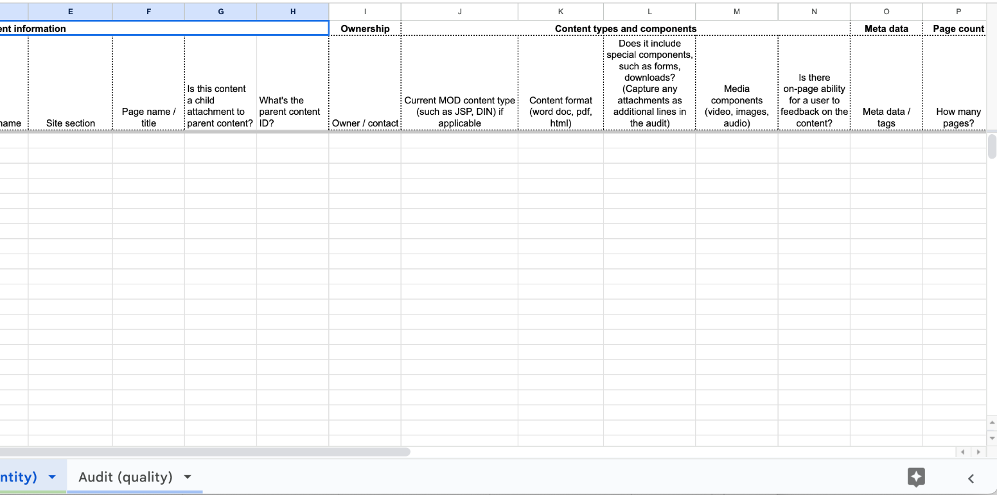
Introducing the Defence Content Toolkit

Slide 16
A content toolkit helps content owners plan, publish and promote good, consistent content across an organisation

Slide 17
What’s in the toolkit?
an introduction to auditing
a step-by-step guide
an audit template and example spreadsheet

Slide 18
Let’s go through an example together
Notes:
[Move to example spreadsheet]

Slide 19
What you can do next
Try running an audit using the Content Toolkit
(use a sample of 10-20 pieces of content)
Notes:
Timings
Wash-up session
Observations
What works? What doesn’t work? How would you make this better for your work? What’s missing?

Slide 20
Tell us how you get on
You can contact us by email or message on Teams:
alyson.fielding105@mod.gov.uk
alyson.fielding@digital.mod.uk

Slide 21
We will also run a 1 hour session with you when you’ve finished, so we can reflect and learn

Slide 22
Thank you for helping to make the Content Toolkit better for everyone

