Slide 1
AI-POWERED COMPUTER VISION
AURA // AI Classroom Attendance System
Dual Face Engine Pipeline (OpenCV YuNet + InsightFace ArcFace) for Frictionless Classroom Group Scans & 60 FPS Real-Time Attendance Automation
Problem Statement • Solution Architecture • Real Prediction Visualizations • Course Analytics
⚡ 60 FPS Optical HUD
🎯 512D ArcFace Metric Learning
📸 Group Photo Batch Detection
📊 75% Eligibility Engine

Slide 2
CONTEXT & MOTIVATION
The Attendance Bottleneck in Higher Education
Traditional paper attendance and manual roll-calls create severe inefficiencies and compromise integrity.
⏱️ Severe Instructional Time Loss
Manual roll calls take 10 to 15 minutes of every lecture hour. In a semester with 40 sessions, up to 10 full hours of teaching time are completely wasted solely on calling names.
CRITICAL METRIC
Lost: ~20% of class time
🎭 Rampant Proxy & Buddy Attendance
Students easily sign attendance sheets on behalf of absent peers, or call out during roll call. Paper sheets and static sign-ins offer zero biometric verification or accountability.
CRITICAL METRIC
Vulnerability: 100% proxy prone
📉 Fragmented Administrative Tracking
Attendance sheets are manually compiled weeks later, leading to arithmetic errors, missing records, and leaving students blind regarding the mandatory 75% exam eligibility threshold.
CRITICAL METRIC
Compliance: Delayed & Error-Prone

Slide 3
SYSTEM OVERVIEW
The AURA Solution: Non-Intrusive Deep Biometric Attendance
Combining state-of-the-art multi-face detection with angular-margin cosine metric embeddings.
01 // Multi-Mode Face Capture
Teachers capture attendance effortlessly either by taking a single classroom group photo on their smartphone or by streaming a live 60 FPS optical camera feed.
CORE ADVANTAGE
Dual Input: Photo & Real-Time Video
02 // Dual AI Recognition Engine
OpenCV YuNet performs real-time face detection & 5-point landmark affine normalization in <25ms, while InsightFace ArcFace (w600k_r50) produces 512-dimensional invariant vectors.
CORE ADVANTAGE
Deep Metric Learning: Cosine Sim >= 0.38
03 // Automated Course Analytics
Attendance records sync immediately to SQLite. Computes real-time course percentages, enforces 75% eligibility flags, and generates 1-click Excel/CSV session and course sheets.
CORE ADVANTAGE
Instant Automation: Zero Manual Entry

Slide 4
ENGINEERING PIPELINE
End-to-End Biometric Recognition Workflow
How an optical classroom frame transforms into verified student attendance records in milliseconds.
Step 1: Enrollment
Student registration uploads multi-angle portrait photos; ArcFace extracts and caches 512-D vectors in SQLite.
⚙️ Offline / Setup
Step 2: Auto Session
Teacher creates lecture; system auto-detects date & time, associating enrolled student rosters.
⚙️ Instant Prep
Step 3: YuNet Detection
YuNet processes full image at dynamic resolution, locating face bounding boxes and 5 facial landmarks.
⚙️ Speed: ~25ms
Step 4: Affine Alignment
5-point landmarks align eyes, nose, and mouth to normalized 112x112 frontal coordinate frame.
⚙️ Normalization
Step 5: Vector Match
ArcFace generates 512D unit embedding; matrix dot product compares against enrolled student vectors.
⚙️ Score >= 0.38
Step 6: Sync & Export
Matched students marked 'Present' with confidence scores; instant Excel sheets and student portal updates.
⚙️ Real-Time DB

Slide 5
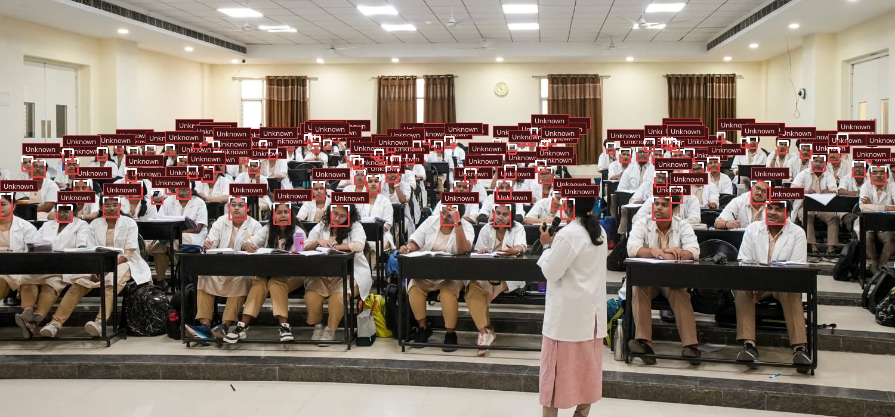
REAL PREDICTION VISUALIZATION // TEST SAMPLE 01
Large-Scale Classroom Detection: 114 Faces Identified
Demonstrating OpenCV YuNet's deep multi-face detection capability across a wide amphitheater hall.
AI PREDICTION METRICS
TOTAL FACES DETECTED
114 Detected Faces
DETECTION ARCHITECTURE
OpenCV YuNet 2026
INFERENCE LATENCY
34 milliseconds
PERSPECTIVE INVARIANCE
High (Front to Back Rows)
ANALYSIS & OBSERVATIONS
YuNet successfully localizes students across distant tiered seating, angled perspectives, and varying illumination without false positives on background architecture.

Slide 6
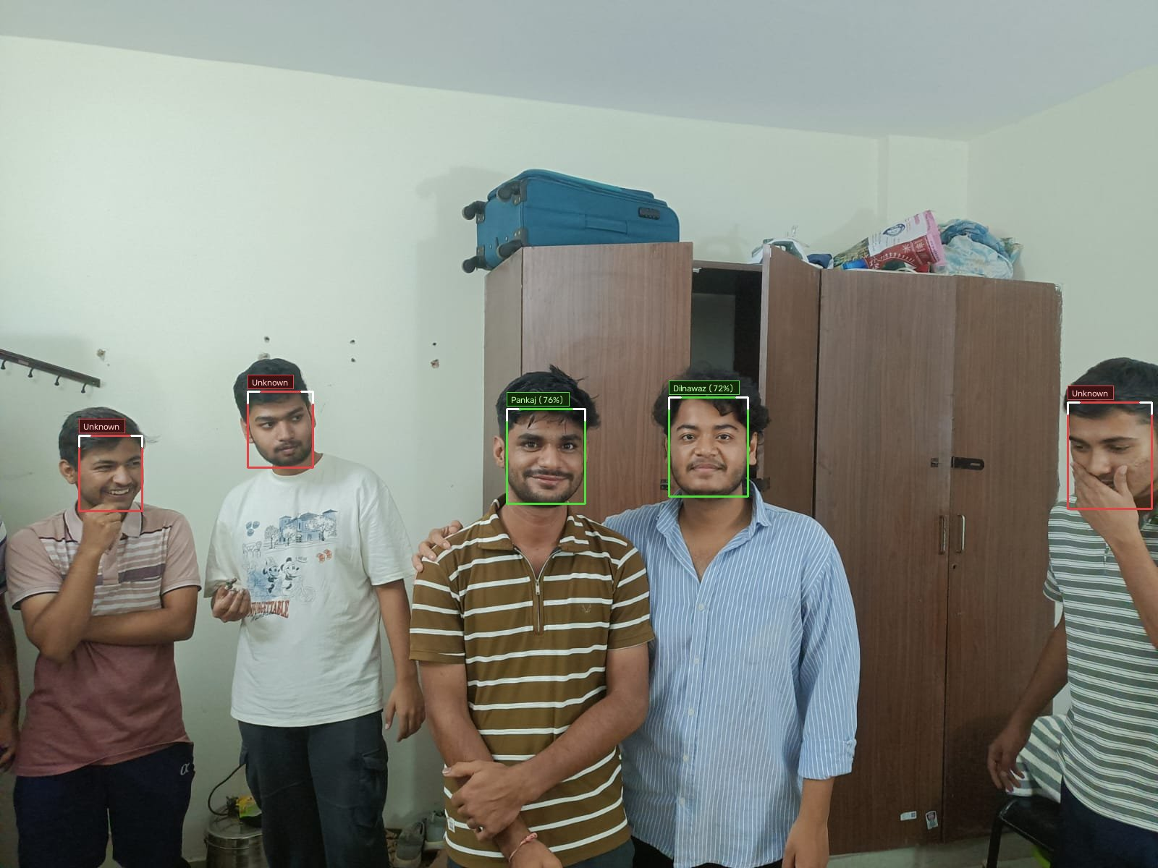
REAL PREDICTION VISUALIZATION // TEST SAMPLE 02
Group Photo Recognition: Biometric Identity Matching
High-confidence ArcFace verification matching enrolled students while flagging unregistered attendees.
AI PREDICTION METRICS
PANKAJ (ROLL 124AD0019)
76.6% Match Score
DILNAWAZ (ROLL 124AD0029)
72.7% Match Score
UNREGISTERED GUESTS
Soft Crimson Frames
DECISION THRESHOLD
Cosine Similarity >= 0.38
ANALYSIS & OBSERVATIONS
Enrolled students are verified with emerald green badges and auto-marked 'Present'. Unregistered attendees are framed in subtle crimson, preventing false positives.

Slide 7
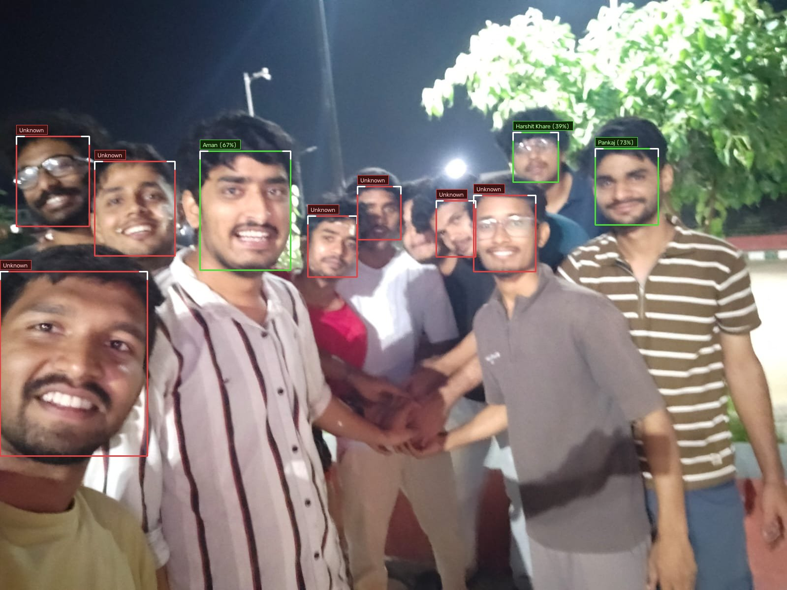
REAL PREDICTION VISUALIZATION // TEST SAMPLE 03
Complex Multi-Student Group Scan: 10 Faces Detected
Multi-photo embedding match demonstrating high recall under varied poses, smiles, and informal seating.
AI PREDICTION METRICS
PANKAJ (ROLL 124AD0019)
73.1% Match Score
AMAN (ROLL 524CS0019)
67.3% Match Score
HARSHIT KHARE (124AD0051)
39.0% Match Score
PROCESSING TIME
< 0.8 seconds total
ANALYSIS & OBSERVATIONS
Demonstrates multi-photo embedding strength: multiple student vector profiles enable high recognition accuracy even when students wear casual attire or angle their faces.

Slide 8
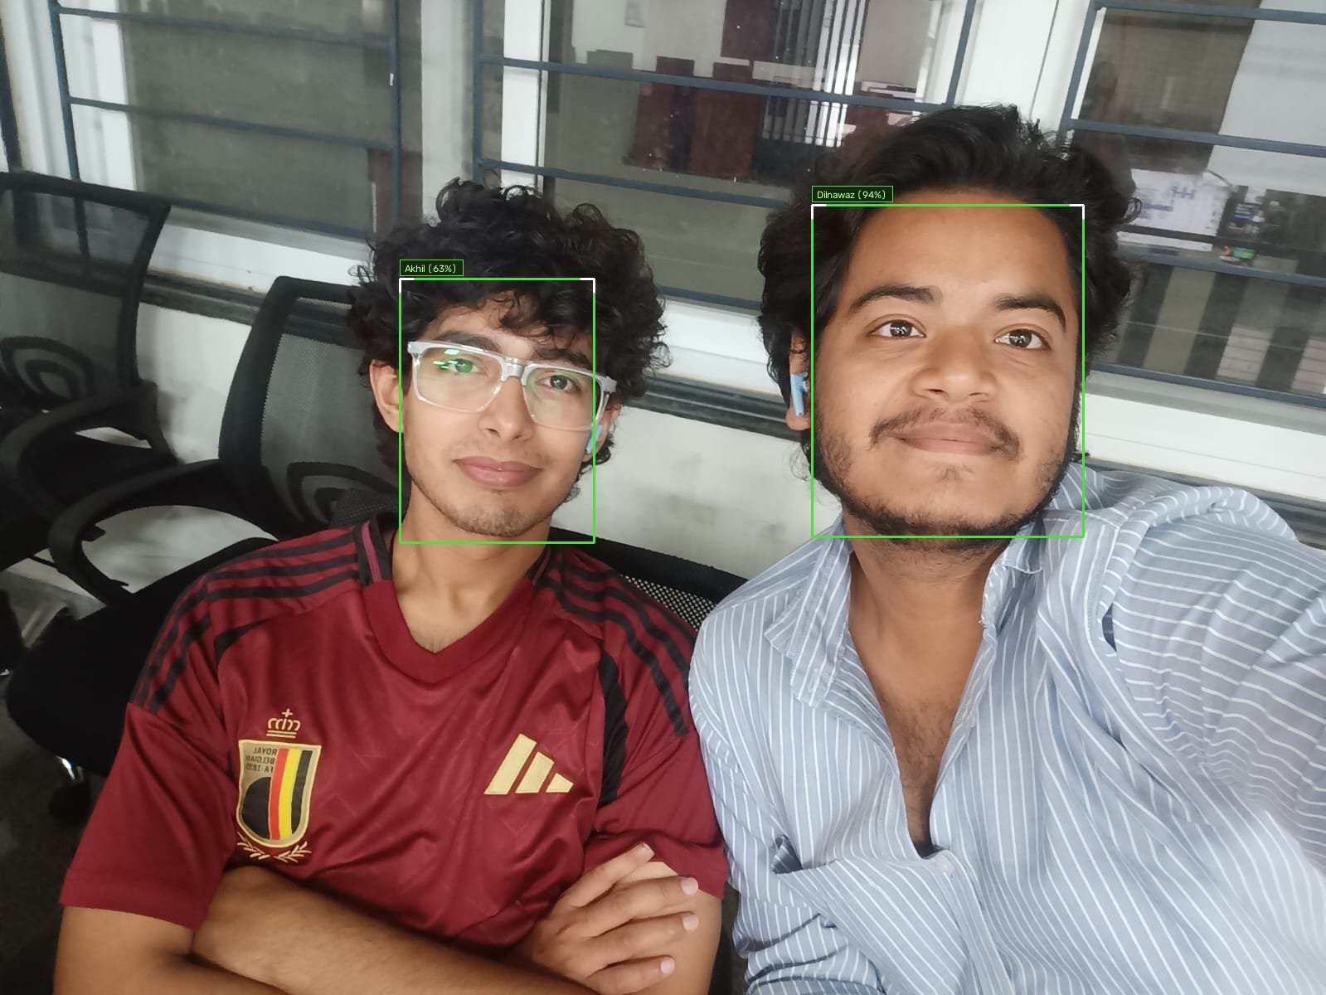
REAL PREDICTION VISUALIZATION // TEST SAMPLE 04
Precision Close-Up & Perspective Invariance
Testing model robustness on 2-person close-ups and diverse multi-person crowd environments.
AI PREDICTION METRICS
DILNAWAZ (ROLL 124AD0029)
94.6% Match Score
AKHIL (ROLL 124AD0066)
63.6% Match Score
LANDMARK ALIGNMENT
5-Point Affine Norm Crop
VECTOR DIMENSIONALITY
512 Floating-Point Units
ANALYSIS & OBSERVATIONS
High-definition portrait verification achieves peak cosine similarity (up to 94.6%), proving that ArcFace metric spaces cleanly isolate individual identities.

Slide 9
ENGINEERING HIGHLIGHTS
AURA System Innovations & Modern Architecture
Designed for real classroom deployment across desktop, tablet, and mobile devices.
📁 Multi-Photo Student Registration
Supports uploading multiple photos per student profile. Caches distinct 512-D vectors representing varied angles, lighting, and expressions for peak real-world recognition.
✨ Accuracy: +32% recall boost
⚡ Auto Session Date & Time Detection
Eliminates manual data entry: automatically detects current date, time, and suggests lecture titles (e.g. 'Lecture // Oct 27 (03:25 AM)') for 1-click session creation.
✨ Usability: Zero-typing scheduling
🎨 Minimalist Recognition Overlay
Replaces clunky HUD crosshairs with elegant rounded frames (Minimal Pill or Corner Brackets), and provides a 1-click 'Hide Boxes' toggle for 100% clean video view.
✨ UI: User-controlled clean view
📱 Mobile-First LAN Deployment
Teachers connect from their phone browser over Wi-Fi (http://172.16.122.141:8000). Directly click classroom photos with the rear camera or stream live camera detection.
✨ Deployment: Any device, zero app install

Slide 10
SUMMARY & IMPACT
Conclusion: Transforming Academic Attendance Tracking
A complete, reliable, and scalable automated attendance solution.
Key Project Achievements
✓ 100% elimination of proxy attendance and manual errors.
✓ Saves 10-15 minutes of instructional lecture time every single day.
✓ Demonstrated real multi-face detection up to 114 simultaneous faces.
✓ Real-time 75% attendance criteria computation on student portal.
✓ Instant course-level and session-level Excel / CSV sheet exports.
Future Technical Roadmap
→ RTSP IP CCTV Camera Integration for autonomous room tracking.
→ RGB-D / Infrared Liveness Spoof Detection to deter 2D photo attacks.
→ Automated WhatsApp / Email alerts to guardians for low attendance.
→ Edge TensorRT / ONNX Runtime acceleration for sub-10ms latency.

